Slide 1
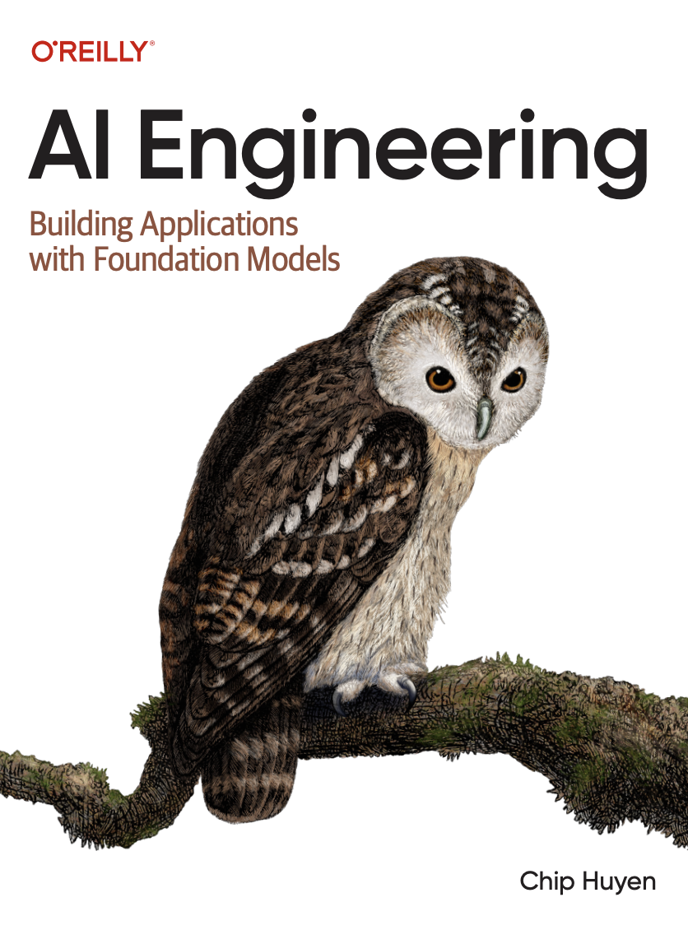
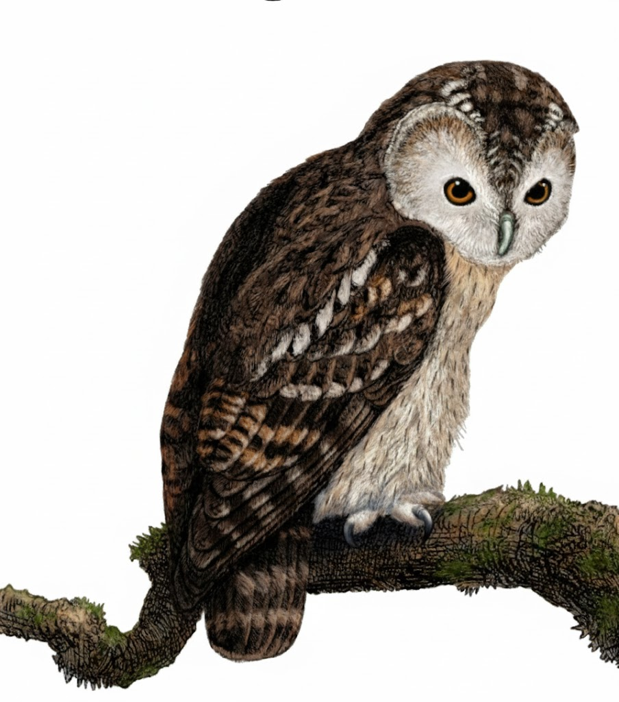
A Comprehensive Summary
Chapter 7, Part 1
Finetuning

Slide 2
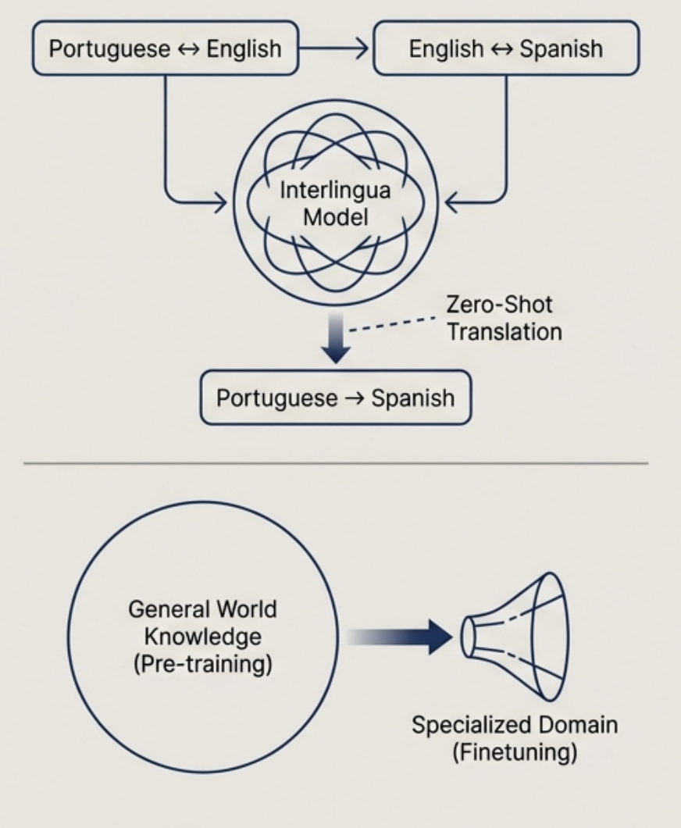
Finetuning is a Form of Transfer Learning
Finetuning is the process of taking a pre-trained foundation model and continuing its training on a smaller, task-specific dataset.
It's a modern application of transfer learning, a concept from 1976 about transferring knowledge from a general task to a related, specific task.
Early Success (Google, 2016): A multilingual translation system trained on Portuguese-English and English-Spanish pairs demonstrated zero-shot translation, successfully translating Portuguese to Spanish without direct training examples. This proved that models can transfer learned "interlingua" knowledge.
Today's Analogy: Foundation models are pre-trained on general world knowledge. Finetuning specializes this knowledge for a specific domain, behaviour, or style.

Slide 3
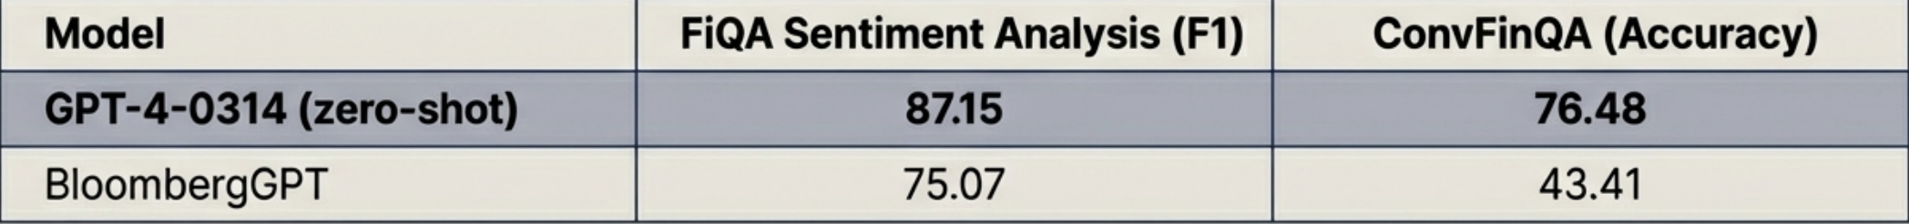
Deciding to Finetune: A Strategic Checklist
Reasons to Finetune
Teach New Knowledge/Skills: For information absent from pre-training data or for tasks the base model cannot perform (e.g., mastering a niche API).
Change Model Behaviour/Style: To adopt a specific persona, brand voice, or generate structured outputs like JSON.
Improve Reliability: Moves complex instructions from the prompt into the model's weights, making it more robust and less dependent on "brittle" prompts.
Reasons NOT to Finetune
A Better Base Model Exists: A larger, more capable general model often outperforms a finetuned smaller one, even on domain-specific tasks.
Simpler Methods Suffice: Prompt engineering or RAG might solve the problem with less cost and complexity.
Lack of High-Quality Data: Finetuning is highly sensitive to data quality. 'Garbage in, garbage out" can actively degrade performance.

Slide 4
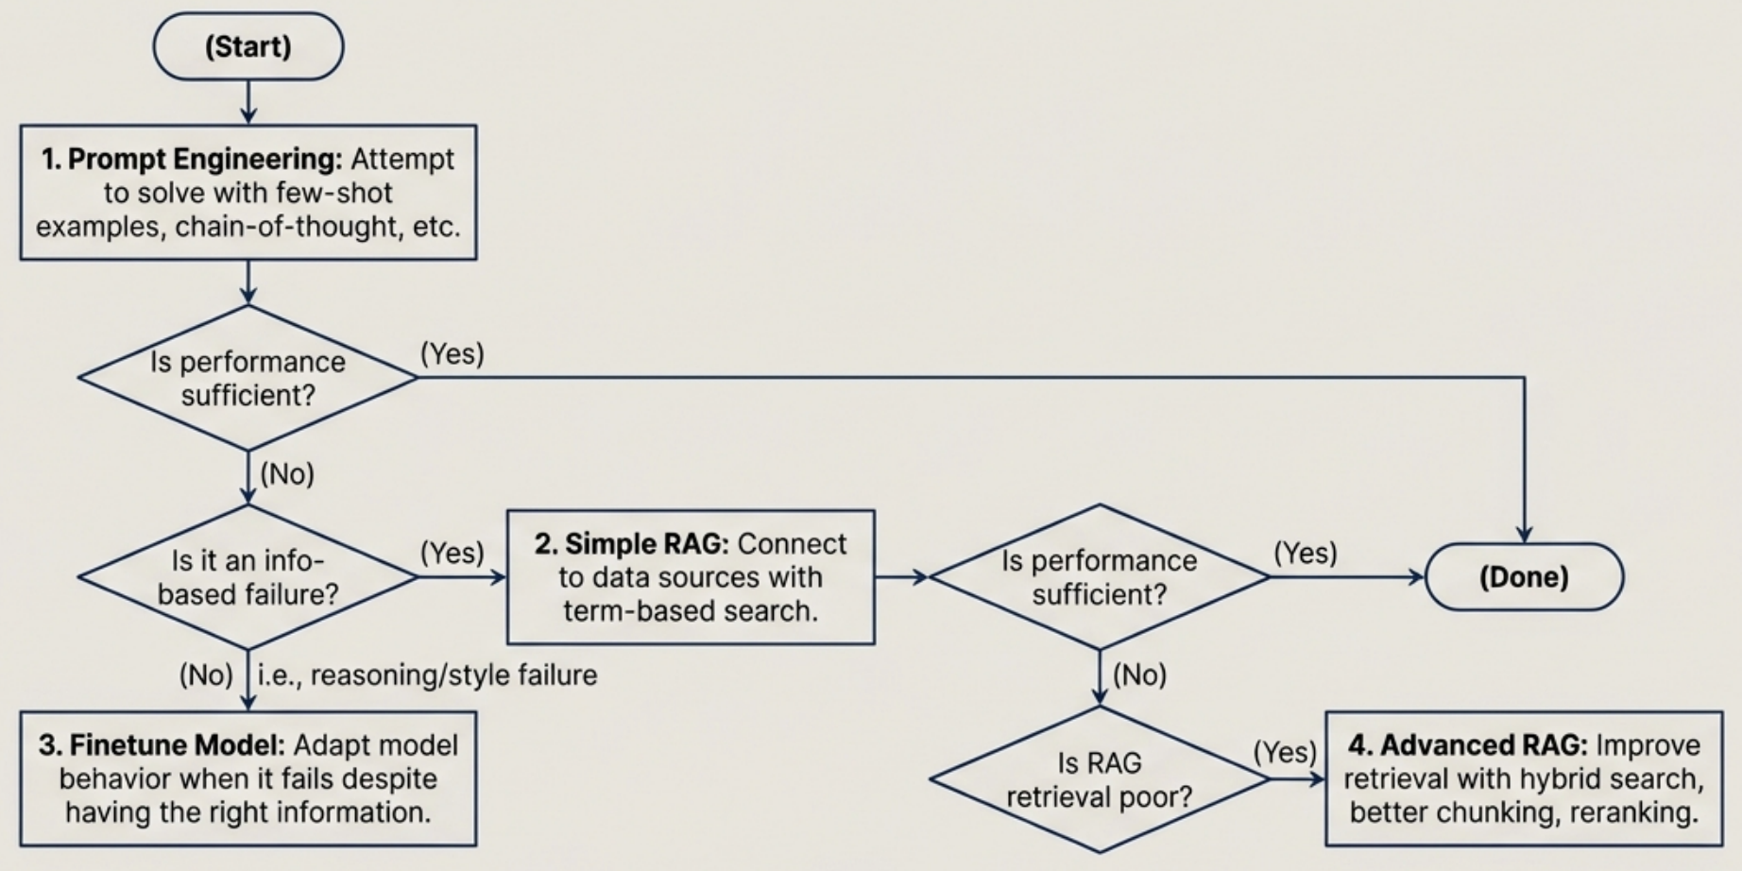
The Application Development Flow: When to Finetune vs. RAG

Slide 5
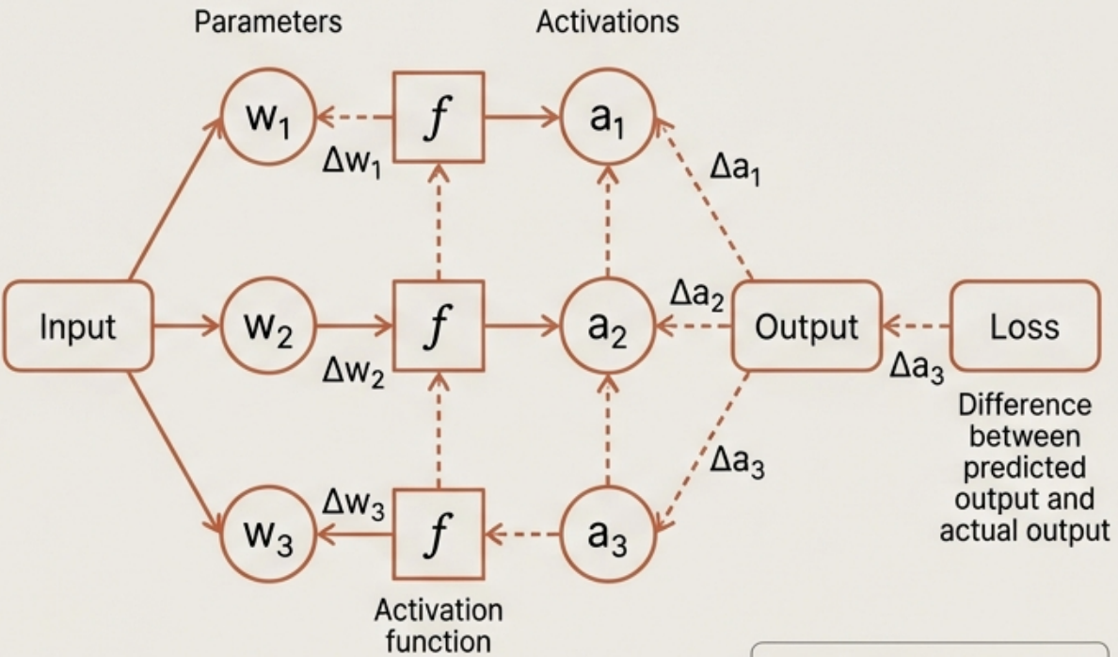
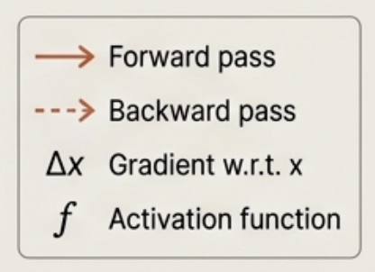
The Memory Bottleneck: Why Training is So Demanding
Inference (Forward Pass) requires memory for:
1. Model Weights: The parameters of the model
2. Activations: Intermediate values computed during the forward pass (e.g., KV Cache)
Training (Forward + Backward Pass) adds significant memory requirements for:
3. Gradients: The calculated error signal for each trainable parameter
4. Optimizer States: Momentum values used by optimizers like Adam to guide weight updates.
Core Concept: The memory required for gradients and optimizer states scales directly with the number of trainable parameters. Training memory is substantially larger than inference memory.

Slide 6
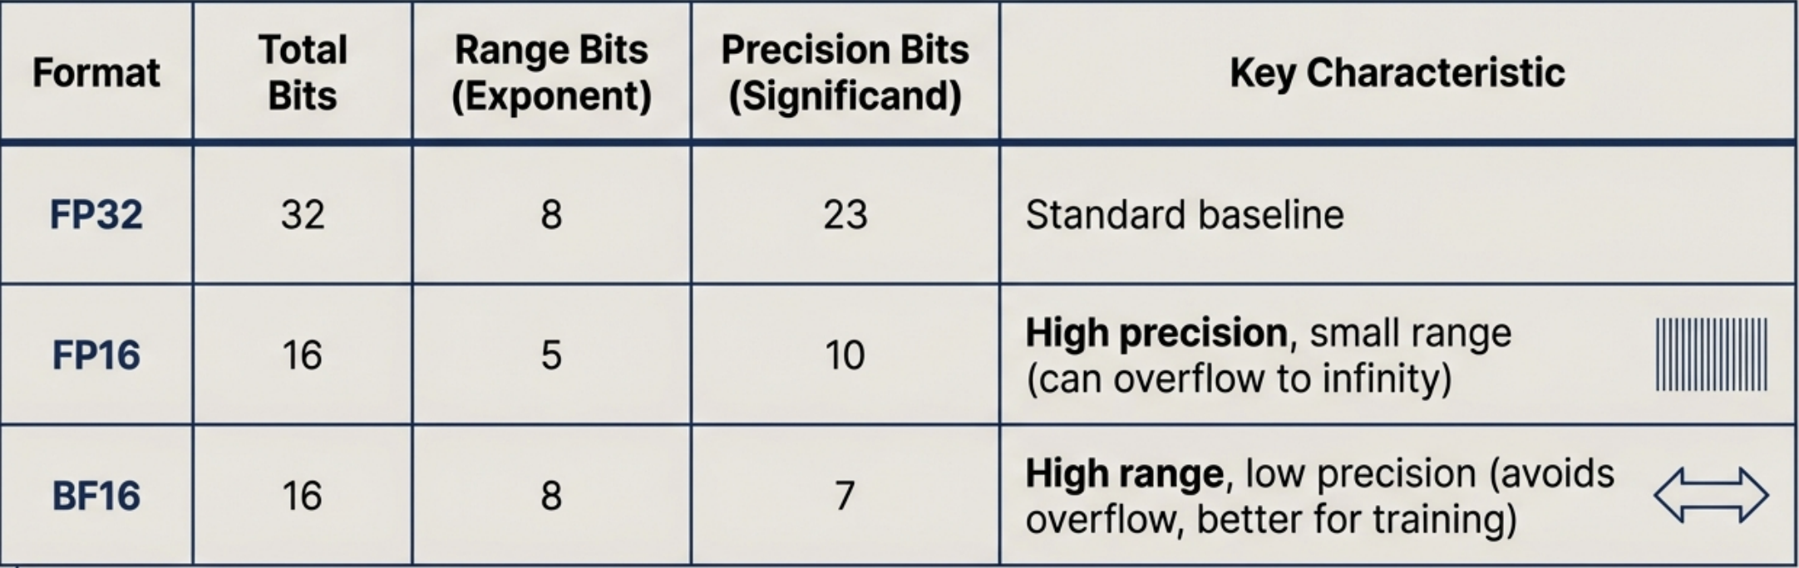
The Language of Hardware: Precision Formats and Trade-offs
The number of bits used to store a value determines its memory footprint, range, and precision. Quantization is the process of converting from a higher-precision format to a lower-precision one.
Practical Implication: BF16 has the same wide range as FP32, making it more stable for training than FP16, which can easily overflow with large values. This stability is often worth the slight loss in precision.

Slide 7
The Memory Math of Full Finetuning
Memory Needed per Trainable Parameter (FP16/BF16): Model Weight: 2 bytes Gradient: 2 bytes Optimizer States (Adam): 4 bytes (2 values, 2 bytes each for momentum and variance) Total: ~8 bytes per trainable parameter (excluding activations) Example: Full Finetuning a 13B Model (FP16, Adam) Model Weights: 13B params × 2 bytes = 26 GB Gradients: 13B params × 2 bytes = 26 GB Optimizer States: 13B params × 4 bytes = 52 GB
Total (excluding activations): 26 + 26 + 52 = 104 GB of VRAM Conclusion: This memory requirement exceeds the capacity of most server-grade GPUs, making full finetuning inaccessible and creating the primary motivation for Parameter Efficient Finetuning (PEFT).

Slide 8
In the next part, we will discuss
The Problems of Full Finetuning
Parameter-Efficient Finetuning (PEFT)
Detailed Look at Low-order Rank Adaptation
Introduction to Quantized LoRA
and much more…

