Slide 1
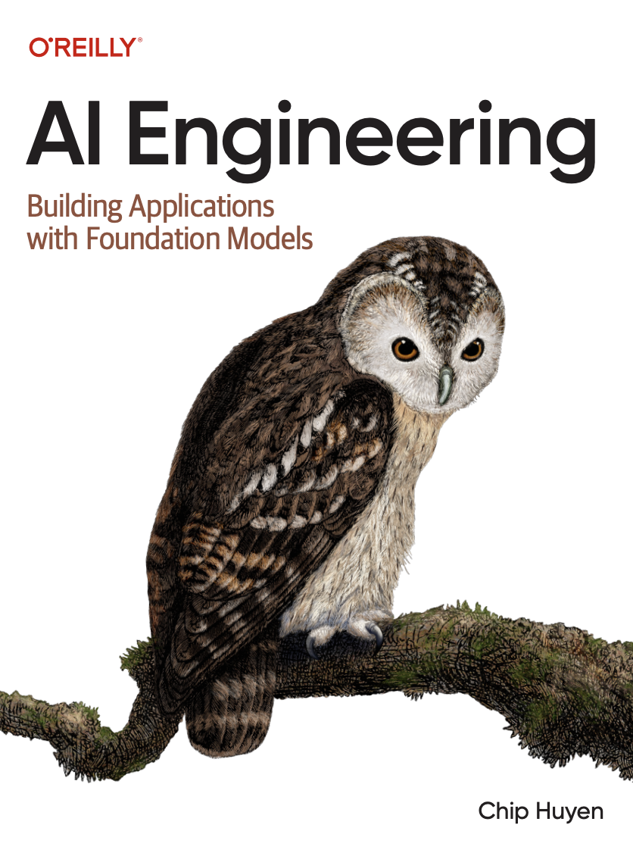
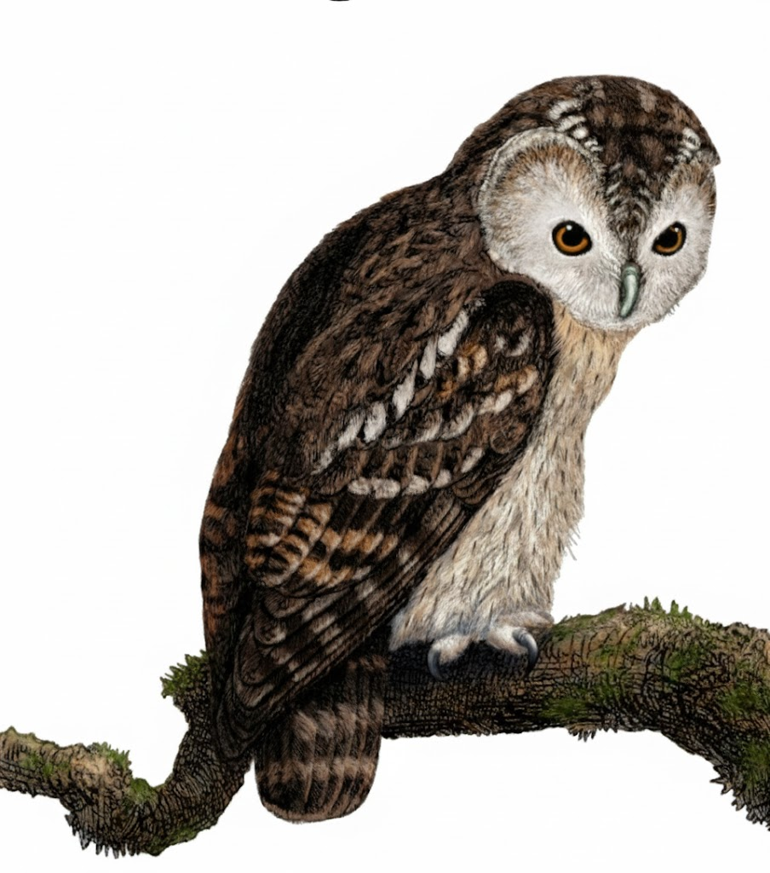
A Comprehensive Summary
Chapter 7, Part 3
Finetuning

Slide 2
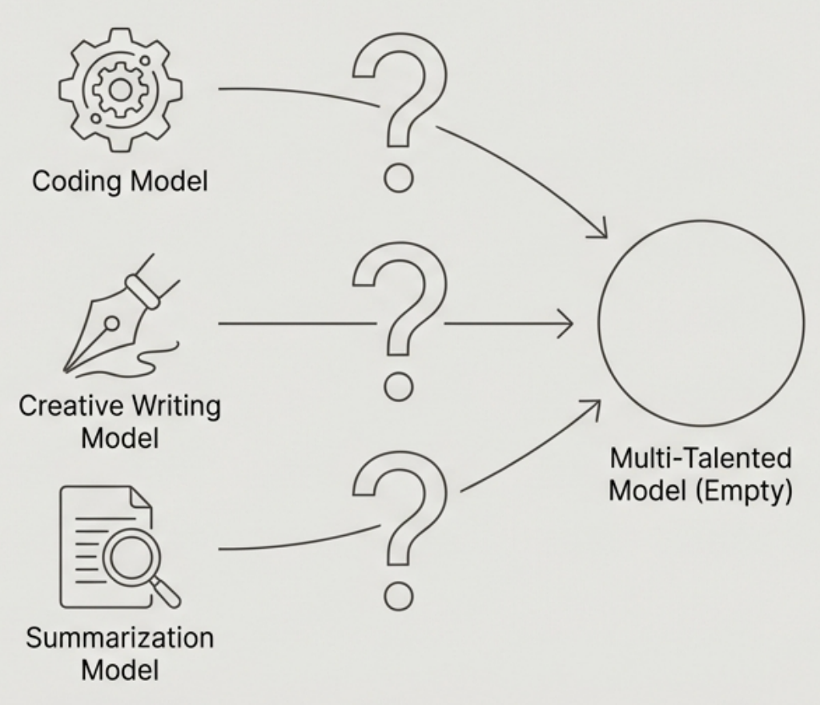
The Problem: Creating a Multi-Talented Model
The Challenge You have successfully created several specialist models: one is great at coding, another excels at creative writing, and a third is a master of summarization. How do you combine these distinct skills into a single, versatile model without simply training a giant, generalist model from scratch?
Why Not an Ensemble? Running multiple models and routing requests (an ensemble) is resource intensive and adds latency.
The Goal Create a single model that inherits the specialized strengths of its "parent" models, offering a more efficient and powerful solution than running them all separately.

Slide 3
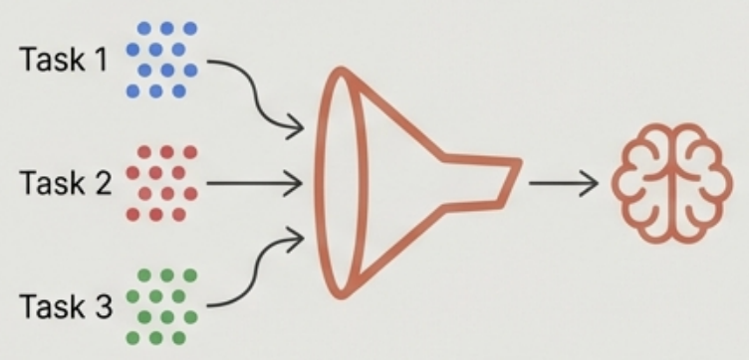
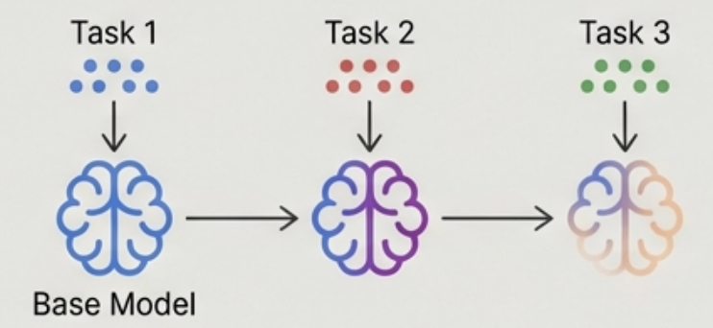
Solution Path 1: Multi-Task Finetuning
Instead of training separate models, train a single model on a dataset that combines examples from multiple tasks.
Simultaneous Finetuning
Sequential Finetuning
Method: Mix data from all tasks into a single dataset. Train the model on this combined dataset in one go. Benefit: Simpler process. The model learns to generalize across tasks concurrently.
Method: Finetune the model on one task, then take the resulting model and finetune it on a second task, and so on. Benefit: Can be effective if tasks are related or build on each other. Risk: Potential for "catastrophic forgetting," where the model loses proficiency in earlier tasks as it learns new ones.

Slide 4
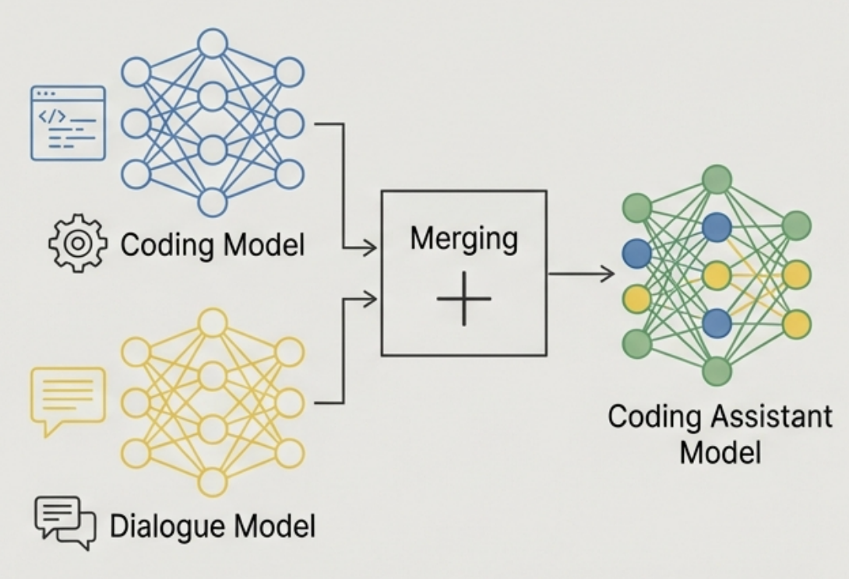
Solution Path 2: Model Merging
Key Advantages
Compute-Free (Post-Finetuning): The merging process itself often requires no GPUs or additional training. It's an arithmetic combination of existing weights. Knowledge Combination: Creates a single model that can exhibit the capabilities of all its constituent models.
Enables Federated Learning: Models can be trained separately on private, on-device data, and then their learned weights can be merged centrally to create an improved base model without sharing the raw data.
Core Idea: Instead of training on multiple tasks, take multiple models that have already been finetuned on different tasks and merge their weights to create a single, new model.

Slide 5
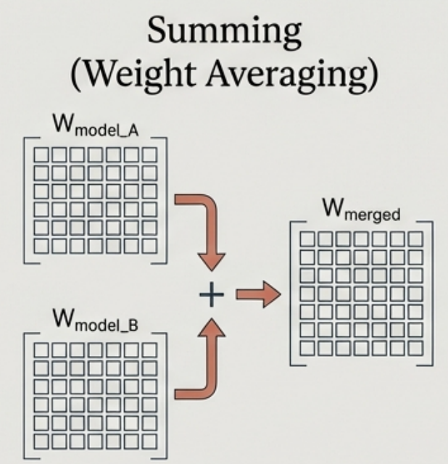
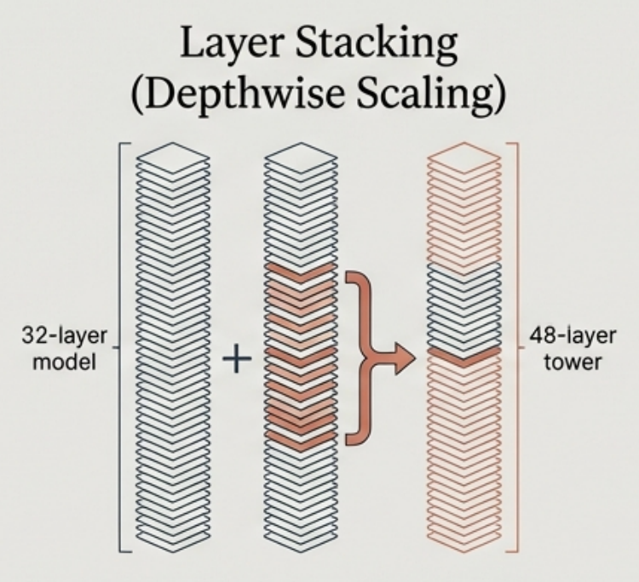
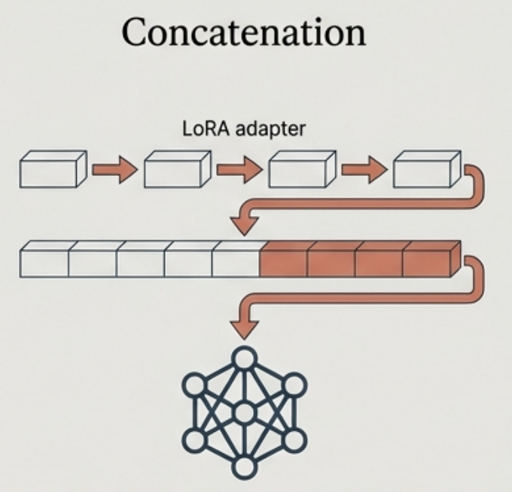
A Toolkit of Model Merging Techniques

Slide 6
A Toolkit of Model Merging Techniques
Summing
(Weight Averaging)
Layer Stacking
(Depth-wise Scaling)
Concatenation
Method: The simplest form. The weights of the new model are a linear combination (weighted average) of the corresponding weights from the parent models.
Example: W_merged = 0.5 * W_model_A + 0.5 * W_model_B
Method: Creates a deeper model by stacking layers from parent models. Can involve both stacking and summing layers. Concrete Example (SOLAR 10.7B):
Start with two copies of a 32-layer model
Sum 16 corresponding layers, stack the remaining 32
Result: a 48-layer model (32*2 - 16 = 48).
Method: Specifically for adapters (like LoRA). Multiple adapters are concatenated to create a larger, multi-task adapter which is then applied to the base model.

Slide 7
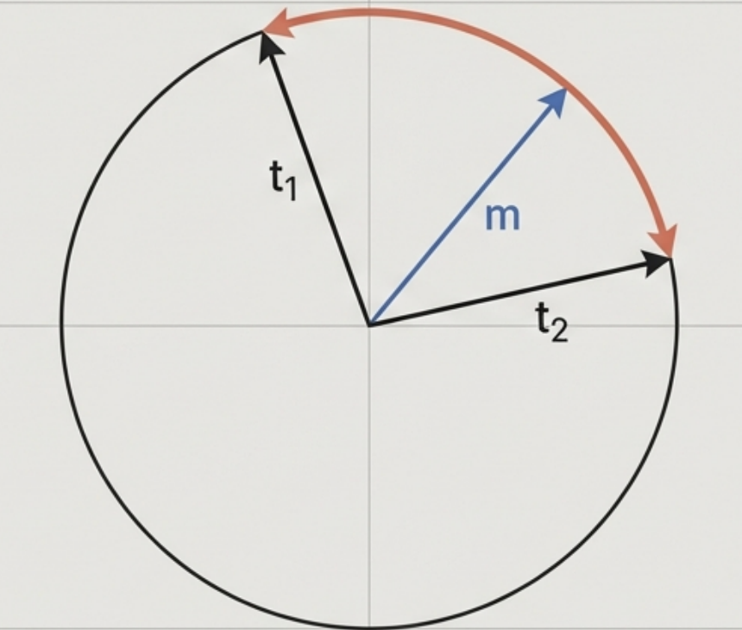
Merging Deep Dive: Spherical Linear Interpolation (SLERP)
SLERP is an alternative to simple linear averaging for merging two models' weights. It often yields better results by preserving the geometric relationships in the high-dimensional weight space.
Intuitive Analogy
- Imagine each model's weight vector is a point on the surface of a sphere.
- Linear interpolation would cut a straight line through the sphere.
- SLERP finds the shortest path along the surface of the sphere between the two points.
- The merged model is a point along this curved path.
How SLERP works for two vectors t1 and t2. The red line is their shortest path on the spherical surface. Depending on the interpolation, the merged vector can be any point along this path. The blue vector is the resulting merged vector when the interpolation factor is 0.5
Limitation SLERP is mathematically defined for only two vectors at a time. To merge more, it must be applied sequentially.

Slide 8
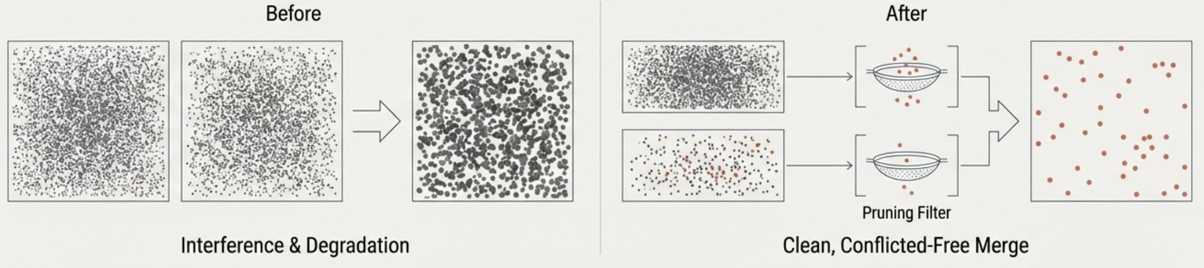
Optimizing Merges by Pruning Redundant Parameters
The Problem When finetuning a model for a specific task, only a small subset of the weight changes are actually important. Many parameter changes are minor or redundant. When merging multiple models, these redundant parameters can interfere with each other, degrading the performance of the final merged model.
The Solution Prune the redundant parameters from each task-specific model before merging.
Key Techniques TIES (Trim, Elect Sign, and Merge): Identifies and removes redundant parameter changes within each model. DARE (Drop and Rescale): Randomly drops a large portion of the weight changes and rescales the rest.

Slide 9
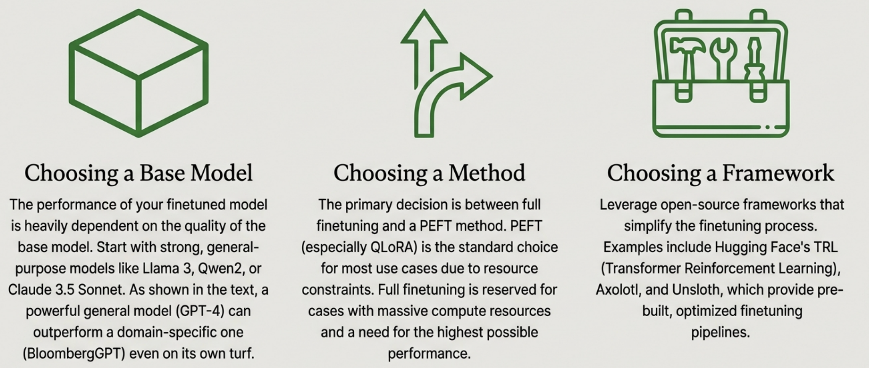
Finetuning Tactics: Your Practical Toolkit

Slide 10
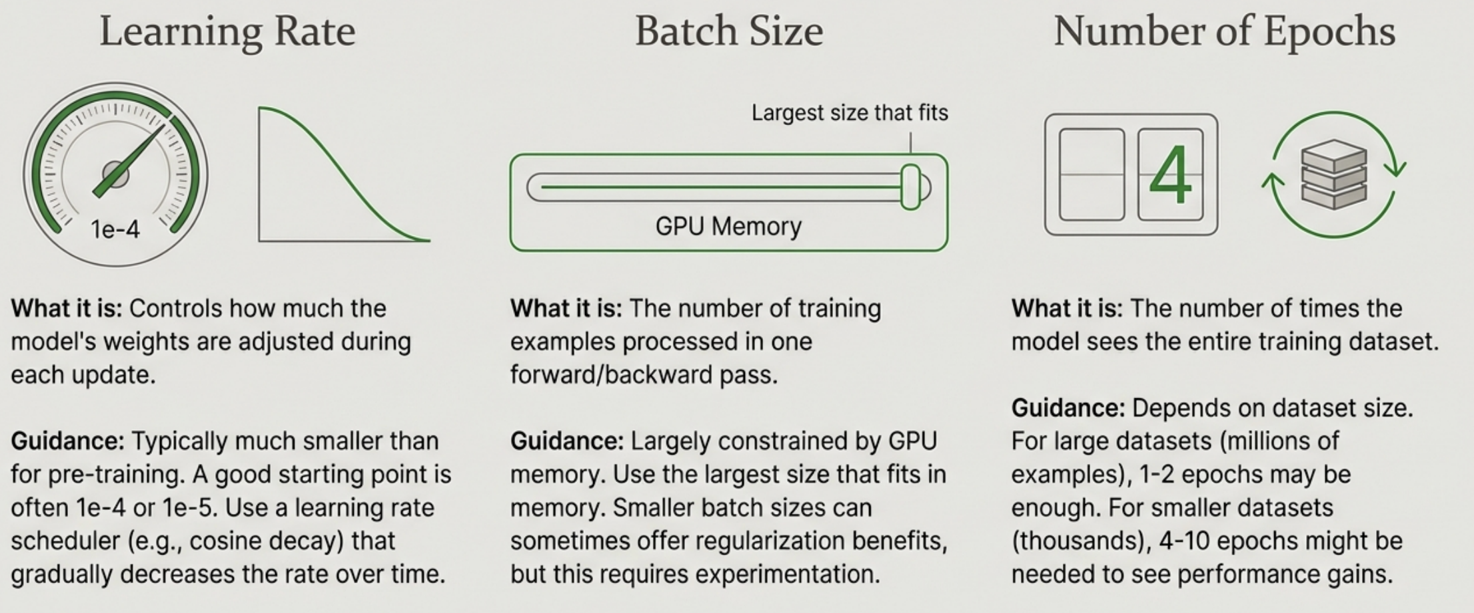
Mastering Key Finetuning Hyperparameters

Slide 11
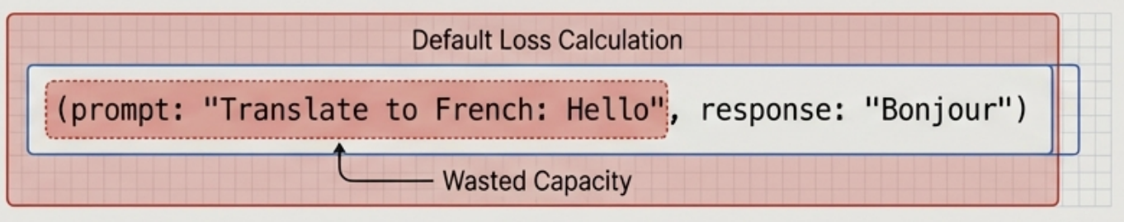
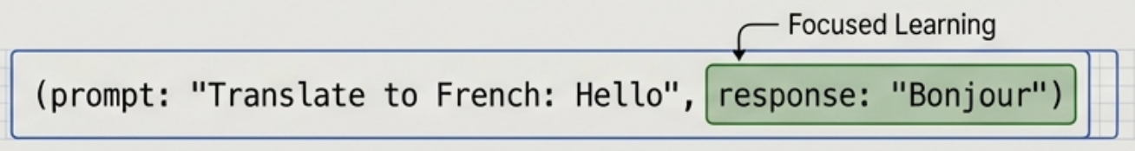
A Specialized Tool: Prompt Loss Weight for Instruction Tuning
The Problem Scenario: In instruction finetuning, a training example consists of an instruction (prompt) and a response. For example: (prompt: "Translate to French: Hello", response: "Bonjour").
By default, the model tries to learn to predict the *entire* sequence, including the prompt tokens. This wastes training capacity on learning to predict the input.
The Solution: prompt_loss_weight What it is: A hyperparameter that controls how much weight is given to the loss calculated on the prompt tokens. How it's used: Set prompt_loss_weight=0. The Effect: This instructs the training process to completely ignore errors made when predicting the prompt tokens. The model's learning is focused exclusively on getting the response tokens correct.
With prompt_loss_weight=0.
This leads to more efficient training and often better performance, as the model concentrates its limited updates on the part of the task that actually matters.

Slide 12
In the next part, we will discuss
Pillars of Data Curation
Data Quality Characteristics
Data Coverage
Data Quantity
Data Synthesis
and much more…

