Slide 1


A Comprehensive Summary
Chapter 4, Part 3
Evaluate AI Systems

Slide 2
Data contamination with public benchmarks
Data contamination is so common that there are many different names for it, including data leakage, training on the test set, or simply cheating.
While some might intentionally train on benchmark data to achieve misleadingly high scores, most data contamination is unintentional. Many models today are trained on data scraped from the internet, and the scraping process can accidentally pull data from publicly available benchmarks.
You can detect contamination using heuristics like n-gram overlapping and perplexity:
N-gram overlapping : For example, if a sequence of 13 tokens in an evaluation sample is also in the training data, the model has likely seen this evaluation sample during training. This evaluation sample is considered dirty.
Perplexity Perplexity measures how difficult it is for a model to predict a given text. If a model’s perplexity on evaluation data is unusually low, meaning the model can easily predict the text, it’s possible that the model has seen this data before during training.

Slide 3
The Solution: Build a Custom, Weighted Leaderboard
Instead of relying on a public leaderboard's final score, create your own to reflect your application's priorities.
Select
Assign Weights
Calculate
Choose public benchmarks that are most relevant to the capabilities your application requires (e.g., code generation, factual consistency).
Give each benchmark a weight based on its importance to your specific use case. A legal chatbot would weight a legal benchmark higher than a coding one.
Compute a weighted average score to rank models according to your priorities, not a generic standard.
Note on Practicality Be aware that running benchmarks can be expensive. Stanford's full HELM suite cost approximately $80,000–$100,000 to evaluate 30 models.

Slide 4
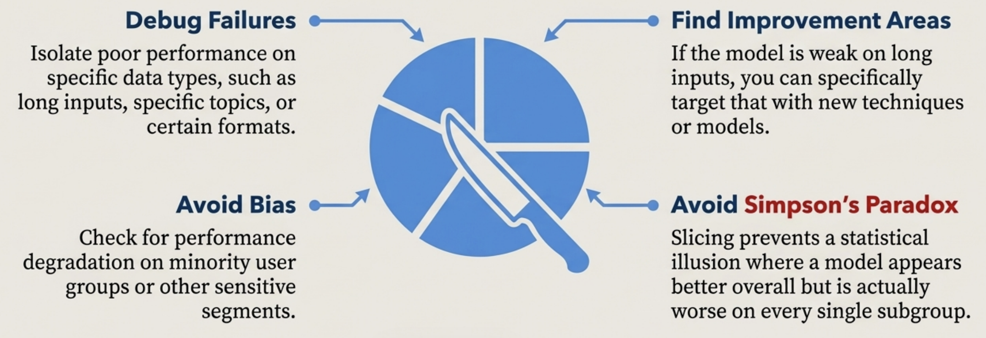
Gain Deeper Insights by Slicing Your Data
Don't just look at the overall score. Analyse performance on different subsets (slices) of your data to gain a finer-grained understanding.

Slide 5
Designing Your Own Evaluation Pipeline (1/3)
Step 1. Evaluate All Components in a System
Real-world AI applications consist of many interdependent components. When a system fails, you must identify where the failure occurs by evaluating each component independently.
Example: Resume Parser
A system extracting current employer from resumes has two steps:
Extract text from PDF → Evaluate using text similarity Extract employer from text → Evaluate using accuracy
Turn-Based Evaluation
Evaluates the quality of each individual output and response in a conversation
vs.
Task-Based Evaluation
Evaluates whether the system completes the overall task, the ultimate measure of success

Slide 6
Designing Your Own Evaluation Pipeline (2/3)
Step 2. Create an Evaluation Guideline
The hardest part of evaluation isn't determining if an output is good, but rather what good means. A correct response isn't always a good response.
Create Scoring Rubrics with Examples
The backbone of reliable evaluation is an unambiguous guideline.
Create a detailed rubric with concrete examples. What does a score of "1" look like versus a "5"?
Tie Metrics to Business Goals
Map evaluation metrics directly to business outcomes. Know what each metric improvement means for your business.
Example: Customer Support Chatbot
80% factual consistency → automate 30% of support requests 90% factual consistency → automate 50% 98% factual consistency → automate 90%
Example: For a customer support chatbot, good responses might use 3 criteria:
Relevance: the response addresses the user's query
Factual Consistency: the response is accurate within the context
Safety: the response is not toxic or harmful

Slide 7
Designing Your Own Evaluation Pipeline (3/3)
Step 3. Define Evaluation Methods and Data
Different criteria require different evaluation methods. Mix and match approaches based on cost and quality needs.
Selecting Evaluation Methods:
Automatic Metrics
Toxicity classifiers, semantic similarity, logprobs for confidence
AI Judges
Models to evaluate factual consistency and quality
Human Evaluation
Expert manual review: the "North Star" for open-ended responses
Hybrid Approach
Cheap classifier on 100% of data + expensive judge on 1%
Annotate Evaluation Data with Slicing
Slice your data into subsets to gain finer-grained understanding of your system's performance and avoid blind spots.
Slicing Benefits: Detect biases against minority groups Debug poor performance on specific subsets Avoid Simpson's Paradox (model A beats B overall but loses on every subset) Find improvement opportunities
Ensure Evaluation Reliability To verify your evaluation set size is sufficient, use bootstrap sampling: repeatedly sample from your evaluation set with replacement and check if results are consistent.
Bootstrap Test:
If results vary wildly between bootstraps (e.g., 90% vs. 70%), you need a larger evaluation set.

Slide 8
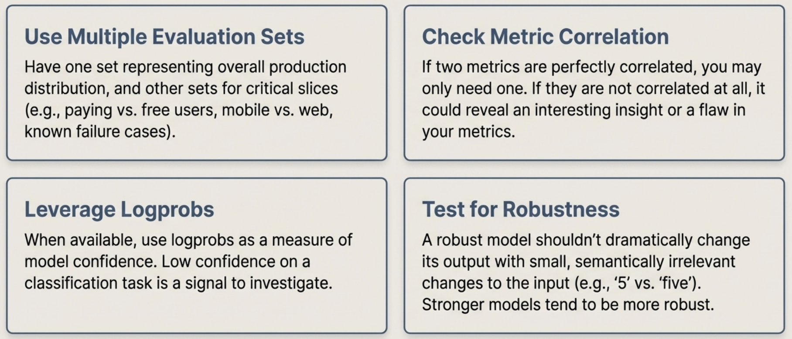
Principles for a World-Class Evaluation Pipeline
A collection of actionable principles to guide your implementation.

Slide 9
In the next part, we will discuss
In-Context Learning (ICL)
System vs. User Prompts
Exponential Growth of the Context Window
Needle in the Haystack (NIAH)
Chain-of-Thought (CoT)
Organizing and Versioning Prompts
Prompt Engineering Best Practices
and much more…

