Slide 1


A Comprehensive Summary
Chapter 6, Part 3
RAG and Agents

Slide 2
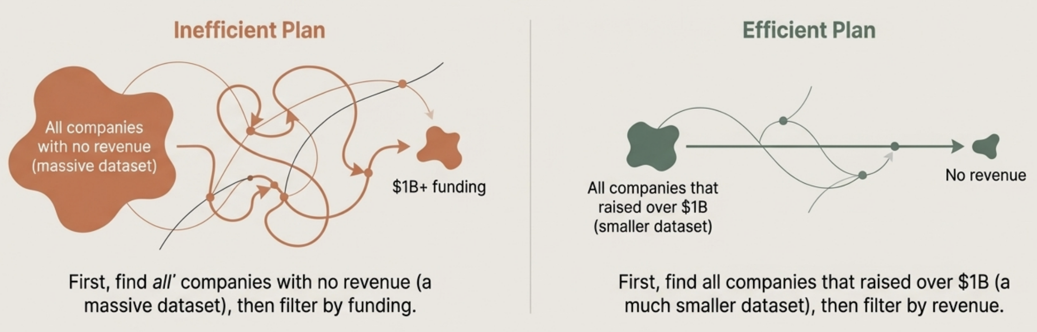
Planning: The Agent's Reasoning Engine
Planning is the process of decomposing a complex task into a manageable and effective sequence of actions.
Why Planning is Crucial
Not all action sequences lead to a successful outcome. Among correct solutions, some are vastly more efficient than others.
Query: "How many companies without revenue have raised at least $1 billion?"

Slide 3


The Shift: Using Foundation Models as Planners
Traditional Approach: Reinforcement Learning (RL)
Modern Approach: Foundation Models (FMs)
Agents learn a "policy" (а mapping from state to action) through extensive trial-and-error.
Highly effective for well-defined, closed environments like chess or Go.
Struggles with the ambiguity and open-ended nature of real-world tasks.
Leverages the FM's built-in commonsense reasoning and instruction-following capabilities.
The FM is prompted with the task, a description of available tools, and examples.
It generates a coherent plan as a sequence of tool calls, making it far more flexible and adaptable to novel problems.

Slide 4
From Task to Action Sequence: A Practical Example
The Input: A System Prompt for the Planner
SYSTEM PROMPT Propose a plan to solve the task. You have access to 5 actions:
get_today_date()
fetch_top_products(start_date, end_date, num_products)
fetch_product_info (product_name)
generate_query(task_history, tool_output)
generate_response(query)
The User's Goal
Task: "What was the best selling product last week?"
The Model's Output: A High-Level Plan
Plan: [get_today_date, fetch_top_products, generate_query, generate_response]
Key Insight: The plan is a sequence of actions. The exact parameters for each action are determined dynamically during execution.

Slide 5
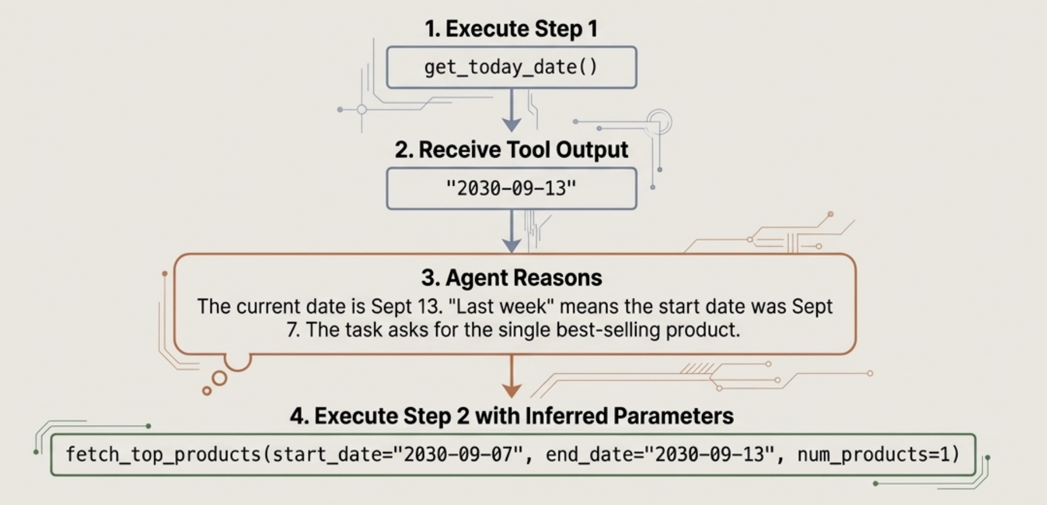
Executing the Plan: Dynamic Function Calling
The agent doesn't pre-determine all parameters. Instead, it extracts them from the outputs of previous tool calls, creating a chain of reasoning.

Slide 6
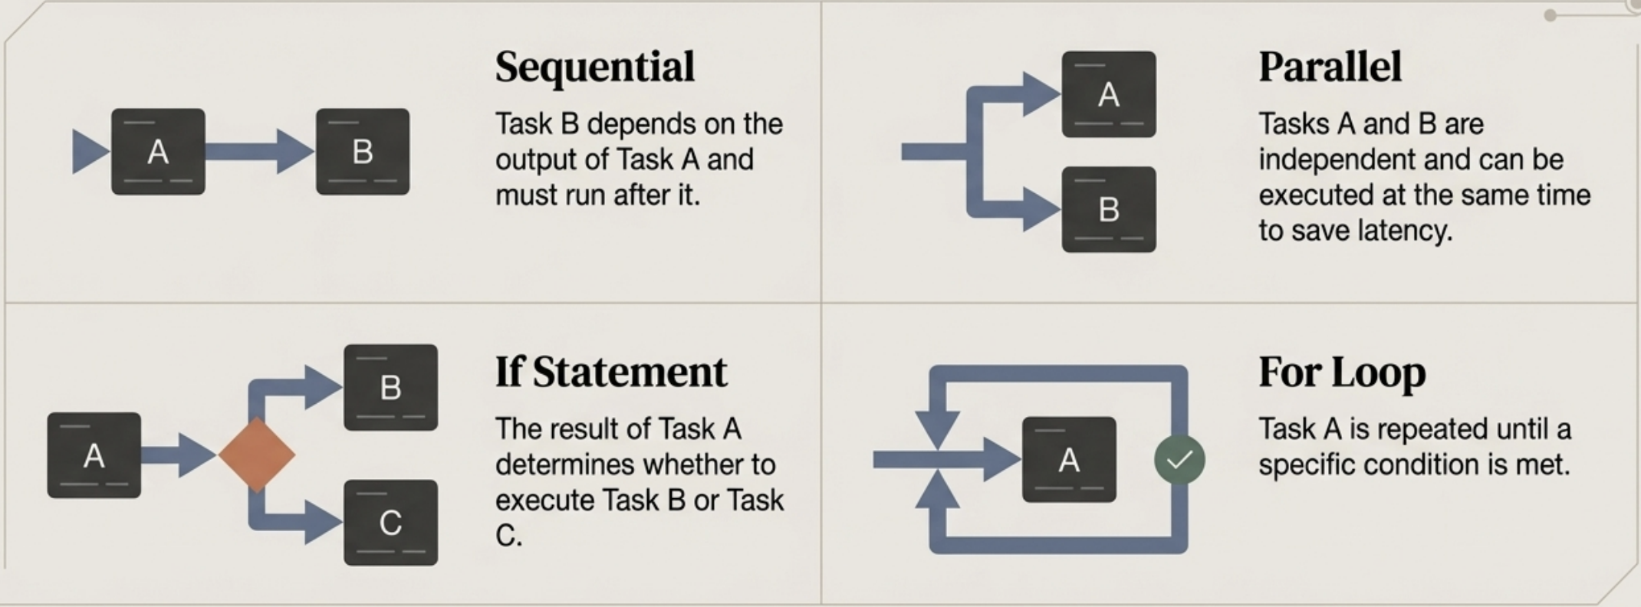
Beyond Sequential: Complex Control Flows
To tackle real-world complexity, agents must generate plans that incorporate advanced logical structures, moving beyond simple step-by-step sequences.

Slide 7
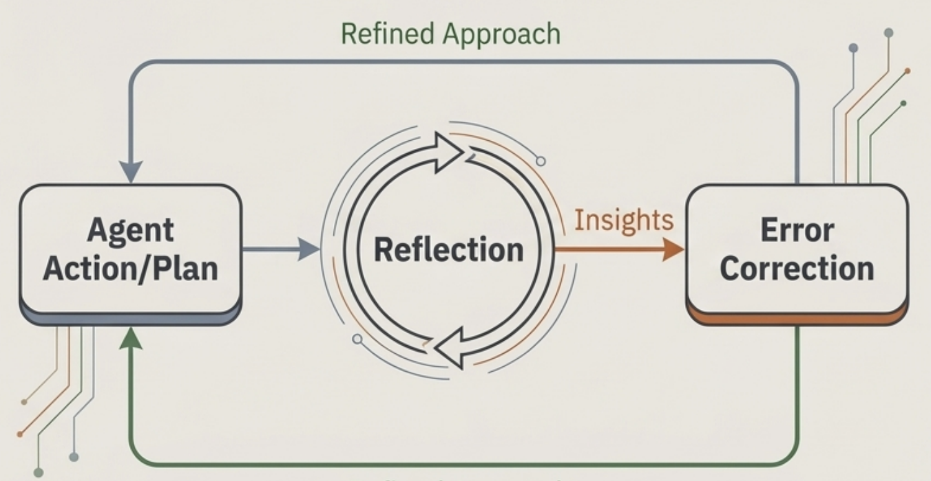
Reflection: The Agent's Inner Monologue
After generating a plan or receiving a tool's output, an agent can pause to evaluate the outcome, check for errors, and refine its approach.
Two Key Mechanisms:
Reflection: The agent generates insights about its own performance. This can be done through a self-critique prompt ("Is this a logical plan?") or by using a separate, specialized scoring model.
Error Correction: The agent uses the insights from reflection to generate a new, improved plan or to retry a failed action with different parameters.
Analogy: This process is similar to the “actor-critic” methods found in reinforcement learning.

Slide 8
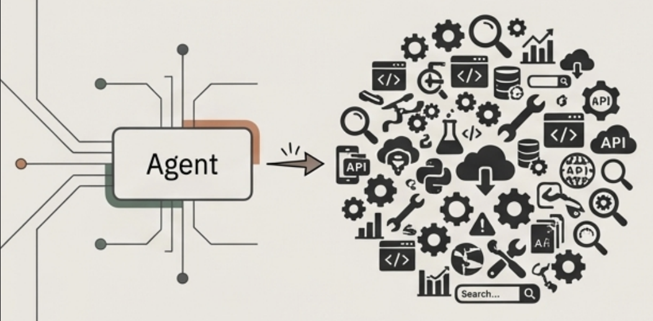
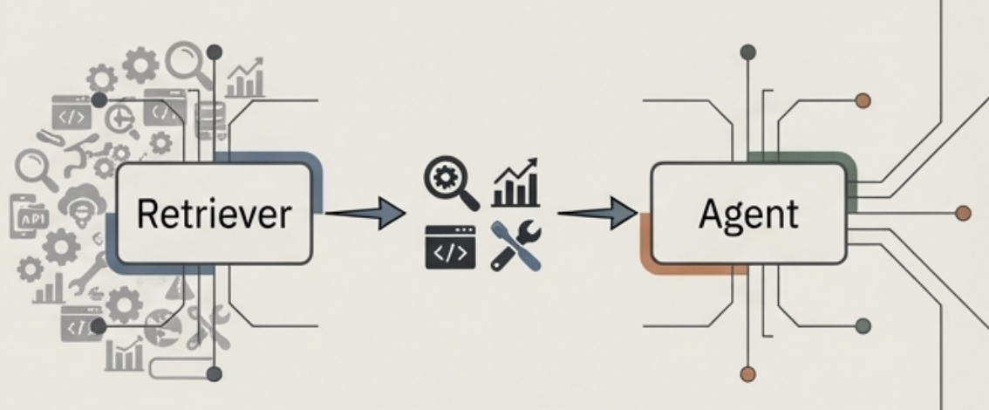
The Right Tool for the Job: Tool Selection
At each step in a plan, the agent must select the most appropriate tool from its inventory. This becomes difficult as the number of tools grows.
Approach 1: One-Shot Selection
Approach 2: Retrieve-then-Select (Two-Step)
Method: Provide the model with the entire list of available tools and their descriptions in the prompt.
Limitation: Performance degrades with many tools, and it consumes significant context space.
Step 1 (Retrieve): Use a semantic retriever to find a small subset of the most relevant tools for the current sub-task.
Step 2 (Select): Provide the model with only this smaller, relevant list of tools to choose from. Advantage: Much more scalable and efficient for agents with large tool inventories.

Slide 9

How Good Is Our Agent? Core Evaluation Metrics
Task Success Rate
What percentage of assigned tasks does the agent successfully complete from start to finish?
Autonomy
How often does the agent require human intervention or clarification? A lower intervention rate signifies higher autonomy.
Quality of Final Outcome
Is the final result not just complete, but also correct, well-formed, and of high quality?
Robustness
How well does the agent handle ambiguity in the task description or unexpected errors from its environment and tools?

Slide 10
Failure Mode: When the Plan is Flawed
Focus: Errors that occur within the agent's 'brain’: its ability to reason and structure a solution.
Common Types of Planning Failures:
Incorrect Decomposition: The agent breaks the task into the wrong logical steps.
Hallucinated Plan: The agent attempts to use tools or parameters that do not exist.
Inefficient Plan: The plan is technically correct but is unnecessarily slow, expensive, or convoluted.
Misinterpreted Intent: The agent correctly executes a plan for the wrong goal because it misunderstood the user's initial request.

Slide 11
Failure Mode: When the Tools Malfunction
Focus: Errors that occur in the agent's "hands”: its interaction with its tool inventory and the external world.
Common Types of Tool Failures:
Incorrect Tool Selection: The plan is sound, but the agent chooses the wrong tool for a specific step.
Incorrect Tool Invocation: The agent calls the right tool but with improperly formatted or incorrect parameters.
Tool Execution Errors: The external tool itself fails (e.g., an API is down, a database query times out, a file is not found).
Misinterpreting Tool Output: The tool returns valid data, but the agent misunderstands its meaning, leading to subsequent errors.

Slide 12
Beyond Correctness: The Efficiency Dilemma
An agent that successfully completes a task but does so in a way that is too slow or expensive is not a viable solution.
Key Efficiency Metrics
Total Cost: The aggregate cost of all model calls and tool API usage.
Total Latency: The end-to-end time required to complete the task.
Number of Steps/Redundancy: How many actions did the agent take? Were any of them unnecessary?
Critical Insight: "What's considered efficient for humans might be inefficient for Al, and vice versa. An Al agent can visit 100 web pages in parallel, a trivial task for it but impossible for a human."

Slide 13
The Exponential Challenge of Compound Mistakes
In a multi-step process, small, per-step error rates compound exponentially, leading to a high probability of overall failure.
The Math of Failure Assume a model has a 95% accuracy rate per step.
After 10 steps, the probability of overall success drops to 0.95¹⁰ = ~60%.
After 100 steps, the probability of success plummets to 0.95¹⁰⁰=~0.6%.
Conclusion: This highlights the absolute necessity for high per-step reliability and robust reflection and error-correction mechanisms in any agent designed for complex tasks.

Slide 14
In the next part, we will discuss
Finetuning vs Transfer Learning
When to Finetune
Finetune vs RAG
Memory Bottleneck with Training
Precision Formats and Trade-offs
Memory Math for Finetuning
and much more…

