Slide 1


A Comprehensive Summary
Chapter 10
AI Engineering Architecture and User Feedback

Slide 2
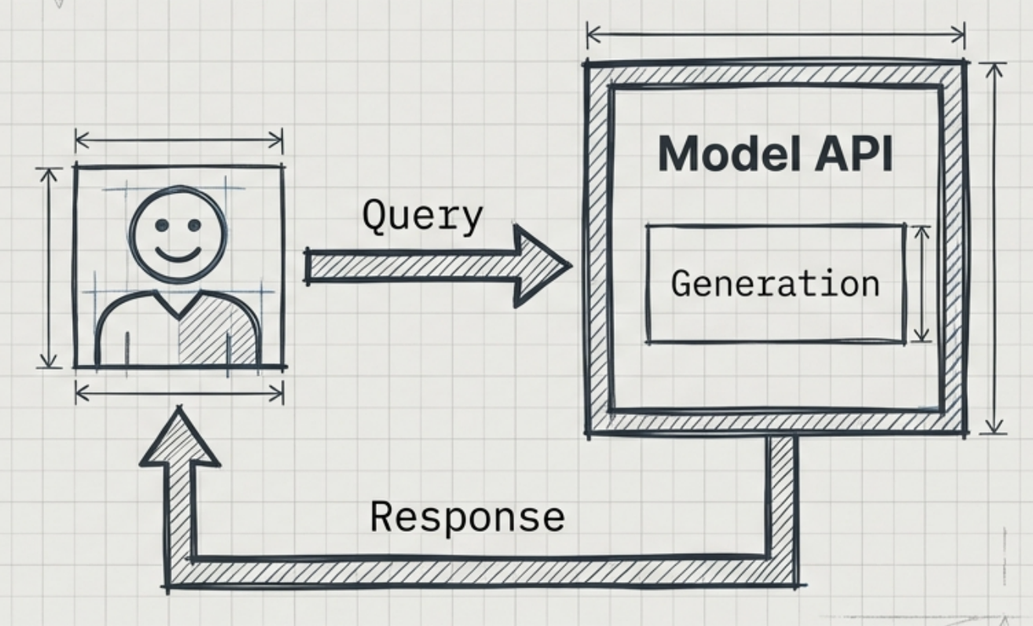
The Starting Point: The Direct Model Loop
This is the simplest unit of AI engineering-the "naked" model. In this state, a user sends a query, and the model generates a response based solely on its training data. While sufficient for demos, this architecture is fragile. It lacks context awareness, safety mechanisms, and cost optimization.
Status: Non-Production. Lacks context, guardrails, and caching.

Slide 3
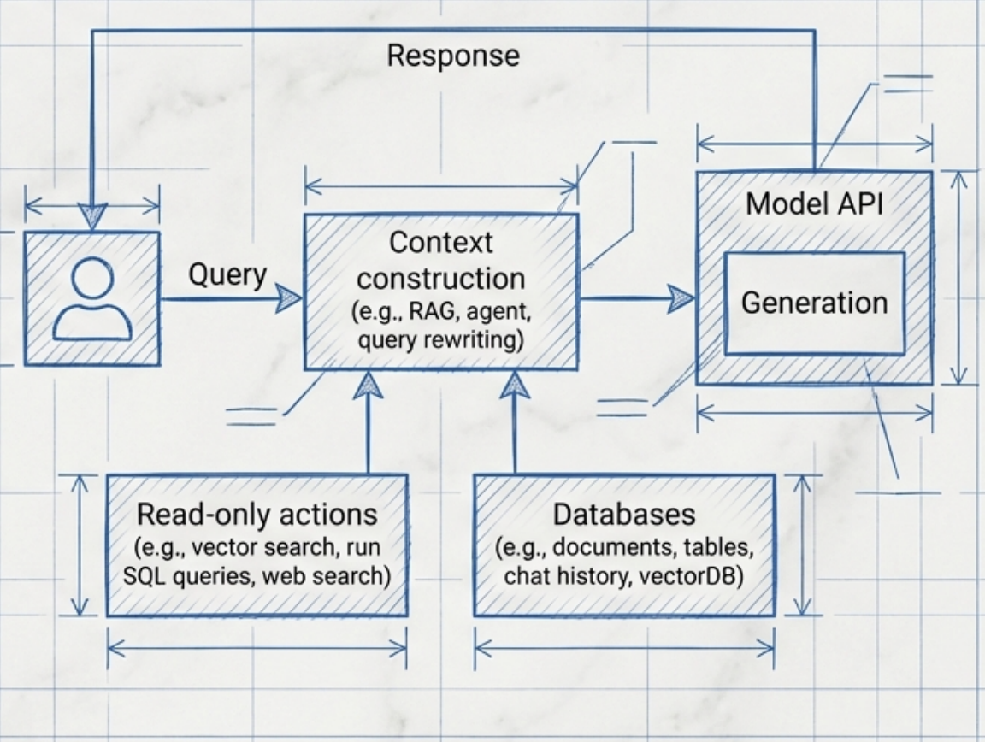
Step 1: Enhance Context
Context construction is the feature engineering of Foundation Models. Instructions are static, but context is dynamic. To move beyond the 'naked' model, we must fetch relevant information before generation.
RAG: Retrieve data from vector DBs or documents.
Tools: Read-only actions (Web Search, APIs).
Query Rewriting: optimizing user intent.

Slide 4
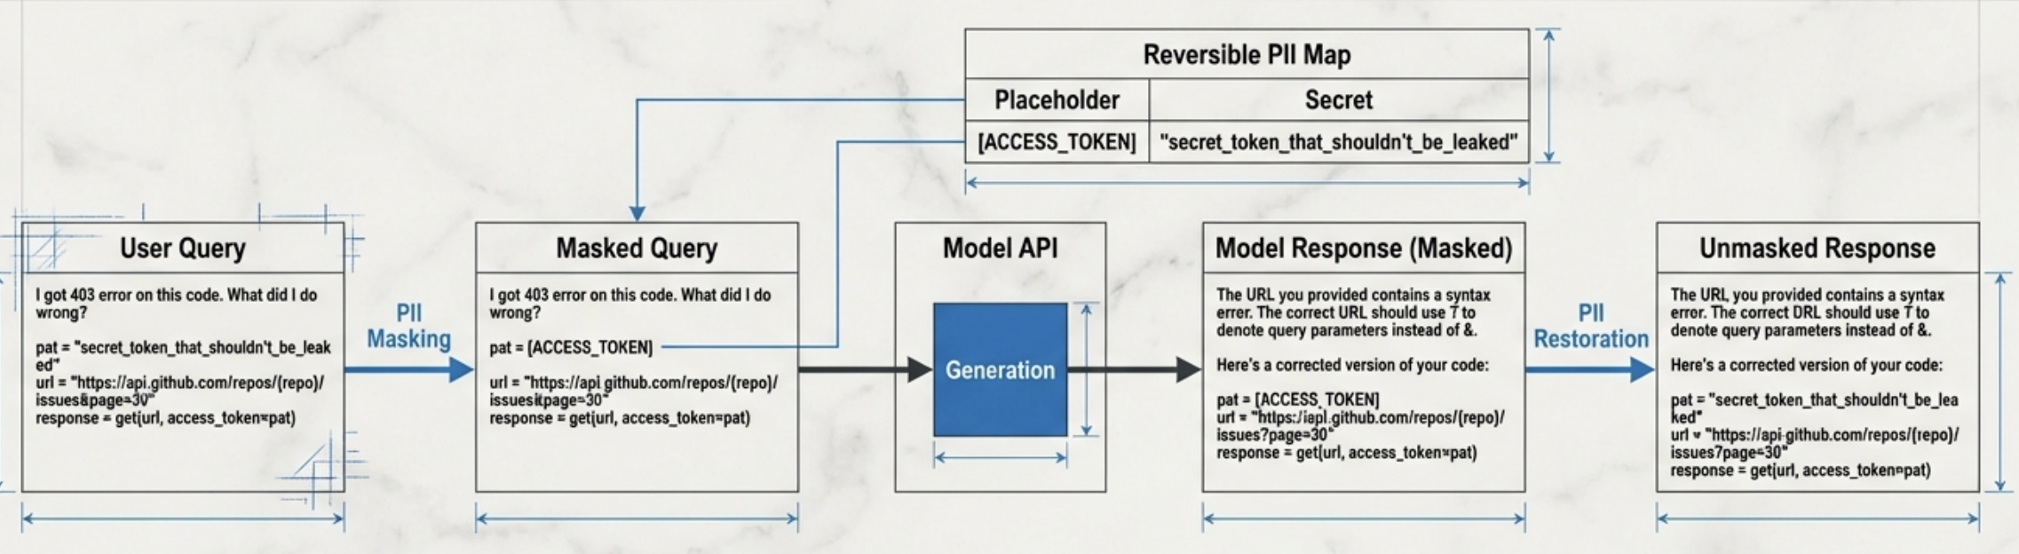
Step 2: Input Guardrails (Protection Before Processing)
The Risk
Data leaks occur when sensitive PII or secrets are sent to third-party Model APIs. Once the data leaves your infrastructure, it is out of your control.
The Solution
Detect and replace sensitive entities (e.g. API keys, names) with placeholders before the request hits the model. Store the mapping locally.
The Restoration
Once the model generates a response using the placeholder, the system uses the map to restore the original data in the final output to the user.

Slide 5
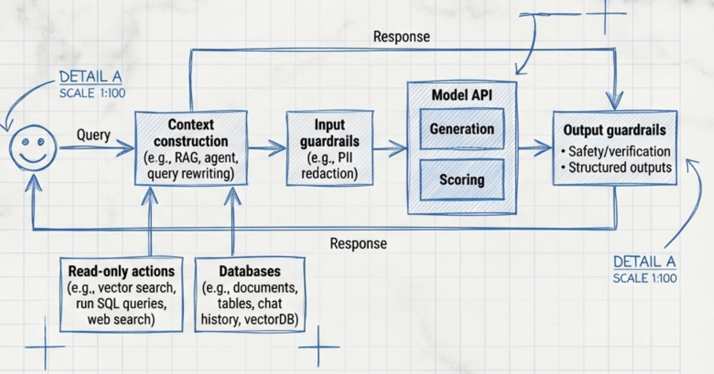
Step 2: Output Guardrails (Quality Control)
We must validate the system's output before showing it to the user. This layer mitigates hallucinations, toxicity, and format errors (e.g., broken JSON).
Technical Insight: Models are probabilistic. A "Retry" logic is often the cheapest fix for for malformatted or empty responses. We also track "False Refusal Rate" to ensure safety filters aren't degrading usability.

Slide 6
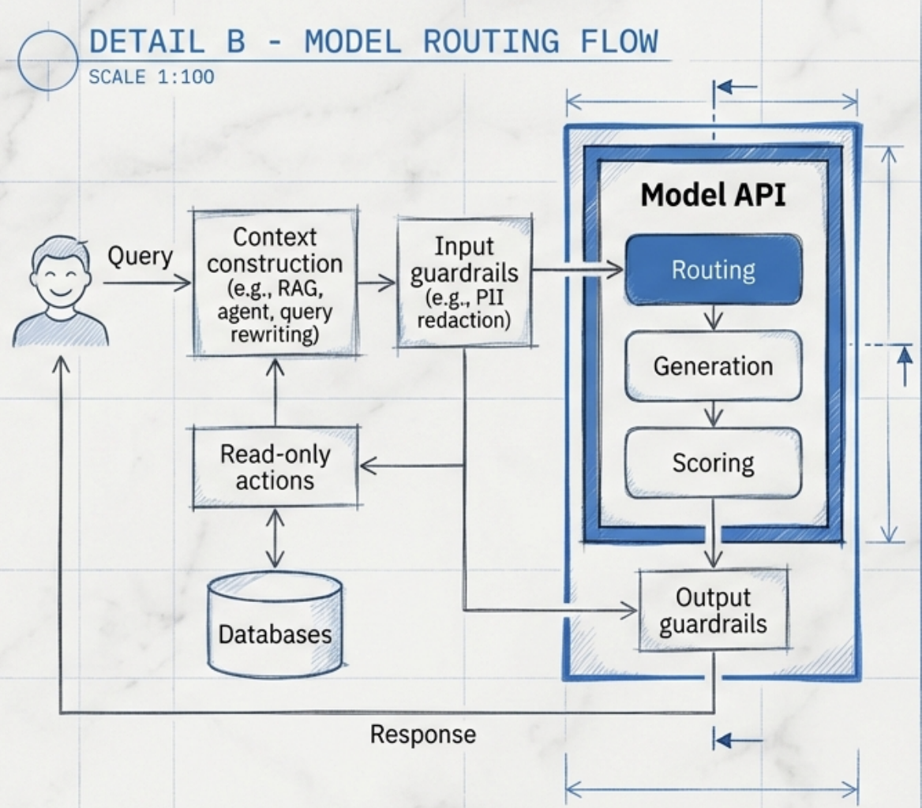
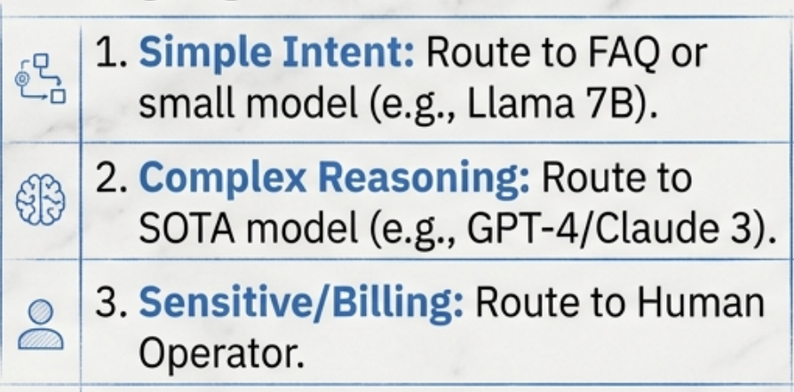
Step 3: The Model Router
Not every query requires the smartest, most expensive model. A Router acts as a traffic controller, classifying user intent to direct the query efficiently.
Routing Logic:

Slide 7
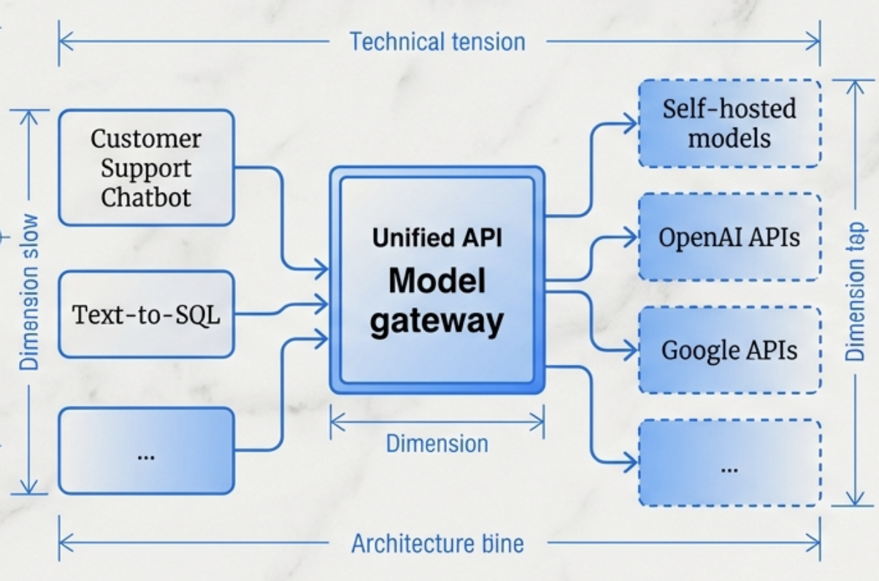
Step 3: The Model Gateway (The Enterprise Interface)
Core Function: A unified interface decoupling applications from specific providers. If OpenAI goes down, the Gateway can reroute to Anthropic or Azure without code changes.
Key Features:
Access Control: Centralized management of API keys preventing leaks.
Rate Limiting & Cost: Monitor usage across the organization.
Fallbacks: Graceful handling of AРІ outages.

Slide 8
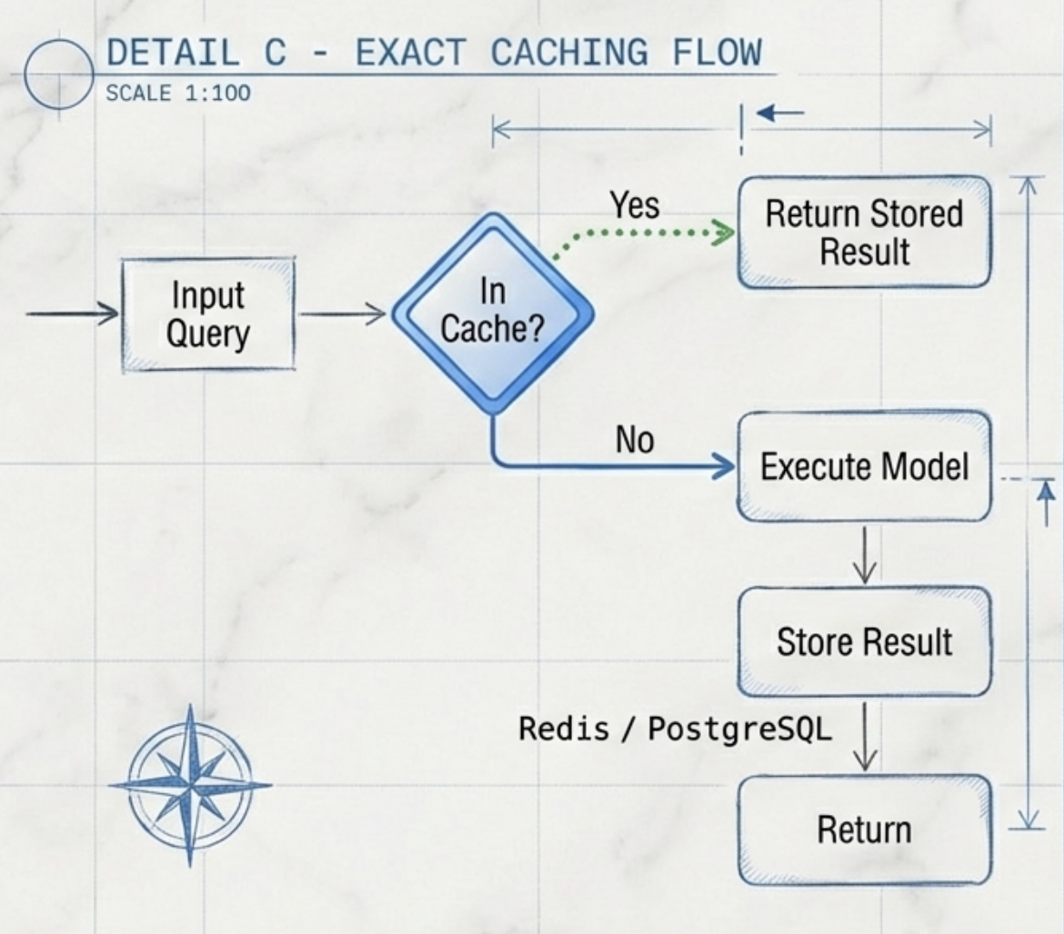
Step 4: Exact Caching
The fastest generation is no generation. Exact caching stores results for queries that have been processed before, matching the input string exactly.
Use Cases
- Deterministic Steps: Caching SQL query results or Vector Search outputs.
- Multi-step Chains: Storing intermediate reasoning steps.
Warning: Implement strict eviction policies (LRU/LFU) and ensure User A cannot retrieve User B's cached PIІ.

Slide 9
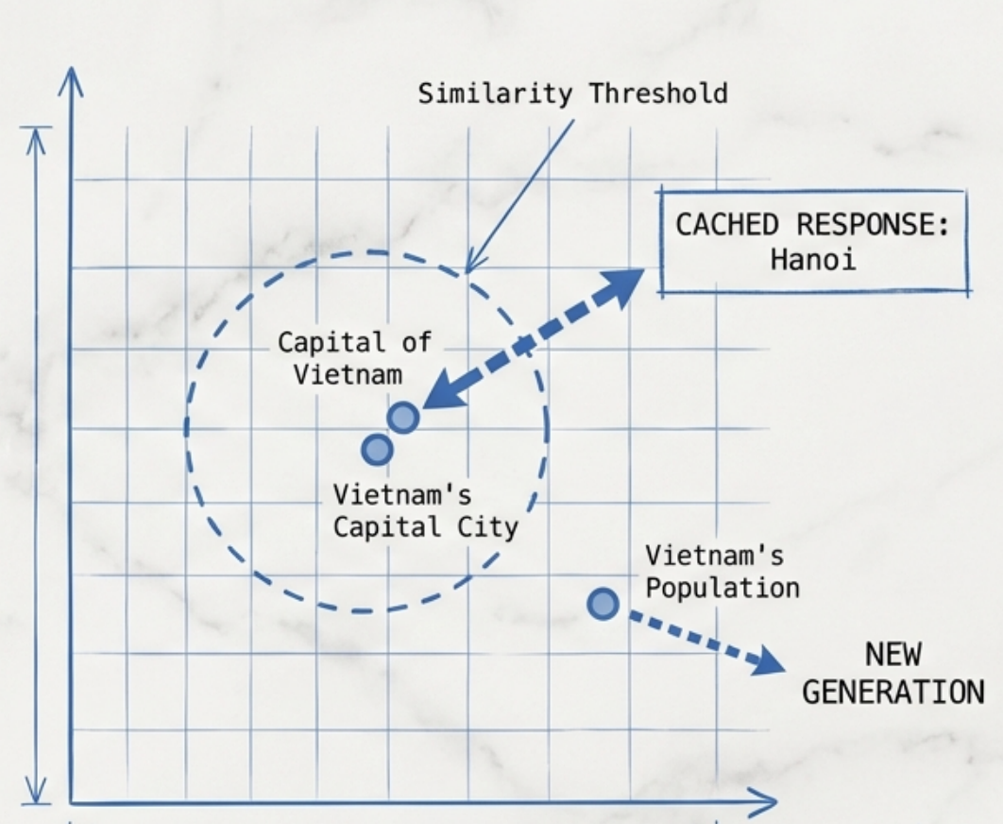
Step 4: Semantic Caching
Leveraging embeddings to return cached responses for queries that are similar in meaning, even if wording differs (e.g., "Pricing?" vs "How much does it cost?").
The Mechanism 1. Generate Embedding for input
2. Vector Search against Cache.
3. If Similarity > Threshold, return Cache.
The Trade-off
High cost of vector search vs. generation savings. Risk of false positives if the threshold is too low.

Slide 10
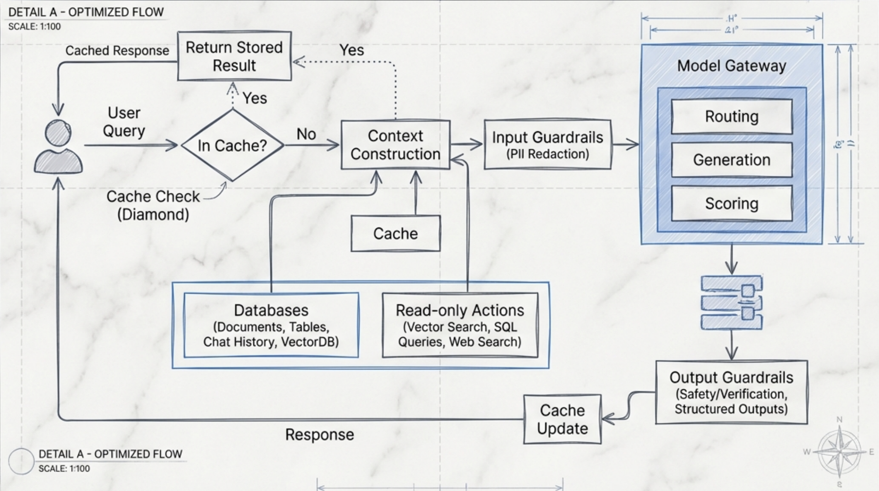
The Optimized Architecture (Steps 1-4)

Slide 11
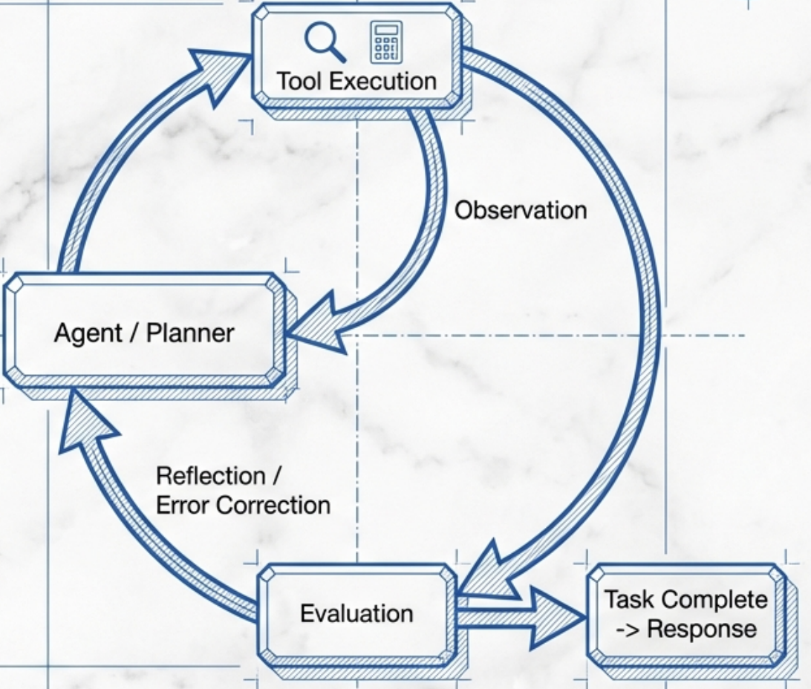
Step 5: Agent Patterns (The Looр)
Agents move us from linear pipelines to recursive loops. The model acts as a brain, planning actions, observing outputs, and deciding if the task is complete.
The Agent Loop
- Plan: Decomposition of the user request.
- Action: Tool execution (e.g., 'Search', 'Calculate’).
- Observation: Reading the tool output.
- Reflection: Did I solve it? If no, loop back.

Slide 12
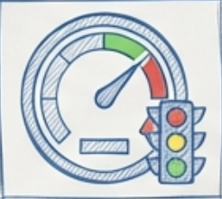

Monitoring vs. Observability
Monitoring
Observability
Definition
Tells you the system status.
Definition
Allows you to debug *why* the system is acting that way.
The Question
Is the system healthy?
The Question
Why did this specific request fail?
Example
Alert: Latency > 2000ms.
Example
Latency is high because the semantic cache vector search is choking on large embeddings.
Analogy
The dashboard of a car.
Analogy
Lifting the hood to inspect the engine.

Slide 13
Metrics for Observability Quality
How do we measure the effectiveness of our diagnostic stack? We look at three key engineering metrics.
MTTD
Mean Time to Detection
How fast do you become aware of a problem?
Goal: IBM Plex Mono Minimize time between failure onset and alert.
MTTR
Mean Time to Resolution
How fast can you fix the problem once detected?
Note: IBM Plex Mono The ultimate goal of observability is to drive this to zero.
CFR
Change Failure Rate
How often do new updates (prompt changes, model swaps) break the system?
Context: IBM Plex Mono Crucial in AI engineering where prompts are tweaked frequently.

Slide 14
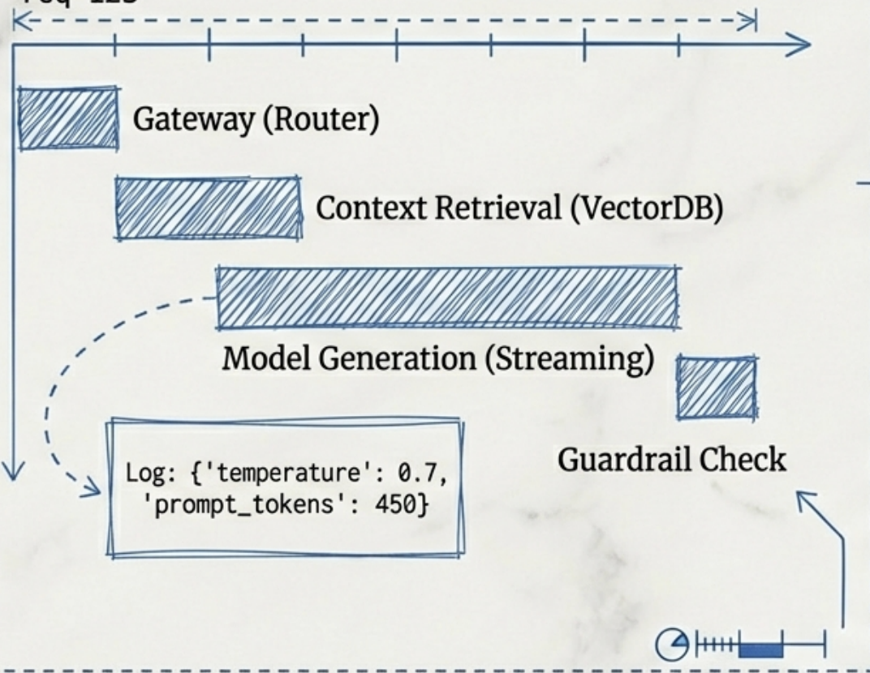
Logs and Traces
Logs and Traces
You cannot debug what you do not log. In AI Engineering, we must capture the "intermediate state"-the thoughts between the input and output.
Trace Visualization
What to Log (Checklist):
Configs: Temperature, Top-P, Model Version.
Prompts: The final rendered prompt (including system instructions).
Intermediates: Raw retrieved context snippets and tool outputs.

