Slide 1

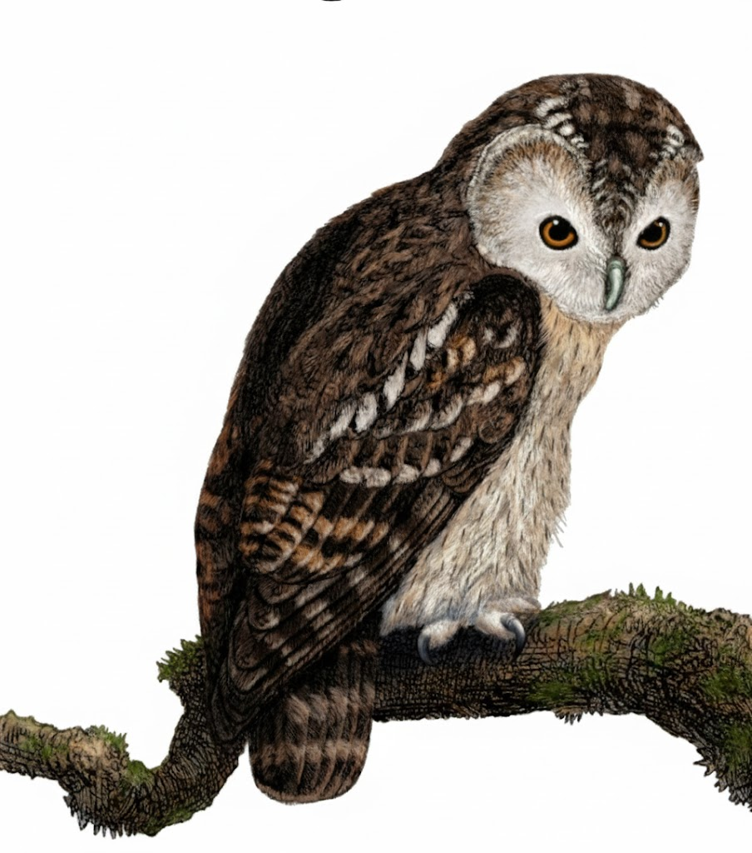
A Comprehensive Summary
Chapter 8, Part 2
Dataset Engineering

Slide 2
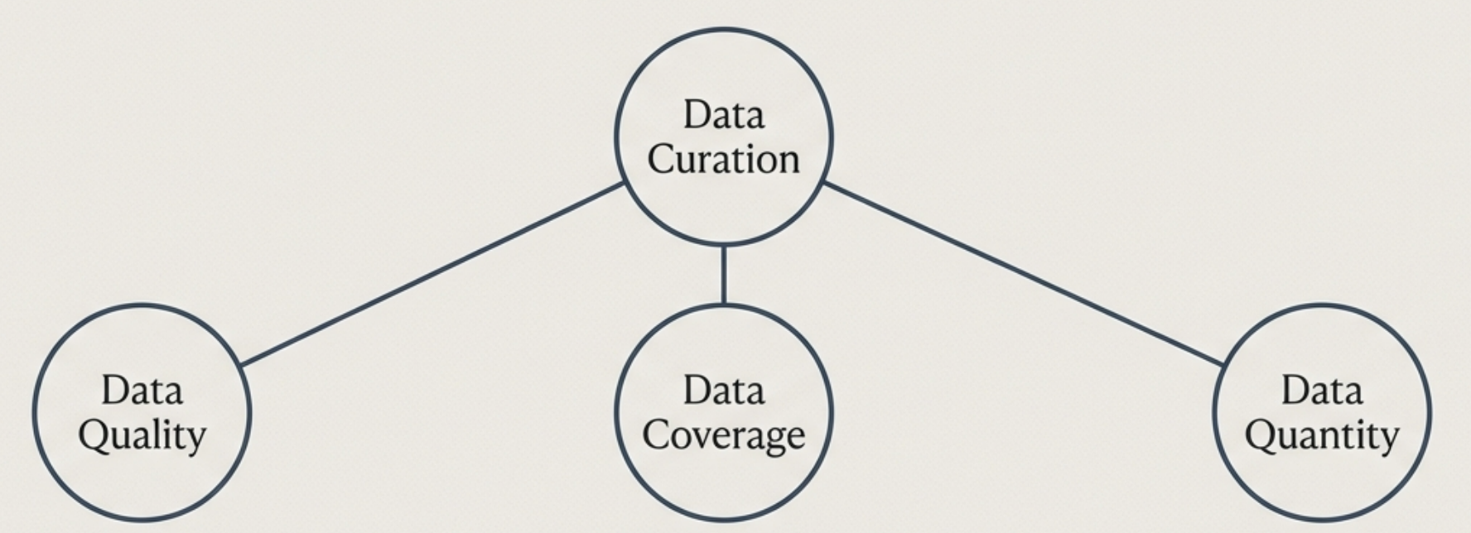
The Three Pillars of Effective Data Curation
The intrinsic value of each data point. "You can't have good food if your ingredients are spoiled."
The right mix and diversity of ingredients. "You shouldn't have too much or too little sugar."
The total amount of ingredients needed.
Data curation is the systematic process of managing data for finetuning. Mastering these three pillars: Quality, Coverage, and Quantity is the essential foundation for achieving high-performance models.

Slide 3
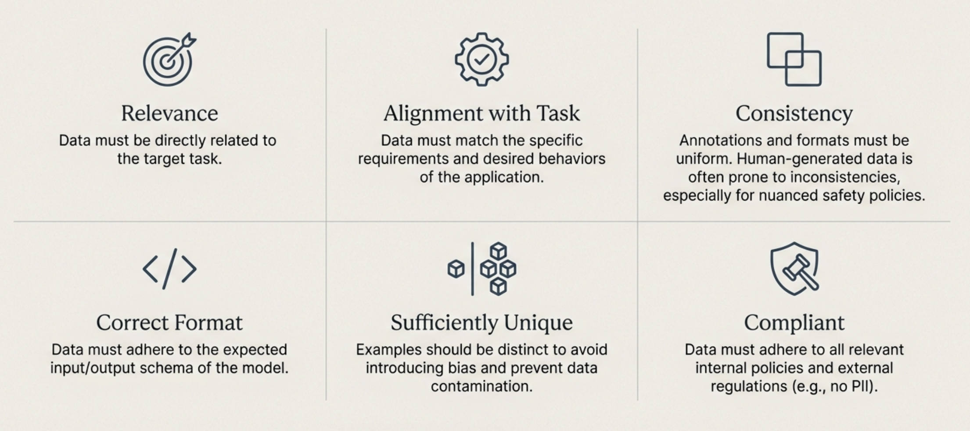
Deconstructing Data Quality: The Six Core Characteristics

Slide 4
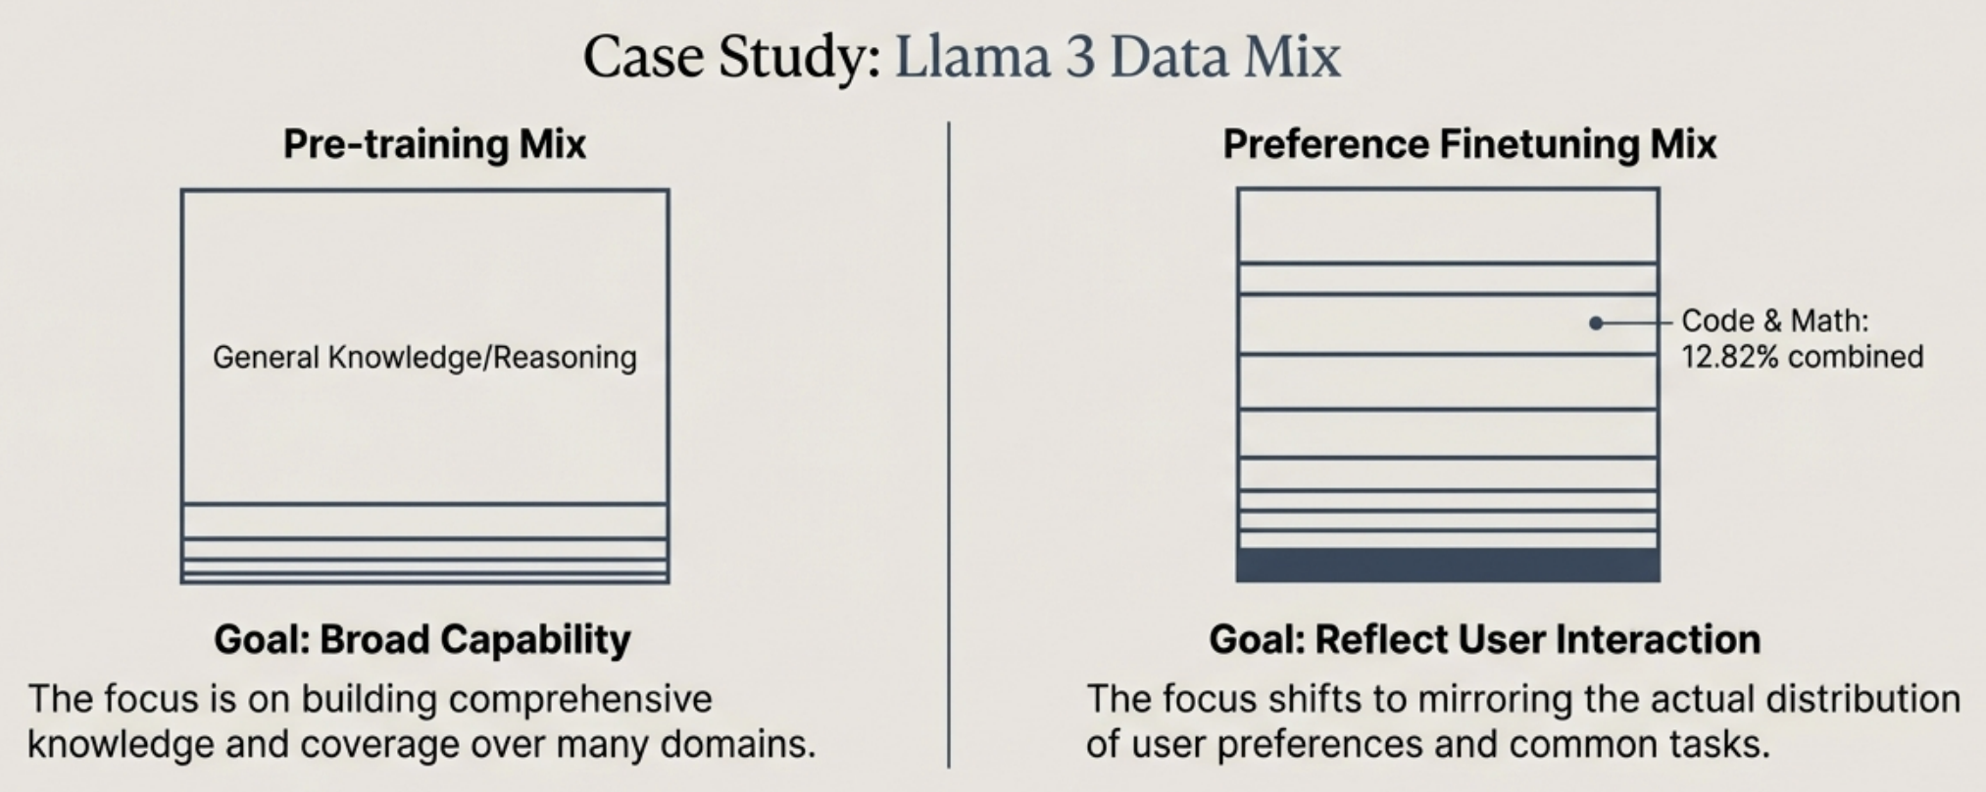
Data Coverage: Engineering the Optimal Data Mix
Data coverage ensures the finetuning dataset reflects the diversity of real-world applications. This includes diversity in topics, lengths, speaking styles, and even common errors like typos.
The optimal data mix is task-dependent. Scaling law experiments on smaller models can predict the performance of larger ones, guiding strategic data composition.

Slide 5
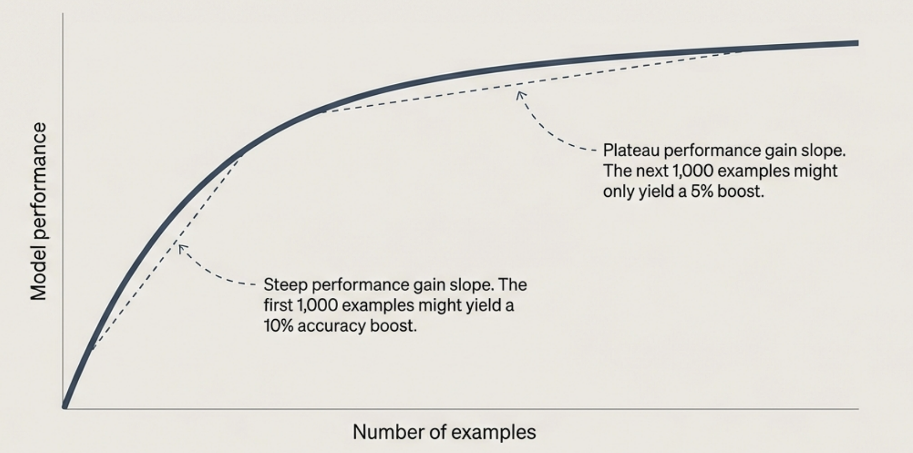
Data Quantity: Beyond a Simple Number
Additional training examples almost always yield diminishing returns. Understanding this curve is crucial for estimating the ROI of further data acquisition and avoiding wasted effort.

Slide 6
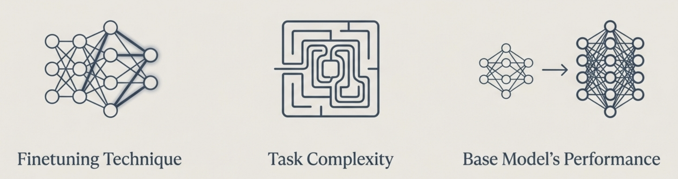
Three Factors That Determine How Much Data?
Full finetuning requires more data. Parameter-Efficient Finetuning (PEFT) like LoRA can achieve high performance with significantly less data.
Simple tasks (e.g., sentiment classification) require less data. Complex tasks (e.g., code generation, reasoning) require much more data to cover the vast problem space.
A highly capable base model (like GPT-4) requires fewer examples to learn a new task compared to а weaker base model. Its existing knowledge provides a stronger starting point.

Slide 7
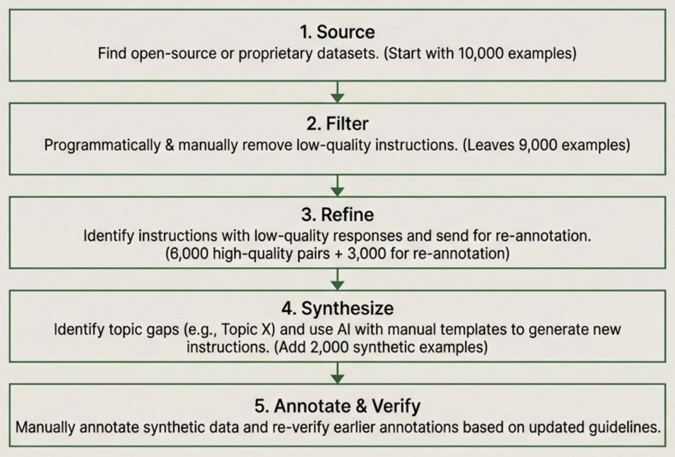
The Applied Workflow of Data Acquisition & Annotation

Slide 8
Curation Challenges for Specialized Data Formats
Single-Turn Data
(e.g., Classification, summarization). Relatively straightforward but requires significant diversity in instructions.
Multi-Turn Data (e.g., Chatbots). Requires maintaining conversational context and logical flow. Annotation is more complex and time-consuming.
Chain-of-Thought (CoT) Data Requires annotating the reasoning process, not just the final answer. Quality is paramount as the model learns how to "think".
Tool Use Data The most complex. Must teach the model to correctly format API calls and interpret their outputs.
Human vs. Al Efficiency Human annotations for tool use can be sub-optimal. A human workflow (Open browser -> Copy/paste Click) is inefficient for an Al, which prefers a direct API call. For agentic tasks, simulations and synthetic data are often superior to direct human annotation.

Slide 9
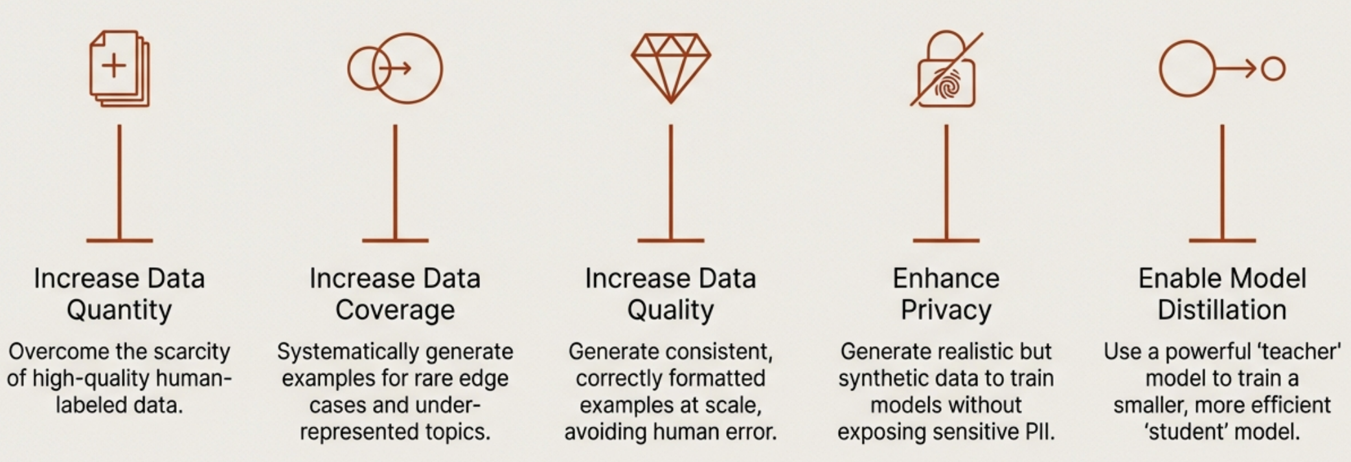
Data Synthesis: A Strategic Imperative
“LM-written datasets approach the quality of human-written ones, sometimes even exceeding them.” - Anthropic (Perez et al., 2022)

Slide 10
In the next part, we will discuss
Traditional Data Synthesis Techniques
AI-Powered Synthesis Model Distillation
Limitation of AI Generated Data Deduplication, Filter and Format
and much more…

