Slide 1
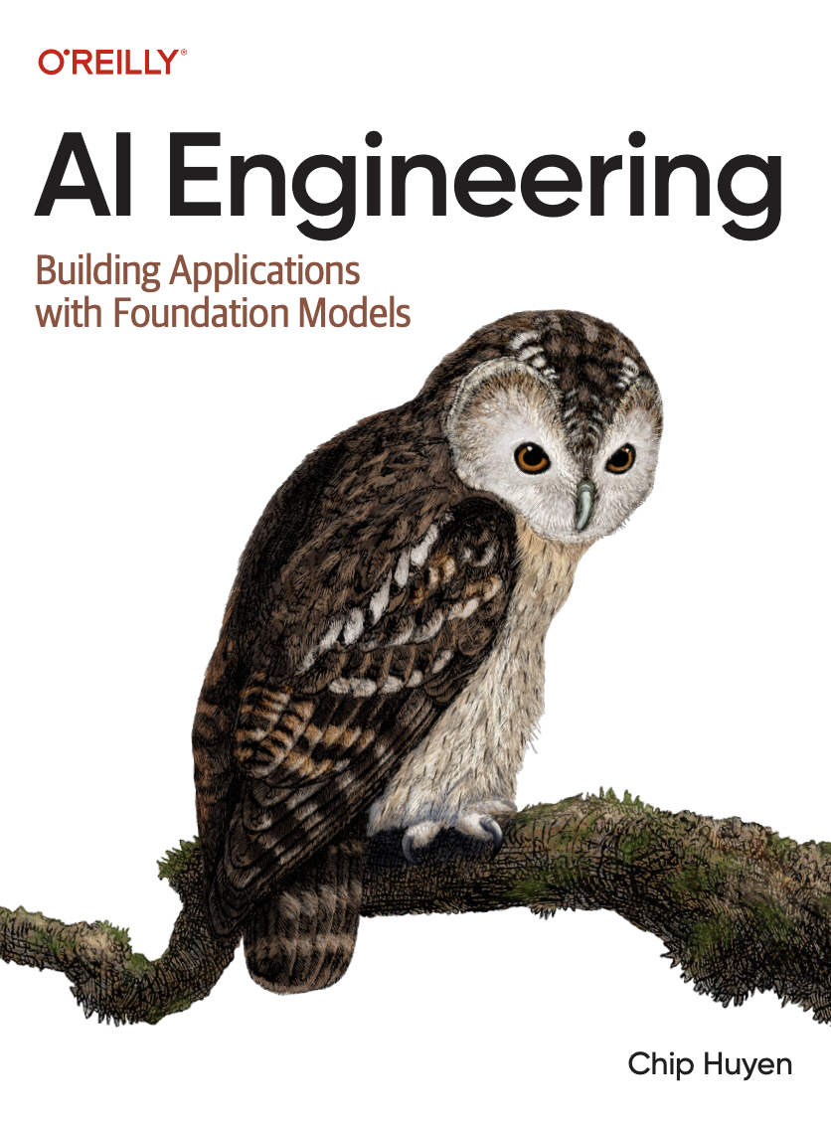
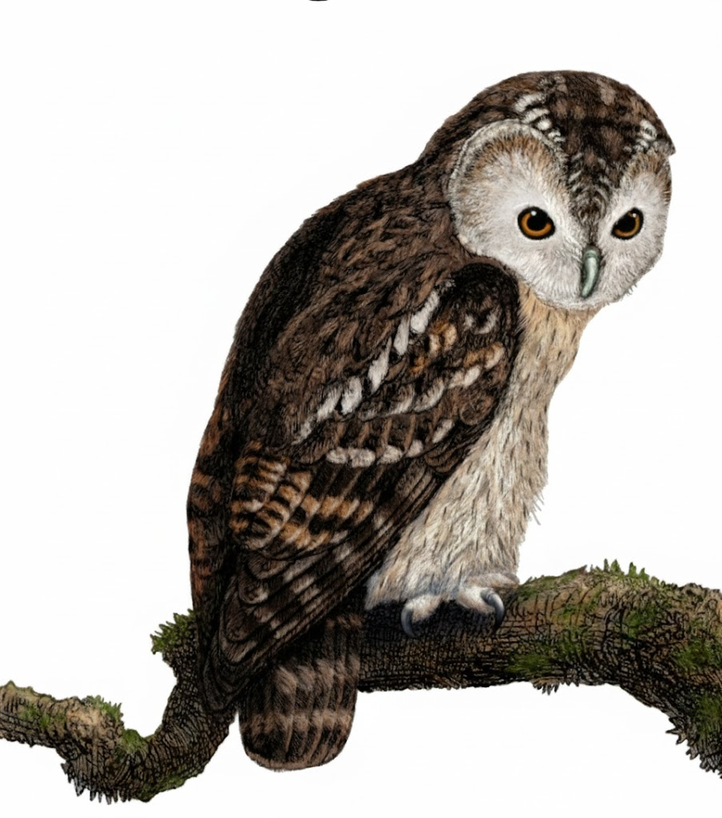
A Comprehensive Summary
Chapter 1, Part 1
Introduction to Building AI Applications with Foundation Models

Slide 2
At its core, a language model predicts the next unit of language.
The basic unit of a language model is a token, which can be a character, word, or sub-word. The set of all possible tokens is the vocabulary.
The process of breaking text into tokens is called tokenization.
GPT-4, for example, has a vocabulary of 100,256 tokens.
Tokenization Process for GPT-4:
“cooking” for example, can be broken into “cook” and “ing”. this reduces the model’s vocabulary size.

Slide 3
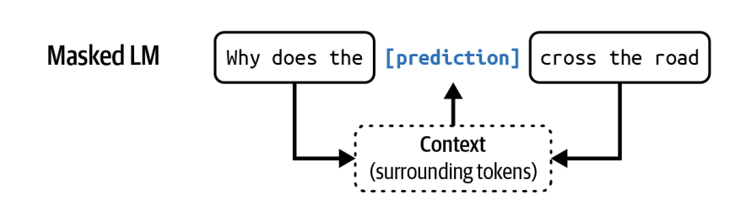
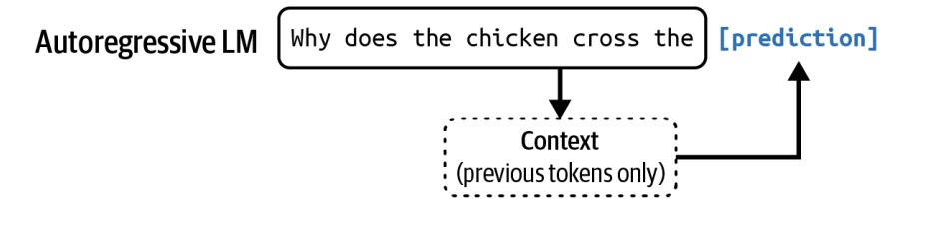
Language models process text in two fundamental ways.
Autoregressive LM (e.g., GPT series)
Masked LM (e.g., BERT)
Predicts the next token using previous tokens only.
This architecture is ideal for text generation.
Predicts a missing token using its surrounding context
(both before and after). This excels at tasks requiring
deep contextual understanding.

Slide 4
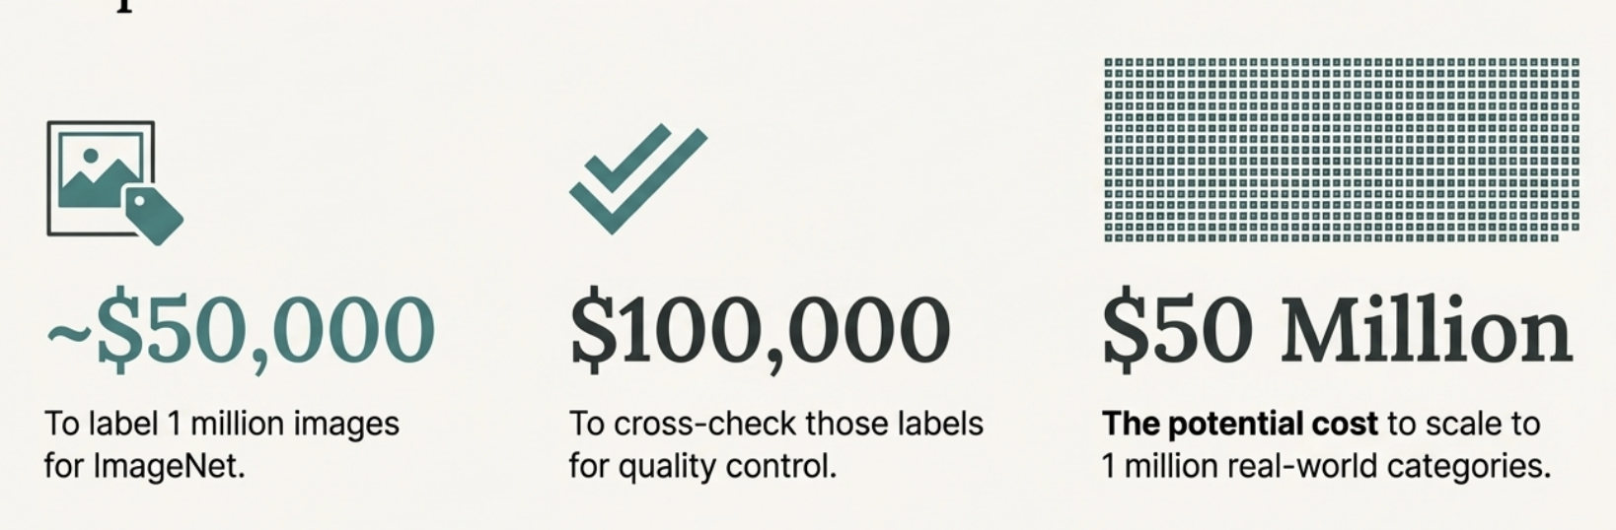
The bottleneck of supervision: Data labelling is expensive and cannot scale.
The deep learning revolution of the 2010s was built on supervised learning
Relying on human supervision is too slow and costly to build models that understand the breadth of the world's knowledge.

Slide 5
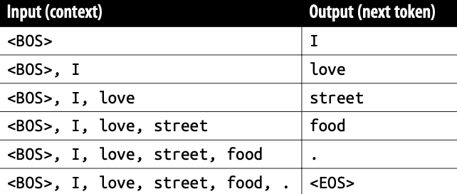
The breakthrough: What if the data could label itself?
Self-Supervision allows a model to generate its own labels directly from unlabelled input data.
Language modelling is self-supervised because each input sequence provides both the labels (tokens to be predicted) and the contexts the model can use to predict these labels.
This unlocks the ability to train on internet-scale, unlabeled data, removing the human bottleneck entirely
The sentence “I love street food.”
gives six training samples,
<BOS> and <EOS> mark the beginning and the end of a sequence.

Slide 6
The result is a new class of AI: The Foundation Model.
These models are the result of self-supervision combined with scaling laws: the predictable performance gains from increasing model size, dataset size, and compute together.
They are not just 'Large Language Models' (LLMs); they can be multimodal (text, image, audio).
The name 'Foundation' signifies they are a base to be built upon and adapted for specialized tasks.
FROM: Training a separate, specialized model for every task.
TO: Adapting one pre-trained foundation model for thousands of tasks.

Slide 7
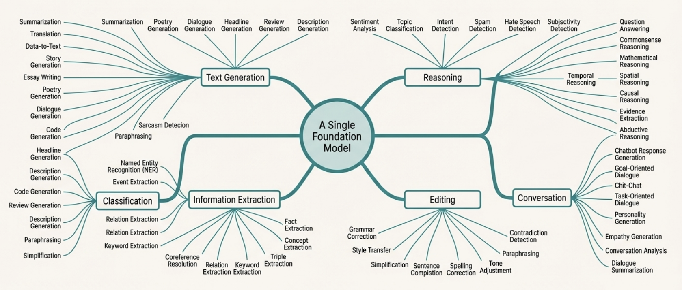
One pre-trained model can perform thousands of distinct tasks.

Slide 8
In the next part, we will discuss
AI’s Greatest Strengths
Need for AI Engineering
Language Model Comparison
AI Stack
AI Engineering vs ML Engineering
and much more…

