Slide 1
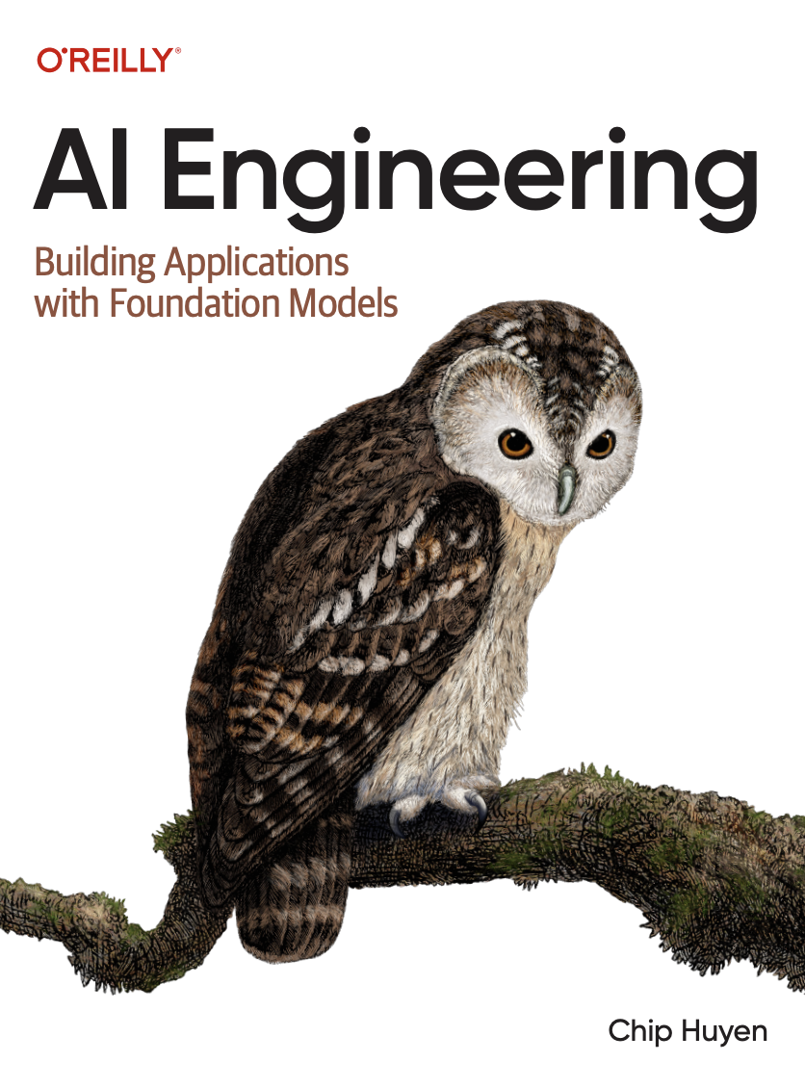
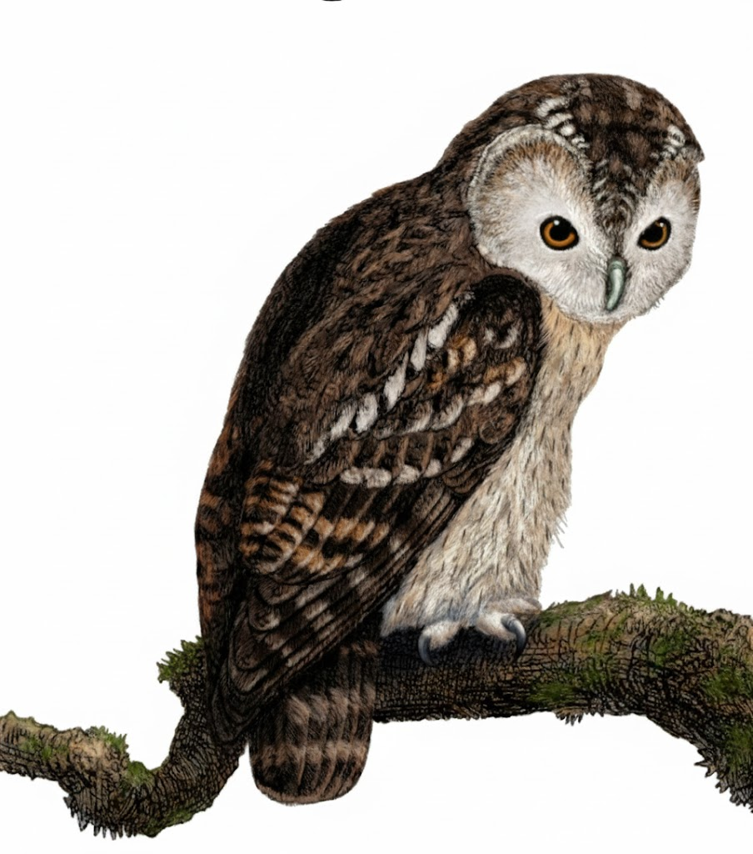
A Comprehensive Summary
Chapter 2, Part 2
Understanding Foundation Models

Slide 2

The Laws of Scale - Model Size, Data, and Compute
A model's performance is not just about clever architecture; it is overwhelmingly determined by scaling three key factors.
Model Size
Compute
Data
The number of parameters (weights) in the model.
Metric: Billions of parameters (e.g., Llama 3-70B)
The total number of floating-point operations operations (FLOPs) used for training.
Metric: PetaFLOPs or FLOP/s-days (e.g., GPТ-3 required 3.14 x 10²³ FLOPs)
The total number of tokens the model is trained on.
Metric: Billions/Trillions of Tokens (e.g., GPT-3 was trained on 300 billion parameters

Slide 3

The Chinchilla Scaling Law: The Optimal Recipe for Training
The Core Finding (DeepMind, 2022): For compute-optimal training, model size and the number of training tokens should be scaled equally.
Scaling Bottlenecks Data Quality: The internet is being polluted by AI generated content, making it harder to find high-quality human data. Compute: The sheer cost and availability of GPUs.
Algorithms: The fundamental Transformer architecture has scaling limitations.
The Golden Ratio: The number of training tokens should be approximately 20 times the number of model parameters Example: A 10 billion parameter model should be trained on ~200 billion tokens. Insight: Earlier models like GPT-3 were undertrained; they were too large for their training datasets.

Slide 4
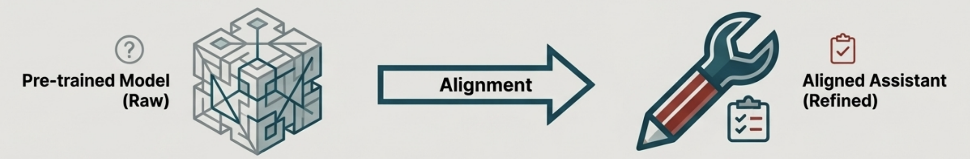
Post-Training Alignment
The Problem: A pre-trained model is a powerful next-token predictor, but it doesn't inherently know how to follow instructions or act as a helpful assistant.
Two-Step Solution:
Supervised Finetuning (SFT) | Preference Finetuning (RLHF)
Teach the model to follow instructions and respond in a specific format. Goal: Learn the style of helpfulness. Method: Train on a small, high-quality dataset of (prompt, ideal response) pairs. | Align the model's behaviour with complex human values and preferences. Goal: Learn what humans consider a 'good' response. Method: Use Reinforcement Learning with a reward signal derived from human feedback.

Slide 5
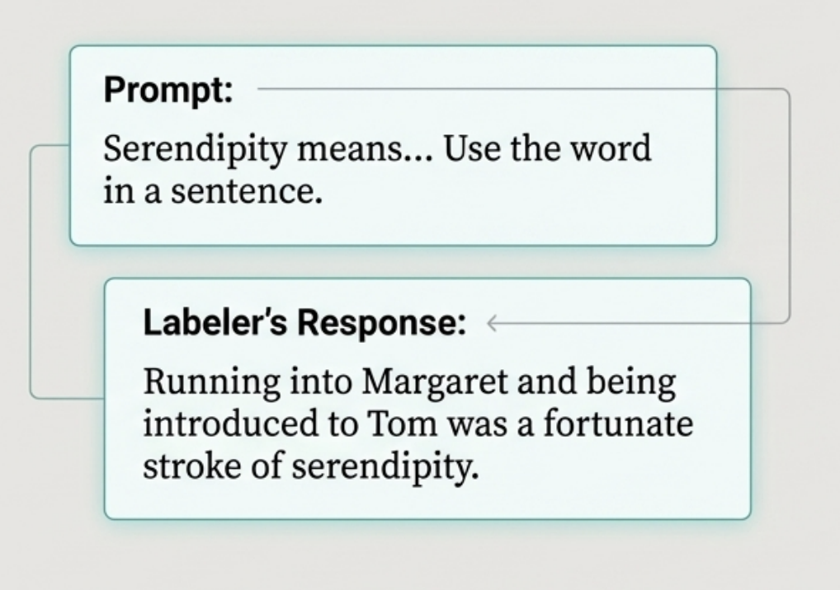
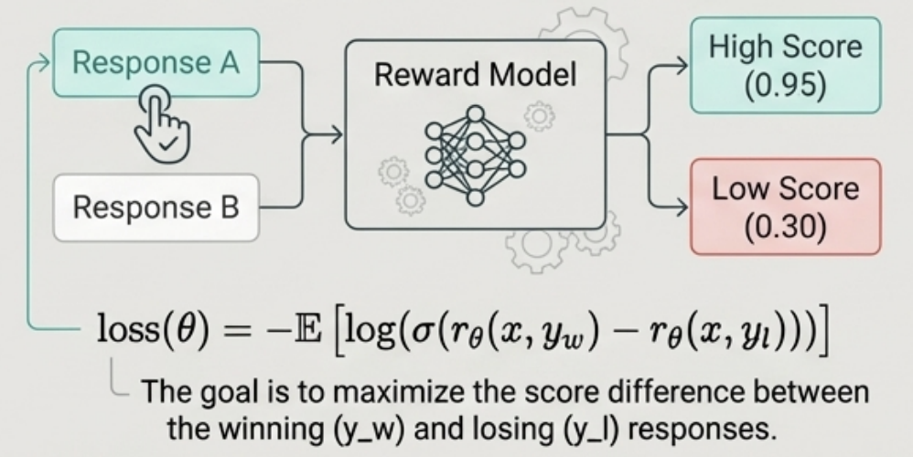
Aligning with Instructions: SFT & The Reward Model
Supervised Finetuning (SFT) in Practice
Training a Reward Model (RM) for RLHF
Step 1: Collect Comparison Data For a single prompt, generate multiple responses. A human labeller chooses the best one. Note: This is cheaper and easier than writing ideal responses from scratch ($3.50 per comparison vs. $25 per SFT example). Step 2: Train the RM

Slide 6
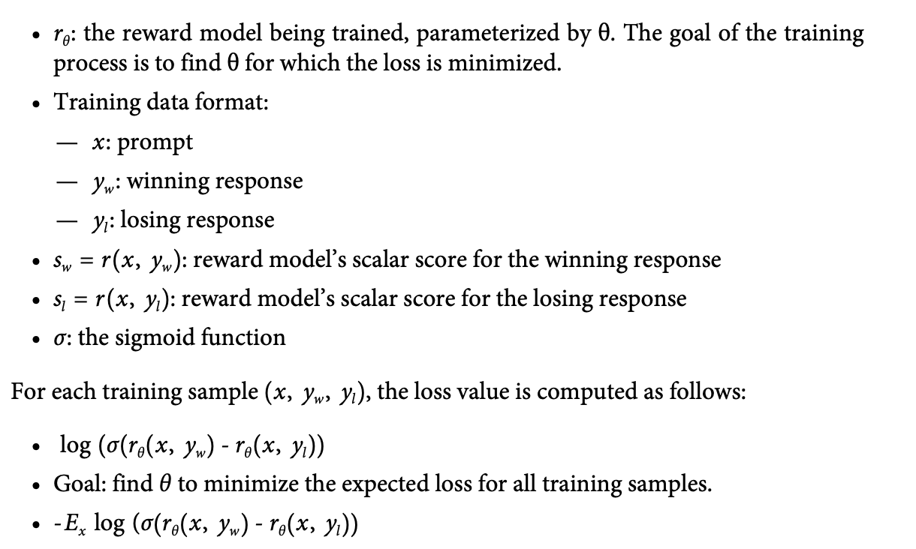
Mathematics behind the Reward Model for InstructGPT

Slide 7
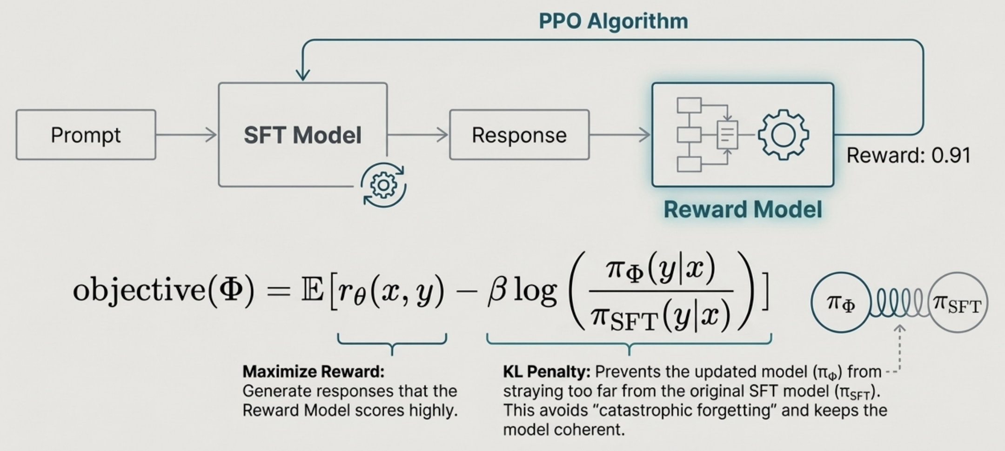
Aligning with Preferences: RLHF in Action
Use the Reward Model as an automated "human preference scorer" to provide a reward signal during finetuning.

Slide 8
In the next part, we will discuss
The Path to a Token Prediction
Temperature
Top-K, Top-P
Test-Time Compute
Probabilistic Nature of AI
Hallucination and its mitigation
and much more…

