Slide 1


A Comprehensive Summary
Chapter 3, Part 2
Evaluation Methodology

Slide 2
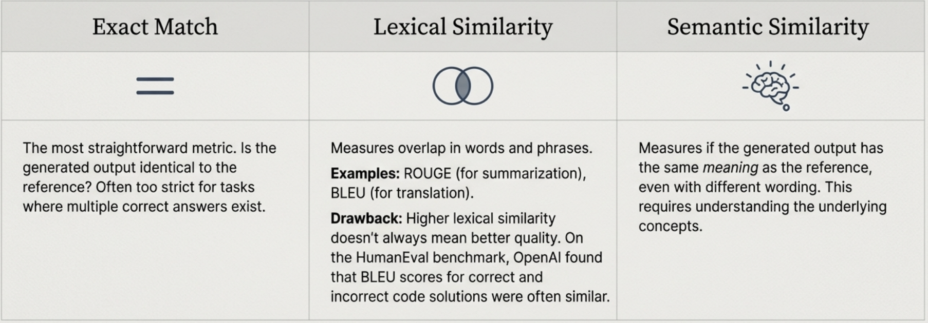
Exact Evaluation: Measuring Against a Ground Truth
This approach evaluates a model's output by comparing it against one or more reference responses (also called "ground truths" or "canonical responses").

Slide 3

The Bottleneck: The Challenge of Reference Data
Generation is Expensive
Creating high-quality reference data is time-consuming and costly, whether generated by humans or Al (which still requires human review). This bottlenecks the entire evaluation process.
References can be wrong: Organizers of the WMT 2023 translation task found many bad reference translations in their own data.
Multiple valid answers exist For many tasks (e.g., translation, summarization), there is no single "correct" answer. An exact evaluation against one reference unfairly penalizes other valid responses.
Due to these challenges, there is growing interest in both improving semantic similarity and developing robust reference-free metrics.

Slide 4
The Core of Semantic Similarity: An Introduction to Embeddings
The Intuition
An embedding is a numerical representation-a vector of numbers-that captures the semantic meaning of the original data (text, image, etc.). Computers work with these numbers to process meaning.
Key Characteristics It's a Vector: As stated above, the sentence 'the cat sits on a mat' might be represented as `[0.11, 0.02, 0.54, ...]`.
It's High-Dimensional: Real-world embedding vectors typically have between 100 and 10,000 elements.
It's a Lower-Dimensional Representation: While a 10,000-element vector seems large, it is a compressed representation of the vastly more complex raw data.

Slide 5
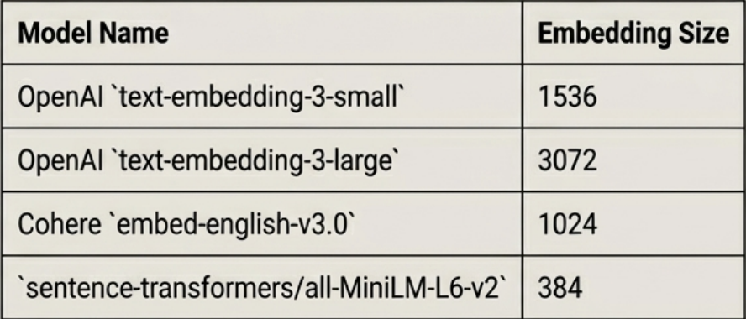
The Models Behind the Embeddings
Key Models
Embeddings are generated by models trained specifically for this purpose. Examples: Open Source: BERT, CLIP (Contrastive Language-Image Pre-training), Sentence Transformers. Proprietary APIs: Many services offer proprietary, high-performance embedding models.
Embedding Dimensions The size of the embedding vector varies by model.
Embedding Vector Sizes for Popular Models
The choice of embedding model and vector size is a critical design decision with trade-offs in performance, cost, and storage.

Slide 6
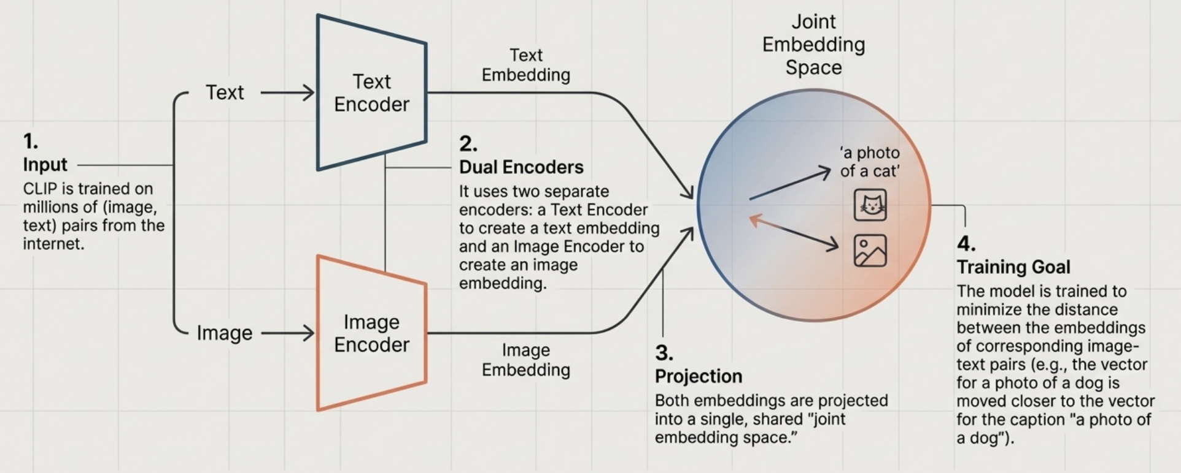
Case Study: How CLIP Learns Multimodal Embeddings
Result: A powerful model that understands the semantic relationship between visual and textual content.

Slide 7
In the next part, we will discuss
Evaluation Toolkit
AI as a Judge – Why and How
Pointwise and Pairwise Evaluation
Limitations of AI Judges
Taxonomy of AI Judges
Comparative Evaluation and its Challenges
and much more…

