Slide 1
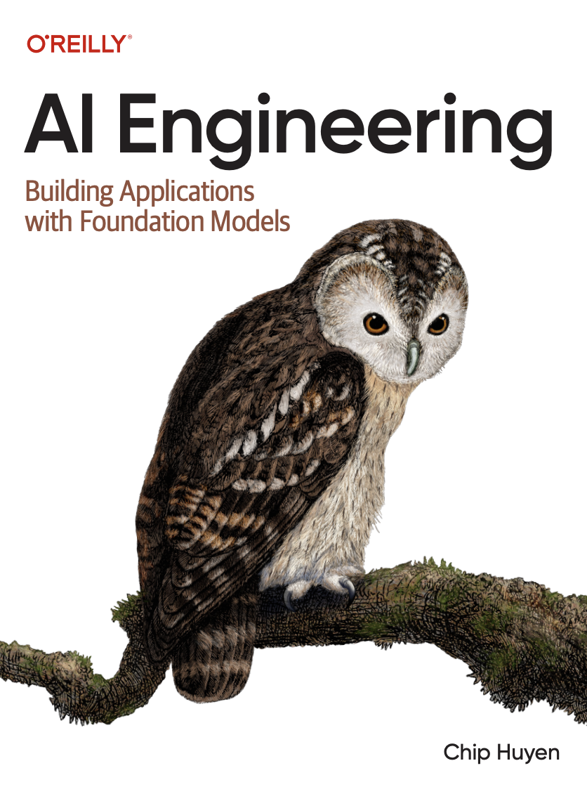
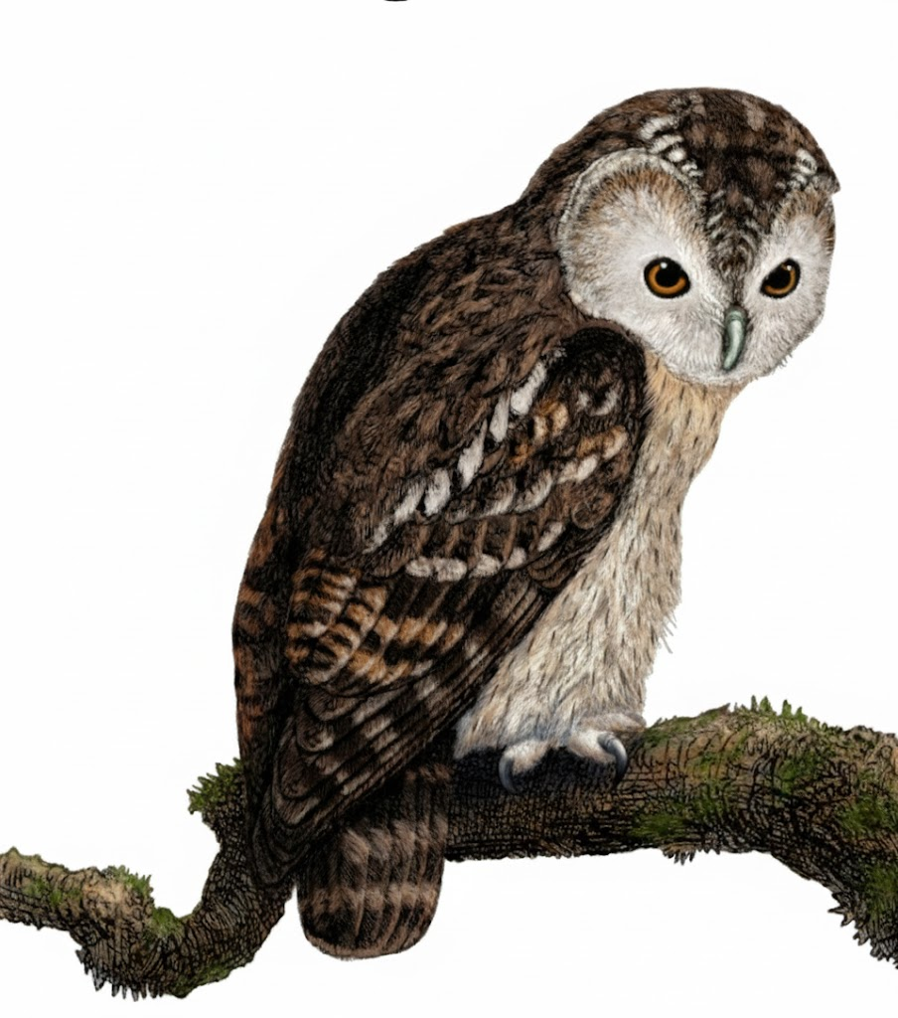
A Comprehensive Summary
Chapter 3, Part 1
Evaluation Methodology

Slide 2
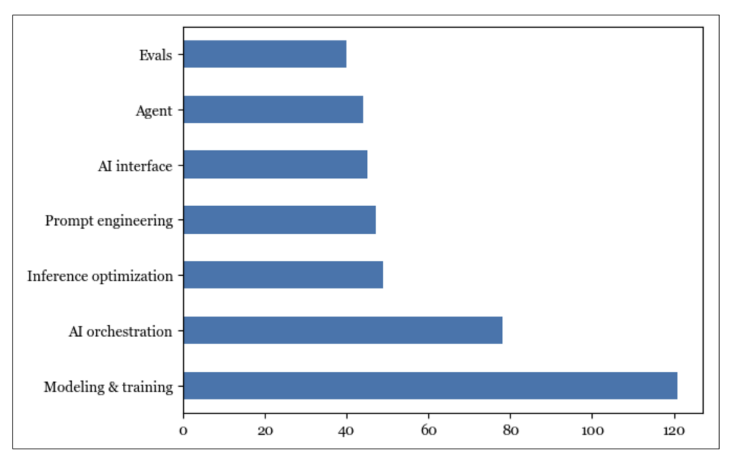
The Exponential Rise of Evaluation in AI
“Evaluation is not only about assessing a model's performance on known tasks but also about discovering new tasks that the model can do. Evaluation takes on the added responsibility of exploring the potential and limitations of AI.”
Evaluation lags behind other aspects of AI engineering in terms of open source tools.
Despite its importance, a DeepMind paper notes that “developing evaluations has received little systematic attention compared to developing algorithms.”

Slide 3
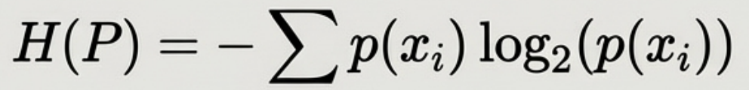
Entropy: The Fundamental Measure of Uncertainty
The Intuition Entropy measures how difficult it is to predict what comes next in a language. A language with lower entropy is more predictable.
Predicting the next token is easier in a language with only two possible tokens than in a language with four. If you can perfectly predict what someone will say, their words carry no new information (zero entropy).
The Mathematics For a probability distribution P with outcomes {X₁, X₂, ..., X_{n}}, Entropy H(P) is the average number of bits required to encode an outcome.
Definition
Entropy, denoted H(P), quantifies the average amount of information contained in each token of a language with a probability distribution P.
Annotation: p(x) is the probability of token x occurring.
The result is measured in bits.

Slide 4

Cross-Entropy: Quantifying the Gap (1)
A language model learns a probability distribution (Q) that approximates the true distribution of the training data (P). Cross-Entropy and Kullback-Leibler (KL) Divergence quantify how well it does this.
The Intuition:
Measures the average number of bits needed to encode tokens from the true distribution P, using the model's learned distribution Q.
The Mathematics P = true data distribution
Q = model's predicted distribution
H(P,Q) measures how well the model (Q) predicts the actual data (P)
Key insight:
A language model is trained to minimize its cross-entropy with respect to the training data. It is not symmetric: H(P,Q) ≠ H(Q, P).

Slide 5
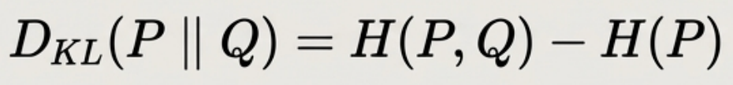
KL Divergence : Quantifying the Gap (2)
A language model learns a probability distribution (Q) that approximates the true distribution of the training data (P). Cross-Entropy and Kullback-Leibler (KL) Divergence quantify how well it does this.
The Intuition.
Measures how much the model's probability distribution Q diverges from the true data distribution P.
The Mathematics It's the difference between cross-entropy and entropy.
Key insight:
KL Divergence is always non-negative. It becomes 0 only when the model has learned the training data perfectly (i.e., Q is identical to Р).

Slide 6
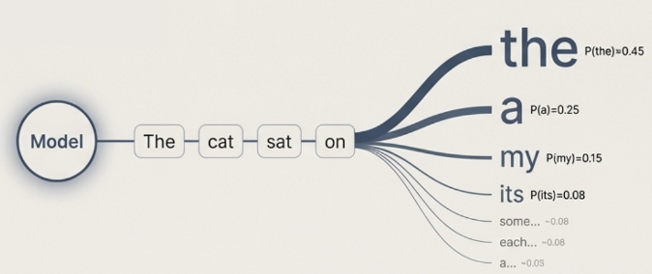
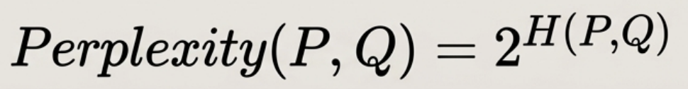
Perplexity (PPL): The Go-To Metric for Language Models
The Intuition Perplexity is a measure of how well a probability model predicts a sample. A low perplexity indicates the model is good at predicting the sequence of tokens. A perplexity of 10 means that at each step, the model is as confused as if it had to choose between 10 equally likely tokens.
The Mathematics Perplexity is the exponentiated cross-entropy. Lower perplexity is better.

Slide 7
Language Modelling Metrics: An Example
Use Case: Predict the next word in: “Dyson vacuums are known for their ____.”
Given: Real usage (P):
“power” = 60%
“design” = 30%
“innovation” = 10%
Model predictions (Q):
“power” = 40%
“design” = 50%
“innovation” = 10%
Probabilities
Entropy
Word | P (True) | Q (Model)
power | 0.6 | 0.4
design | 0.3 | 0.5
innovation | 0.1 | 0.1
−0.6log2​(0.6)=−0.6×(−0.737)=0.442
−0.3log2​(0.3)=−0.3×(−1.737)=0.521
−0.1log2​(0.1)=−0.1×(−3.322)=0.332
H(P)=0.442+0.521+0.332=1.295 bits
Probabilities from P and Q
Cross-Entropy
KL Divergence
−0.6log2​(0.4)=−0.6×(−1.322)=0.793
−0.3log2​(0.5)=−0.3×(−1)=0.300
−0.1log2​(0.1)=0.332 (same as entropy)
H(P,Q)=0.793+0.300+0.332=1.425 bits
D_{KL}​(P∥Q)=1.425−1.295=0.13 bits
Perplexity
=2^{1.425} ≈ 2.68

Slide 8
In the next part, we will discuss
Exact Evaluation
The Challenges with Reference Data
Introduction to Embeddings
Models behind Embeddings
Case Study: CLIP
and much more…

