Slide 1
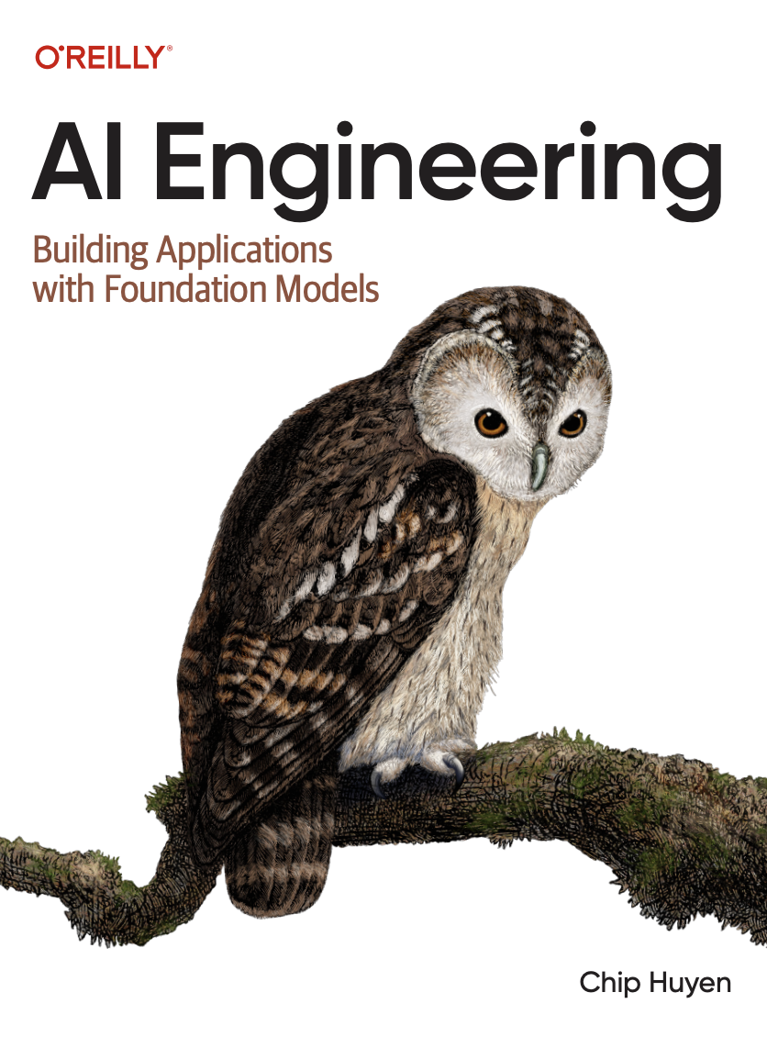

A Comprehensive Summary
Chapter 5, Part 1
Prompt Engineering

Slide 2
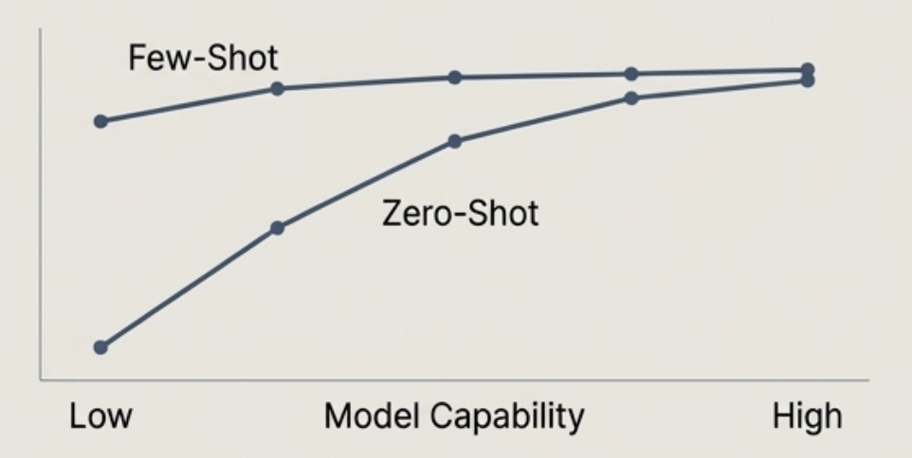
The Core Mechanism: In-Context Learning (ICL)
Prompting is the practice of guiding a model's behaviour through its input alone, without changing the model's weights.
In-Context Learning is the core capability that allows foundation models to incorporate new information at inference time.
This makes ICL a form of continual learning, enabling a model to respond to queries about information created after its training cut-off date
Zero-Shot Learning The model performs a task based on instructions alone, with no examples provided in the context. Relies entirely on the model's pre-trained knowledge and generalization ability.
Few-Shot Learning The model is given 1 to 50 demonstrations (input/output pairs) of the task within the prompt. Guides the model on expected format, style, and content.

Slide 3
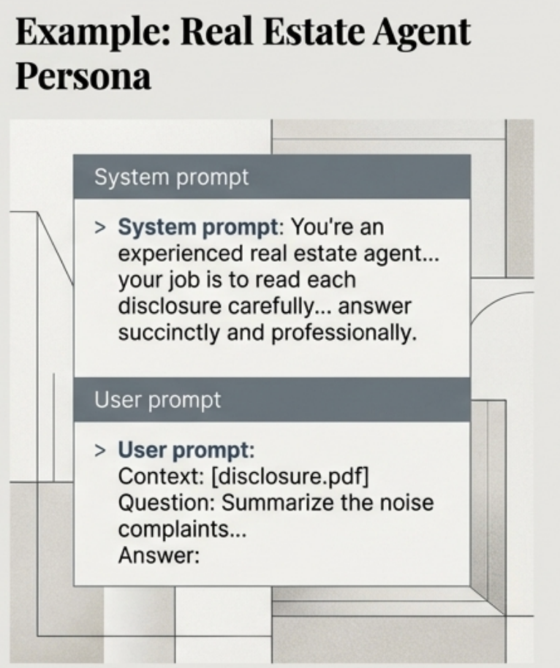
Structuring the Input: System vs. User Prompts
Clarifying the Terms:
Prompt: The specific instructions or query from the user/developer.
Context: The entire set of information the model sees at inference, including system prompt, user prompt, chat history, and any retrieved data.
The Developer Pattern:
User Prompt: Provided by the end-user. Contains the specific task.
System Prompt: Set by the developer. Defines the model's persona, high-level rules, and constraints.
Why would system prompts boost performance compared to user prompts?
The system prompt comes first in the final prompt, and the model might just be better at processing instructions that come first. The model might have been post-trained to pay more attention to the system prompt Training a model to prioritize system prompts also helps mitigate prompt attacks.

Slide 4
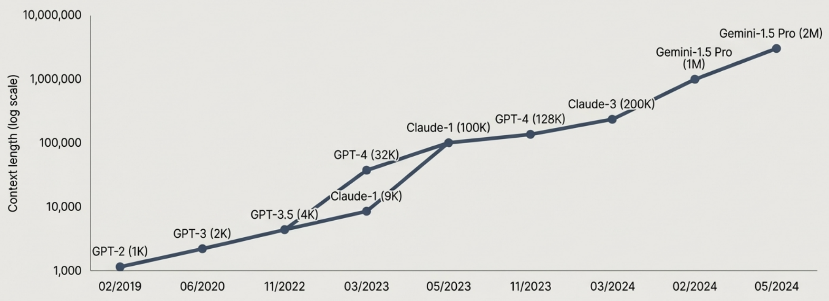
The Exponential Growth of the Context Window
Models' maximum context length has grown from thousands to millions of tokens, enabling significantly more complex tasks to be handled entirely through in-context learning.

Slide 5
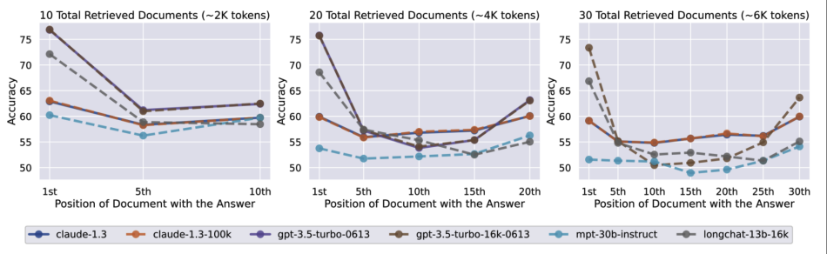
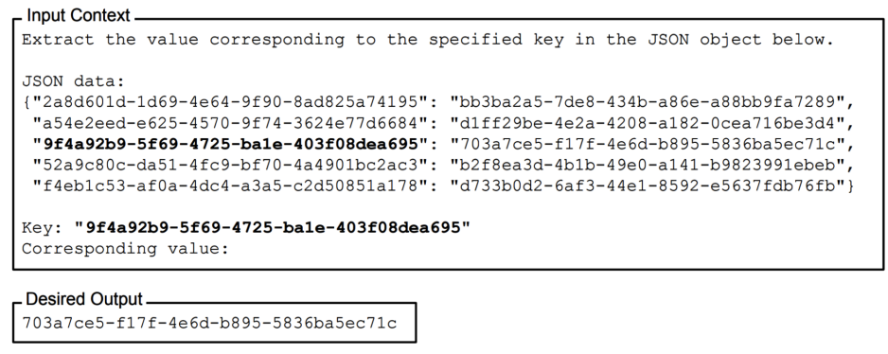
Needle in the Haystack (NIAH)
Not all parts of a prompt are equal. Research has shown that a model is much better at understanding instructions given at the beginning and the end of a prompt than in the middle.
One way to evaluate the effectiveness of different parts of a prompt is to use a test commonly known as the needle in a haystack (NIAH). The idea is to insert a random piece of information (the needle) in different locations in a prompt (the haystack) and ask the model to find it.
The effect of changing the position of the inserted information in the prompt on models’ performance. Lower positions are closer to the start of the input context.

Slide 6
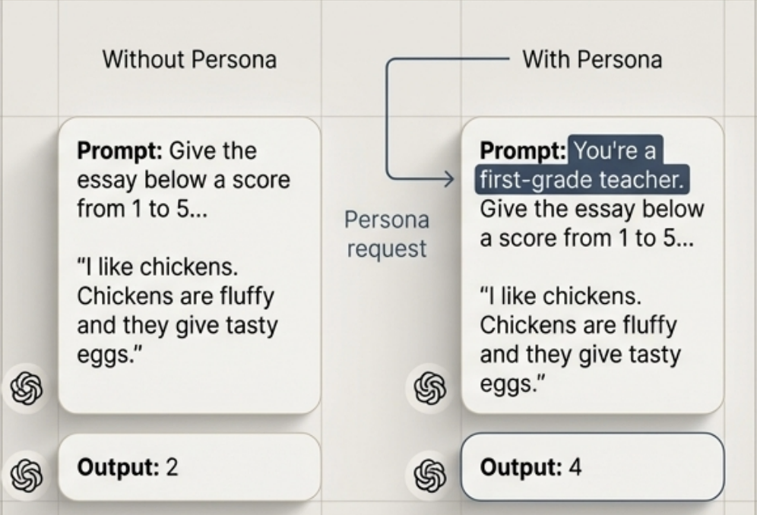
Crafting a Prompt: Precision and Persona
Best Practice 1: Be Specific and Clear
Vague instructions lead to unreliable outputs.
Prompt engineering is an iterative process: start simple, observe undesirable behaviour (e.g., outputting fractional scores), and add specific constraints to refine ("Output only integer scores between 1 and 5.")
Best Practice 2: Ask the Model to Adopt a Persona
Assigning a role constrains the model's knowledge to a relevant subset, improving focus and tone.
Visual Example: Scoring an Essay

Slide 7
Decomposition in Action: Chain-of-Thought (CoT)
Instead of asking a model to solve a complex problem in one go, instruct it to break the problem down and work through it sequentially. - Reduces the cognitive load on the model.
- Makes the reasoning process more transparent and debuggable. - Increases reliability and reduces the likelihood of errors.
One-Shot CoT Provide a single, complete example of step by-step reasoning. Example:
> Question: Which animal is faster: sharks or dolphins? > Answer: 1. The fastest shark breed is the shortfin mako shark... 74 km/h. 2. The fastest dolphin breed is the common dolphin... 60 km/h. 3. Conclusion: sharks are faster.
Question: Which animal is faster: cats or dogs? Answer:
Zero-Shot CoT
- Simply append a phrase to your prompt: "...Let's think step by steр." - Often sufficient to trigger a more deliberative reasoning process in capable models.

Slide 8
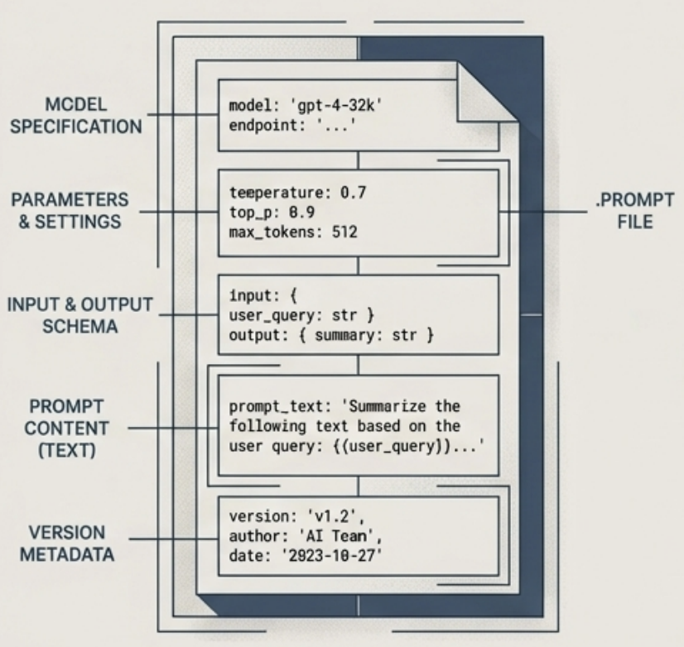
Organizing and Versioning Prompts
Challenge Manual prompt engineering is time-consuming and finding the optimal prompt is elusive. Automation and organization are necessary for production systems.
Best Practice 1: Separate Prompts from Application Logic Avoid hardcoding prompts directly in functions. Store them in separate, dedicated files. This enables reusability, independent testing, and easier updates.
Best Practice 2: Treat Prompts as Versioned Assets
Store prompts in structured files and use version control (e.g., ‘git’). Specialized ‘.prompt’ file formats can store the prompt alongside crucial metadata: - Model name and endpoint URL - Ideal sampling parameters (temperature, top-p)
- Input and expected output schemas

Slide 9
Prompt Engineering Best Practices
Write Clear and Explicit Instructions - Explain, without ambiguity, what you want the model to do
- Ask the model to adopt a persona
- Provide examples
- Specify the output format
Provide Sufficient Context
You can either provide the model with the necessary context or give it tools to gather context. The process of gathering necessary context for a given query is called context construction.
Break Complex Tasks into Simpler Subtasks
For complex tasks that require multiple steps, break those tasks into subtasks. Instead of having one giant prompt for the whole task, each subtask has its own prompt. These subtasks are then chained together.
Iterate on Your Prompts
Prompt engineering requires back and forth. As you understand a model better, you will have better ideas on how to write your prompts.
Give the Model Time to Think
You can encourage the model to spend more time to, for a lack of better words, “think” about a question using chain-of-thought (CoT) and self-critique prompting.

Slide 10
In the next part, we will discuss
Defensive Prompt Engineering
Reverse Prompt Engineering
Training Data Extraction
Risk 3: Copyright Regurgitation
Jailbreaking
Prompt Injection
Defence Strategies against Prompt Hacking
and much more…

