Slide 1


A Comprehensive Summary
Chapter 6, Part 2
RAG and Agents

Slide 2
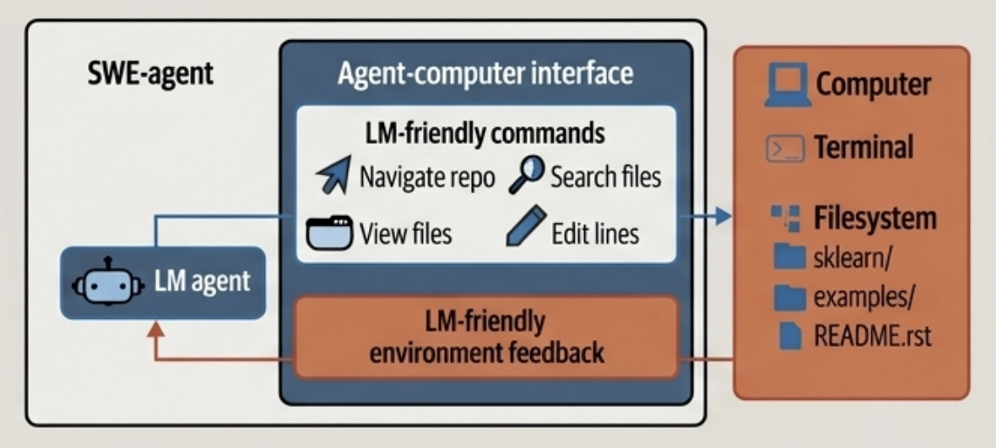
The Definition of an Agent
"An agent is anything that can perceive its environment and act upon that environment."
- An agent is defined by the environment it operates in (a game, the internet, a file system).
- Its capabilities are determined by its set of actions (navigating, searching, editing).
- The environment and actions are inextricably linked; an agent with only a "swim" action is confined to a water environment.
The SWE-agent provides a clear example. Its environment is the computer, including the terminal and filesystem. Its actions are specific commands like “navigate repo”, “search files”, and “edit lines”

Slide 3


Tools: An Agent's Senses and Hands
Tools are the external components that empower an agent to both perceive its surroundings and execute changes within them. An agent's "tool inventory" is the primary determinant of its capabilities.
Write actions (Hands)
Allow the agent to act upon and change the environment. Examples include executing code, writing to a database, or calling an API.
Read-only actions (Senses)
Allow the agent to perceive the environment. Examples include web search, knowledge retrieval from a database, or reading a file.

Slide 4
The Three Core Functions of an Agent's Tools
The core of RAG is the retrieval algorithm. The choice depends on your data and expected queries. Two main families dominate:
Knowledge Augmentation
Solves: A model's static knowledge and lack of access to real-time or private data.
Mechanism: Connects the agent to external information sources like search engines, vector databases, and internal company APIs.
Capability Extension
Solves: A model's weakness in specialized domains Ilke precise calculation or structured data processing.
Mechanism: Provides access to specialized modules like code interpreters, calculators, and OCR tools.
Supporting Fact: Chameleon (Lu et al., 2023) shows that a GPT-4-powered agent, augmented with a set of 13 tools, can outperform GPT-4 alone on several benchmarks.
Write Actions
Solves: A model's inability to affect the real world beyond generating text.
Mechanism: Grants the ability to execute commands that modify the environment, such as writing a file or booking a flight via an API.

Slide 5

An Agent Must Remember
Augmenting a model with a memory system unlocks higher-level behaviours and moves it from a simple tool to an intelligent partner.
Key Benefits of Memory
Personalization: Retains user-specific data, such as preferences and conversation history, for tailored interactions.
Efficiency: Caches previous tool outputs and computations to avoid redundant, costly work.
Learning: Allows the agent to learn from past interactions, successes, and failures to improve future performance.
Two Core System Functions Memory Management: Deciding what information to store and where. Memory Retrieval: Fetching the right information at the right time.

Slide 6
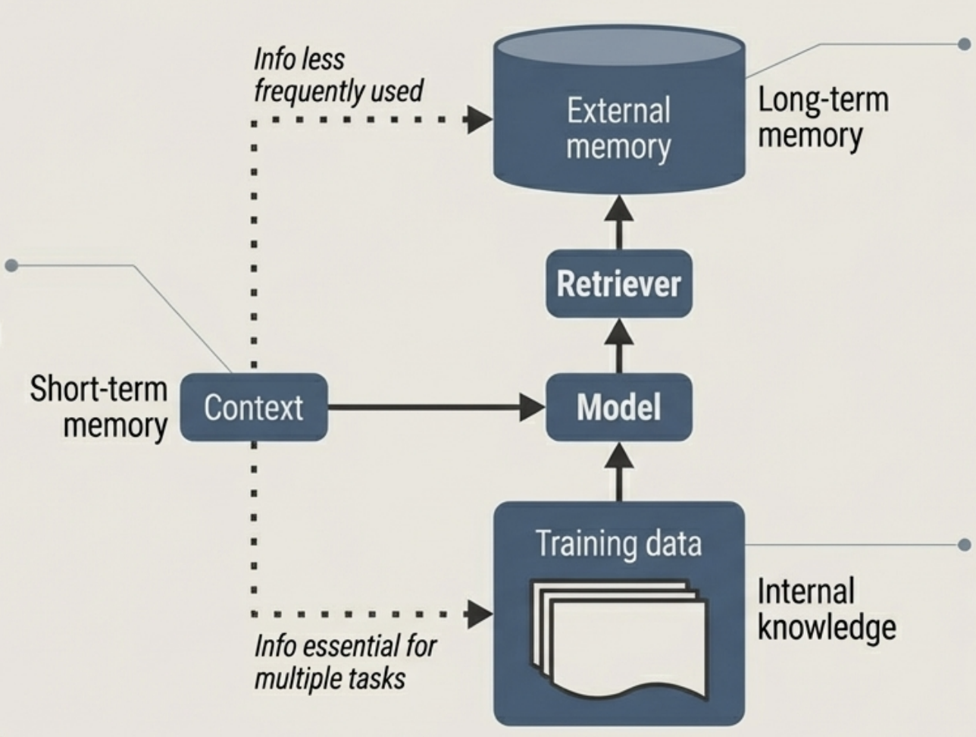
The Three Tiers of Agent Memory
Long-Term Memory (External Storage): The agent's reference library for information that is used less frequently. Stored in external databases and accessed via a retriever.
Short-Term Memory (Context): The agent's "working memory." Holds immediate, task specific information within the model's context window.
Internal Knowledge (Model Weights): The agent's base knowledge, essential for all all tasks. Acquired through pre-training and finetuning.

Slide 7
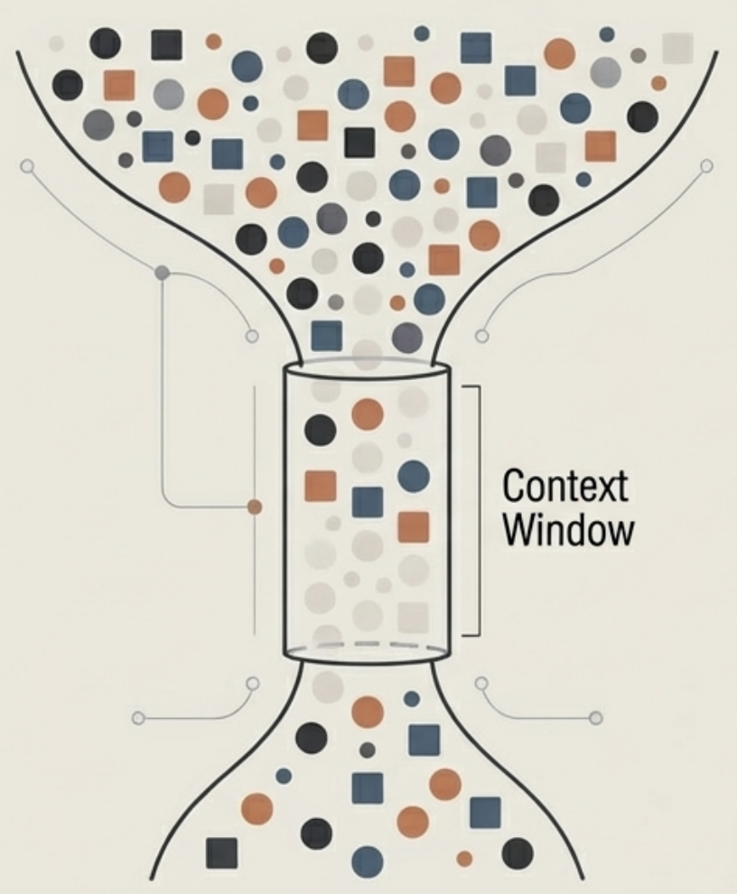
Managing the Bottleneck: Short-Term Memory
An agent's short-term memory is strictly limited by the model's maximum context length. This necessitates intelligent strategies for managing this finite space.
Memory Management Operations
Adding to Memory: What information should be prioritized? Often involves summarizing or compressing information to save spасе.
Deleting from Memory: When the context is full, what gets evicted?
Recency-based: Delete the oldest information.
Relevance-based: Delete information least relevant to the current query.
Importance-based: Assign an importance score to each piece of information and delete the least important.

Slide 8
In the next part, we will discuss
Agent’s Reasoning Engine
Using Foundation Models as Planners
Example of an Agentic Flow
Dynamic Function Calling
Complex Control Flows
Reflection in an Agent
Tool Selection
Evaluating an Agent Agent Failure Modes
and much more…

