Slide 1

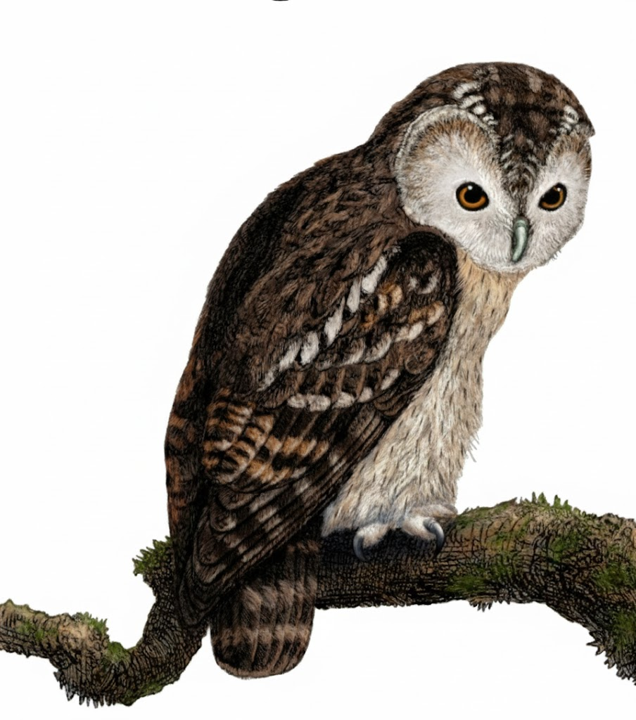
A Comprehensive Summary
Chapter 7, Part 2
Finetuning

Slide 2
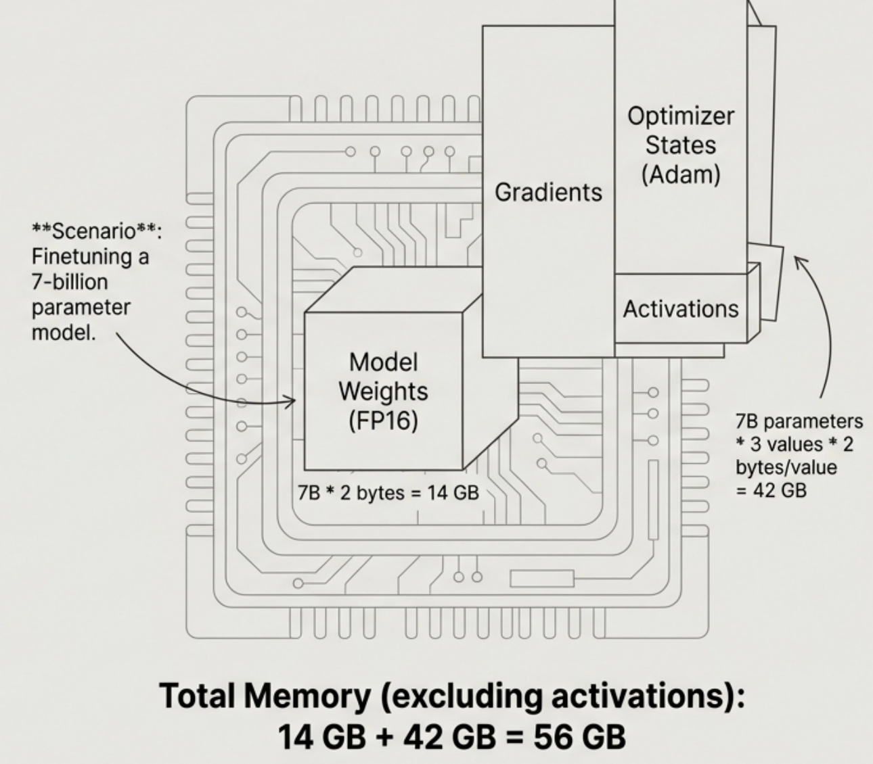
The Problem: Full Finetuning is Prohibitively Expensive
Finetuning a large language model by updating all its weights (full finetuning) requires immense memory, far exceeding the capacity of most available hardware. This is due to the memory required not just for the model's weights, but also for gradients and optimizer states during the backward pass of training.
Training memory = model weights + activations + gradients + optimizer states
This 56 GB requirement surpasses the memory of most consumer GPUs (12-24 GB) and even many high-end server GPUs (48 GB), making full finetuning impractical for many.

Slide 3



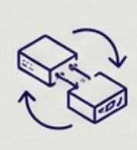
The Solution: Parameter-Efficient Finetuning (PEFT)
Core Concept: PEFT methods address the memory bottleneck by freezing the majority of the pre-trained model's parameters and only training a small, manageable number of new or existing parameters.
Drastically Reduced Memory: By training only a fraction of the parameters ((often <1%), PEFT significantly lowers the memory needed for gradients and optimizer states.
Faster Training: Fewer parameters to update means faster training cycles.
Prevents Catastrophic Forgetting: Since the original weights are frozen, the model retains its powerful general capabilities from pre-training.
Portable and Modular: The small set of trained parameters (adapters) can be easily saved, shared, and swapped, allowing one base model to be adapted for many tasks.

Slide 4
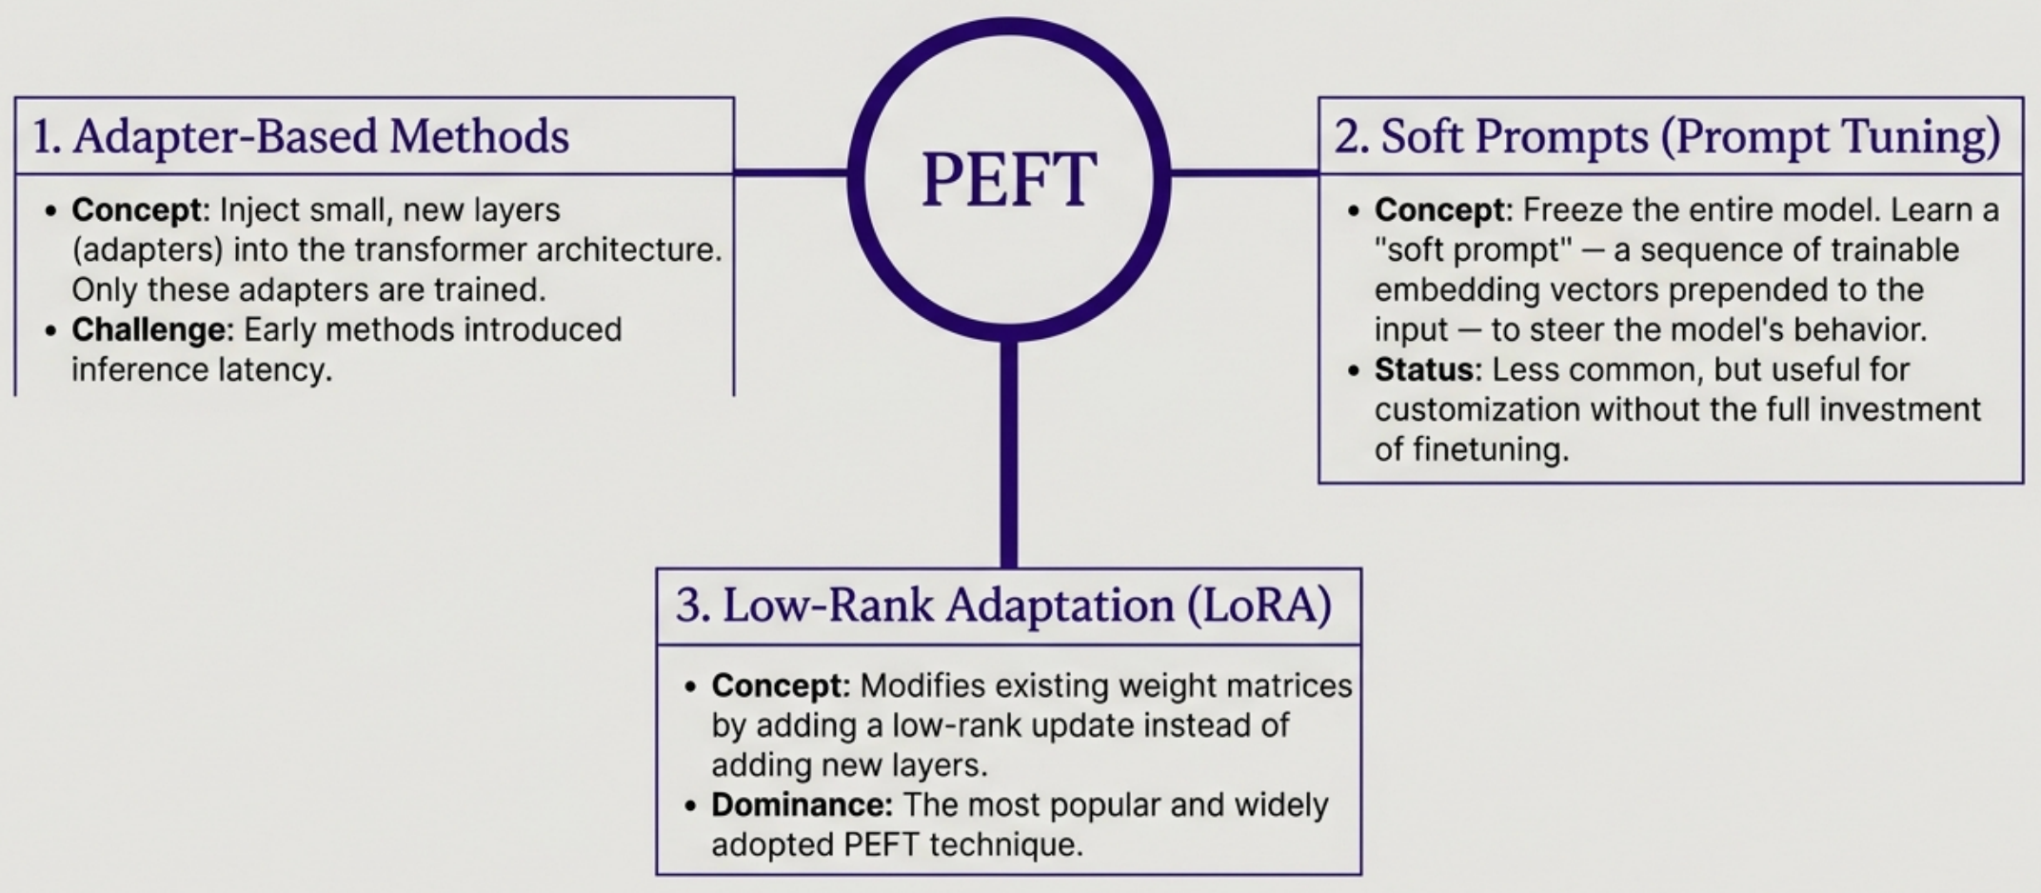
A Landscape of PEFT Techniques

Slide 5
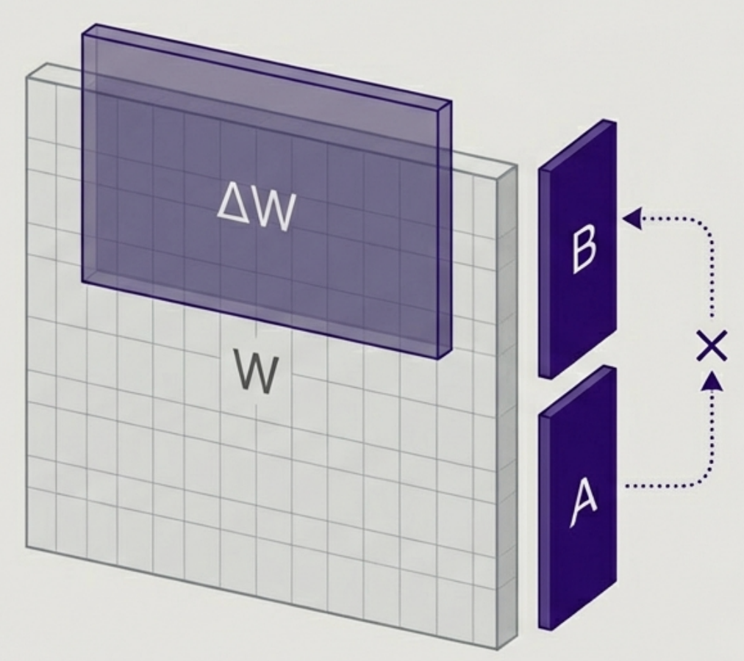
LORA Deep Dive: The Core Idea
Central Principle: Instead of directly changing a large pre-trained weight matrix W, LoRA learns a small change to that matrix, AW, and applies it during computation. The original weights W remain frozen.
How it's achieved:
LoRA represents the change AW as the product of two much smaller, 'low-rank' matrices: A and B.
ΔW = B*A
Only matrices A and B are trained. These are the LoRA adapters.
Key Takeaway: LoRA learns compact updates, not entirely new weights, making it incredibly parameter-efficient.

Slide 6
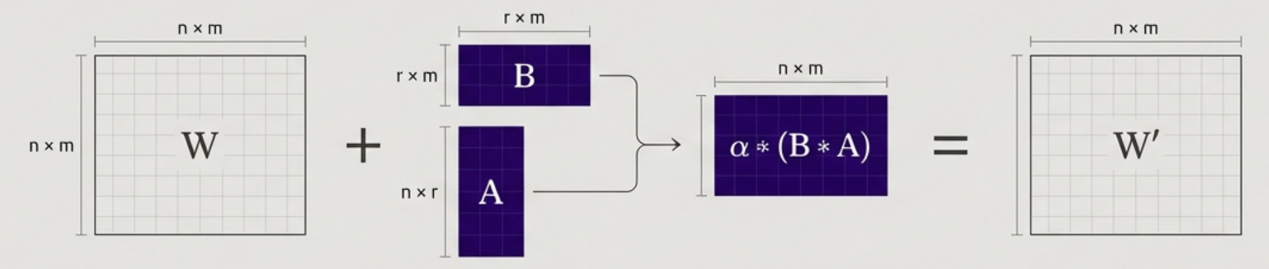
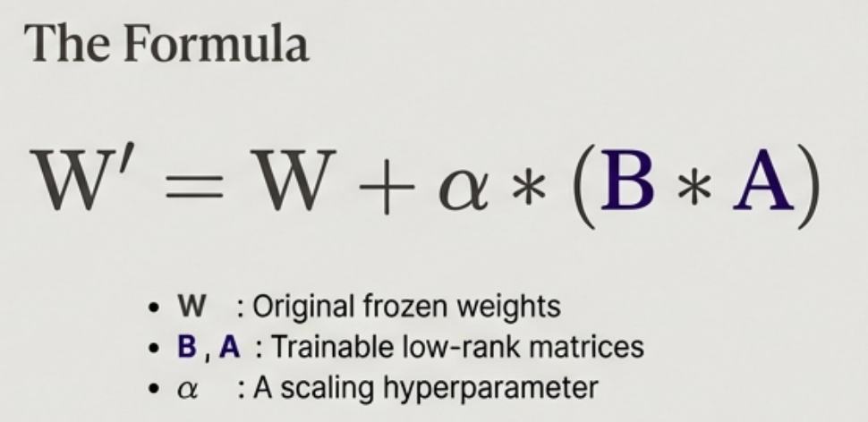
How LORA Works: Deconstructing the Weight Update
The Process: - Start with a frozen pre-trained weight matrix ‘W’ of dimension ‘n x m’.
Define two new, trainable low-rank matrices:
Matrix A with dimension ‘n x r’
Matrix B with dimension ‘r x m’
‘r’ is the rank, a key hyperparameter that is much smaller than ‘n’ or ‘m’.
The update W__{AB} is the product of these matrices.
The new weight matrix ‘W’ used during the forward pass is the sum of the original matrix and the scaled update.
Result: Only ‘A’ and ‘B’ are updated during training, drastically reducing the number of trainable parameters.

Slide 7
Why LoRA Works: The Intrinsic Dimension Hypothesis
The Core Theory Large language models have a low "intrinsic dimension". This means that while they have billions of parameters, the model's knowledge can be effectively adapted for a new task by modifying a much smaller number of parameters.
How it Connects to LoRA Pre-training's Role: The process of pre-training on vast datasets implicitly compresses the model's knowledge, reducing this intrinsic dimension. LoRA's Exploitation: LoRA's low-rank factorization is an effective way to find and modify this low-dimensional subspace. Full-rank training isn't necessary for adaptation because the essential changes can be captured in a low-rank structure.
"Aghajanyan et al.'s argument is correct-that pre-training implicitly compresses a model's intrinsic dimension-full-rank pretraining is still necessary to sufficiently reduce the model's intrinsic dimension to a point where low-rank factorization can work."

Slide 8
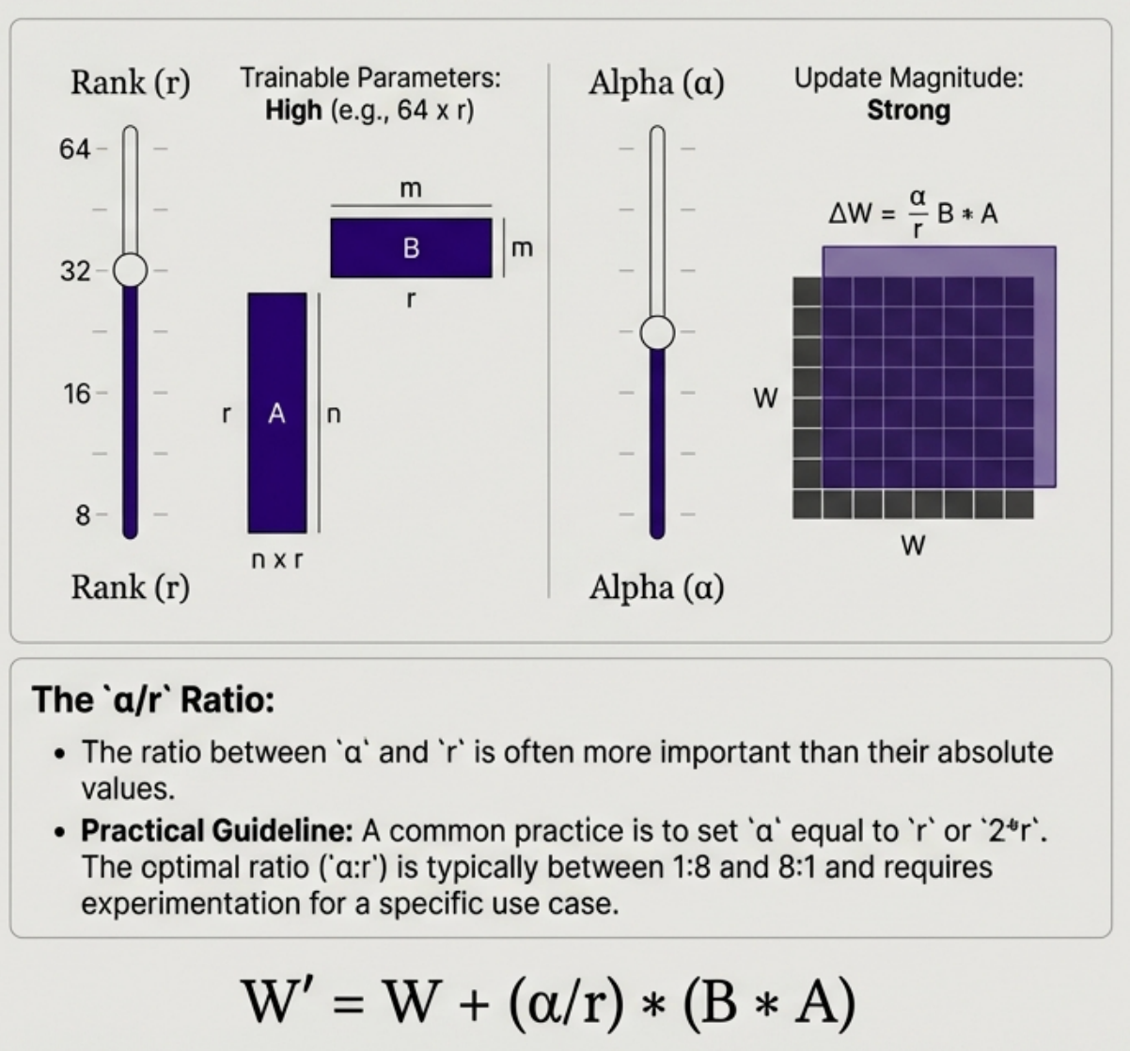
LORA Configurations: Tuning Rank (r) and Alpha (α)
Rank (r):
Definition: The dimension of the low-rank matrices (A and B).
Impact: Directly controls the number of trainable parameters in the LORA adapter. A higher rank means more parameters and potentially more expressive power.
Common Values: Typically a small power of 2, such as 8, 16, 32, or 64. Higher is not always better and can lead to overfitting.
Alpha (α):
Definition: The scaling factor applied to the LoRA update matrix ‘(B * A)’.
Impact: Controls the magnitude of the change applied to the original weights. It acts like a learning rate for the adapter.

Slide 9
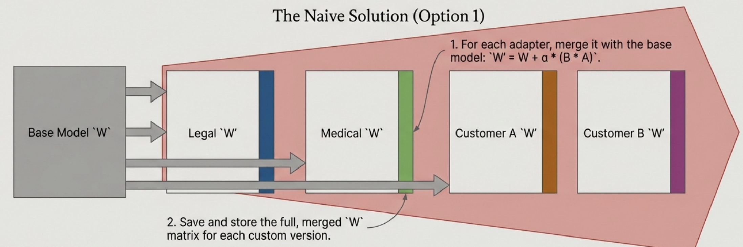
The Challenge: Serving Multiple LoRA Adapters
The Scenario You have one base model (e.g., Llama 3 8B) but need to serve hundreds of customized versions for different customers or tasks (e.g., a "legal" adapter, a "medical" adapter, a "customer A" adapter).
The Problem
Storage Explosion: If you have 100 adapters, you must store 100 copies of the massive base model weights. This negates the storage savings of PEFT. Slow Swapping: Loading an entire new set of model weights into GPU memory to handle a request for a different adapter is slow and inefficient.

Slide 10
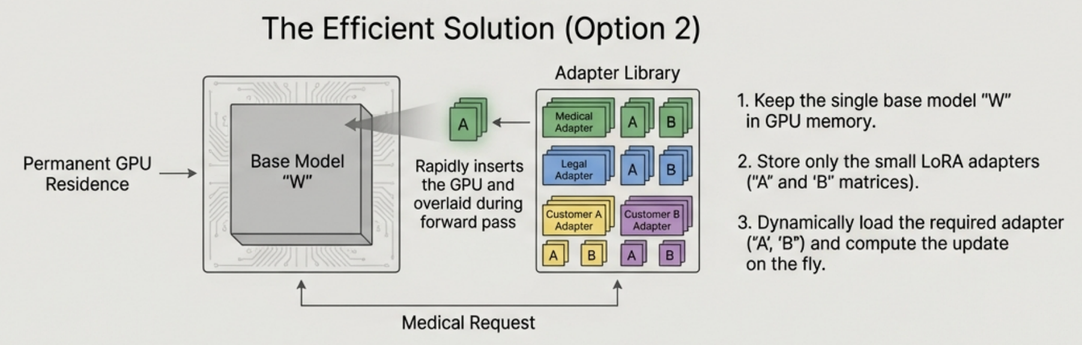
The Solution: Dynamic, On-the-Fly LoRA Serving
LoRA Adapter (‘A’ and ‘B’) with rank r=8
(4096*8) + (8 * 4096) = 65,536 parameters
Base Matrix “W” 4096 x 4096 dimensions 4096 x 4096 = 16.8M parameters
The LoRA adapter is 256 times smaller than the full weight matrix.
For 100 customers, you store one 16.8M parameter matrix and 100 sets of 65k parameter adapters, instead of 100 full 16.8M parameter matrices. This dramatically reduces storage and allows for fast, flexible switching between tasks.

Slide 11
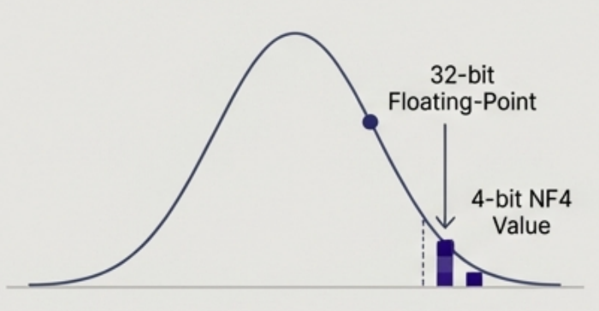
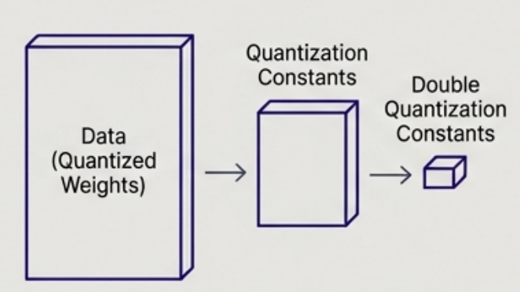
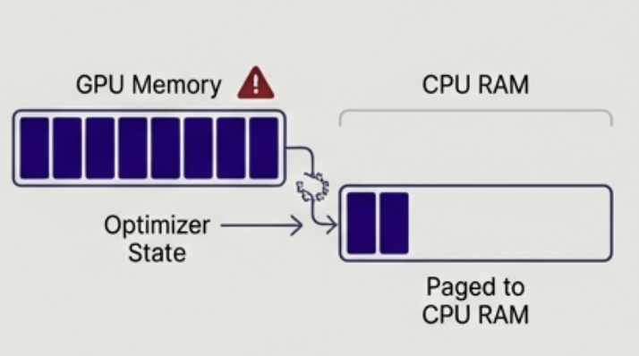
Pushing Efficiency Further with QLoRA
4-bit NormalFloat (NF4) Quantization
Double Quantization
Paged Optimizers
The frozen, pre-trained base model weights are loaded in a 4-bit precision format. NF4 is an information-theoretically optimal format for weights that follow a normal distribution.
A secondary quantization process is used on the quantization constants themselves to save additional memory.
When GPU memory is exhausted, this technique automatically pages optimizer states to CPU RAM, preventing out-of-memory errors.
The Result: These combined techniques make it possible to finetune a 65B-parameter model on a single 48 GB GPU.

Slide 12
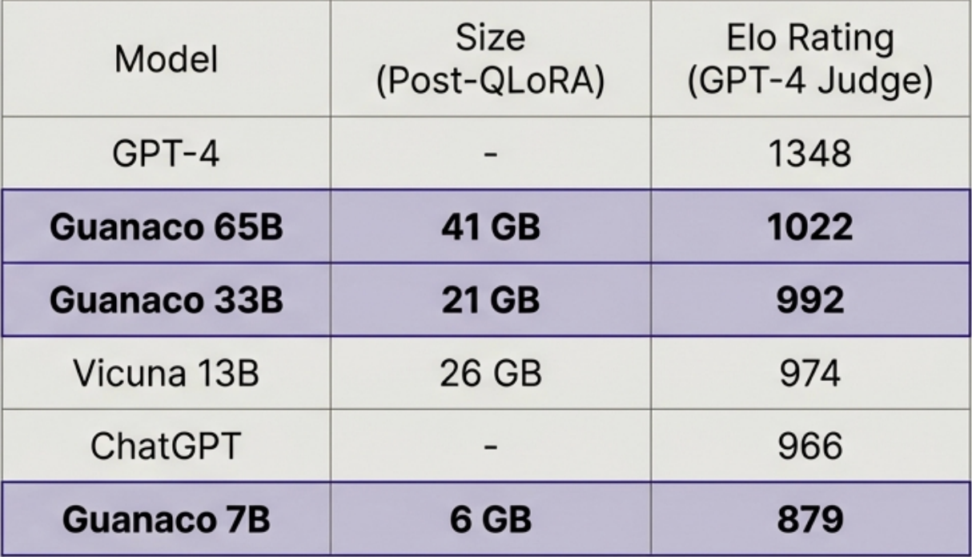
QLORA Performance: The Guanaco Case Study
The Experiment
The QLORA authors finetuned a range of Llama models using their 4-bit method, creating a new family of models called Guanaco.
The Result
Guanaco models showed highly competitive performance against established benchmarks, as judged by GPT-4.
Guanaco 65B, finetuned on a single GPU, significantly outperformed ChatGPT. This proves that extreme memory optimization via QLoRA does not lead to a major loss in performance and can yield state-of-the-art results.

Slide 13
In the next part, we will discuss
Multi-Task Finetuning
Discussion on Model Merging
Model Merging Techniques
Spherical Linear Interpolation (SLERP)
Pruning Redundant Parameters
Key Finetuning Hyperparameters
A look into prompt_weight_loss
and much more…

