Slide 1

Predicting Health Insurance Costs
Ethan Wimmer

Slide 2

Introduction
Healthcare is a complex issue in the United States as insurance costs vary widely between individuals
Understanding driving factors for these costs is useful information for both the insurance provider and policyholder
Insurers can improve business strategies and assess possible risks
Individuals are given insight on how demographics and lifestyle factors influence insurance charges.

Slide 3
Introduction
This project studies the relationship between six characteristics and how they interact with insurance expenses
Based on these predictors alone, the goal of this project is to determine how accurately charges can be predicted
This will be done using statistical and machine learning models such as regression, decision trees, and random forests
Identifying patterns will help improve pricing transparency and highlight the importance of lifestyle factors

Slide 4
Background
Predicting healthcare insurance charges has been well studied in statistics and health economics
Regression models are commonly used with insurance companies to estimate individual risk and determine pricing
In many cases, regression is used as a baseline as it is very interpretable and can quantify relationships

Slide 5
Background
Prior studies of cost data have consistently identified certain variables as strong predictors for insurance charges
More specifically, smokers often suffer significantly higher charges compared to those who don't smoke
Similarly, age and BMI are frequently identified as important factors because of their health risks and long-term costs

Slide 6
Background
Other than linear models, more recent work has explored models like decision trees, random forests, and gradient boosting
This project builds on existing approaches by comparing traditional methods and models with a combined structure
Therefore, the goal is not to only identify the most accurate models, but also understand how choosing different models affects interpretation

Slide 7
Dataset
The data set used for this analysis was obtained from Kaggle and is publicly available
The data represents a simplified sample of people with basic demographics and health attributes
In total, the data set contains a total of 1,338 observations with 7 variables
The data set is a mix of continuous and categorical variables making it flexible for a variety of methods

Slide 8
Dataset
Age: Numerical variable as the age of someone in integer years
Sex: Categorical variable of an individual either being male or female
BMI: Numerical variable being the measure of a person’s body fat based on height and weight
Children: Categorical variable of the number of children that an individual has
Smoker: Categorical variable of where someone is a smoker or not
Region: Categorical variable of the region an individual resides in the United States
Charges: Numerical and target variable being how much a person is charged in medical insurance

Slide 9
Dataset
One limitation with this data is the small number of variables
This means important factors in determining costs may be excluded
These may be factors that are hard to publicly access, like medical condition, income level, and access to healthcare
Second, the data is likely a simplified sample that may not fully capture real world complexity
Finally, the potential for outliers will be considered carefully as to not influence model performance

Slide 10
Data Preparation
The data set was examined for any missing or inconsistent values
No missing or duplicate values were identified in any of the variables, so no observations were excluded
Likewise, all variable ranges and categories were confirmed to be consistent meaning all entries were usable for analysis.
Next, all categorical variables were converted into factors
This allows regression-based models to automatically create dummy variables

Slide 11
EDA: Charges
The minimum charge was found to be $1,122, with a maximum charge of $63,770
The median charge is $9,382, which is noticeably lower than the mean charge of $13,270
Therefore, just by the summary statistics alone, it can be concluded that there is a substantial right skew in the charges data

Slide 12
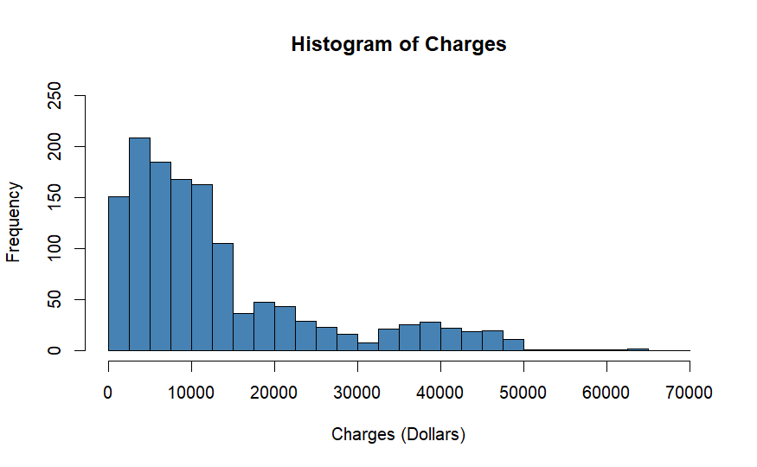
EDA: Charges
Observing the histogram of charges, there is a very long right tail, and a logarithmic transformation will likely be a good fit

Slide 13
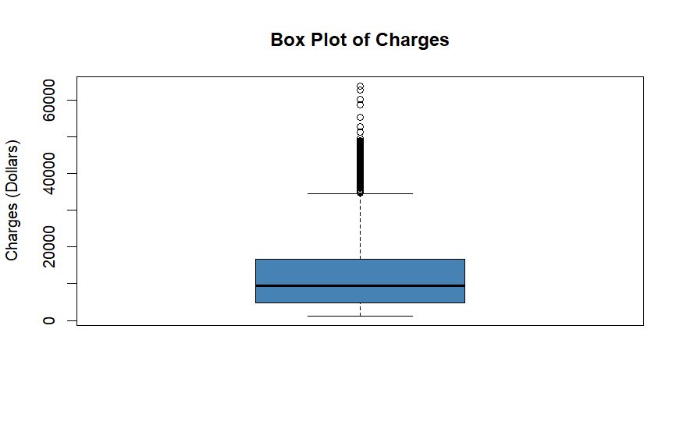
EDA: Charges
Similarly, the box plot indicates a heavy skew to the right
The indication being the large number of outliers and the substantial difference quartiles
Specifically, 139 of the 1,338 observations were considered high outliers.

Slide 14
EDA: Charges
Based on this analysis, a logarithmic transformation was applied to the charge variable
This produced a minimum value of 7.023, and maximum value of 11.063 log dollars
Additionally, the mean and median were now 9.099 and 9.147 log dollars

Slide 15
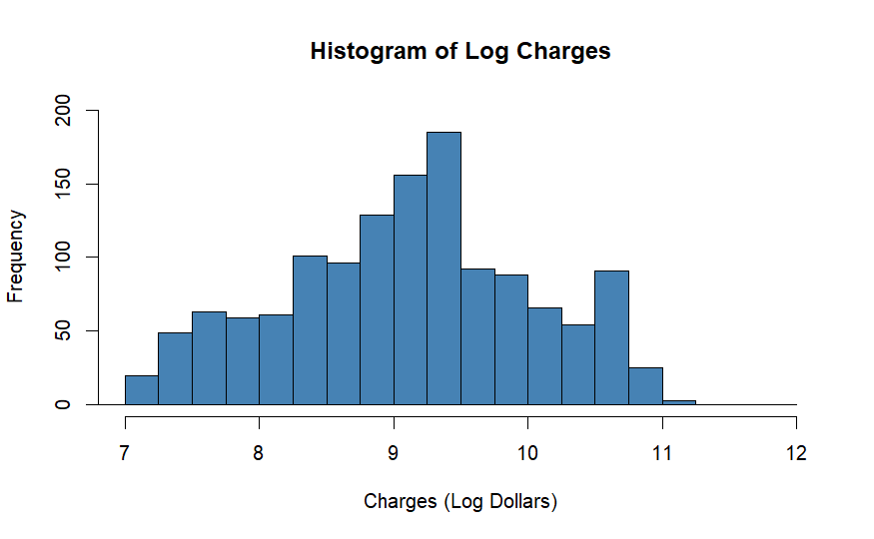
EDA: Charges
The transformation now looks much closer to a normal distribution
While not perfect, it is clearly better with no obvious skew in either direction

Slide 16
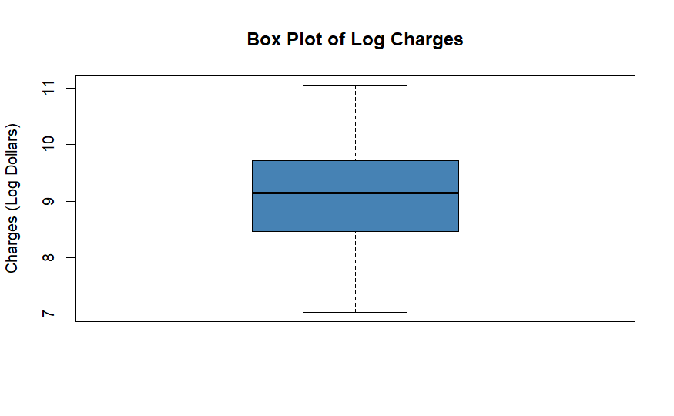
EDA: Charges
This transformation has removed any previous outliers and created more proportional quartiles

Slide 17
EDA: Age
Now that the target variable has been properly dealt with, the predictor variables can be explored for analysis
For age, the minimum is 18 years, the maximum is 64 years, and both the median and mean are 31 years old

Slide 18
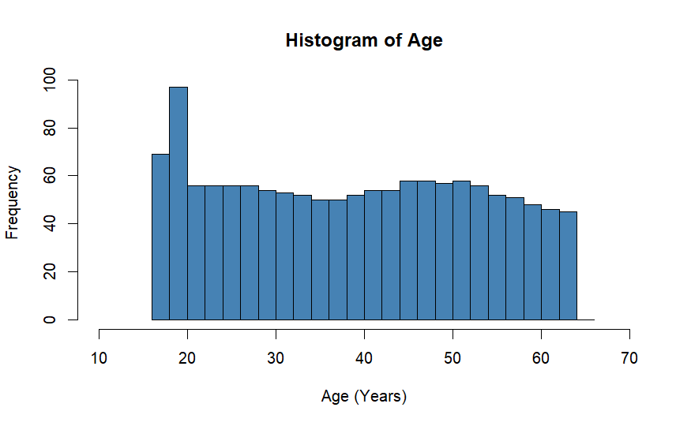
EDA: Age
The histogram of age resembles that of a uniform distribution
Also, there is a noticeably greater frequency of people under the age of 20 years

Slide 19
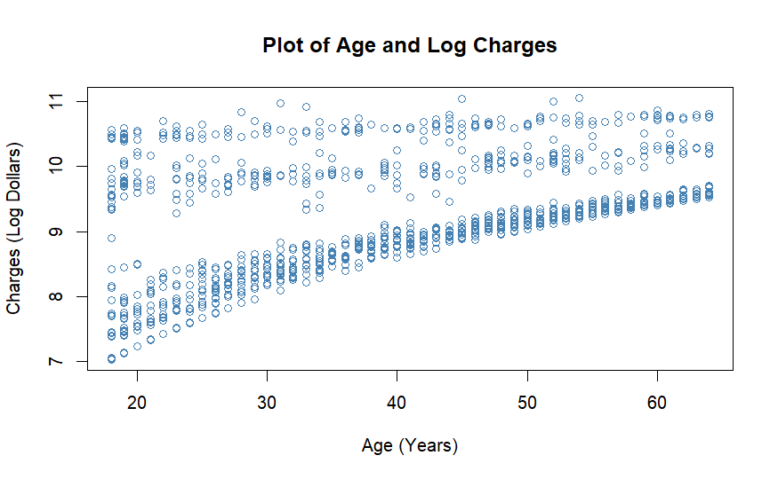
EDA: Age
It seems there may be other factors that are influencing insurance charges against age
For lower costs, it appears there is a pattern between how much someone is charged and how old they are
Likewise, for higher costs, it looks as though charges stay relatively constant for any given age

Slide 20
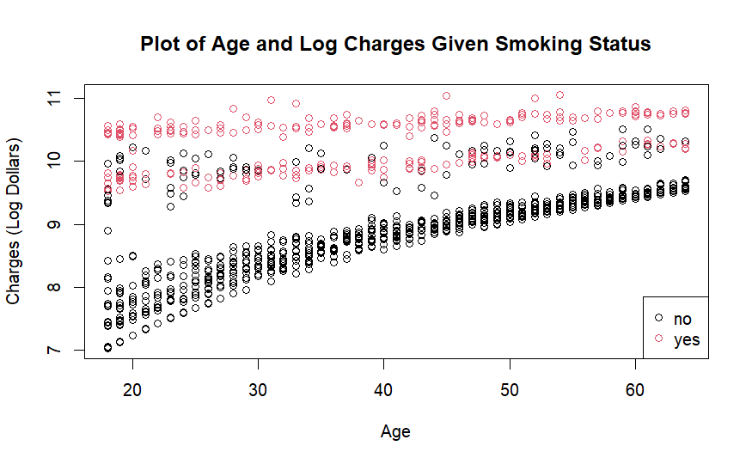
EDA: Age
Using the previous plot, now with smoking status layered over, there is a clear underlying pattern
For those who are smokers, it appears that despite their age, they incur constantly high costs
For those who aren't smokers, there seems to be a linear pattern where charges tend to increase as age increases.

Slide 21
EDA: BMI
Looking at BMI, the minimum body mass index is 15.96, and the maximum is 53.13
The mean BMI is 30.66, and the median is 30.40

Slide 22
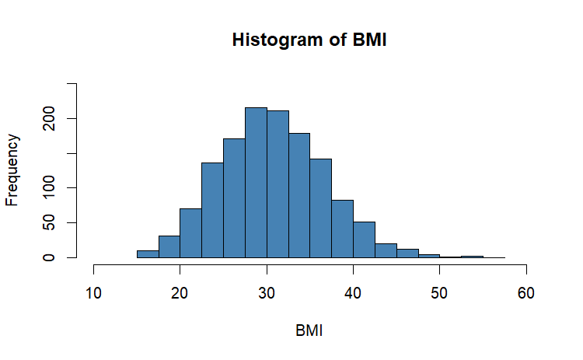
EDA: BMI
The shape of the data is like that of a normal distribution along with a slight right skew

Slide 23
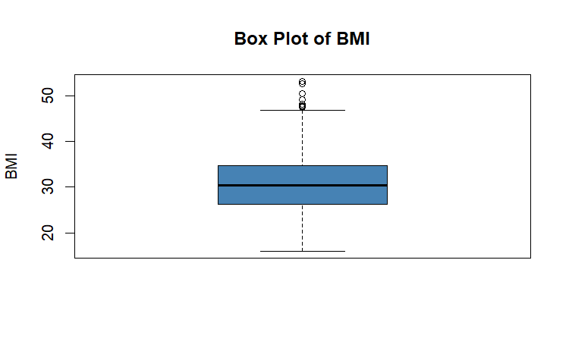
EDA: BMI
There are nine high outliers that are giving the data a positive skew
These outliers were chosen to be retained as they likely represent real life cases

Slide 24
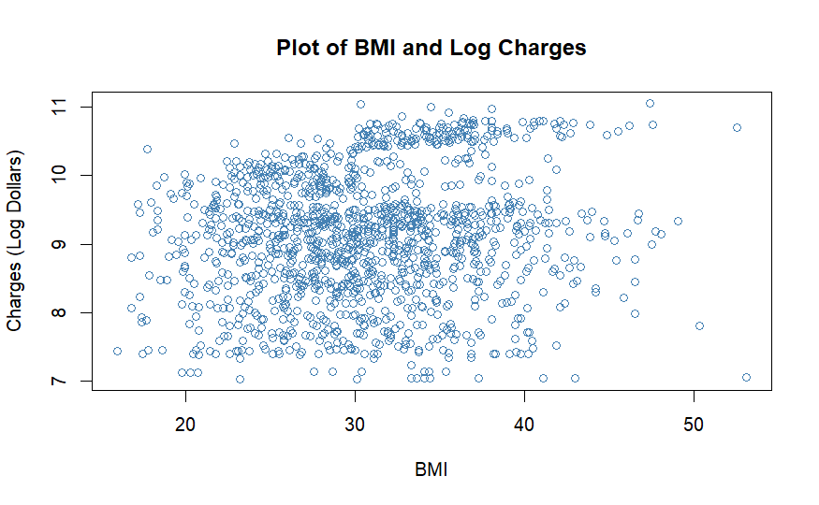
EDA: BMI
The relationship between insurance charges and BMI looks to be very uncorrelated
Visually, there is no clear pattern between the two variables.

Slide 25
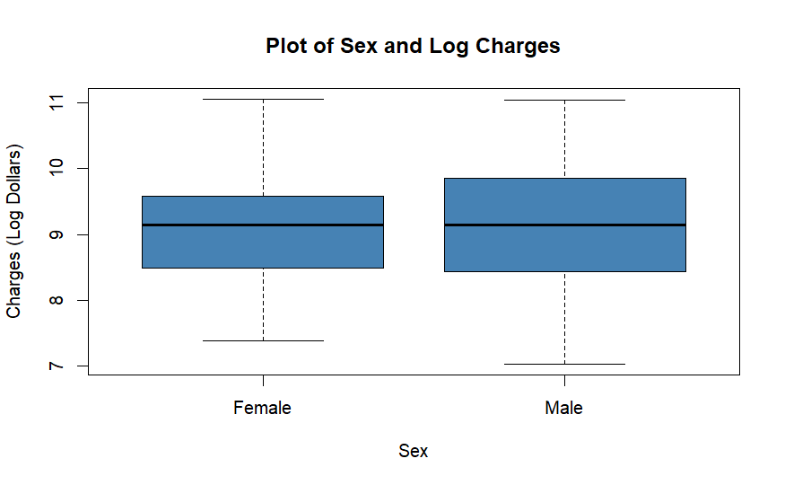
EDA: Sex
The variable sex contains 662 females and 676 males
The box plots of costs for males and females appear to share a similar spread in data
Both plots seem to have a similar maximum value, although females have a slightly greater minimum

Slide 26
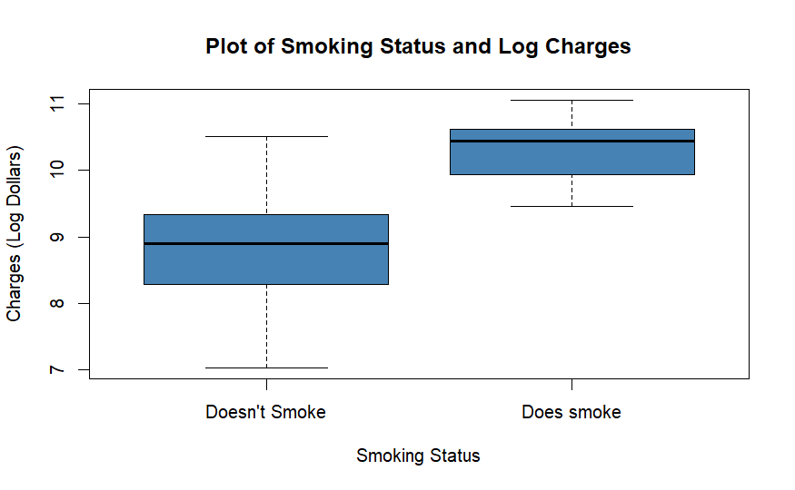
EDA: Smoker
This predictor contains 274 smokers and 1064 non-smokers
Non-smokers have a minimum charge of about $1,121, and a maximum charge of $36,910
Smokers have a minimum charge of around $12,829, and a maximum charge of $63,770
The median value for non-smokers is $7,345, and $34,456 for smokers

Slide 27
EDA: Children
The children variable ranges from 0 to 5 children
Of all observations, 574 have no children, 324 have one child, 240 have two, 157 have three, 25 have four, and 18 have five
As predicted, the number of observations decreases as the number of children increases.

Slide 28
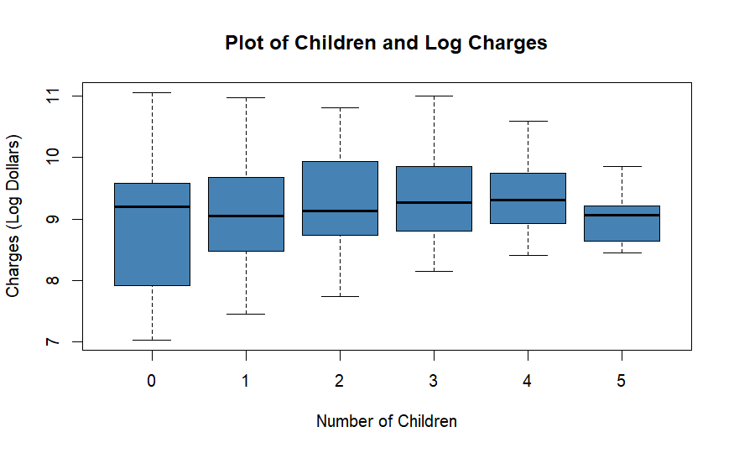
EDA: Children
Ranges for the number of children appear to get smaller for the more children present
The median values for each number of children are all relatively close
The lowest median is one child with $8,483 dollars and the highest median is four children with $11,033

Slide 29
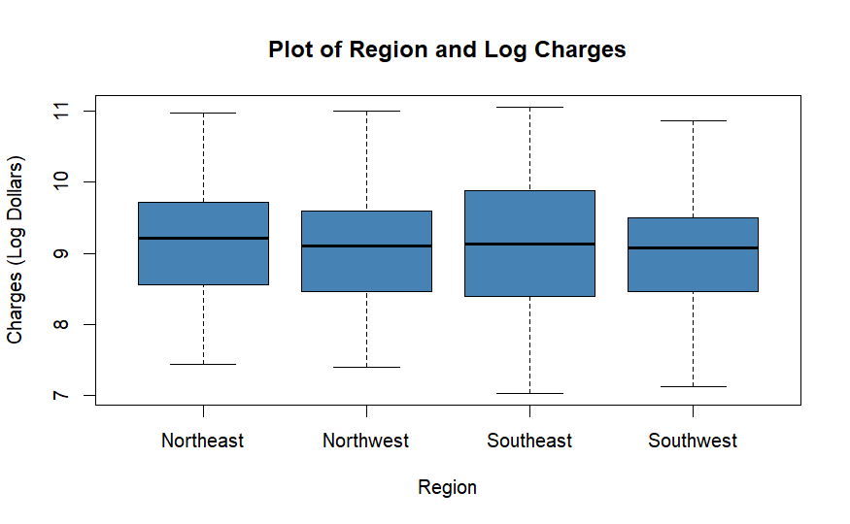
EDA: Region
There are a total of four regions for this analysis, Northwest, Eastwest, Southwest, and Southeast
In total, 324 observations are Northeast, 325 Northwest, 364 Southeast, and 325 Southwest.

Slide 30
Analysis
This project evaluates several predictive modeling approaches to estimate healthcare insurance charges
Because the response variable, insurance charges, is continuous, regression-based methods are appropriate. Multiple models were compared to determine which approach best balances predictive accuracy, interpretability, and the ability to capture nonlinear relationships
Model performance was assessed using training and testing data with evaluation metrics such as Root Mean Squared Error (RMSE), and R-squared

Slide 31
Simple Regression
Simple linear regression models were first used to examine the relationship between individual predictors and insurance charges
These models provide an interpretable starting point and help identify whether single variables have meaningful predictive value

Slide 32

Simple Regression: BMI
A simple linear regression model using BMI as the predictor was fit
Seeing that the correlation between these two variables was weak, this model acted as a baseline for prediction accuracy

Slide 33
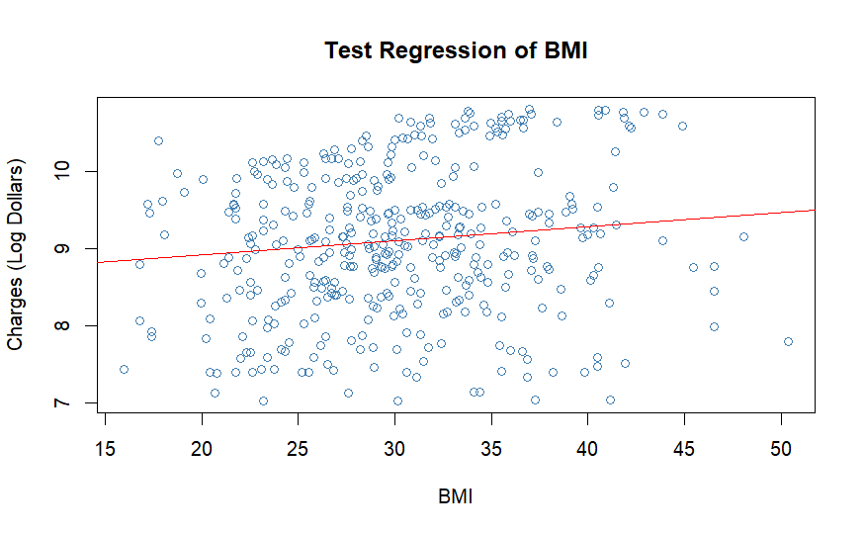
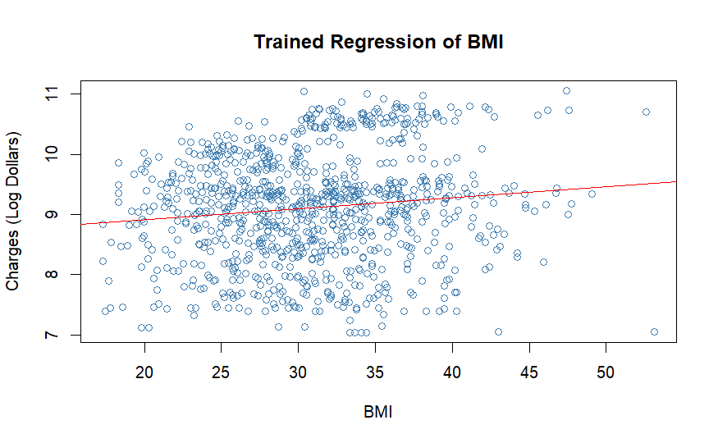
Simple Regression: BMI

Slide 34
Simple Regression: BMI
Results showed a statistically significant positive relationship between BMI and charges (p = 0.0002). The model explained only a small proportion of the overall variation in charges (R-squared = 0.0146), indicating that BMI alone has limited explanatory power.
Predictive performance was also weak. The training RMSE was $12,677.61 and the test RMSE was $12,579.86. Overall, BMI has a statistically meaningful relationship with insurance charges, yet it is not a strong standalone predictor, and additional variables are needed to improve prediction accuracy.

Slide 35
Simple Regression: Age
Next a linear regression model using age as the sole predictor was created
Although there appears to be more than a linear pattern between age and insurance charges, this would help evaluate a simple prediction accuracy

Slide 36
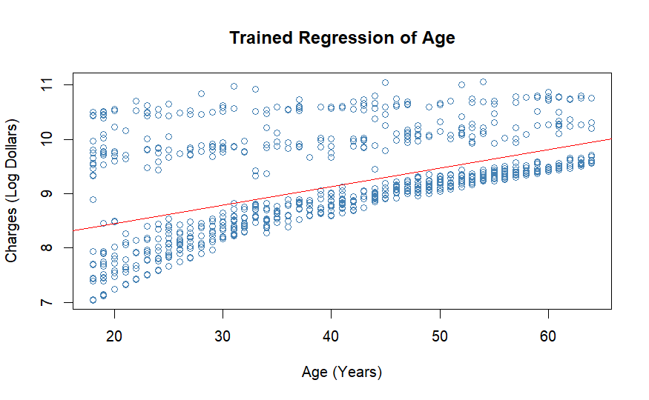
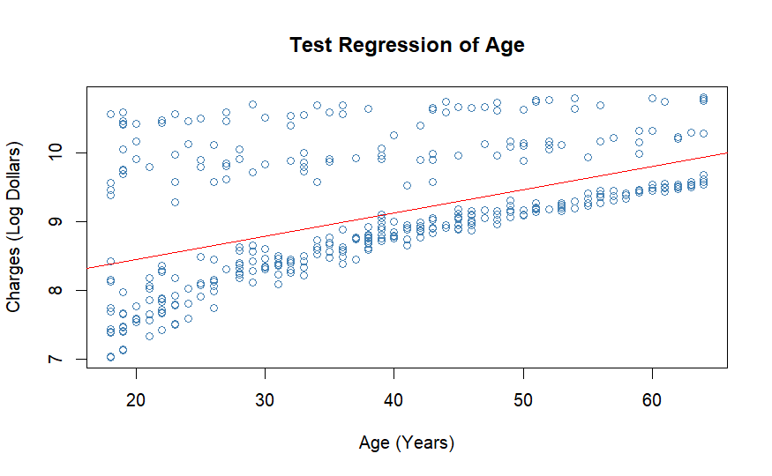
Simple Regression: Age

Slide 37
Simple Regression: Age
Results showed a statistically significant positive relationship between BMI and charges (p < 2e-16). The model explained a substantially larger portion of the variation in charges than the BMI model (R-squared = 0.2742), indicating that age is a much stronger lone predictor of insurance costs. Likewise, training RMSE was $12,062.52 and the test RMSE was $11,993.45.
Overall, age has a strong and statistically meaningful relationship with insurance charges, and it performs considerably better than BMI as a single predictor. However, prediction error remained sizable, indicating that additional variables are still necessary for more accurate cost estimation.

Slide 38
Multiple Regression
This approach was appropriate because the response variable is continuous, and multiple linear regression allows the effect of each predictor to be evaluated while controlling for all other variables.

Slide 39
Multiple Regression: All Predictors
The first model includes smoking status, age, number of children, BMI, region, and sex as predictors
This serves as a comprehensive benchmark using all demographic and health-related information available in the dataset

Slide 40
Multiple Regression: All Predictors
Results showed a strong overall fit, with an R-squared of 0.772, meaning that approximately 77.2% of the variation in insurance charges was explained by the predictors.
This is a substantial improvement over the simple regression models using only BMI or age. The model was also highly statistically significant overall (p < 2.2e-16), indicating that the predictors collectively provide meaningful explanatory power.

Slide 41
Multiple Regression: All Predictors
Smoking status was the strongest predictor in the model. Holding other variables constant, smokers were associated with dramatically higher expected insurance charges than non-smokers.
Age was also a major positive predictor, with charges increasing as individuals became older.
BMI had a statistically significant positive effect, indicating higher charges for individuals with larger BMI values.

Slide 42
Multiple Regression: All Predictors
Several categories of the children variable were also significant, suggesting family size may influence insurance costs.
Regional differences were present, with some regions showing lower expected charges relative to the reference group.
Sex was statistically significant as well, with males associated with slightly lower expected charges than females after controlling for other factors.

Slide 43
Multiple Regression: All Predictors
Predictive performance improved considerably compared to simple linear regression models with a training RMSE of $8,252.76 and test RMSE of $8,588.92. These values are much lower than single regression, indicating stronger practical prediction accuracy.
Overall, the full multiple regression model performed strongly and demonstrated that insurance charges are influenced by several variables. Smoking status, age, and BMI being the most important predictors.

Slide 44
Multiple Regression: Simplified Model
A simplified multiple regression model was developed using only the most influential predictors and interaction terms. The model included smoking status, age, BMI, and interactions between smoking status with both age and BMI
This reduced model was designed to improve interpretability while retaining variables most strongly associated with insurance costs

Slide 45
Multiple Regression: Simplified Model
Results showed excellent overall performance, with an R-squared of 0.7962, meaning that approximately 79.6% of the variation in insurance charges was explained by the model. This exceeded the performance of the full multiple regression model, despite using fewer predictors.
The model was highly statistically significant overall (p < 2e-16), indicating strong explanatory value.

Slide 46
Multiple Regression: Simplified Model
Predictive performance improved substantially compared with previous regression models. The training RMSE was $5,387.14 and the test RMSE was $4,978.82. These were the lowest error values among the linear regression models considered, indicating strong prediction accuracy.
Overall, the simplified regression model performed exceptionally well while using fewer predictors than the full model. The results indicate that smoking status, age, and the interaction between smoking and BMI are central drivers of healthcare insurance charges. This model demonstrates that a carefully selected set of variables can outperform a more complex model while remaining easier to interpret.

Slide 47
Decision Trees
Regression trees were an appropriate method because they can capture nonlinear relationships and interaction effects without requiring the strict assumptions of linear regression
Compared with multiple linear regression, regression trees offered a more flexible structure by identifying decision rules based on predictor thresholds

Slide 48

Decision Trees: All Predictors
Like the multiple linear regression model, a decision tree using all available predictors was fit to estimate healthcare insurance charges
Decision trees are appropriate in this setting because they can capture nonlinear relationships and interaction effects without requiring the linearity assumptions of regression models.

Slide 49
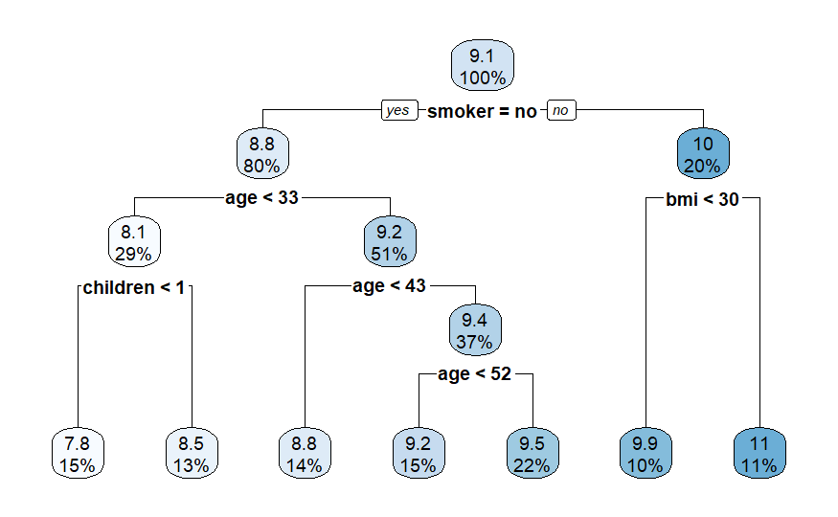
Decision Trees: All Predictors

Slide 50
Decision Trees: All Predictors
Predictive performance was strong with a training RMSE of $4,935.53 and test RMSE of $4,655.86. These values were lower than those of the multiple linear regression models, indicating improved predictive accuracy.
The test RMSE being slightly lower than the training RMSE suggests the tree generalized well to unseen data.
Overall, the decision tree performed very well while remaining very interpretable. The model clearly showed that smoking status is the most important determinant of insurance charges, along with age and BMI.

Slide 51
Decision Trees: Complex Tree
A more complex regression tree was fit using the same predictors as the previous tree model, but now allowing additional splits and a deeper tree structure
This approach was used to determine whether greater tree complexity could improve predictive accuracy by capturing finer subgroup patterns in the data.

Slide 52
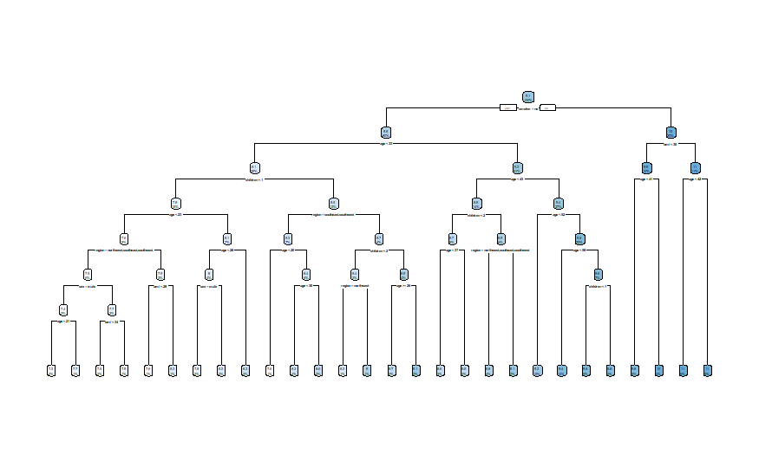
Decision Trees: Complex Tree

Slide 53
Decision Trees: Complex Tree
Predictive performance improved compared with the simpler decision tree. The training RMSE was $4,392.28 and the test RMSE was $4,494.40. The test RMSE being only slightly higher than the training RMSE suggests that the additional complexity did not lead to substantial overfitting and that the model generalized well to unseen data.
Overall, the complex tree provided one of the strongest predictive performances among the models tested. Although there was some trade off in interpretability. This demonstrates that carefully increased tree complexity can improve accuracy without sacrificing generalization.

Slide 54
Decision Trees: Complex Tree
A more complex regression tree was fit using the same predictors as the previous tree model, but now allowing additional splits and a deeper tree structure
This approach was used to determine whether greater tree complexity could improve predictive accuracy by capturing finer subgroup patterns in the data.

Slide 55

Random Forests
Random forests were an appropriate method because they can model nonlinear relationships and interactions while reducing the overfitting risk that is associated with a single decision tree.
Unlike one regression tree, which can be sensitive to small changes in the data, random forests create many trees using bootstrap samples and random subsets of predictors
Predictions are then averaged across all trees, producing more stable and accurate results.

Slide 56
Random Forests: All Predictors
A random forest model using all available predictors was created
Random forests are appropriate for this problem because they combine many decision trees, allowing the model to capture nonlinear relationships and interactions while reducing the overfitting risk often seen in a single tree.

Slide 57
Random Forests: All Predictors
Results indicated that the random forest was one of the strongest-performing models tested. By averaging predictions across 500 trees, the model was able to identify complex patterns in the data that were not fully captured by linear regression or a single decision tree.
Predictive performance slightly improved relative to the decision trees. The training RMSE was $4,017.60 and the test RMSE was $4,221.20 indicating superior prediction accuracy.

Slide 58
Random Forests: All Predictors
Although random forests typically sacrifice interpretability compared with regression equations or single trees, they offer strong predictive power and more stable results.
Overall, the full random forest model delivered excellent predictive accuracy and demonstrated that ensemble tree methods are highly effective for estimating healthcare insurance charges.

Slide 59
Evaluation
Overall, the results show that healthcare insurance charges can be predicted with a moderate degree of accuracy with demographic and lifestyle variables. Across nearly all models, smoking status was the most influential predictor, followed by age and BMI.
This indicates that both personal health behaviors and age-related risk are major drivers of insurance costs, while variables such as region, sex, and number of children had smaller but still measurable effects.

Slide 60
Evaluation
Also, model comparisons showed clear differences in performance. Simple linear regression models using only BMI or age were useful for understanding individual relationships but had limited predictive accuracy.
Multiple linear regression substantially improved performance by combining predictors, and interaction terms further increased model quality by capturing how smoking changes the effects of age and BMI.
Decision trees provided strong results while remaining interpretable, and random forests achieved the best overall predictive accuracy by modeling complex nonlinear relationships through an ensemble approach.

Slide 61
Evaluation
The strongest models produced test RMSE values near $4,000 to $4,500, representing a major improvement over the single-predictor models whose errors exceeded $11,000. This suggests that combining multiple relevant variables is essential for accurate cost estimation.
While no model perfectly predicts charges, the results demonstrate that predictive methods can explain a large share of variation in healthcare costs.

Slide 62
Conclusion
In conclusion, my research question was successfully addressed
Insurance charges are strongly influenced by a combination of demographic and behavioral characteristics, and these factors can be used to build effective predictive models.
Among the approaches tested, tree-based ensemble methods offered the best predictive performance, while regression models provided the greatest interpretability.

Slide 63
Thank You!

