Slide 1
CSCI 444 Data Visualization
Final Project Presentation
RWIS Daily Dashboard
Ethan Wimmer
Wednesday, May 1, 2024

Slide 2
Introduction to Dashboard
Due to a very unpredictable world, it’s important that we are able to understand, learn, and prepare for what we don’t know. Although seemingly invaluable, data we are able to collect and show can mean a lot towards expecting the unexpected. It isn’t just how you gain data, but also how you present it.

Slide 3
Map Section

Slide 4
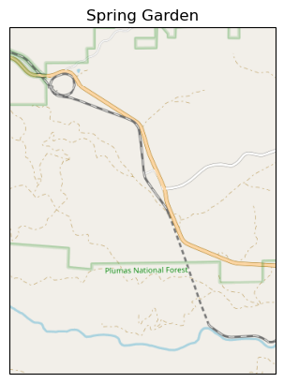
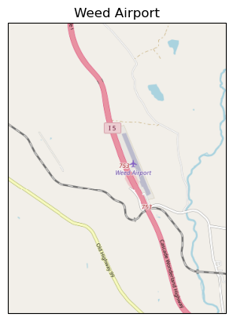
Map Showing Location of Site

Slide 5
Time Series Plots Section

Slide 6
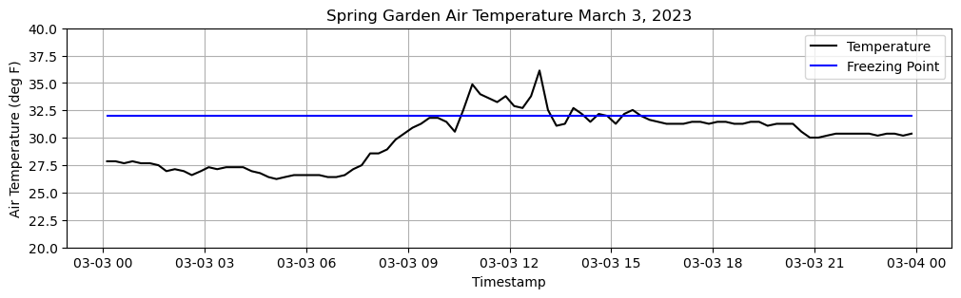
Time Series: Air Temperature
Freezing Point Line
Continuous

Slide 7
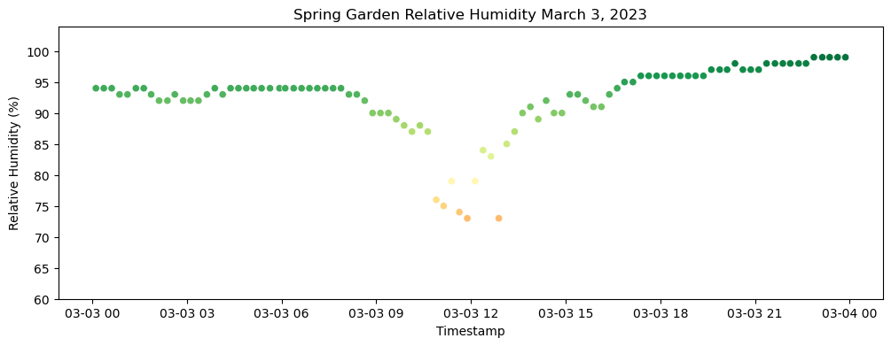
Time Series: Humidity
Color Hue
Fit For Scatterplot

Slide 8
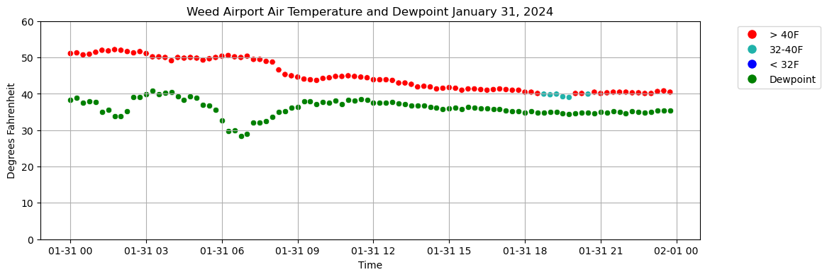
Time Series: Air Temperature and Dewpoint
Plot Points To Compare
Changed Air Temperature

Slide 9
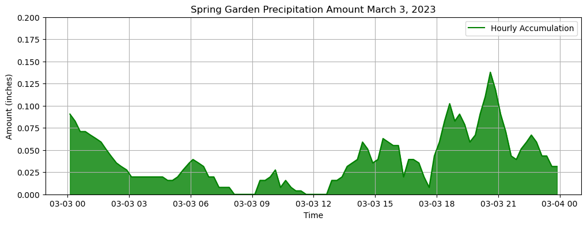
Time Series: Precipitation Amount

Slide 10
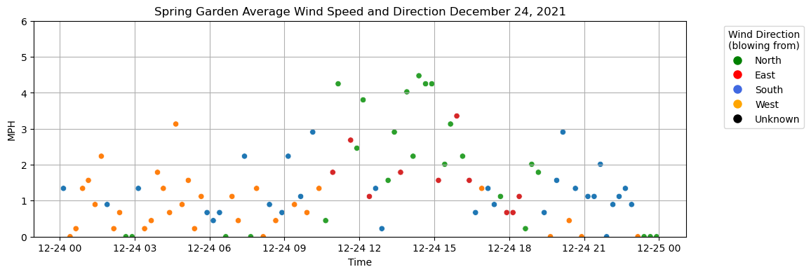
Time Series: Wind Average Speed and Direction
Color To Show Direction
Y-Axis Showing Speed

Slide 11
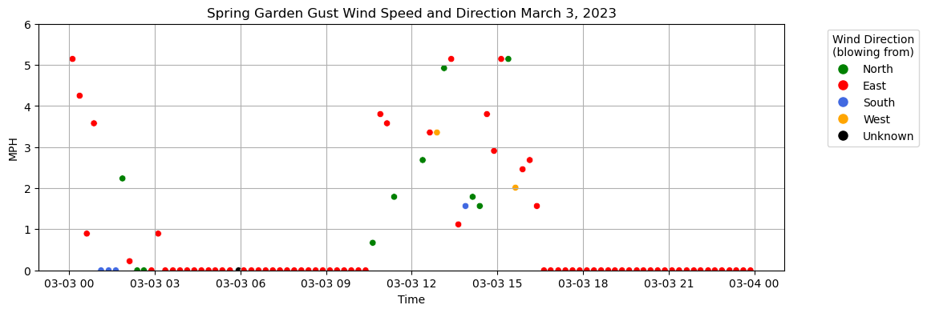
Time Series: Wind Gust Speed and Direction

Slide 12
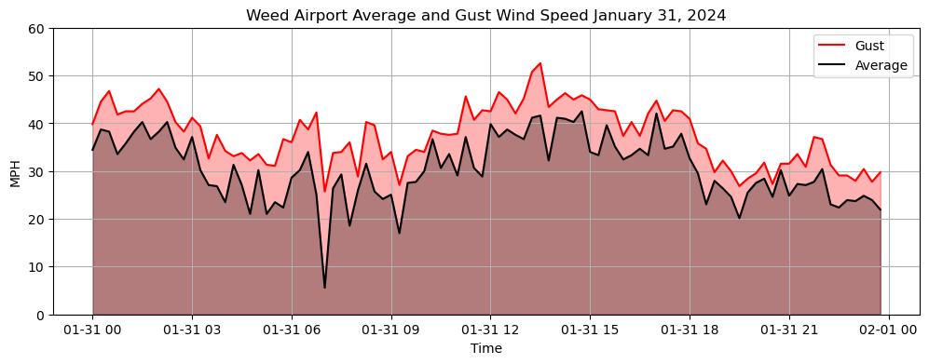
Time Series: Wind Average and Gust Speeds
Density Comparison

Slide 13
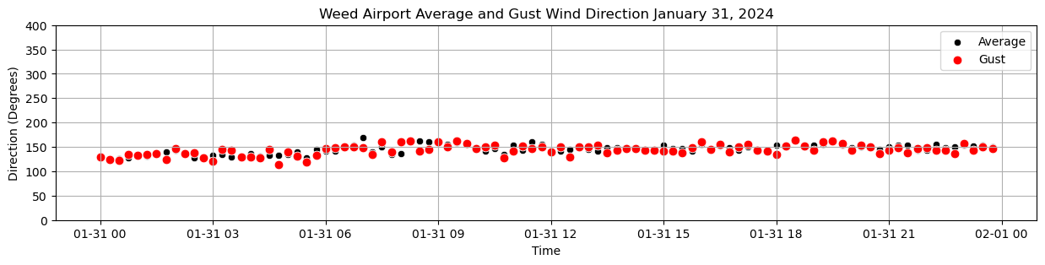
Time Series: Wind Average and Gust Directions

Slide 14
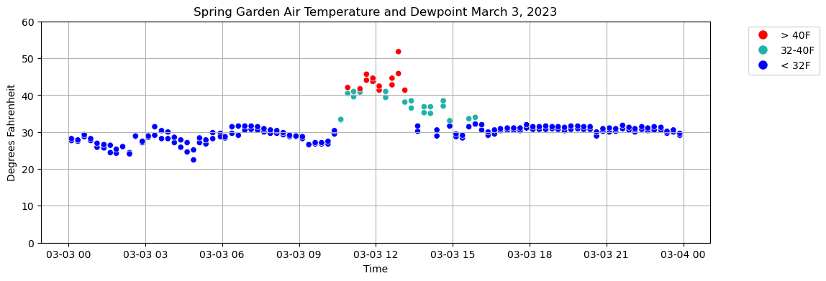
Time Series: Surface Temperature – All Sensors (Multiple Sensors)

Slide 15
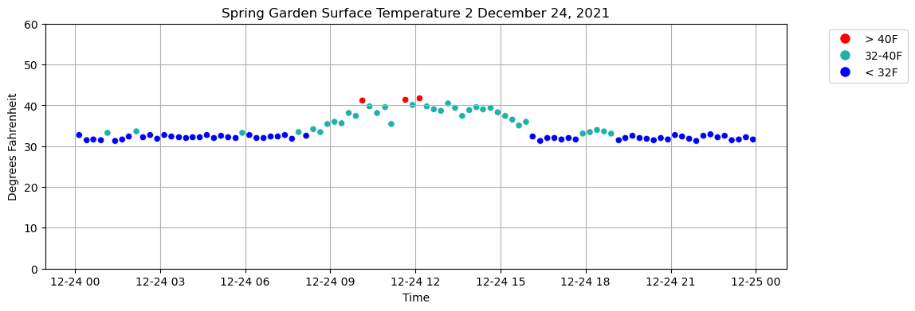
Time Series : Surface Temperature 1 (or 2) (Single Sensor)
Informative Color
Reduced Chart Junk

Slide 16
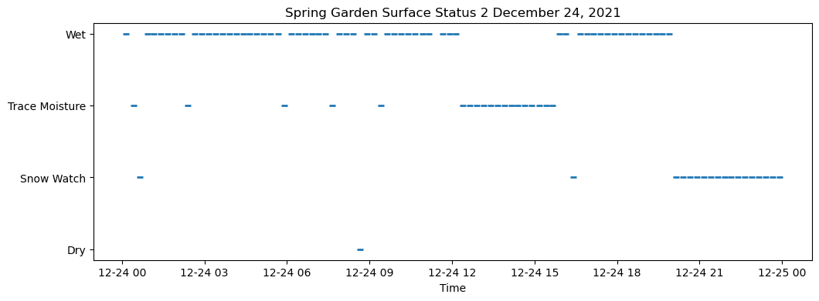
Time Series : Surface Status 1 (or 2) (Single Sensor)
Simplicity
Digestible For Audience

Slide 17
Daily Summary Plots

Slide 18
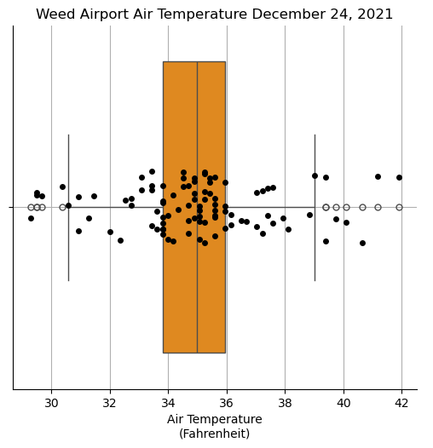
Daily Summary: Air Temperature
Specific Data And Numerical Summary
Point Jitter

Slide 19
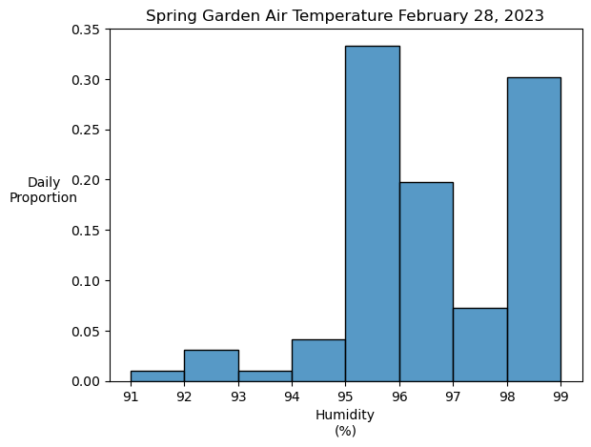
Daily Summary: Humidity
Proportion Without Time
Understandable

Slide 20
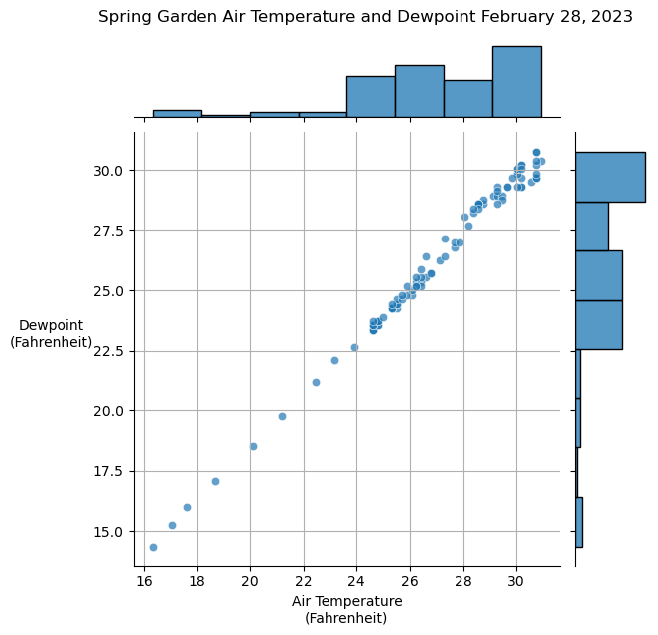
Daily Summary: Air Temperature and Dewpoint
Better Visualize Density
Maintaining Dependent Relationship

Slide 21
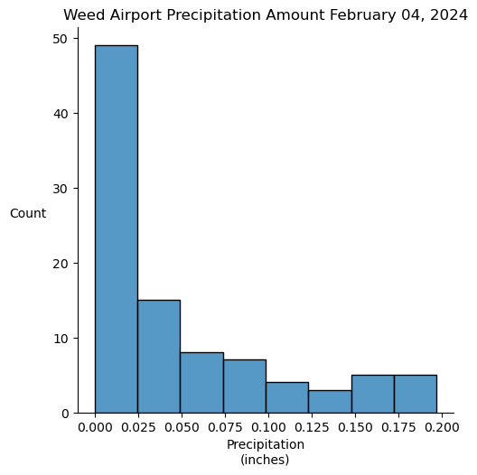
Daily Summary: Precipitation Amount
Identify Max And Min Values
Independent Bars

Slide 22
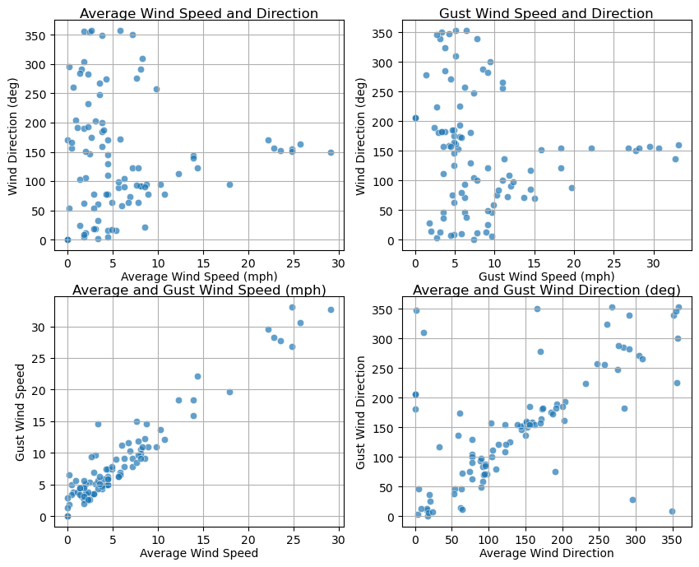
Daily Summary: Wind Average/Gust Speed and Direction
Side By Side Comparison
Similar Plots Reduce Confusion

Slide 23
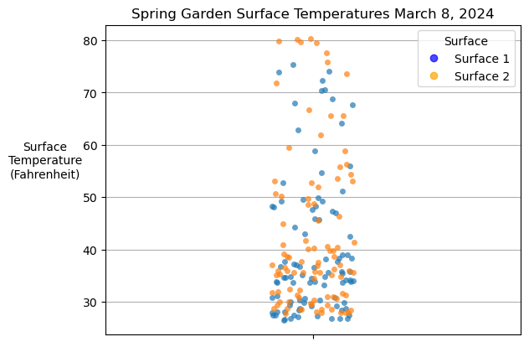
Daily Summary: Surface Temperature – All Sensors (Multiple Sensors)

Slide 24
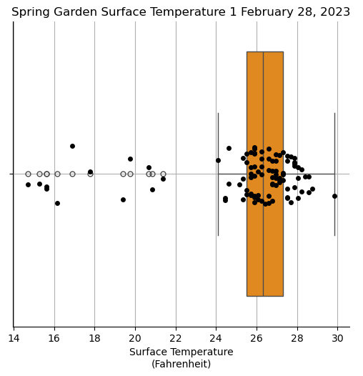
Daily Summary: Surface Temperature 1 (or 2) (Single Sensor)

Slide 25
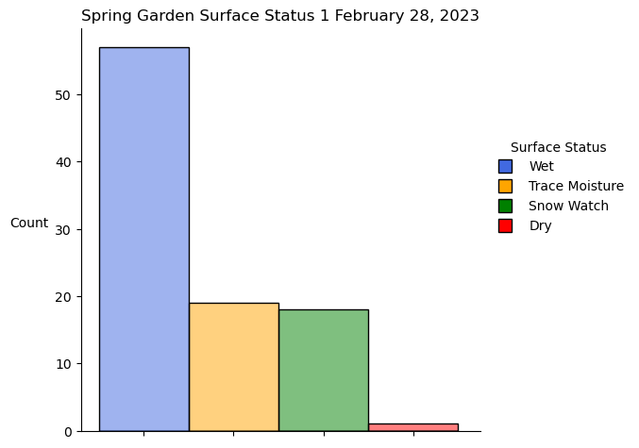
Daily Summary: Surface Status 1 (or 2) (Single Sensor)
Color Legend For Limited Space
Count For Bar Comparison

Slide 26
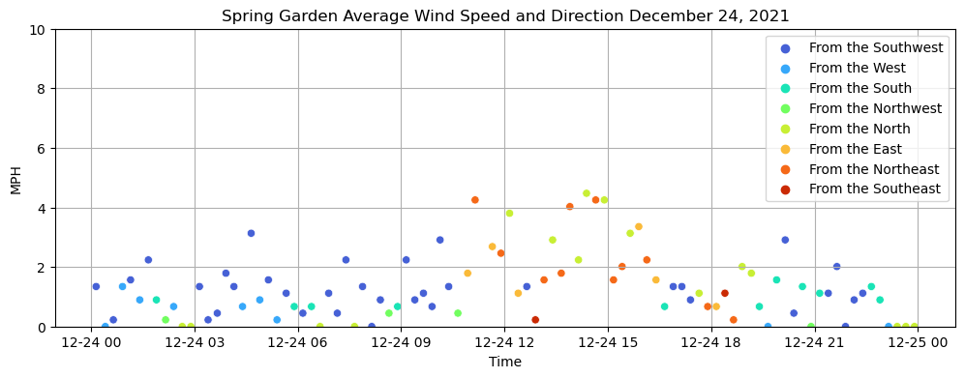

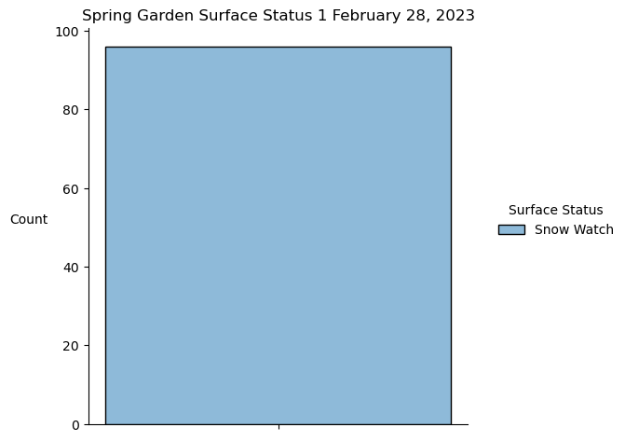
Changes Made from Prior Versions

Slide 27
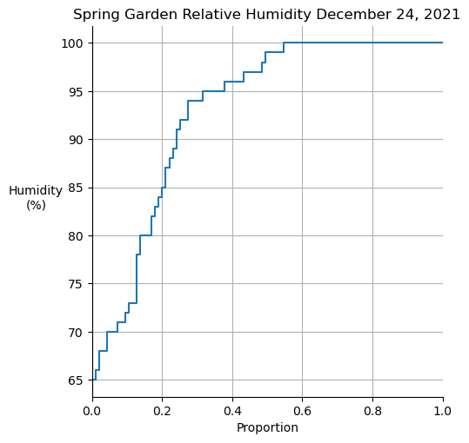
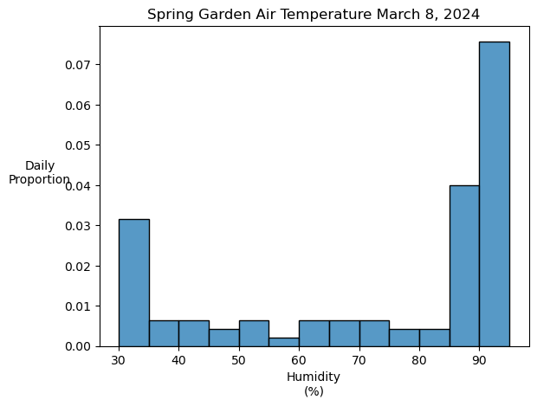
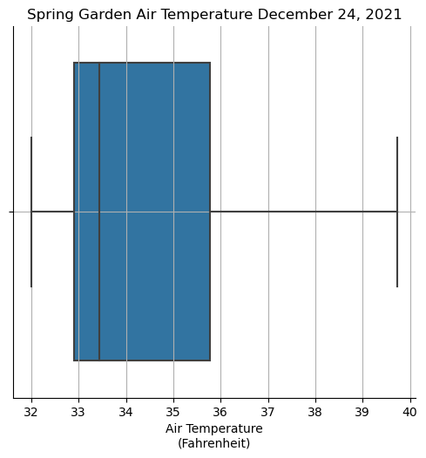
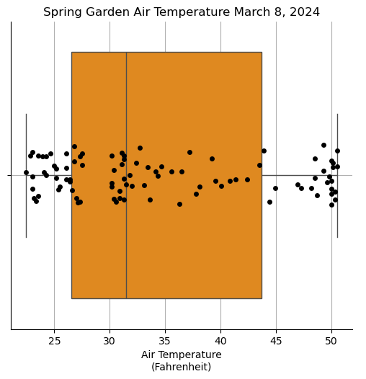
Changes Made from Prior Versions

Slide 28
Challenges Faced
Most of the challenges that I faced were due to the barrier of what I wanted to create or change in a plot, and the vast field of unlearned pieces with Seaborn and Matplotlib. I was surprised at how much time could be spent changing very subtle variables within a plot, and how much trial and error there was with design. There is something a little frustrating about knowing that you could easily create you desired change with pen and paper, but you have to suffer through extensive research for a slight change.

Slide 29
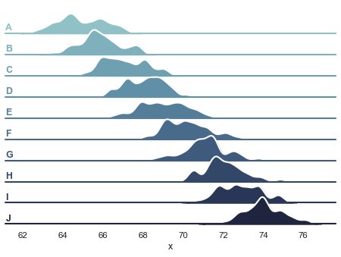
What I Learned
Ever since I had started plotting data in this class, I can’t help but to look at a visualization and wonder what are behind the scenes to create what’s there. It’s a bit of a humbling experience to attempt to create something that seemed so simple but in fact wasn’t at all. Also, I learned that data can’t be tossed into a pie chart and called a day. Not only do you have to take time to decide how you data will be represented visually, there are many more aspects like is it accessible? Is it misleading? Who is the audience? Is this chart junk?

Slide 30
Summary
Although data visualization is seen as part art and part science, it seems more to be the art of understanding science. You want the audience of your creations to easily understand your visuals while also provoking deeper thought. Although there is many variables to the programming behind plots like these, it’s also how much experience you’re able to gain from testing.

