Slide 1
CMSC204
Kartchner
V(StateGraph) = {Oregon, Alaska, Texas, Hawaii, Vermont, NewYork, California}
E(StateGraph) = {(Alaska, Oregon), (Hawaii, Alaska), (Hawaii, Texas), (Texas, Hawaii), (Hawaii, California), (Hawaii, New York), (Texas, Vermont), (Vermont, California), (Vermont, Alaska)}
1. Draw the StateGraph
Alaska
Oregon
Texas
Hawaii
New York
California
Vermont

Slide 2
a. Show the adjacency matrix that would describe the edges in the graph. Store the vertices in alphabetical order
States
Alaska
California
Hawaii
New York
Oregon
Texas
Vermont
0 | 0 | 0 | 0 | 1 | 0 | 0
0 | 0 | 0 | 0 | 0 | 0 | 0
1 | 1 | 0 | 1 | 0 | 1 | 0
0 | 0 | 0 | 0 | 0 | 0 | 0
0 | 0 | 0 | 0 | 0 | 0 | 0
0 | 0 | 1 | 0 | 0 | 0 | 1
1 | 1 | 0 | 0 | 0 | 0 | 0
3. b. Show the adjacency lists
that would describe the edges in the graph
Alaska
California
Hawaii
New York
Oregon
Texas
Vermont
Oregon /
/
Alaska /
/
/
Hawaii /
Alaska /
California / New York / Texas /
Vermont /
California /

Slide 3
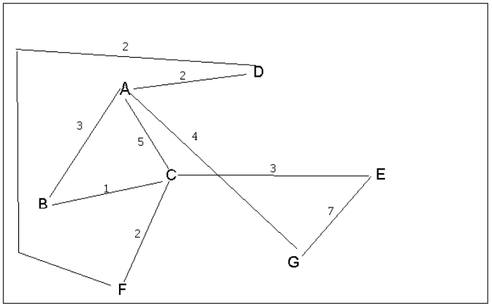
4 a. Which of the following lists the graph nodes in depth first order beginning with E?
A) E, G, F, C, D, B, A
B) G, A, E, C, B, F, D
C) E, G, A, D, F, C, B
D) E, C, F, B, A, D, G
4 b. Which of the following lists the graph nodes in breadth first order beginning at F?
A) F, C, D, A, B, E, G
B) F, D, C, A, B, C, G
C) F, C, D, B, G, A, E
D) a, b, and c are all breadth first traversals

Slide 4
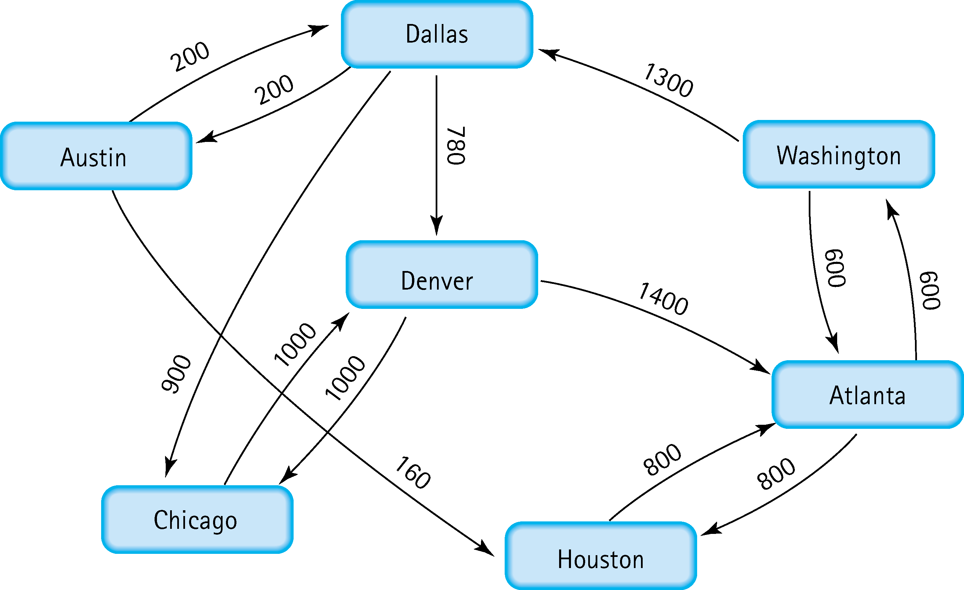
5. Find the shortest distance from Atlanta to every other city
Atlanta to Atlanta: None
Atlanta to Washington: 600
Atlanta to Houston: 800
Atlanta to Dallas: 1900
Atlanta to Denver: 2680
Atlanta to Chicago: 2800
Atlanta to Austin: 2100

Slide 5
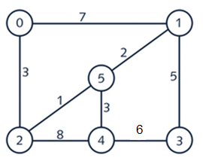
6. Find the minimal spanning tree using Prim’s algorithm. Use
0 as the source vertex . Show the steps.
0 | 2 | 3
2 | 5 | 1
5 | 1 | 2
5 | 4 | 3
1 | 3 | 5
0
1
5
2
4
3

Slide 6
7. Find the minimal spanning tree using Kruskal’s algorithm.
Show the weights in order and the steps.
Edge to edge | Cost
2-5 | 1
5-1 | 2
5-4 | 3
0-2 | 3
1-3 | 5
0
1
5
2
4
3

Slide 7
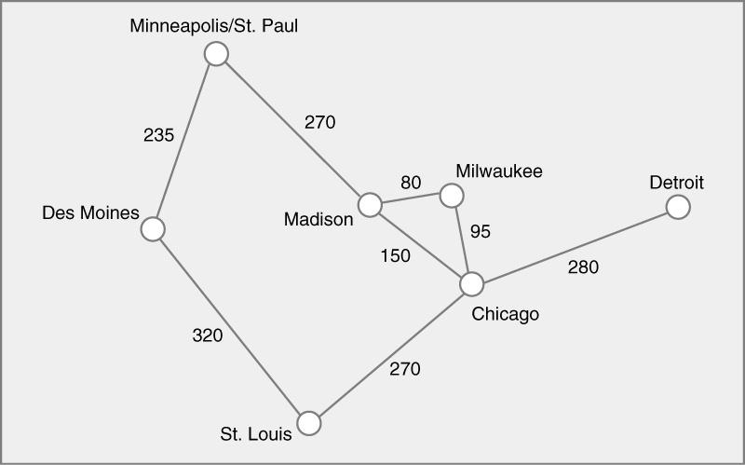
8. Find the minimal spanning tree using the algorithm you prefer. Use
Minneapolis/St. Paul as the source vertex
Edge to edge | Cost
Madison-Milwaukee | 80
Milwaukee-Chicago | 95
Madison-Chicago | 150
Des Moines-Minneapolis | 235
Chicago-St. Louis | 270
Minneapolis-Madison | 270
Chicago-Detroit | 280
Des Moines-St. Louis | 320
Minneapolis
Des Moines
Madison
Milwaukee
Detroit
Chicago
St. Louis

Slide 8
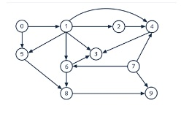
9. List the nodes of the graph in a breadth first topological ordering. Show the
steps using arrays predCount, topologicalOrder and a queue
In Degree
0 | 0
1 | 1 0
2 | 1 0
3 | 3 2 1 0
4 | 3 2 1 0
5 | 2 1 0
6 | 2 1
7 | 0
8 | 2 1
9 | 2 1 0
Queue: 0 1 5 2 7 4 6 3 8 9
0 1 5 2 7 4 6 3 8 9

Slide 9

10. List the nodes of the graph in a breadth first topological ordering.
Start
Discrete Math,
Programming 1
Programming 2
Algorithms
Theory of Computation
High-Level Languages
Computer Organization
Operating Systems
Compilers
Senior Seminar
End

