Slide 1
Streaming ASR 코드 분석
Arxiv, 04/2023
2023. 05. 11.
최용석 ETRI

Slide 2
참고 자료 및 실험 환경
ESPNet Documentation
https://espnet.github.io/espnet/notebook/espnet2_streaming_asr_demo.html
Paper
Streaming Transformer ASR with Blockwise Synchronous Beam Search
ESPNet version: 202301
Code Editor: Vscode

Slide 3
디버깅 실행 코드
./espnet2/bin/asr_train.py \
--use_preprocessor true \
--bpemodel none \
--token_type char \
--token_list "${root}/data/zh_token_list/char/tokens.txt" \
--non_linguistic_symbols none \
--cleaner none \
--g2p none \
--valid_data_path_and_name_and_type "${root}/dump/raw/dev/wav.scp,speech,sound" \
--valid_shape_file "${root}/exp/asr_stats_raw_zh_char_sp/valid/speech_shape" \
--resume true \
--ignore_init_mismatch false \
--fold_length 51200 \
--output_dir ".${root}/exp/asr_train_asr_streaming_transformer_raw_zh_char_sp" \
--config "${root}/conf/train_asr_streaming_transformer.yaml" \
--frontend_conf "fs=16k" \
--normalize=global_mvn \
--normalize_conf "stats_file=${root}/exp/asr_stats_raw_zh_char_sp/train/feats_stats.npz" \
--train_data_path_and_name_and_type "${root}/dump/raw/train_sp/wav.scp,speech,sound" \
--train_shape_file "${root}/exp/asr_stats_raw_zh_char_sp/train/speech_shape" \
--fold_length 150 \
--train_data_path_and_name_and_type "${root}/dump/raw/train_sp/text,text,text" \
--train_shape_file "${root}/exp/asr_stats_raw_zh_char_sp/train/text_shape.char" \
--valid_data_path_and_name_and_type "${root}/dump/raw/dev/text,text,text" \
--valid_shape_file "${root}/exp/asr_stats_raw_zh_char_sp/valid/text_shape.char" \
--ngpu 1 \
--multiprocessing_distributed True

Slide 4
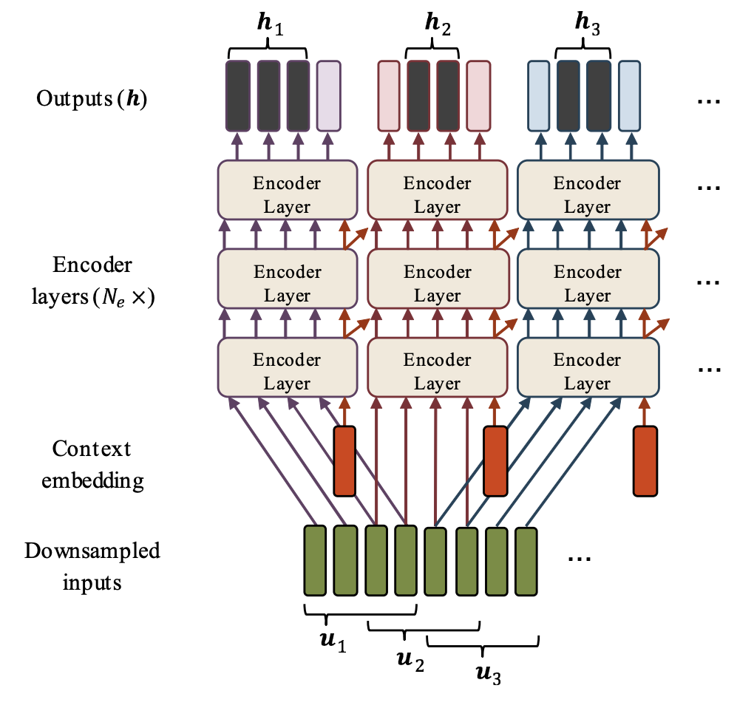

Streaming ASR Model
인코더 부분
학습 과정을 중심으로 살펴봄
$$u_{b}=\left(u_{\left(b−1\right)∙L_{hop}+1}, …, u_{\left(b−1\right)∙L_{hop}+L_{block}}\right)$$
Emiru Tsunoo et al., “Transformer ASR with Contextual Block Processing”, ASRU, 2019

Slide 5










Streaming ASR Model
Extractor Features
Feature
Extractor
$$(batch, lengths)$$
$$(batch, nFrame, nDim)$$
Contextual Block Processing
Encoder
$$…$$
COPY
$$…$$
Decoder
$$…$$
$$…$$
$$…$$
Encoder
$$…$$
$$(batch, nFrame, nDim)$$
코드 분석 부분
Emiru Tsunoo et al., “Transformer ASR with Contextual Block Processing”, ASRU, 2019

Slide 6
Streaming ASR Model
Extractor Features
Feature
Extractor
$$(batch, lengths)$$
$$(batch, nFrame, nDim)$$
Contextual Block Processing
Encoder
$$…$$
merging
$$…$$
Decoder
$$…$$
$$…$$
$$…$$
Encoder
$$…$$
$$(batch, nFrame, nDim)$$
코드 분석 부분
Emiru Tsunoo et al., “Transformer ASR with Contextual Block Processing”, ASRU, 2019

Slide 7
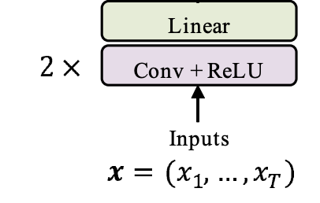
Assumption & Hyperparameters etc.
가정
하이퍼파라미터
Speech lengths: 52,785
Speech Feature lengths: 413
Downsampling lengths: 102
Block size: 40
Hop size: 16
Look ahead size: 16
CNN+Linear
BLOCK
Block size: 40
PAST
(8)
CURRENT
(16)
NEXT
(16)
Emiru Tsunoo et al., “Transformer ASR with Contextual Block Processing”, ASRU, 2019

Slide 8
The Number of Block
Downsampling lengths: 102
Block size: 40
Hop size: 16
Look ahead size: 16
BLOCK
PAST
(8)
CURRENT
(16)
NEXT
(16)
block_num = math.ceil(
float(total_frame_num - past_size - self.look_ahead) / float(self.hop_size)
) #espnet2/asr/encoder/contextual_block_transformer_encoder.py #L251-253
downsampling length: 102
BLOCK(#1:40): 1-40
CURRENT: 1-24
BLOCK(#2:40): 17-57
CURRENT: 25-41
BLOCK(#3:40): 33-73
CURRENT: 42-58
BLOCK(#4:40): 49-89
CURRENT: 59-75
BLOCK(#5:38): 65-102
CURRENT: 76-102
Emiru Tsunoo et al., “Transformer ASR with Contextual Block Processing”, ASRU, 2019

Slide 9
Context embedding initialization
Context embedding initialization: Average or Maximum Input
#espnet2/asr/encoder/contextual_block_transformer_encoder.py #L254-285
bsize = xs_pad.size(0)
addin = xs_pad.new_zeros(
bsize, block_num, xs_pad.size(-1)
) # additional context embedding vecctors
# first step
if self.init_average: # initialize with average value
addin[:, 0, :] = xs_pad.narrow(1, cur_hop, self.block_size).mean(1)
else: # initialize with max value
addin[:, 0, :] = xs_pad.narrow(1, cur_hop, self.block_size).max(1)
cur_hop += self.hop_size
# following steps
while cur_hop + self.block_size < total_frame_num:
if self.init_average: # initialize with average value
addin[:, cur_hop // self.hop_size, :] = xs_pad.narrow(
1, cur_hop, self.block_size
).mean(1)
else: # initialize with max value
addin[:, cur_hop // self.hop_size, :] = xs_pad.narrow(
1, cur_hop, self.block_size
).max(1)
cur_hop += self.hop_size
# last step
if cur_hop < total_frame_num and cur_hop // self.hop_size < block_num:
if self.init_average: # initialize with average value
addin[:, cur_hop // self.hop_size, :] = xs_pad.narrow(
1, cur_hop, total_frame_num - cur_hop
).mean(1)
else: # initialize with max value
addin[:, cur_hop // self.hop_size, :] = xs_pad.narrow(
1, cur_hop, total_frame_num - cur_hop
).max(1)
(
)
Context(#1)
mean or max
BLOCK(#1:40): 1-40
(
)
Context(#2)
mean or max
BLOCK(#2:40): 17-57
(
)
Context(#3)
mean or max
BLOCK(#3:40): 33-73
(
)
Context(#4)
mean or max
BLOCK(#4:40): 49-89
(
)
Context(#5)
mean or max
BLOCK(#5:38): 65-102
Emiru Tsunoo et al., “Transformer ASR with Contextual Block Processing”, ASRU, 2019

Slide 10
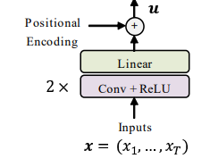
Position Encoding
# espnet2/asr/encoder/contextual_block_transformer_encoder #L287-290
if self.ctx_pos_enc:
addin = self.pos_enc(addin) #Figure 1
xs_pad = self.pos_enc(xs_pad) #Figure 2
addin
xs_pad
Positional
Encoding
+
Context
Embedding
Figure 1. context embedding add to positional embedding
Figure 2. Input add to positional embedding
Emiru Tsunoo et al., “Transformer ASR with Contextual Block Processing”, ASRU, 2019

Slide 11
Set up Chunks
CHUNK
42
(1)
BLOCK
(40)
(1)
Previous
Context Embedding
Current
Context Embedding
Chunks
# espnet2/asr/encoder/contextual_block_transformer.py #L300-302
xs_chunk = xs_pad.new_zeros(
bsize, block_num, self.block_size + 2, xs_pad.size(-1)
)
#bsize: batch(64)
#block_num: 5
#chunk_size: 42
#dimension: 256
Emiru Tsunoo et al., “Transformer ASR with Contextual Block Processing”, ASRU, 2019

Slide 12
Set up Chunks
fill the input in chunks
42
#espnet2/asr/encoder/contextual_block_transformer.py #L304-324
# fill the input
# first step
left_idx = 0
block_idx = 0
xs_chunk[:, block_idx, 1 : self.block_size + 1] = xs_pad.narrow(
-2, left_idx, self.block_size
)
left_idx += self.hop_size
block_idx += 1
# following steps
while left_idx + self.block_size < total_frame_num and block_idx < block_num:
xs_chunk[:, block_idx, 1 : self.block_size + 1] = xs_pad.narrow(
-2, left_idx, self.block_size
)
left_idx += self.hop_size
block_idx += 1
# last steps
last_size = total_frame_num - left_idx
xs_chunk[:, block_idx, 1 : last_size + 1] = xs_pad.narrow(
-2, left_idx, last_size
)
(1)
BLOCK
(40)
(1)
BLOCK(#1:40): 1-40
BLOCK(#2:40): 17-57
BLOCK(#3:40): 33-73
BLOCK(#4:40): 49-89
BLOCK(#5:38): 65-102
Emiru Tsunoo et al., “Transformer ASR with Contextual Block Processing”, ASRU, 2019

Slide 13
Set up Chunks
fill the initial context vector
42
#espnet2/asr/encoder/contextual_block_transformer.py #L326-329
# fill the initial context vector
xs_chunk[:, 0, 0] = addin[:, 0]
xs_chunk[:, 1:, 0] = addin[:, 0 : block_num - 1]
xs_chunk[:, :, self.block_size + 1] = addin
(1)
BLOCK
(40)
(1)
C#1
BLOCK(#1:40): 1-40
C#1
C#1
BLOCK(#2:40): 17-57
C#2
C#2
BLOCK(#3:40): 33-73
C#3
C#3
BLOCK(#4:40): 49-89
C#4
C#4
BLOCK(#5:38): 65-102
C#5
Emiru Tsunoo et al., “Transformer ASR with Contextual Block Processing”, ASRU, 2019

Slide 14


Set up masks
$$Key$$
42
#espnet2/asr/encoder/contextual_block_transformer.py #L292-298
# set up masks
mask_online = xs_pad.new_zeros(
xs_pad.size(0), block_num, self.block_size + 2, self.block_size + 2
)
mask_online.narrow(2, 1, self.block_size + 1).narrow(
3, 0, self.block_size + 1
).fill_(1)
prev
ctx
42
block
$$Query$$
current
ctx
prev
ctx
block
current
ctx
Emiru Tsunoo et al., “Transformer ASR with Contextual Block Processing”, ASRU, 2019

Slide 15
forward
#espnet2/asr/encoder/contextual_block_transformer_encoder.py
#L331-334
# forward
ys_chunk, mask_online, _, _, _, _, _ = self.encoders(
xs_chunk, mask_online, False, xs_chunk
)
Emiru Tsunoo et al., “Transformer ASR with Contextual Block Processing”, ASRU, 2019

Slide 16
Copy Output
8
#1
Encoder
16
#espnet2/asr/encoder/contextual_block_transformer_encoder.py #L336-355
# copy output
# first step
offset = self.block_size - self.look_ahead - self.hop_size + 1
left_idx = 0
block_idx = 0
cur_hop = self.block_size - self.look_ahead
ys_pad[:, left_idx:cur_hop] = ys_chunk[:, block_idx, 1 : cur_hop + 1]
left_idx += self.hop_size
block_idx += 1
# following steps
while left_idx + self.block_size < total_frame_num and block_idx < block_num:
ys_pad[:, cur_hop : cur_hop + self.hop_size] = ys_chunk[
:, block_idx, offset : offset + self.hop_size
]
cur_hop += self.hop_size
left_idx += self.hop_size
block_idx += 1
ys_pad[:, cur_hop:total_frame_num] = ys_chunk[
:, block_idx, offset : last_size + 1, :
]
#2
Encoder
16
COPY
#3
Encoder
16
#4
Encoder
16
#5
Encoder
16
14
Emiru Tsunoo et al., “Transformer ASR with Contextual Block Processing”, ASRU, 2019

Slide 17
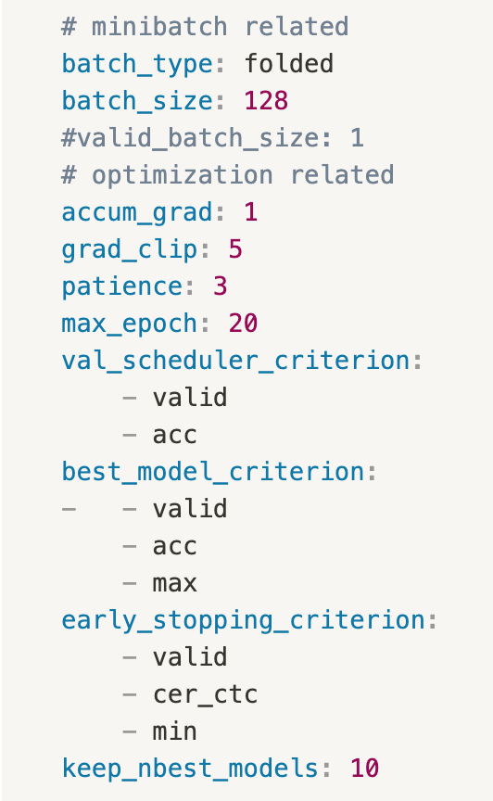
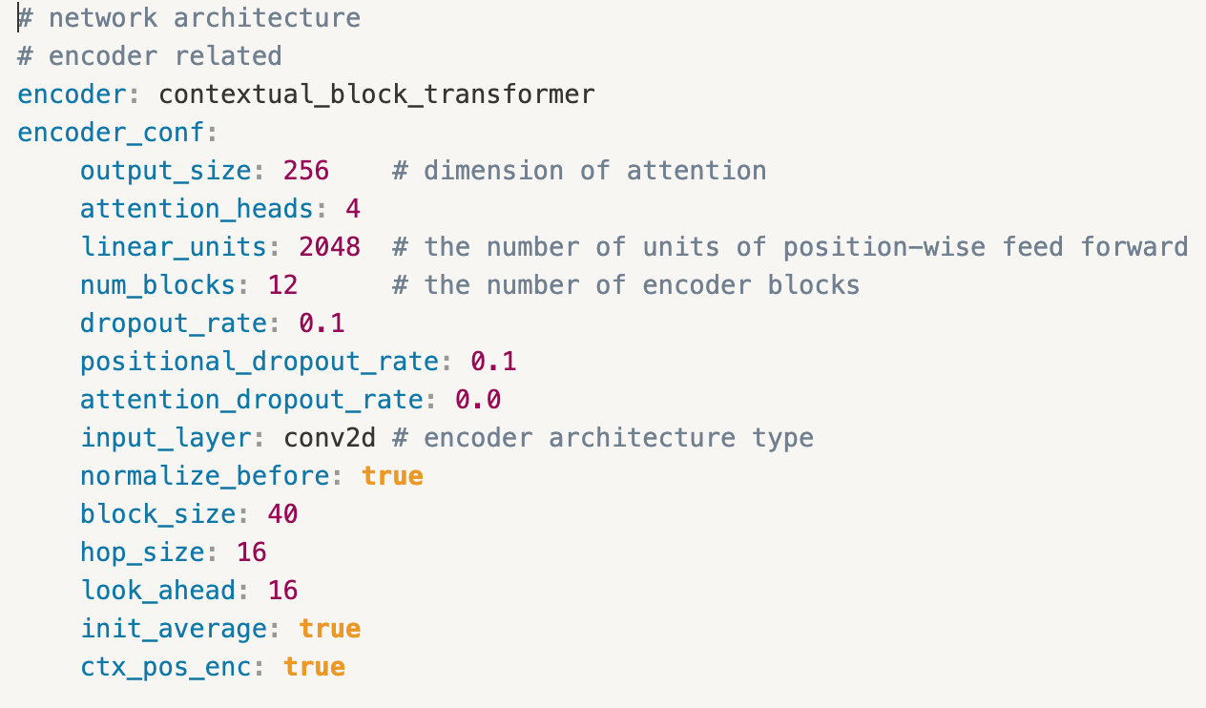
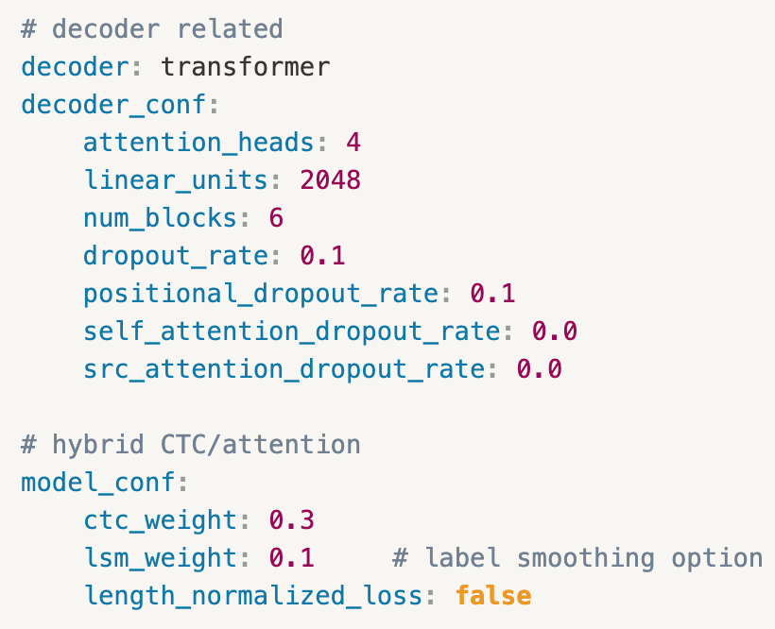
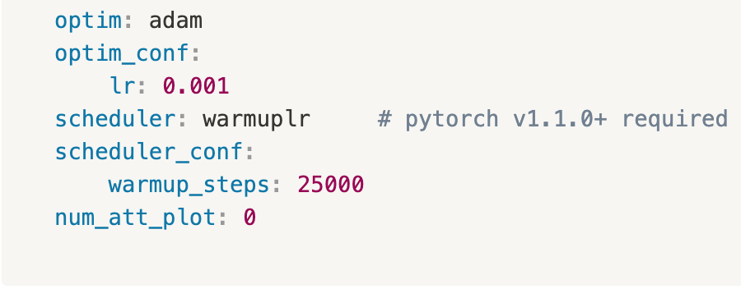
Appendix
train_asr_streaming_transformer.yaml

Slide 18
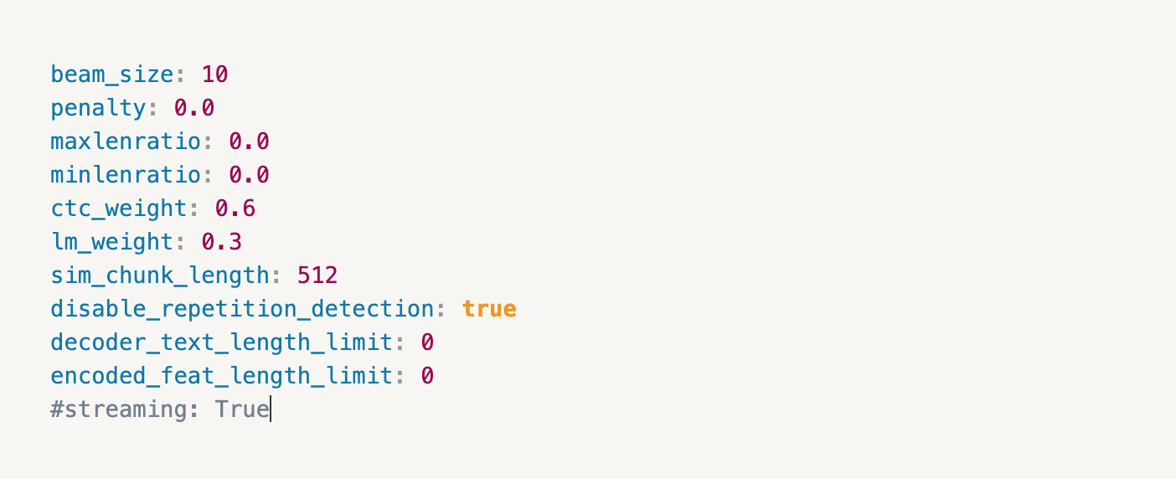
Appendix
decode_asr_streaming

