Slide 1
Spectral laplace representation
IMPLEMENTATION IN OPENGL
Software Engineering PROJECT
PRAMITA WINATA
Dragutin

Slide 2
AGENDA
INTRODUCTION
APPLICATION – OPENGL WIDGET APPLICATION
BASIC LAPLACE MESH REPRESENTATION
DEMO

Slide 3
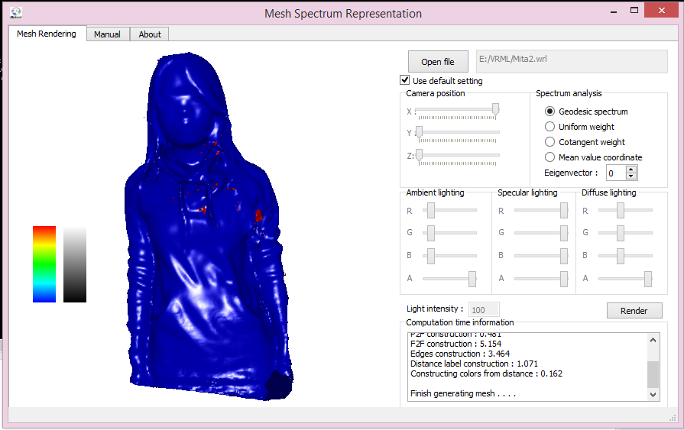
APPLICATION – Qt aPPLICATION
QT SDK 5.30, MinGW 32 bit
OPENGL
EIGEN Library

Slide 4
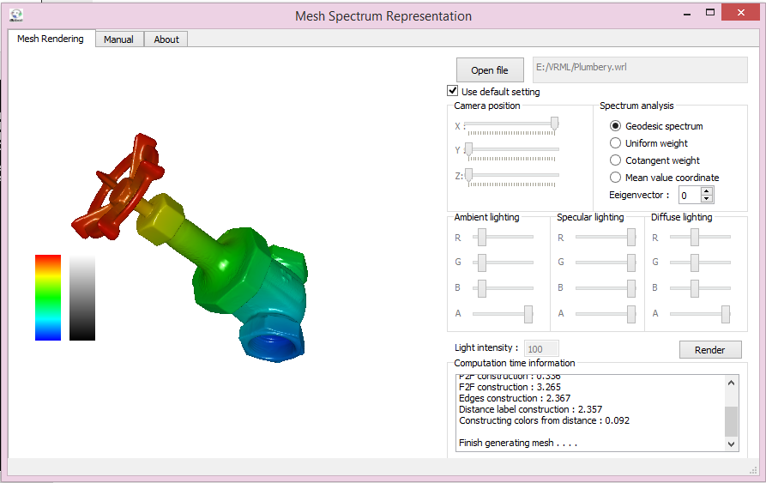
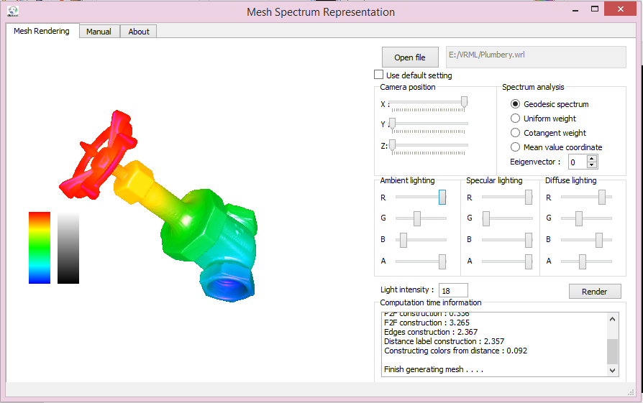
Default setting vs user configuration

Slide 5
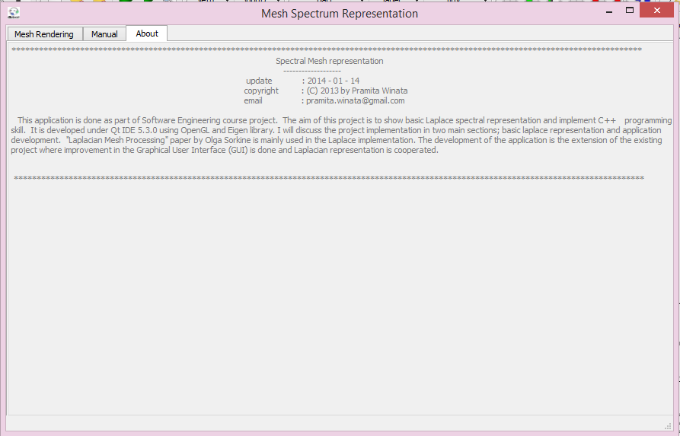
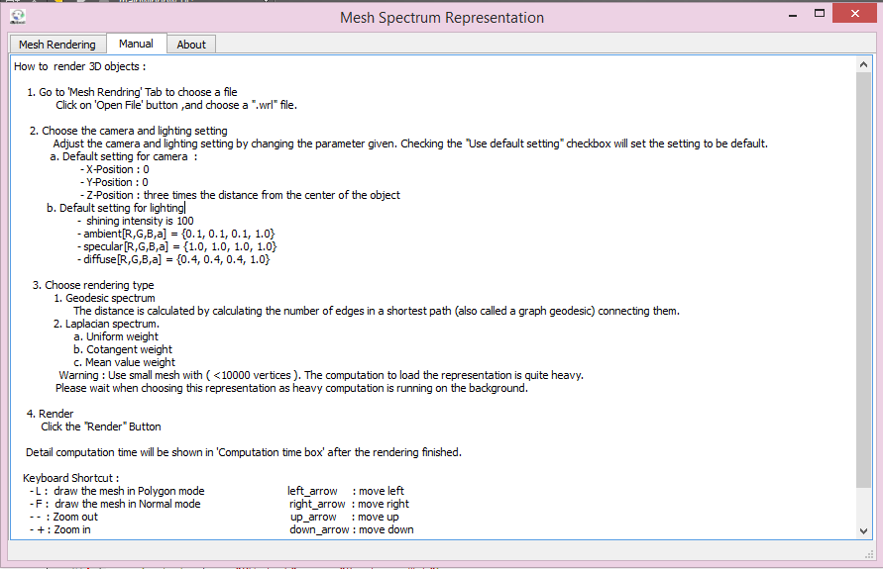

Slide 6
BASIC LAPLACE REPRESENTATION
In Laplacian framework, each vertex is represented with consideration to its neighbors. Laplacian meshes store the location of a vertex relative to its neighboring vertices, delta coordinate. This is useful when the information of object's shape are important for example when deforming the object itself. With Laplacian mesh representation, we can use manipulate one vertex, as known as 'anchor' based on, to have the overall objects deformed in a correct way.
Since a delta coordinate is a linear combination of a vertex and its neighbors, to obtain delta coordinates for all vertices can be represented as a matrix, called the Laplacian Matrix .
It is important to understand that each vertex will have weight correspond to each of its neighbor. In this project, I will implement three method to get the weight of the vertex. These method are uniform weight, cotangent weight, and mean-value-coordinate.

Slide 7
Uniform weight
Based on the size of its immediate neighbor.
The Laplacian Matrix is constructed as follows:
If i = j, the ij^{th} entry is equal to the size of its immediate neighbour
If i ≠ j then the ij^{th} entry is -1
0, otherwise

Slide 8
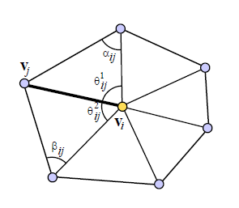
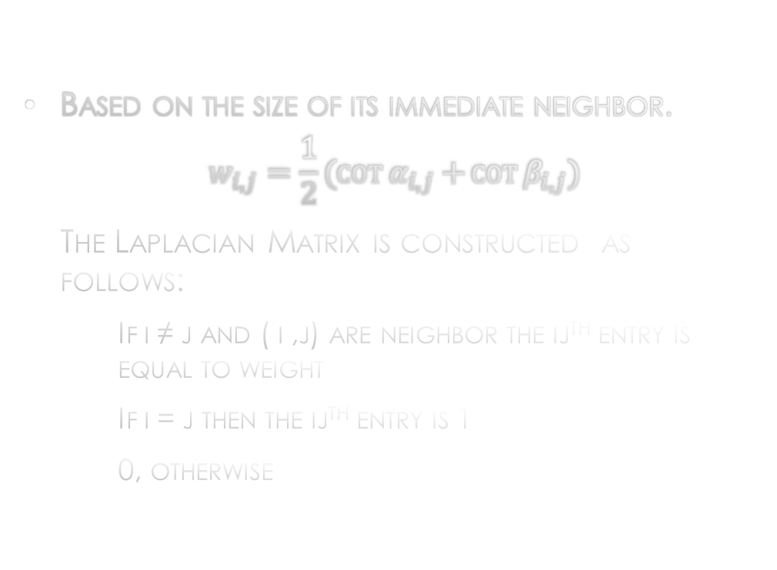
Cotangent weight
Based on the size of its immediate neighbor.
$$w_{i,j}=\frac{1}{2}(\cot{α_{i,j}+}\cot{β_{i,j}})$$
The Laplacian Matrix is constructed as follows:
If i ≠ j and ( i ,j) are neighbor the ij^{th} entry is equal to weight
If i = j then the ij^{th} entry is 1
0, otherwise
Cotangent weight illustration
Obtained from Olga Sorkine STAR report, EUROGRAPHICS 2005.

Slide 9

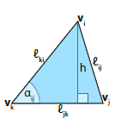



Getting the cotangent weight
MEYER M., DESBRUN M., SCHRÖDER P., BARR A. H.: Discrete differential-geometry operators for triangulated 2-manifolds. In \textit{“Visualization and Mathematics III}, Hege H.-C., Polthier K., (Eds.). Springer-Verlag, Heidelberg, 2003, pp. 35–57.

Slide 10
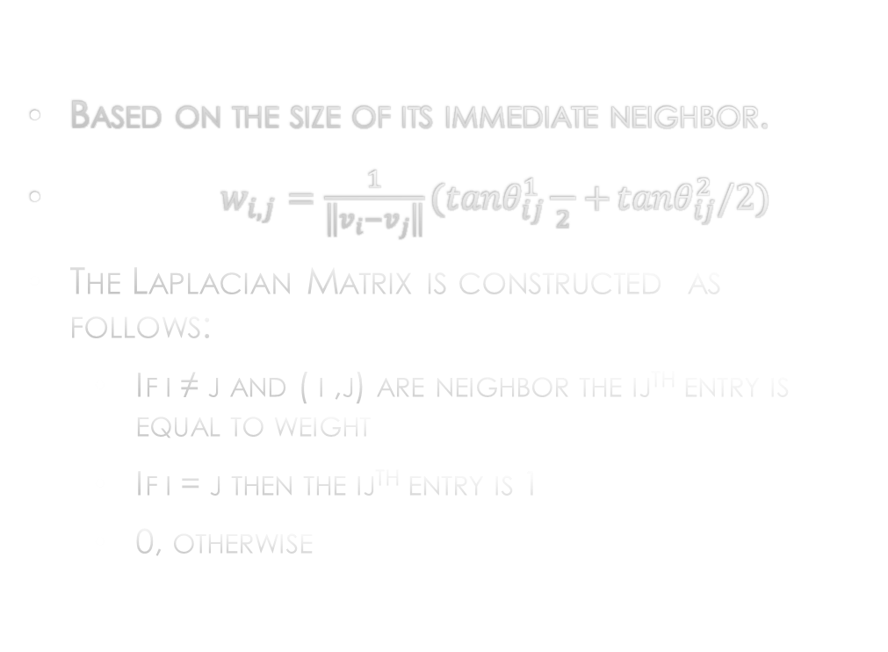
MEAN VALUE COORDINATE
Based on the size of its immediate neighbor.
$w_{i,j}=\frac{1}{\left\|v_{i}−v_{j}\right\|}({tanθ}_{ij}^{1}{\frac{}{2}+}{tanθ}_{ij}^{2}/2)$
The Laplacian Matrix is constructed as follows:
If i ≠ j and ( i ,j) are neighbor the ij^{th} entry is equal to weight
If i = j then the ij^{th} entry is 1
0, otherwise
Mean value coordinate illustration
Obtained from Olga Sorkine STAR report, EUROGRAPHICS 2005.

Slide 11
Eigen decomposition – color map
OPENGL – EIGEN SOLVER
Choose one eigenvector from the generated by the solver
BUILD A COLOR MAP – 6 areas of colors
result

Slide 12
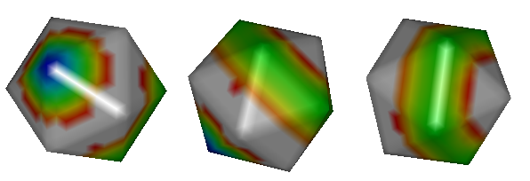
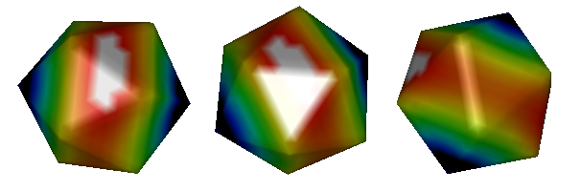
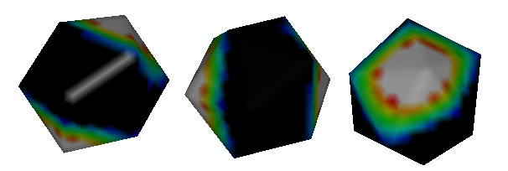
result
Uniform weight
Cotangent weight
Mean value coordinate

Slide 13
demo

Slide 14
REFERENCES
[1] Olga Sorkine, Laplacian Mesh Processing. STAR report, Eurographics, 2005.
[2] Mesh Processing, G. Peyr, https://www.ceremade.dauphine.fr/ peyre/teaching/manifold-sci/
[3] Eigen library, http://eigen.tuxfamily.org/index.php?title=Main Page
[4] The C++ Standard library, see http://www.yolinux.
[5] MEYER M., DESBRUN M., SCHRDER P., BARR A. H.: Discrete dierential-geometry operators for triangulated 2-manifolds. In Visualization and Mathematics III, Hege H.-C., Polthier K., (Eds.). Springer-Verlag, Heidelberg, 2003, pp. 3557.
[6] HERON. 60. Metrica. Alexandria, Roman Egypt.
[7] FIEDLER M.: Algebraic connectivity of graphs. Czech. Math. Journal 23 (1973), 298305.
[8] LOATER M. S.: Mean value coordinates. CAGD 20, 1 (2003), 1927.

