Slide 1

CodeU Class 11 & 12 Welcome!
The class will start shortly
Reproduction and distribution of the presentation deck is prohibited

Slide 2
Agenda for today’s class
Recap of last class
01
02
Material revision
We’ll revise the previous material!
To refresh our minds!
Topic of the day:
03
04
Practice time!
We will code the project!
Final CodeU Project: TURTLE RACE
Wrap-up
Conclusion
05
06
CodeU Robot
Summary of what we’ve learned today
Homework and questions

Slide 3
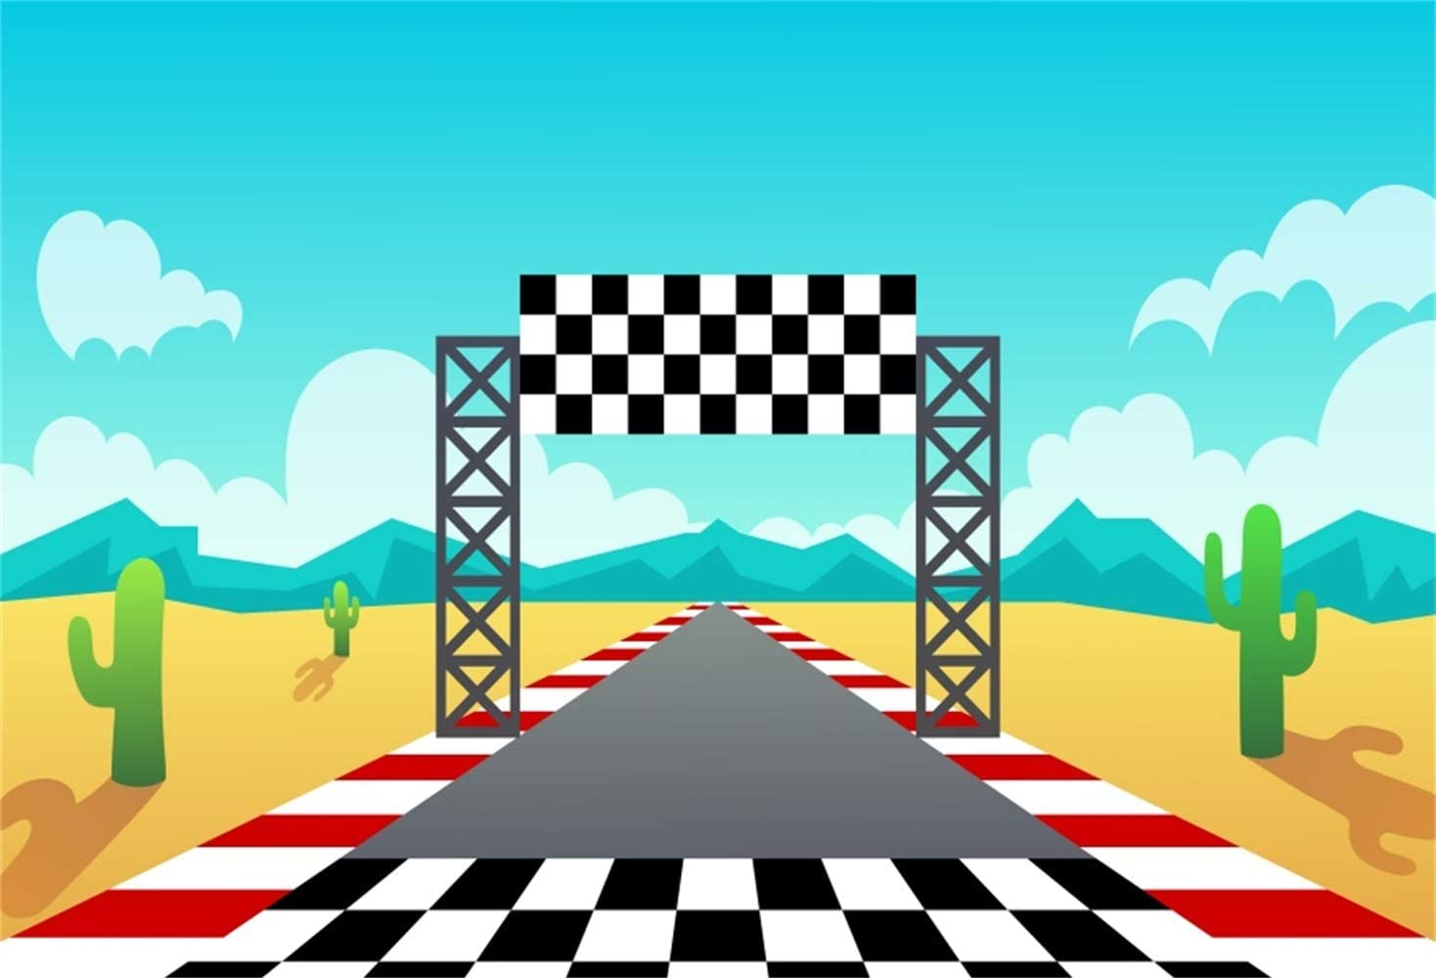
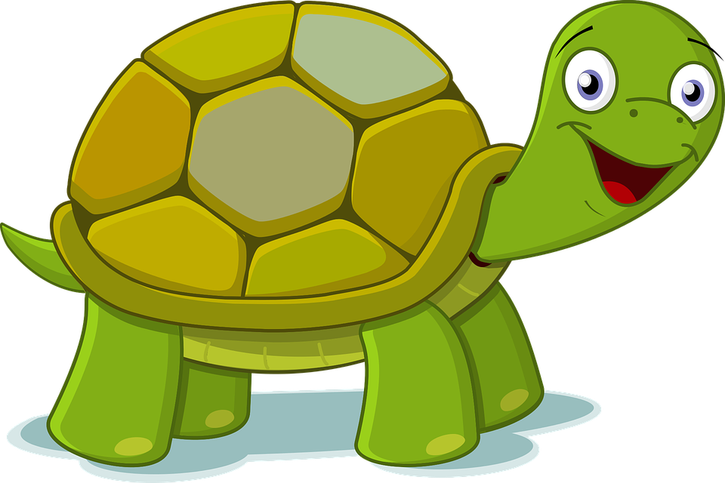
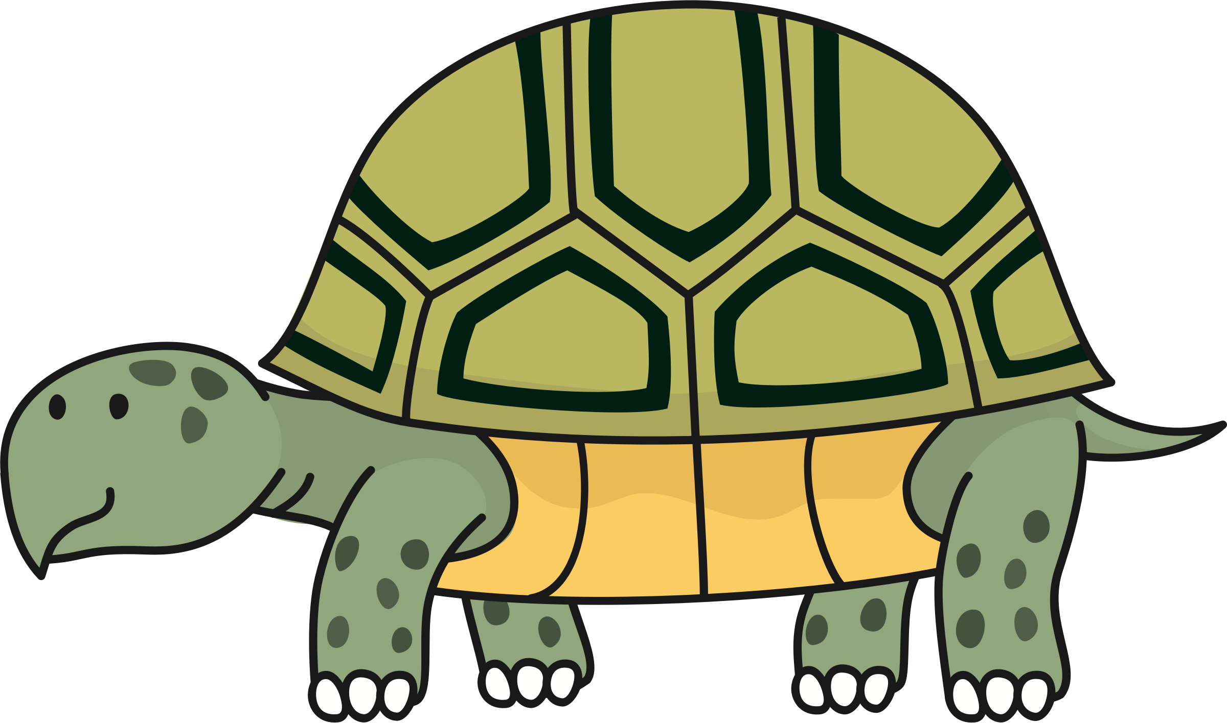
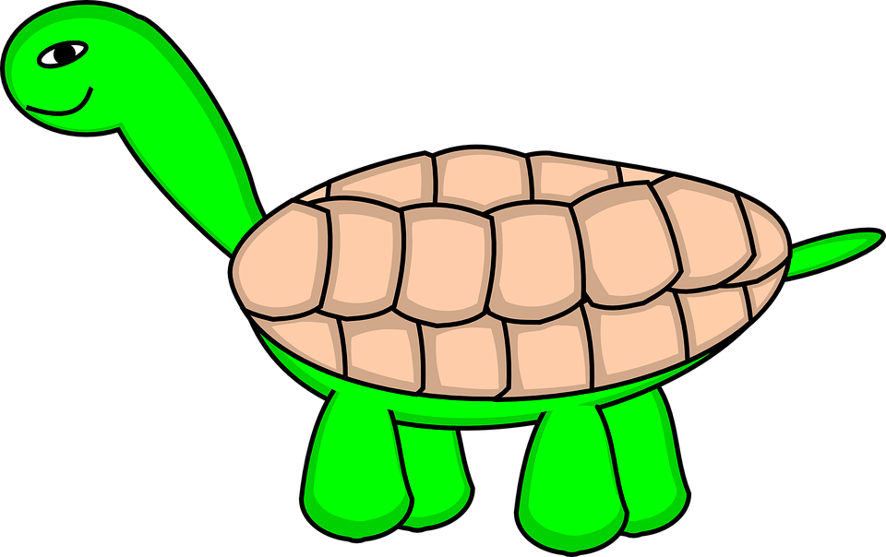

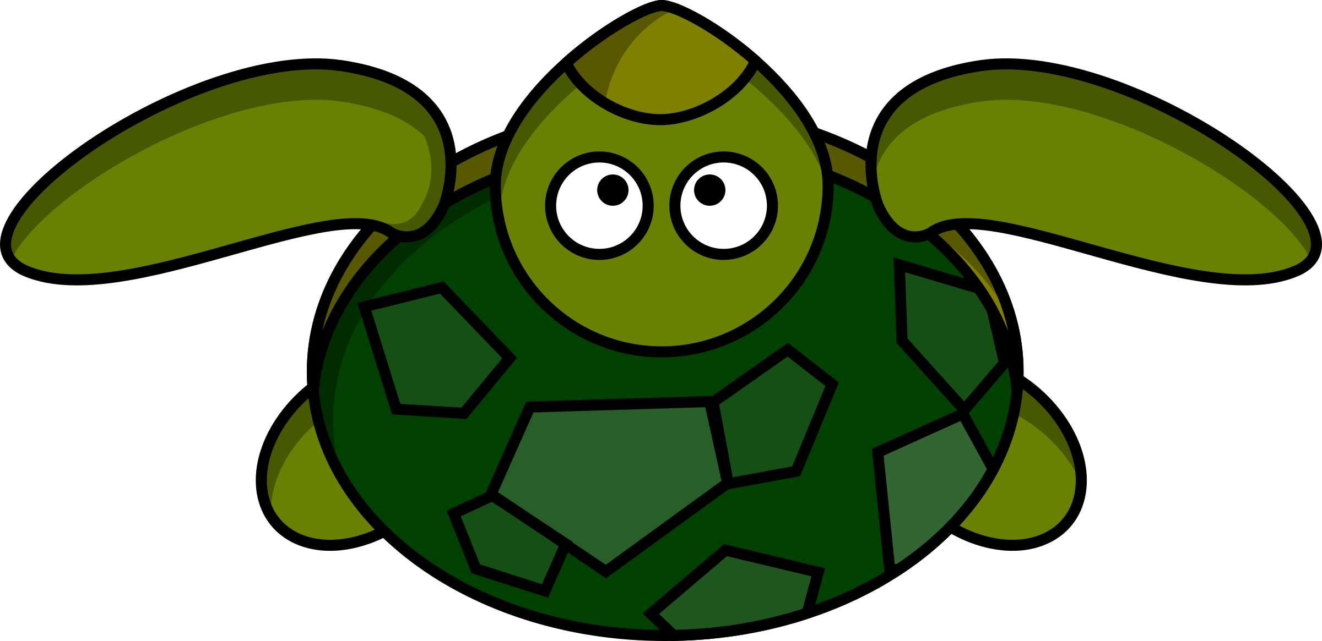
CODEU
TURTLE RACE

Slide 4

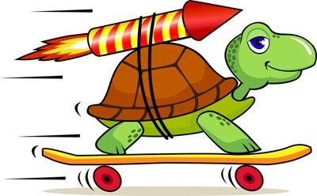

Project Description
Goal
The goal of the project is to create a race between a set of turtles using the Turtle and Random Module! Each turtle will have the same starting point and must race to the finish line. The first one to arrive wins!
Requirements
The project must contain:
A minimum of 4 different turtles
A drawn finish line
Each turtle must move from 1 to 5 pixels. This is chosen randomly.
A reaction once a turtle wins(Ex.: The green turtle has won!)

Slide 5
Step 1 – Mapping out
1
2
3
Layout
Turtles
Functionalities
This is where we will design everything we need for this project!
Elements
Designing our background
Designing our finish line
This is where we will build our turtles(pens) for the race!
Elements
Turtle #1: Blue
Turtle #2: Green
Turtle #3: Purple
Turtle #4: Black
This is where we build the code that allows for the turtles to move and to determine that the finish line has been reached.
Elements
Turtle movement
Conditionals for when the finish line is reached.

Slide 6
Step 2 – Build the Layout!
Modules
Import the Turtle, Random and Time modules
Background
1. Determine the background color using turtle.bgcolor()
2. Determine the text color for the title using turtle.color()
3. Set a turtle speed of 0 using turtle.speed(0)
4. Set the position for your title using turtle.setpos(). Don’t forget to penup()!
5. Write the title “CODEU TURTLE RACE” using turtle.write(text, font = (name, size, weight))

Slide 7
Step 2 – Build the Layout!
Finish line (checkered)
We will split the Finish line in 2 separate vertical lines where we will add squares to make it checkered!
1. Determine the color using turtle.color()
2. Determine the shape using turtle.shape()
3. Set the shape size using turtle.shapesize() at 0.75
4. Raise the pen off the canvas using turtle.penup()
5. Define a variable squareSize for the size of a square in the checkered finish line.
6. Set the 1st vertical line of squares using a FOR loop that will repeat 9 times. Inside the loop, set the turtle position at (250, 150 – (i*squareSize*2)). Then, draw a square using turtle.stamp().
7. Set the 2nd vertical line of squares using a FOR loop that will repeat 9 times. Inside the loop, set the turtle position at (250+squareSize, (150 – squareSize) – (i*squareSize*2)). Then, draw a square using turtle.stamp().

Slide 8
Step 3 – Build the Turtles!
Build our Turtles
1. Define a variable for a new pen using turtle.Turtle() that will represent a turtle in the race!
2. Set the pen’s speed to 0 using .speed()
3. Set a color to your pen using .color(). Make sure to assign a different color for each turtle!
4. Set the shape to “turtle” using .shape()
5. Set the starting position for your turtle at (-250, 100) using setpos(). Substract 50 to the y coordinate for each next turtle you create. Don’t forget penup() when setting your position!
6. Repeat steps 1-5 for each new turtle!

Slide 9
Step 4 – Build the Functionalities!
Time delay
1. Set a slight delay before the turtles start moving using time.sleep(1)
Functionalities
1. Create a WHILE loop that will keep looping until a turtle has reached the finish line. The loop will be manually be ended using break.
2. Set the 1st turtle’s movement forward using .forward(). The distance will be determined randomly between 1 and 5 pixels using random.randint(1,5). Repeat for all turtles.
3. Set the conditionals where if a turtle reaches the x coordinate of 240 using .pos(), the winner is declared and the loop breaks. (Ex.: if t1.pos() >= (240,100): ).
4. Inside the conditional, to declare the winner, you will use turtle.write(string, font=(name, size, weight)). You must set the position beforehand using setpos() of the place where this will be written!
5. You must then break the loop using break.

Slide 10
Step 5 – Start the Race!
Run the code and find out who the winner is!
Feel free to customize the layout as much as you would like ☺
You can ask your family and friends to try out your new project for themselves!

Slide 11
Congratulations Misha!
Congratulations on completing 3 awesome months with CodeU! We hope you had a great time ☺

