Slide 1

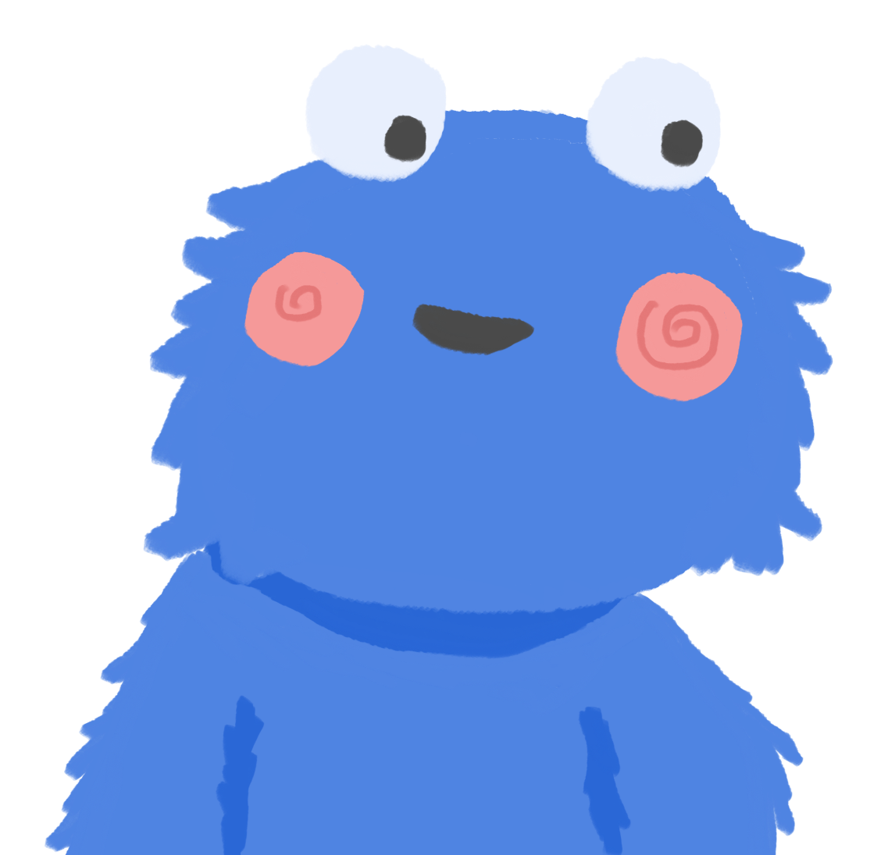
a challenge.

Slide 2
Coding Session
You’ll be creating a clicker game called ‘Cookie Party.’ Get ready to use everything you learned in previous lessons as well as events!

Slide 3

Getting Started
Clone stemleague/cookie_party from Repl.it
Open the index.html and cookie-party.js file

Slide 4
What you’ll need to know
JavaScript Functions
DOM manipulation
Events
Accessing Objects
You will only be manipulating the JavaScript code except for the first step

Slide 5
What are objects?
Objects are a way to store data in a more categorized and ordered way that uses key and values

Slide 6
Object Example
For example, if I wanted to store pet information, I could store it in two ways:
A.) I could have multiple variables each designated to store different values
(i.e. name, age, type)
B.) Store in an object that groups the information together
let pet = { name: 'milky’, type: 'cat’, color: 'grey’, age: 2 } | let name = 'Milky'; let type = 'cat'; let color = 'grey'; let age = 2;
As you can see it is way more efficient to store the data in an object if the information are all related in some way
Name, type, color, and age are the keys of the object (on the left side before the colon)
milky, cat, grey, and 2 are all values (right side after the colon)

Slide 7
More About Objects
How to access a value in an object
There are two ways: dot notation or bracket notation
Note: both will output ‘milky’
let pet = { name: 'milky’, type: 'cat’, color: 'grey’, age: 2 } | // Dot notation pet.name // Bracket notation pet['name']
How get the all the keys or values in an object
Note the results are in an Array
Object.keys(pet) // returns: ['name', 'type', 'color', 'age'] | Object.values(pet) // returns: ['milky', 'cat', 'grey', 2]

Slide 8
Still Confused?
Check out these links:
https://www.w3schools.com/js/js_objects.asp
https://developer.mozilla.org/en-US/docs/Web/JavaScript/Reference/Global_objects/Object/values
https://developer.mozilla.org/en-US/docs/Web/JavaScript/Reference/Global_objects/Object/keys
https://developer.mozilla.org/en-US/docs/Web/JavaScript/Guide/Working_with_Objects

Slide 9
Step 1: Link JavaScript to HTML
Code and place the <script> tag applying the cookie-party.js file to the index.html file
Make sure to place the <script> tag at the bottom of the <body> tag
This ensures the JavaScript will only be run when the html has been fully loaded
Helpful links:
https://www.w3schools.com/tags/tag_script.asp

Slide 10
Step 2.1: Generate the Dropdown Cookie Options
Create a function called generateCookieOptions that does the following:
Grab the keys of the cookies object variable using the Object.keys() method
For each key create an <option> tag with the key as the text and value of option
Append each <option> tag to the <select> tag
Helpful links:
https://developer.mozilla.org/en-US/docs/Web/JavaScript/Reference/Global_Objects/Object/keys
https://developer.mozilla.org/en-US/docs/Web/JavaScript/Reference/Global_Objects/Array/forEach
https://www.w3schools.com/jsref/dom_obj_option.asp
const cookies ={
burnt: -20,
broccoli: -10,
mnm: 10,
chocolate: 20,
snickerdoodle: 5,
fudge: 2
}

Slide 11
Step 2.2: OnChange Dropdown
Add an ‘change’ event listener to the dropdown assigning the selectedCookie variable the value of the dropdown
Helpful links:
https://developer.mozilla.org/en-US/docs/Web/JavaScript/Reference/Global_Objects/Object/keys
https://developer.mozilla.org/en-US/docs/Web/JavaScript/Reference/Global_Objects/Array/forEach
https://www.w3schools.com/jsref/event_onchange.asp

Slide 12


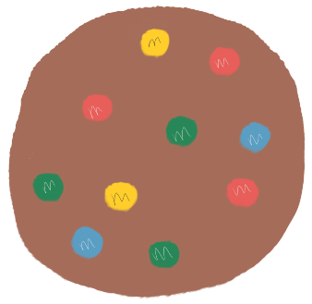
Step 3.1: Generate a Cookie
Create a function called generateCookie that does the following:
Create an <img> element
Adds the ‘cookie’ class to the element
Adjust the element based on the type of cookie selected in the dropdown menu
Use the selectedCookie variable to:
assign the src of img element
Add a unique class to the img element
Append cookie <img> element to the #cookie-container
Helpful links:
https://developer.mozilla.org/en-US/docs/Web/API/Element/classList
https://developer.mozilla.org/en-US/docs/Web/API/ParentNode/append
https://www.w3schools.com/jsref/dom_obj_image.asp

Slide 13
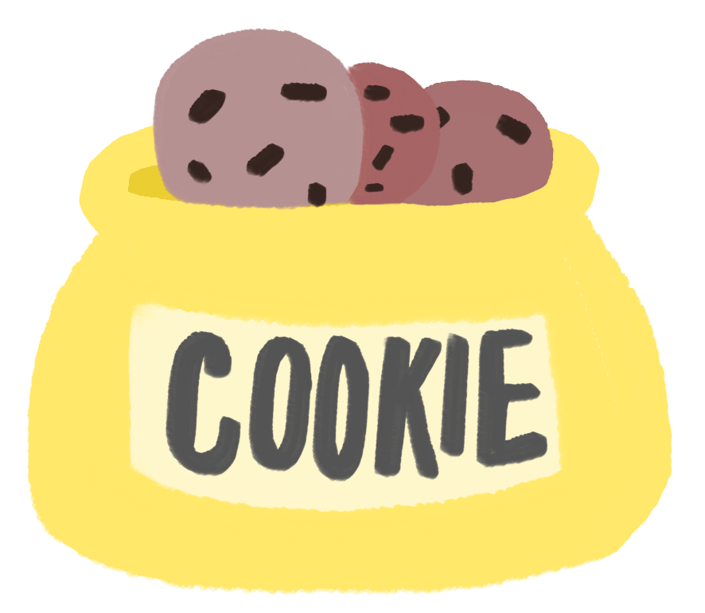
Step 3.2: Generate a Cookie
Add an on ‘click’ event listener to the cookie jar <img> element that calls on the generateCookie function you made in the last step
Whenever you click on the cookie jar img it should generate a cookie
Helpful links:
https://www.w3schools.com/jsref/event_onclick.asp

Slide 14
Step 4.1: Cookie Eaten Event
Create a function called monsterEat that does the following:
Takes in an event parameter
The event.target is equal to selected cookie to eat. Removes the selected cookie from the ‘#cookie-container’
Adjust the full progress bar by
calling the calculateHunger(cookie) function passing in the cookie that was selected (event.target)
Assigning the returned value of the calculateHunger function to the width of the progress bar
Helpful links:
https://www.w3schools.com/jsref/prop_style_width.asp
https://developer.mozilla.org/en-US/docs/Web/API/Event/target
https://developer.mozilla.org/en-US/docs/Web/API/Node/removeChild

Slide 15
Step 4.2: Cookie Eaten Event
Add the monsterEat function you just made as the function that is run whenever the user clicks on a cookie
(hint: add it to the generateCookie function)
Whenever you click on a cookie it should now disappear and the full progress bar should go up
Helpful links:
https://www.w3schools.com/jsref/event_onclick.asp

Slide 16
Step 5: Refactor code
To ensure the code is run only when the html and its elements has been loaded. Create a window event listener where the following code will only run in the given order when the window has loaded:
Call GenerateDropdown function
Dropdown on change event listener code
Cookie jar on click event listener code
Helpful links:
https://developer.mozilla.org/en-US/docs/Web/API/Window/load_event

Slide 17

Challenge
So you want a challenge, huh?
When the full progress bar for Cookie Monster becomes full, make a pop up that says he’s successfully full. When the user clicks on the pop-up it should disappear.

Slide 18
YOU DID IT!
That was hard, but you got through it! Now you have a cool game to show off to your friends and family! ☺

