Slide 1
DSL Design
A conceptual framework
for building good DSLs
Markus Voelter
independent/itemis
voelter@acm.org
http://www.voelter.de
@markusvoelter

Slide 2
Introduction

Slide 3
A DSL is a focussed, processable language for describing a specific concern when building a system in a specific domain. The abstractions and notations used are natural/suitable for the stakeholders who specify that particular concern.

Slide 4
Concepts (abstract syntax) (concrete) Syntax semantics (generators) Tools and IDE

Slide 5
 | more in GPLs | more in DSL
Domain Size | large and complex | smaller and well-defined
Designed by | guru or committee | a few engineers and domain experts
Language Size | large | small
Turing-completeness | almost always | often not
User Community | large, anonymous and widespread | small, accessible and local
In-language abstraction | sophisticated | limited
Lifespan | years to decades | months to years (driven by context)
Evolution | slow, often standardized | fast-paced
Incompatible Changes | almost impossible | feasible

Slide 6
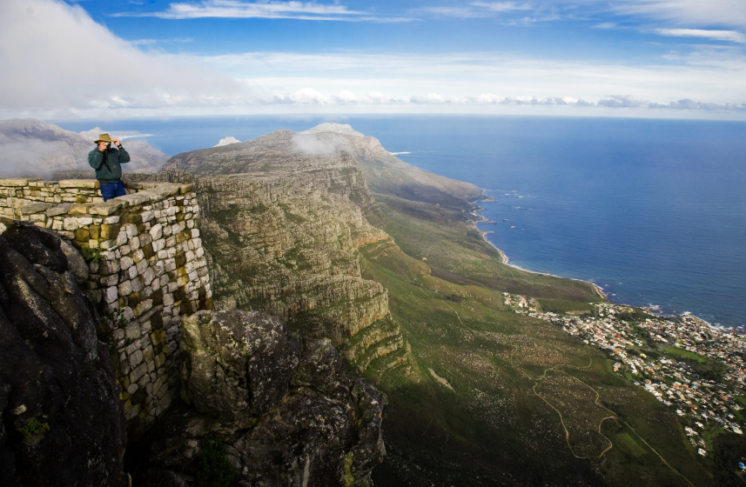
General Purpose
C
Components
Domain Specific
State Machines
Sensor Access
LEGO Robot Control

Slide 7
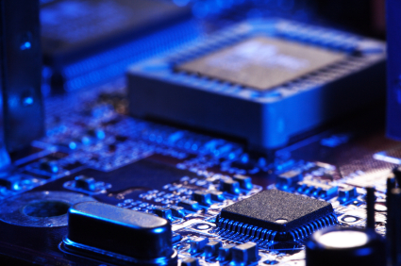
Big Language
L
c
d
e
b
f
g
h
i
j
k
m
n
o
a
with many first class concepts!

Slide 8
Small Language
L
α
β
λ
ω
δ
with a few, orthogonal
and poweful concepts

Slide 9
Modular Language
my L
α
β
a
b
c
d
e
f
g
h
i
j
k
l
with many optional,
composable concepts

Slide 10
Case Studies

Slide 11
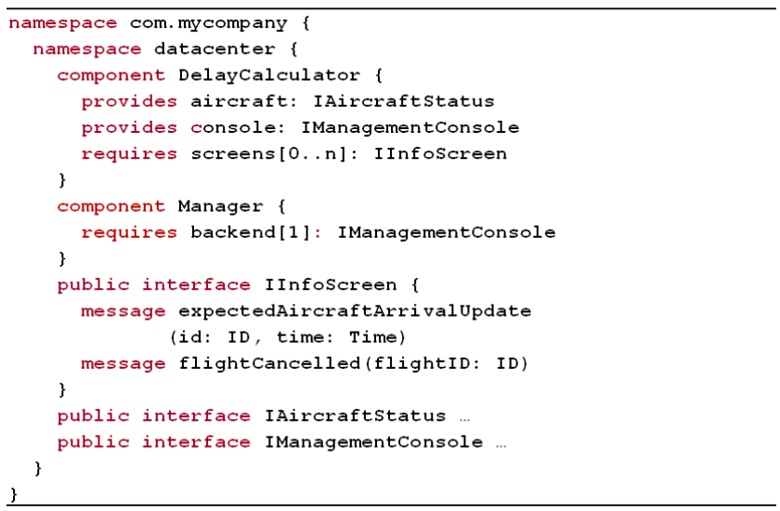
Components

Slide 12
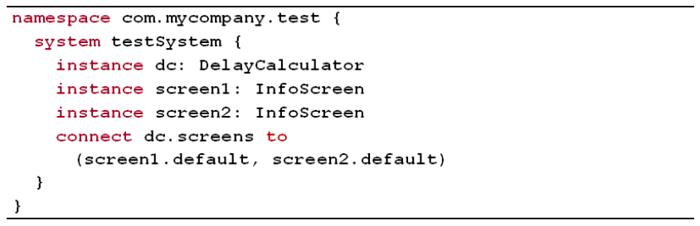
Components

Slide 13
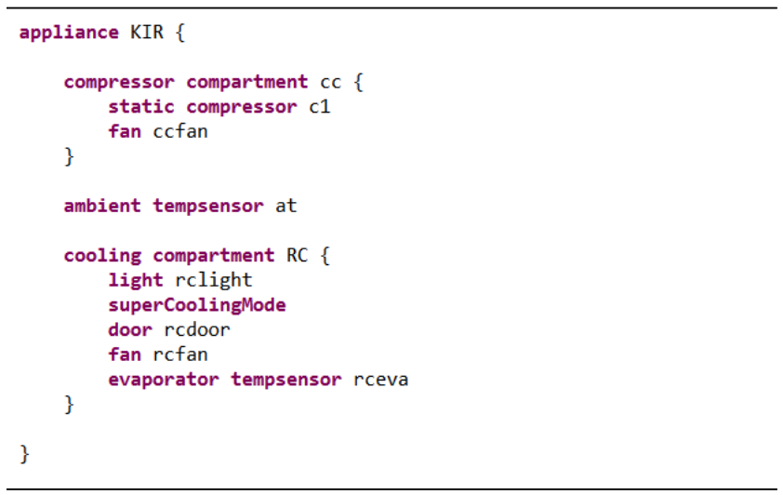
Refrigerators

Slide 14
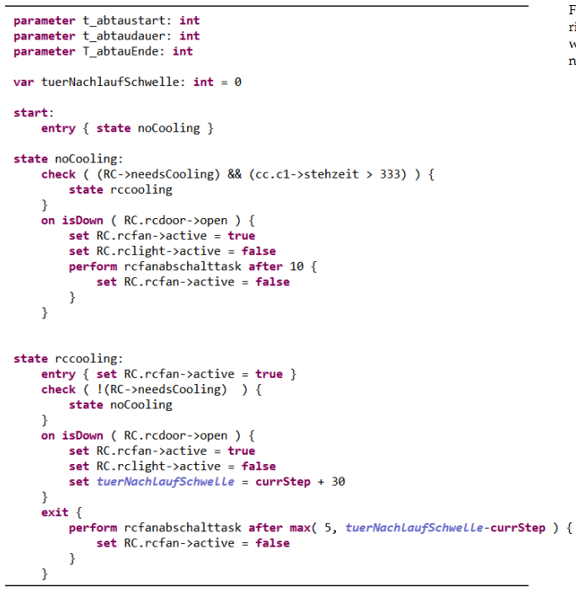
Refrigerators

Slide 15
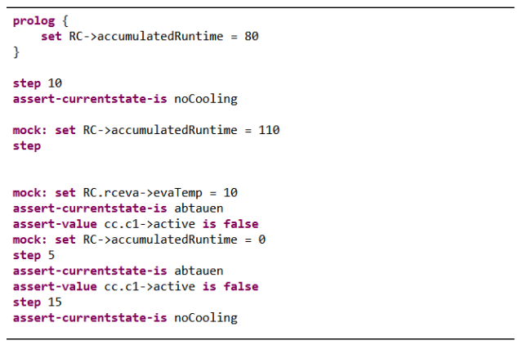
Refrigerators

Slide 16
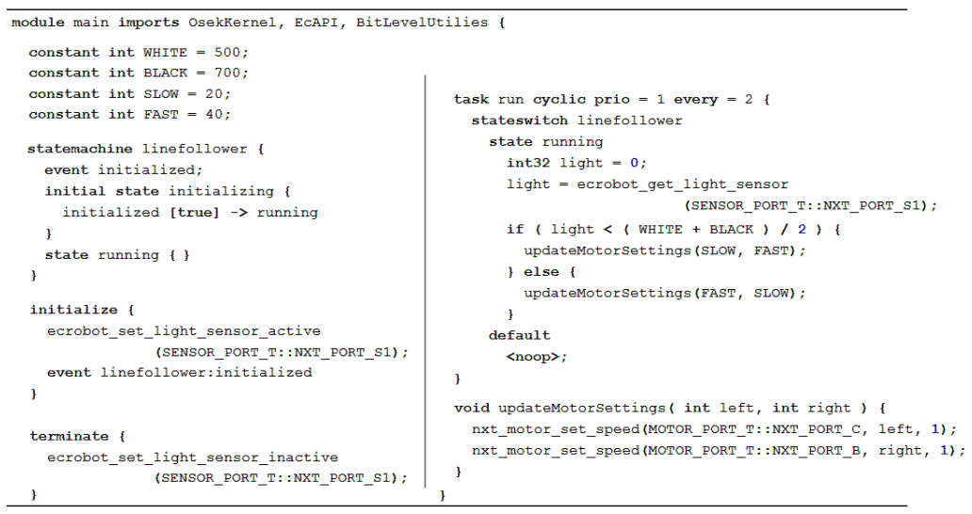
Extended C

Slide 17
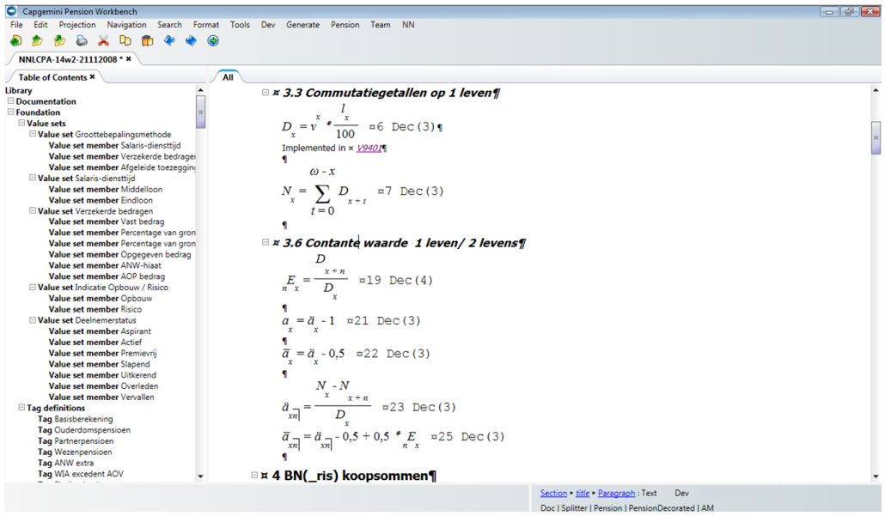
Pension Plans

Slide 18
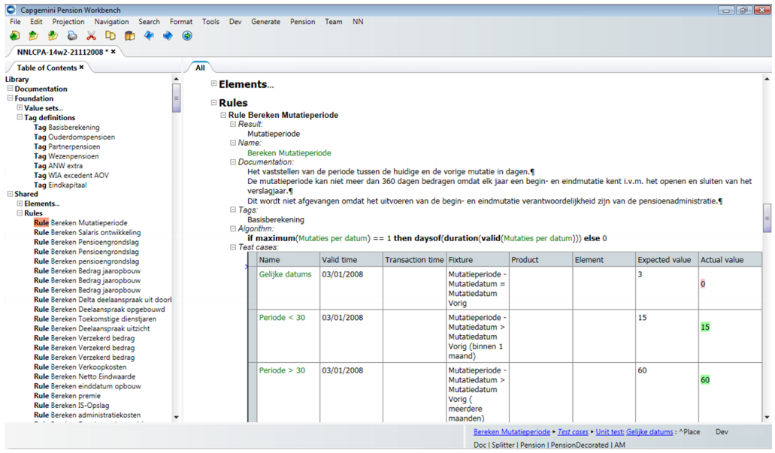
Pension Plans

Slide 19
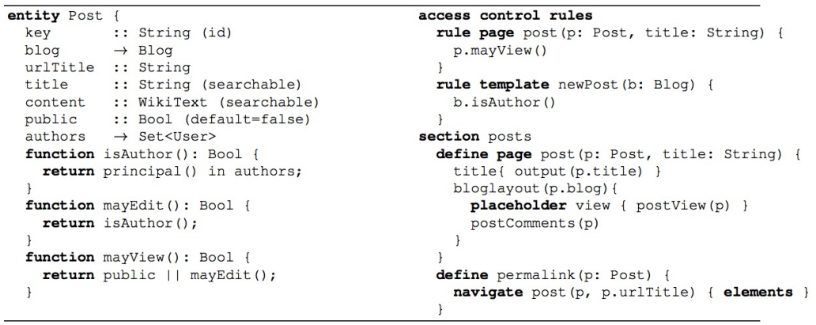
WebDSL

Slide 20
Terms & Concepts

Slide 21
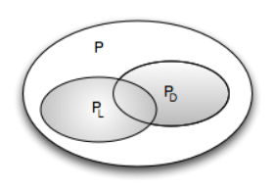
Programs Languages Domains

Slide 22
Domain
body of knowledge
in the real world
deductive
top down
inductive
bottom up
existing software (family)

Slide 23
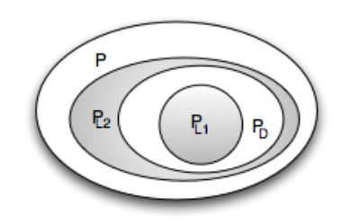
A DSL L_{D} for D is a language that is specialized to en-coding P_{D} programs.
more efficient
smaller

Slide 24
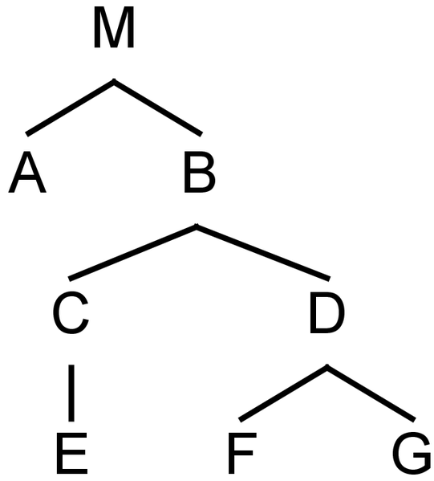
Programs are trees
element

Slide 25
Fragments are subtrees w/ root
fragment root
f
fragment

Slide 26



Parent-Child Relation
f

Slide 27

Programs and Fragments
f

Slide 28
Programs are graphs, really.
reference

Slide 29



Programs are graphs, really.

Slide 30
Languages are sets of concepts
C₂
C₁
C_{n}
C₃
L

Slide 31

Languages are sets of concepts
C₂
C₁
C_{n}
C₃
L

Slide 32

Programs and languages
C₂
C₁
C_{n}
C₃

Slide 33




Language: concept inheritance
C₂
C₁
L₁
C₃
L₂
C₁

Slide 34
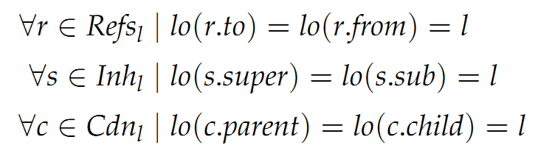
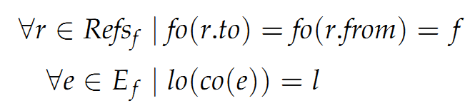
Independence
Language
does not depend on any other language
Fragment
does not depend on any other fragment

Slide 35
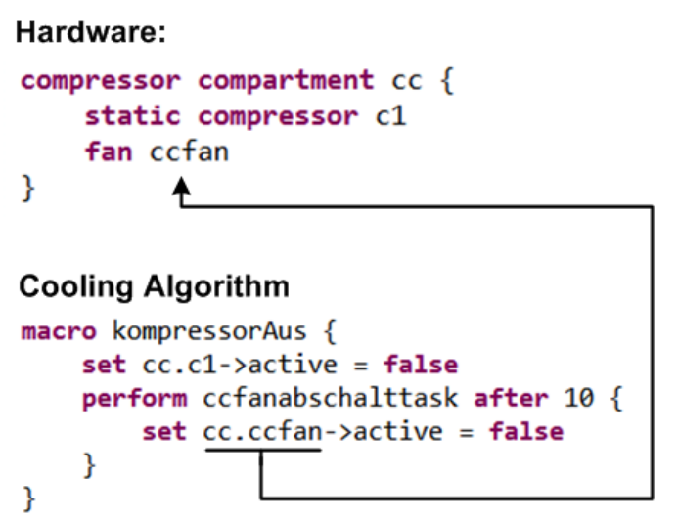
Independence

Slide 36

Homogeneous
Fragment
everything expressed with one language

Slide 37
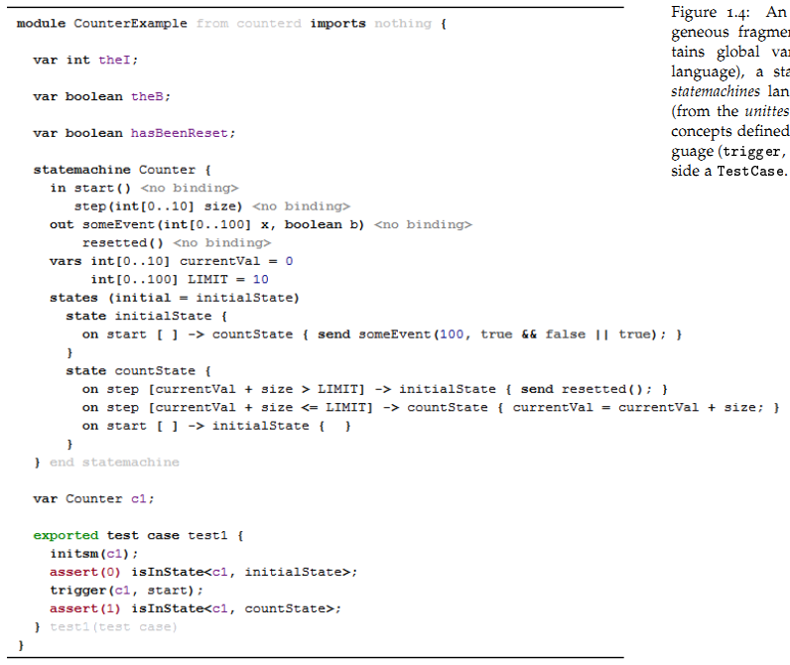
Heterogeneous

Slide 38
Heterogeneous
C
Statemachines
Testing

Slide 39
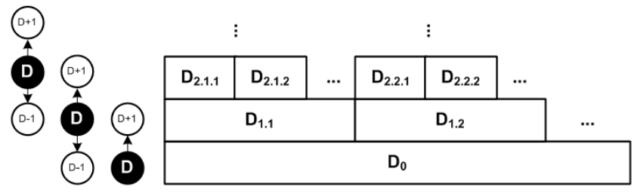
Domain Hierarchy

Slide 40
Domain Hierarchy
avionics
automotive
embedded
software
all programs

