Slide 1
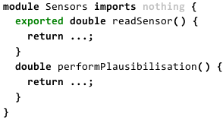
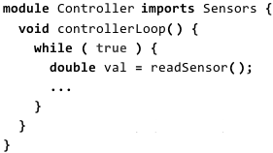
#ifndef SENSOR_H
#define SENSOR_H
double Sensor_readSensor();
#endif
#include "Sensor.h"
double Sensor_readSensor() { … }
double Sensor_performPlausibilisation()
{ … }
Sensor.h
Sensor.c
#ifndef CONTROLLER_H
#define CONTROLLER_H
#endif
#include "Controller.h"
#include "Sensor.h"
void Controller_controllerLoop() {
while (1) {
double val = Sensor_readSensor();
…
} }
Controller.h
Controller.c

Slide 2
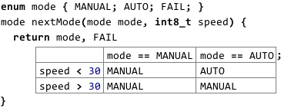
typedef enum __MODE {MANUAL, AUTO, FAIL } _MODE;
_MODE nextMode( _MODE mode, int8_t speed ) {
if (current == MANUAL) {
if (speed <= 30) {return MANUAL;}
if (speed >= 30 && speed < 50) {return MANUAL;}
}
if (current == AUTO) { ... }
return FAIL;
}

Slide 3
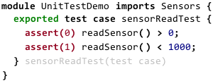
#include "Sensor.h"
int8_t UnitTestDemo_test_sensorReadTest() {
int8_t __failures = 0;
printf("running test @UnitTestDemo:test_sensorReadTest:0\n");
if ( !(Sensor_readSensor() > 0) ) {
__failures++;
printf("FAILED: @UnitTestDemo:test_sensorReadTest:1\n");
printf(" testID = %d\n",0);
}
if ( !(Sensor_readSensor() < 1000) ) { … }
return __failures;
}

Slide 4
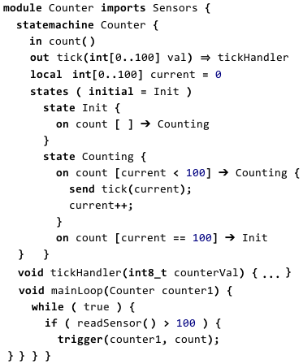
#include "Counter.h"
#include "Sensor.h"
void Counter_sm_execute_Counter(struct Counter_sm_data_Counter* instance,
Counter_sm_events_Counter event, void** arguments) {
switch (instance->__curState) {
case Counter__state_Init: { … }
case Counter__state_Counting: {
switch (event) {
case Counter__event_count: {
if ( instance->current < 100 ) {
Counter_tickHandler(instance->current);
instance->__curState = Counter__state_Counting;
instance->current++;
return ;
}
if ( instance->current == 100 ) { … }
}
void Counter_tickHandler(int8_t counterVal) { … }
void Counter_mainLoop(struct Counter_sm_data_Counter counter1) {
while (1) {
if ( Sensor_readSensor() > 100 ) {
void* ___args[] = {};
Counter_sm_execute_Counter(&counter1, Counter__event_count, &___args);
} } }
typedef enum _sm_events_Counter{
Counter__event_count
} Counter_sm_events_Counter;
typedef enum _sm_states_Counter{
Counter__state_Init,
Counter__state_Counting
} Counter_sm_states_Counter;
struct _sm_data_Counter {
Counter_sm_states_Counter __curState;
int8_t current;
};
Counter.h
Counter.c

Slide 5
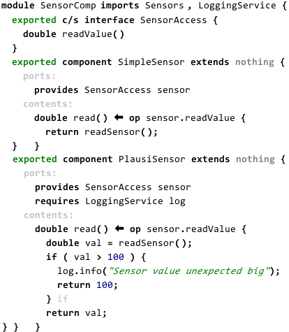
struct Sensors_compdata_SimpleSensor {};
double Sensors_SimpleSensor_read(void* inst_data);
struct Sensors_data_PlausiSensor {
void* port_log;
void (*op_log_info)(char*, void*);
}
double Sensors_PlausiSensor_read(void* inst_data);
Sensors.h
#include "Sensors.h"
#include "Sensor.h"
#include "LoggingService.h"
double Sensors_SimpleSensor_read(void* inst_data) {
return Sensor_readSensor();
}
double Sensors_PlausiSensor_read(void* inst_data) {
double val = Sensor_readSensor();
if (val > 100) {
(*((struct Sensors_data_PlausiSensor*)inst_data)->op_log_info)
("Sensor value unexpected big",
((struct Sensors_data_PlausiSensor*)inst_data)->port_log);
return 100;
}
return val;
}
Sensors.c

