Slide 1
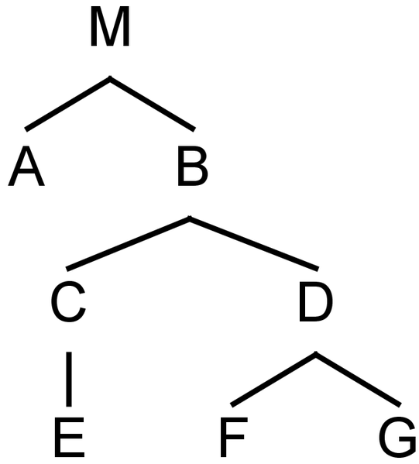
Programs are trees
root
element

Slide 2
Fragments are subtrees w/ root
fragment
f
fragment
root

Slide 3



Parent-Child Relation
f

Slide 4

Programs and Fragments
f

Slide 5
Programs are graphs, really.
reference

Slide 6



Programs are graphs, really.

Slide 7
Languages are sets of concepts
C₂
C₁
C_{n}
C₃
L

Slide 8

Languages are sets of concepts
C₂
C₁
C_{n}
C₃
L

Slide 9

Programs and languages
C₂
C₁
C_{n}
C₃

Slide 10




Language: concept inheritance
C₂
C₁
L₁
C₃
C₁
L₂

