Slide 1
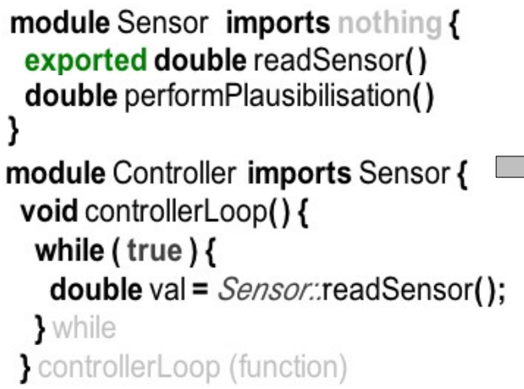
#ifndef SENSOR_H
#define SENSOR_H
double Sensor_readSensor();
#endif
#include "Sensor.h"
double Sensor_readSensor() { … }
double Sensor_performPlausibilisation() { …
Sensor.h
Sensor.c
#ifndef CONTROLLER_H
#define CONTROLLER_H
#endif
#include "Controller.h"
#include "Sensor.h"
void Controller_controllerLoop() {
while (1) { double val = Sensor_readSensor(); … }
Controller.h
Controller.c

Slide 2
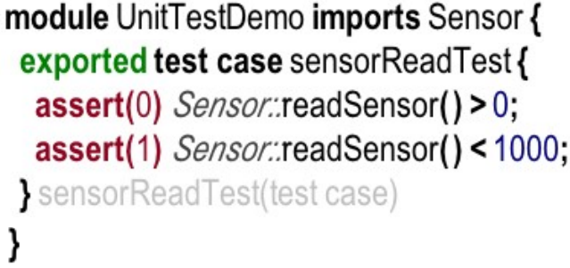
#include "Sensor.h"
int8_t UnitTestDemo_test_sensorReadTest() {
int8_t __failures = 0;
printf("runningTest: running test @UnitTestDemo:test_sensorReadTest:0\n");
if ( !(Sensor_readSensor() > 0) ) {
__failures++;
printf("FAILED: ***FAILED*** @UnitTestDemo:test_sensorReadTest:1\n");
printf(" testID = %d\n",0);
}
if ( !(Sensor_readSensor() < 1000) ) { … }
return __failures;
UnitTestDemo.c

Slide 3
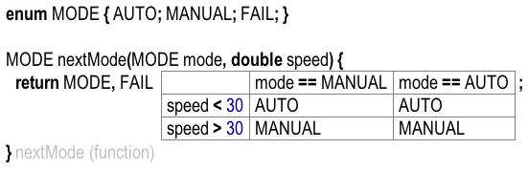
typedef enum ___MODE { MANUAL, AUTO, FAIL } _MODE;
_MODE nextMode(_MODE mode, int8_t speed) {
if ( current == MANUAL ) {
if ( speed <= 30 ) { return MANUAL; }
if ( speed >= 30 && speed < 50 ) { return MANUAL; }
}
if ( current == AUTO ) { … }
return FAIL; … }

Slide 4
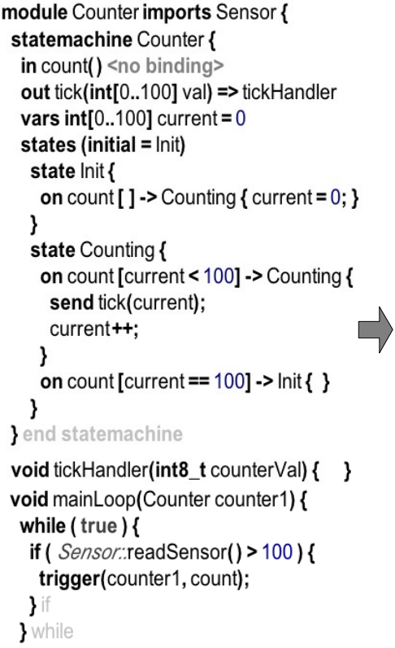
typedef enum _sm_events_Counter{
Counter__event_count
} Counter_sm_events_Counter;
typedef enum _sm_states_Counter{
Counter__state_Init, Counter__state_Counting
} Counter_sm_states_Counter;
struct _sm_data_Counter {
Counter_sm_states_Counter __currentState;
int8_t current;
};
Counter.h

Slide 5
#include "Counter.h"
#include "Sensor.h"
void Counter_sm_execute_Counter(struct Counter_sm_data_Counter* instance,
Counter_sm_events_Counter event, void** arguments) {
switch (instance->__currentState) {
case Counter__state_Init: { … }
case Counter__state_Counting: {
switch (event) {
case Counter__event_count: {
if ( instance->current < 100 ) {
Counter_tickHandler(instance->current);
instance->__currentState = Counter__state_Counting;
instance->current++;
return ;
}
if ( instance->current == 100 ) { … }
}
void Counter_tickHandler(int8_t counterVal) { … }
void Counter_mainLoop(struct Counter_sm_data_Counter counter1) {
while (1) {
if ( Sensor_readSensor() > 100 ) {
void* ___args[] = {};
Counter_sm_execute_Counter(&counter1, Counter__event_count, &___args);
} } }
Counter.c

Slide 6
