Slide 1


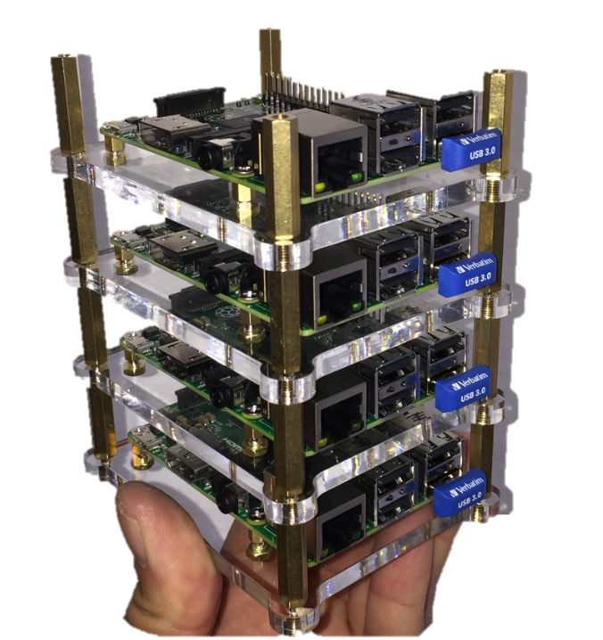
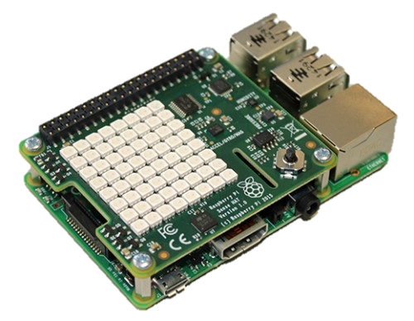
R Runtime
Zoo
DPLYR
HTTR
RODBC
HBase REST API (Stargate)
Hive
HTTP/JSON
HBase
Pig Latin
Workflow
Pythonista
HDFS
Raspbian OS
WiFi
Sensor Data Net
Raspberry PI + Sense-HAT

