Slide 1
IOT INTERNSHIP CAPSTONE PROJECT
Edge AI-Based EV
Charging Station
Multi-bay charging simulation with on-device AI prediction, cloud monitoring, remote control, and overload alarms — built on ESP32 and ThingsBoard.

Slide 2
INTRODUCTION
What is IoT?
The Internet of Things connects everyday physical devices — sensors, machines, appliances — to the internet, letting them collect data, communicate, and be monitored or controlled remotely.
1
2
3
4
Sense
Connect
Analyze
Act
Devices gather real-world data through sensors — voltage, current, temperature, presence.
Devices push that data to the cloud over Wi-Fi using lightweight protocols like MQTT.
Cloud platforms store, visualize, and apply intelligence to the incoming data streams.
Systems respond automatically, or let a remote operator control the device in real time.
Edge AI-Based EV Charging Station
2

Slide 3
PROBLEM STATEMENT
Why EV charging stations need
smart monitoring
Charging bays run unattended — operators can't see live status, load, or faults without visiting the site.
16A
Overcurrent from wiring faults or a wrong vehicle plugged in can overheat equipment or, worst case, cause fire.
overload threshold
used to trigger an
alarm on any bay
Without predictive insight, stations can't anticipate demand — every bay is treated the same regardless of expected arrivals.
Manual control means no way to intervene remotely if a bay needs to be throttled or shut off during an issue.
Goal: give operators live visibility, predictive insight, and remote control — from anywhere.
Edge AI-Based EV Charging Station
3

Slide 4
PROJECT OVERVIEW
How the system works
Three simulated charging bays (ESP32) sense, decide, and report — each bay flows through the same four-stage pipeline before reaching the cloud dashboard.
1
2
3
4
Sense
Predict
Decide
Publish
→
→
→
Potentiometers simulate voltage & current sensors; DHT22 reads temperature; switches simulate plug-in/out.
An on-device AI model estimates arrival probability and predicted charging duration from live readings.
Local logic sets the load decision (Allow / Standby / Throttle) and drives status LEDs — green, yellow, red.
Data streams to ThingsBoard over MQTT every 5s, powering dashboards, remote RPC control, and alarms.
Edge AI-Based EV Charging Station
4

Slide 5
IMPLEMENTATION · HARDWARE
Each bay = one ESP32
The station is simulated with three independent ESP32 projects — Bay1, Bay2, Bay3 — each running the same firmware with a unique device token.
Voltage sensing
Current sensing
•
•
Potentiometer simulates the bay's output voltage reading.
A second potentiometer simulates current draw, feeding the overload check.
Temperature
Plug detection
•
•
DHT22 sensor reports bay temperature alongside every telemetry publish.
Two switches simulate plug-in / plug-out, driving bay status (FREE / CHARGING).
Status LEDs
Relay control
•
•
Green = free, Yellow = charging, Red = alarm — a local readout with no cloud needed.
A relay switches the charger on/off, driven locally or remotely via RPC.
All three bays share one firmware codebase — reviewed and debugged together for consistency before final submission.
Edge AI-Based EV Charging Station
5

Slide 6
IMPLEMENTATION · EDGE AI
Predicting before it happens
A trained AI model runs alongside the sensing logic, turning raw readings into forward-looking signals before anything is published to the cloud.
Arrival probability
Predicted duration
Likelihood that a new vehicle arrives at this bay soon, feeding the load decision (Allow / Standby).
Estimated minutes remaining to complete the current charge, shown live on the dashboard.
These two values drive the local load decision — Allow, Standby-Expecting, or Throttle — before the reading is even sent to the cloud.
Edge AI-Based EV Charging Station
6

Slide 7
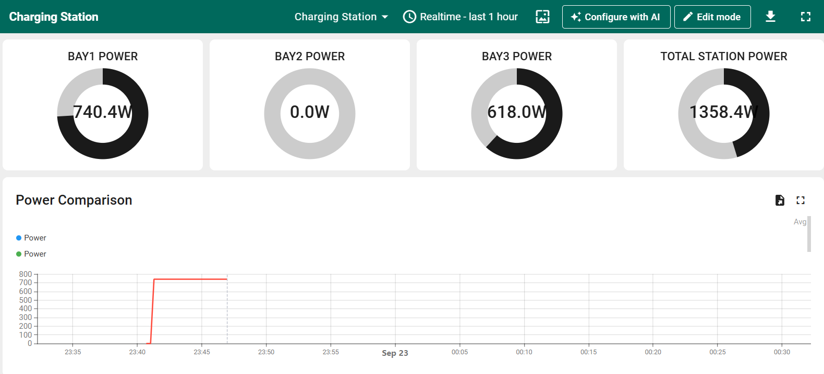
CLOUD PLATFORM · THINGSBOARD
Monitoring each bay in real time
Every bay has its own dashboard: live voltage, current, power, temperature, base status, load decision, and AI predictions — refreshed every 5 seconds via MQTT.
Voltage
Current
Power
Temperature
Bay status
Load decision
Arrival probability
Predicted duration
Edge AI-Based EV Charging Station
7

Slide 8
CLOUD PLATFORM · REMOTE CONTROL
Controlling a bay from the dashboard
RPC buttons on the dashboard send commands over MQTT; the ESP32 receives them, applies the change, and reports the new state back on its next publish.
Turn On Relay
Turn Off Relay
Set Throttle
setRelayState(true) — charger switches on, manual override engaged.
setRelayState(false) — charger switches off immediately.
setThrottle(level) — caps delivered power to a chosen percentage.
Round trip: dashboard button press → MQTT RPC request → device parses & applies it → device state updates → confirmed back in the next telemetry publish (e.g. loadDecision: "MANUAL_THROTTLE").
Edge AI-Based EV Charging Station
8

Slide 9
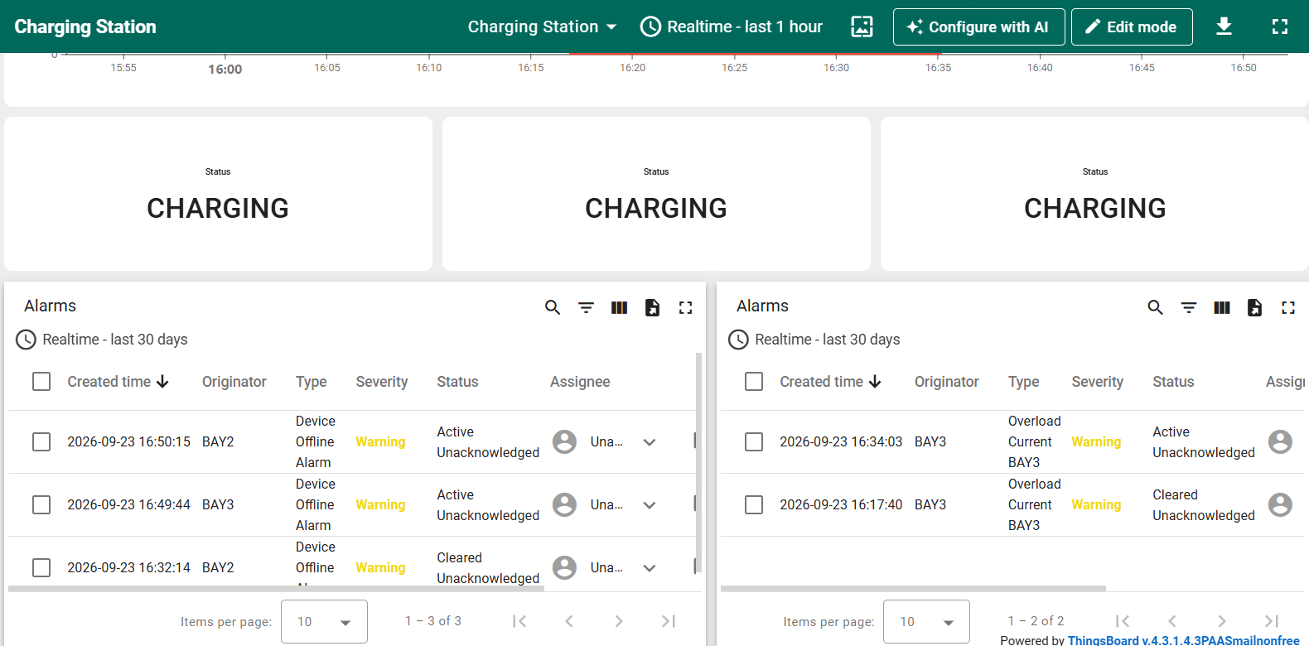
CLOUD PLATFORM · SAFETY
Overload alarms per bay
Each bay device carries its own alarm rule watching live current — a safeguard against wiring faults, overdraw, or the wrong vehicle being plugged in.
Argument
Latest telemetry key: current
Trigger condition
current > 16 A → Warning alarm raised
Clear condition
current < 16 A → alarm auto-clears
Scope
One rule per bay device — Overload Bay1 / Bay2 / Bay3
Edge AI-Based EV Charging Station
9

Slide 10
CLOUD PLATFORM · STATION VIEW
One dashboard for the whole station
A Charging Station asset links all three bays; a calculated field sums their power in real time, giving operators a single view of total load.
Asset created
(Charging Station)
Bay1/2/3 linked
via relations
Calculated field:
power1+power2+power3
totalStationPower
on the gauge
→
→
→
Sample result: Bay1 740.4W + Bay2 0.0W + Bay3 618.0W = 1358.4W total station power, live on the gauge.
Edge AI-Based EV Charging Station
10

Slide 11
REFLECTION
What this project covered
1
Embedded development
2
IoT cloud platforms
Writing and debugging ESP32 firmware in C++ — sensor reads, MQTT publish/subscribe, RPC handling.
Modeling devices and assets in ThingsBoard: telemetry, attributes, relations, calculated fields.
3
Two-way device control
4
Alerting & operations thinking
Closing the loop from dashboard to device and back — not just monitoring, but acting.
Designing threshold-based alarms that matter for real-world safety, not just demo value.
Edge AI-Based EV Charging Station
11

Slide 12
Thank you
A working edge-AI IoT system — sensing, predicting, monitoring, controlling, and alerting across a simulated three-bay EV charging station.
Edge AI-Based EV Charging Station
12

