Slide 1




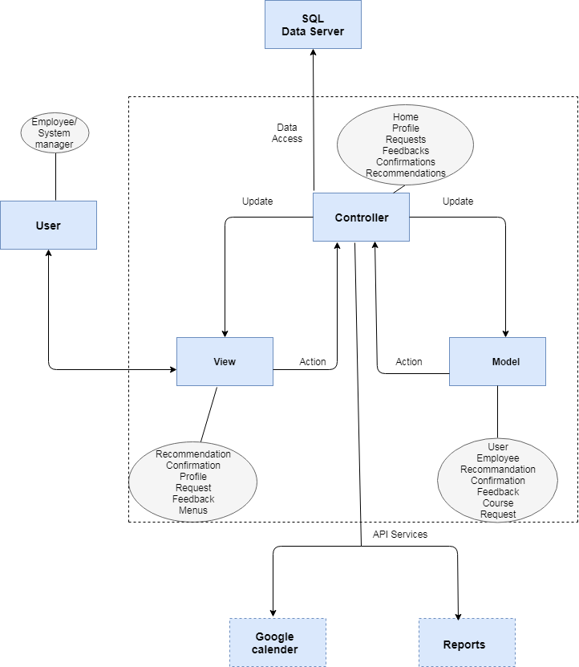







ETMS
Employee Training Management System
DESCRIPTION
TARGET AUDIENCE
The system will allow the employees to apply for internal and external courses, view the status of the application, and to the managers to reject or approve the request, view details about employees capacitation, see statistics and find a worker with a specific capacitation.
The system is design to bring value to any large organization that gets involved in employees training, both internal training and external courses.
TO BE DEVELOPED
THE TEAM
Nofar Talyas – Client Side development – HTML, CSS, JS, API.
Raz Nagar –Back-End development – C#, SQL, API.
David Tabacman – Client Side development – HTML, CSS, JS, API.
PRINCIPAL PROCESSES
PRINCIPAL OBJECTS
Employee management - update personal and employment status, links to external documents, management assessments, tests, and analysis of competencies and certifications. Employee`s request for a course – the employee can request a specific training or course, both inside and outside the organization, adding details of the course, costs and syllabus. The request will be sent to the relevant managers to be approved or rejected.
Course and lecturers management - the training manager can enter and update internal courses held throughout the year. Additionally will be allowed to manage employees requests for external courses.
Information retrieval - Queries, reports, alerts and statistics for managers - The system will enable the training manager to produce up-to-date reports easily and efficiently and provide him with an overview of the costs of the various courses against the budget, schedules, training programs, participants and their needs.
Users - all system users, including employees of different grades: researchers, engineers, technicians, administrative personnel, etc.
Courses – all available internal and external courses, workshops, etc.
Tests - online tests, exercises and assignments for the purpose of maintaining professional competence and evaluate course comprehension.
TECHNOLOGIES
Server side - will be developed in C# using the .NET MVC architecture (known from online courses).
Client side - HTML, CSS and JS (learned in Web Development course).
DB - SQL SERVER 2012 R2 (learned in DB course).
API – Google Calendars, report service.

