Slide 1

Google Cloud Platform (GDPEE)

Slide 2
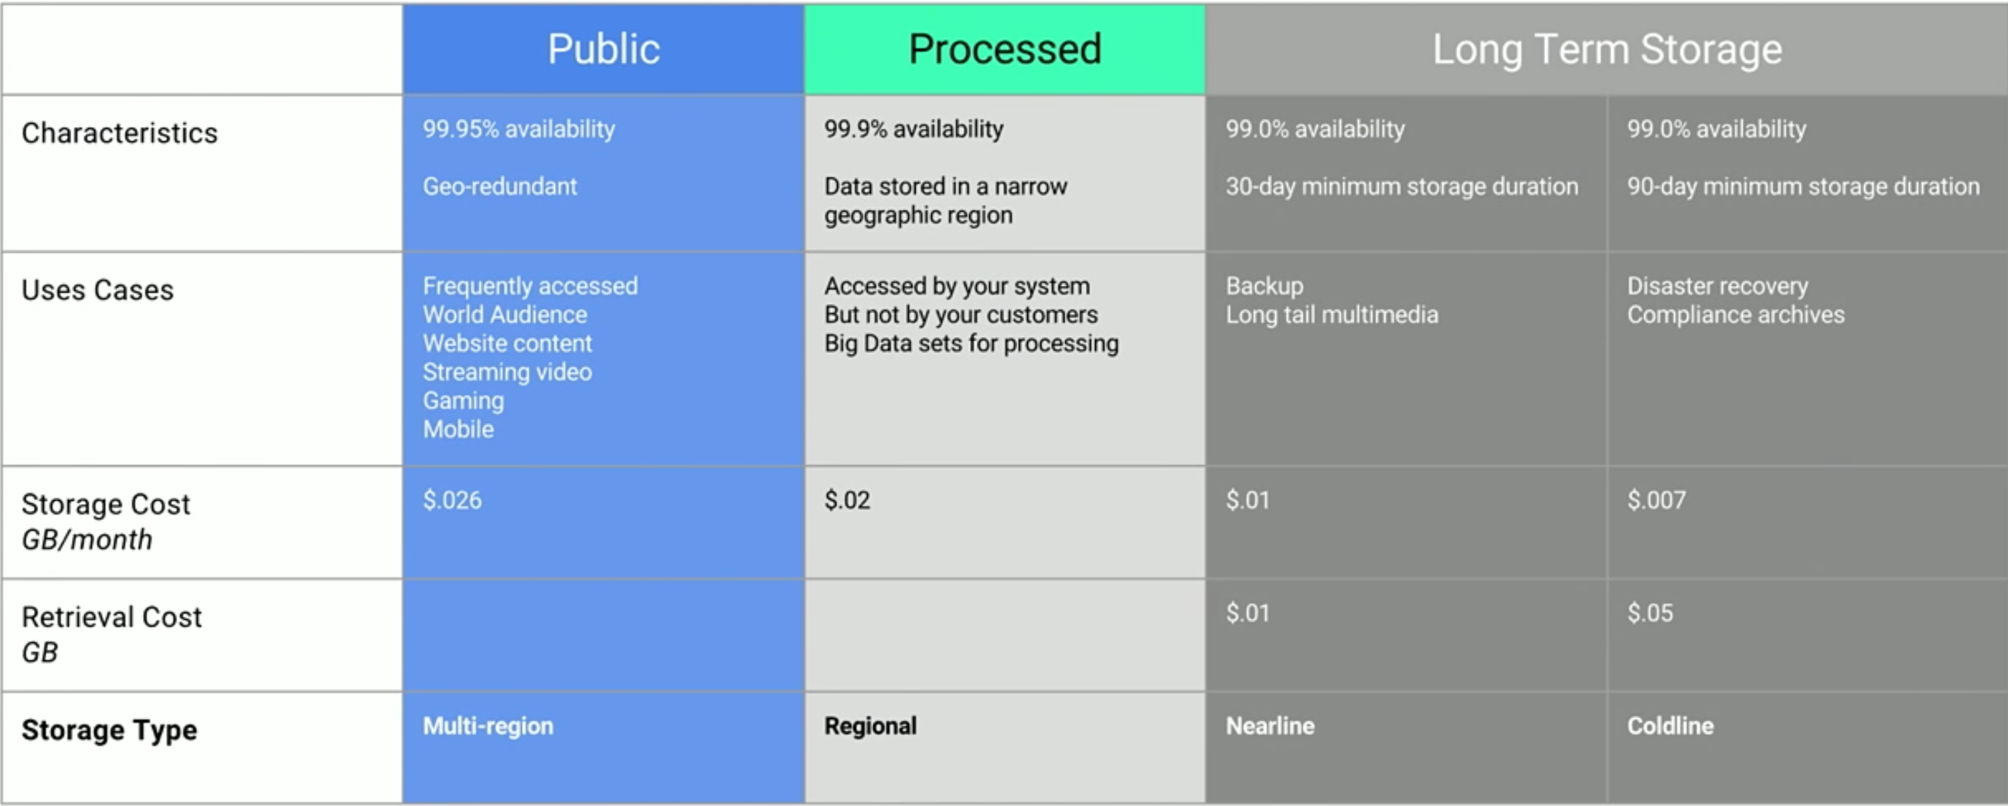
Cost
- No upfront costs
- Pay-as-you-go
- No termination fees
- Calculator https://cloud.google.com/products/calculator/#tab=app-engine

Slide 3
Compute Engine (IAAS)
Virtual Machines, Disks, and Network
An IaaS service that provides virtual machines (VMs) hosted on Google’s infrastructure.
Competitor services include Amazon Elastic Compute Cloud, and on-premises equivalents such as OpenStack.

Slide 4
App Engine(PAAS)
Managed Application Platform
A PaaS service for building web applications and mobile backends using container instances preconfigured with one of several available runtimes, each of which include a set of standard App Engine libraries.
Competitor services include Amazon Elastic Beanstalk and Microsoft Azure Web Sites.

Slide 5
Container Engine
Managed Kubernetes / Containers
Cluster management and orchestration system for coordinating Docker containers.
It is based on the open source Kubernetes project.

Slide 6
On premise
Not possible
No cloud platform in Africa, performance issues possibly

Slide 7
Very Usefull
- Intellij plugin integration
- Debugging live system on web or via Intellij

