Slide 1


Page 01
DESIGNING A
28-BIT FUNCTIONING
COMPUTER SYSTEM
CPU + MEMORY
CACHE
BOOTH MUL
DMA
LOGISIM

Slide 2






Introducing our Undergrad Engineers
01
02
03
04
05
DATAPATH & ALU
CONTROL UNIT
ARITHMETIC
MEMORY SYSTEM
CACHE & DMA
Shemonty 2407107
Ratul 2407108
Mahima 2407106
Rup 2407109
Thowai 2407109
LOGISIM
28-bit Computer Designing
Computer Architecture Laboratory
Page 02

Slide 3



Page 03
What Are We Building?
CONTROL UNIT
ROM + FSM
DATAPATH
REGISTERS + ALU
ARITHMETIC
BOOTH MUL
DMA BLOCK COPY → CACHE STAYS COHERENT

Slide 4
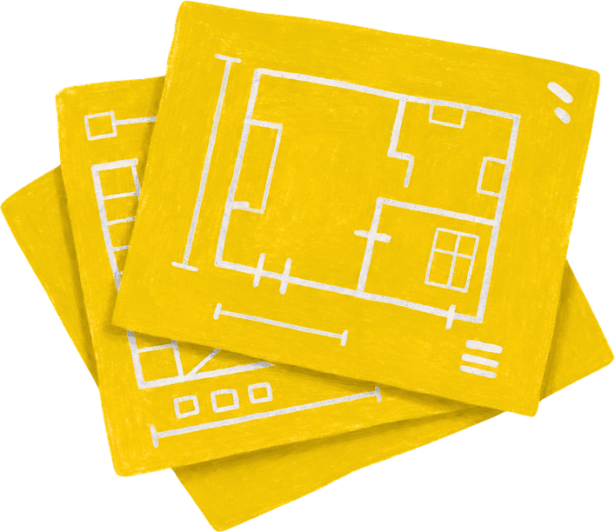
System Architecture
Page 04
REGISTER FILE
R0–R15
28-bit
ALU
28-bit
CACHE
16 lines
PC
IR
CONTROL UNIT • Opcode Decoder • FSM
MAIN MEMORY
4K × 28
BOOTH MUL • DMA

Slide 5
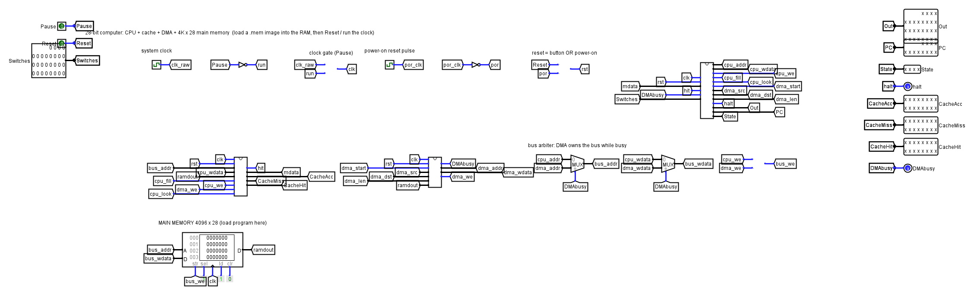
The Finished Circuit
Computer_28bit.circ • main circuit, screenshot from Logisim 2.7.1

Slide 6
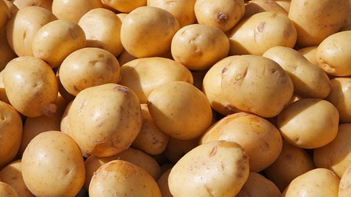

01
Datapath & ALU
Designing Architect: Shemonty
ADDR • PC / EA
DATAPATH & ALU
REGISTER FILE
R0 R1 R2 R3
R4 … R15
28-bit each
Shemonty 2407107
28-BIT ALU
ADD / SUB
AND / OR / XOR
SHIFT
EQ / LT
MUX A
CACHE • Data
Core idea: registers hold state → ALU transforms it
→ result is written back.
RESULT
IR • Instruction
MUX B
PC • Next
Page 05

Slide 7
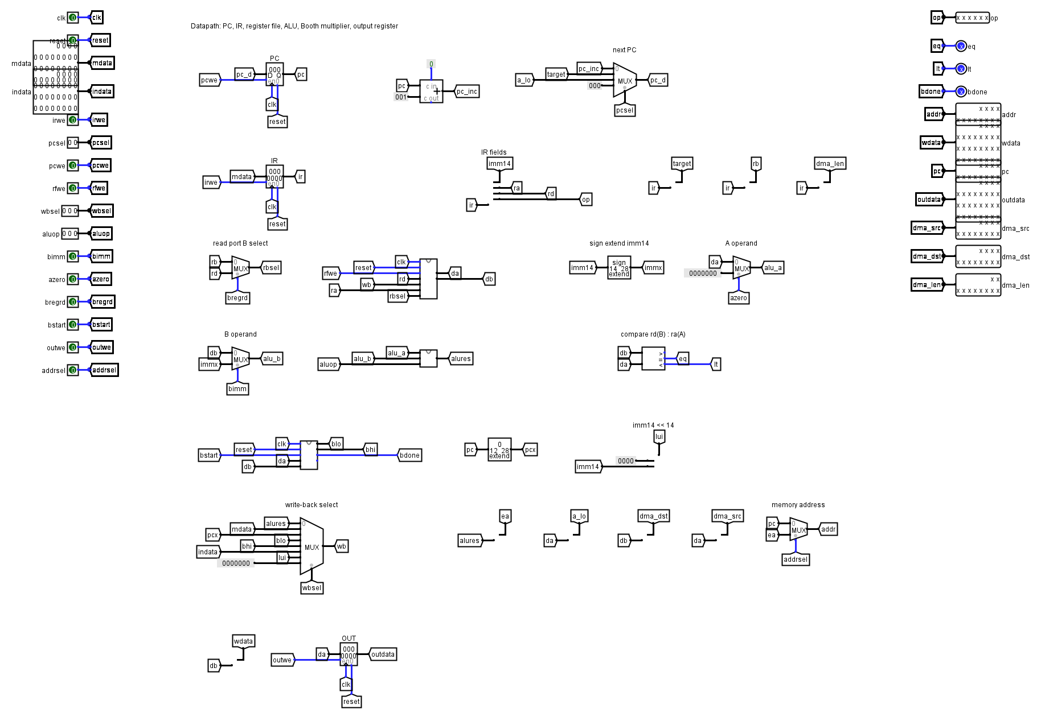
Datapath
PC, IR, 16-register file, ALU, Booth unit, write-back mux

Slide 8
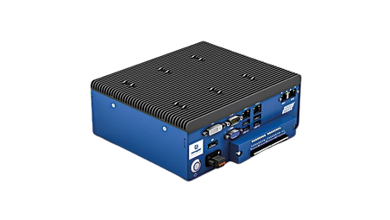
02
Control Unit
Designing Architect: Ratul
CONTROL UNIT
Ratul 2407108
A multi-cycle FSM turns an instruction into an ordered sequence of control signals.
FETCH
PC → address
Cache read
DECODE
IR → opcode
Select registers
EXECUTE
ALU / MUL
MEMORY
Cache / RAM
for LOAD/STORE
WRITEBACK
Result → Rd
OPCODE → CONTROL SIGNALS
Page 06

Slide 9
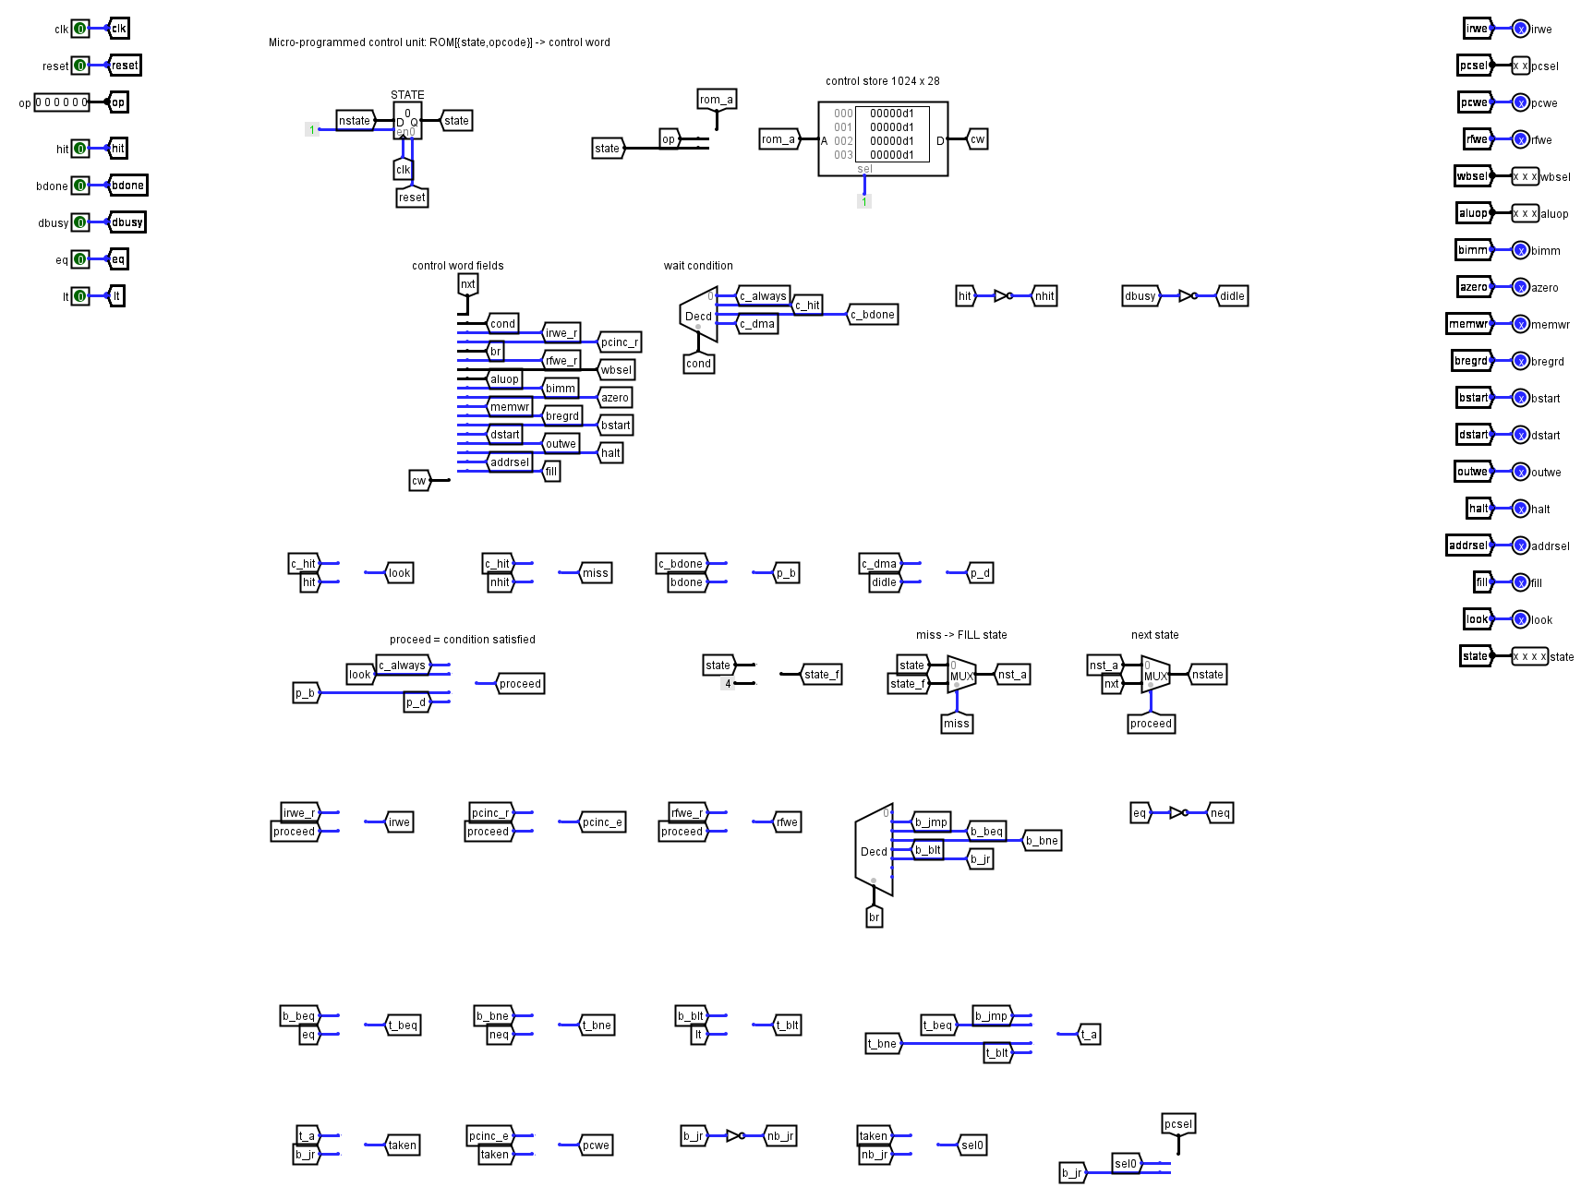
Control Unit: ROM + State Register
1024 × 28 control ROM, addressed by {state, opcode}

Slide 10

03
Arithmetic Accelerator
Designing Architect: Mahima
ARITHMETIC
MUL IN: 28-bit × 28-bit
28 STEPS: one per clock
Mahima 2407106
MUL
LOW 28
MULH
HIGH 28
The 56-bit product is built over 28 clocks with one adder, so the main ALU stays small.
A
Q
Q−1
Q
M
DONE
FLAG
BOOTH FSM
Shift • Add/Sub • Repeat
29-BIT ADDER
+M • −M • 0
Page 07

Slide 11
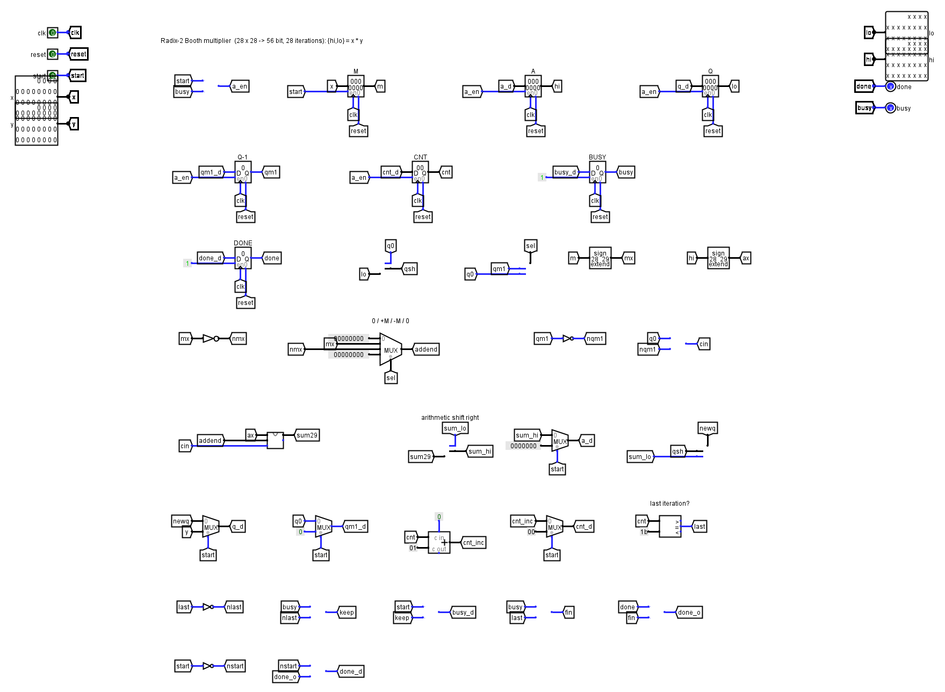
Booth Multiplier
M, A, Q, Q−1 and a counter around one 29-bit adder

Slide 12

04
Memory System
Designing Architect: Rup
MEMORY SYSTEM
Rup 2407109
TAG
INDEX
WORD
A 16-line direct-mapped cache sits between the CPU and 4K × 28-bit main memory.
TAG MATCH?
VALID = 1
HIT
MISS
00
0
TAG
28-bit DATA
01
1
TAG
24-bit DATA
02
0
TAG
24-bit DATA
MAIN MEMORY • 4K × 28-bit
03
0
TAG
24-bit DATA
Page 08

Slide 13
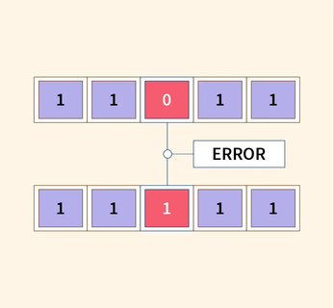
05
!
DMA CONTROLLER
Designing Architect: Thowai
CACHE & DMA
CPU
DMA rd,ra,len
DMA
takes the bus
RAM
read source
Thowai 2407109
!
DMA BUSY
CPU
resumes
CACHE
invalidate line
RAM
write dest.
Page 09

Slide 14
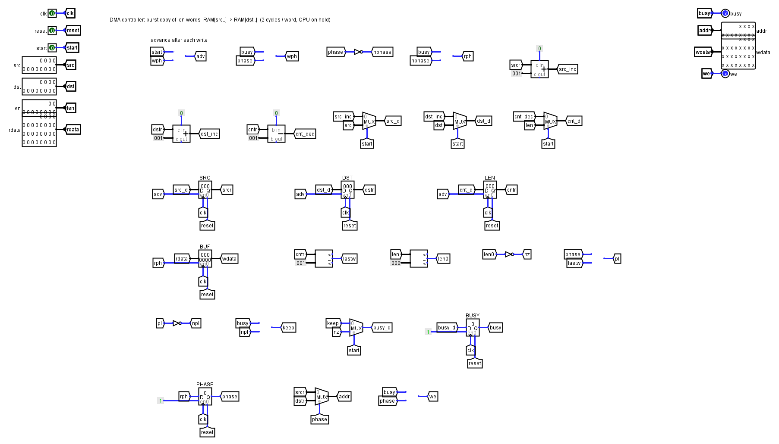
DMA Controller
Two cycles per word; every write clears the matching cache line

Slide 15
Page 10
Instruction Set (32 opcodes, 9 shown)
Opcode
Instruction
Operation
Type
000010
ADD Rd,Ra,Rb
Rd ← Ra + Rb
R
000011
SUB Rd,Ra,Rb
Rd ← Ra − Rb
R
011011
SHLI Rd,Ra,n
Rd ← Ra << n
I
001101
LDI Rd,imm
Rd ← imm
I
010000
LD Rd,[Ra+imm]
Rd ← MEM[Ra+imm]
M
010001
ST Rd,[Ra+imm]
MEM[Ra+imm] ← Rd
M
010100
BNE Rd,Ra,addr
if Rd ≠ Ra: PC ← addr
B
001010
MUL Rd,Ra,Rb
Rd ← low28(Ra × Rb)
A
011010
DMA Rd,Ra,len
copy len words Ra → Rd
D

Slide 16
Page 11
How an Instruction Executes?
Let us see an Example
ADD R1,R2,R3
F
D
E
W
Fetch
Decode
ALU ADD
Write R1
MUL R1,R2,R3
F
D
S
I
I
W
Fetch
Decode
Start MUL
Iterate
Iterate
Write

Slide 17
Page 13
Integration & Verification
We integrate bottom-up so every module is testable before the final CPU run.
1
UNIT TEST
2
CONNECT
3
EXPAND
ALU + registers
Datapath + FSM
Cache + RAM
Known operands → expected result
Single-cycle ADD/SUB first
LOAD/STORE + HIT/MISS
4
ACCELERATE
5
HARDEN
6
FINAL
Booth multiplier
DMA + demo
Program execution
Edge cases: −2^27
Copy a block, cache stays right
Fetch → decode → execute → repeat
SUCCESS = matches the golden model + visible HIT/MISS + verified DMA copy

Slide 18
Results: checked in real Logisim 2.7.1
How we tested
• A Python instruction-set simulator, written separately from the circuit, runs every program too
• The circuit runs headless in Logisim 2.7.1; we compare every value written to Out
• 4 hand-written programs + 37 random programs
• All match, including Booth edge cases like (−2^27) × (−2^27)
Demo program
• 818 instructions executed, 17 output values, all correct
• 10! = 3628800; 123456789 × 98765432 = 45423444 × 2^28 + 195687384
• Cache: 914 look-ups, 208 misses, 706 hits (about 77% hit rate)
• DMA copy of 32 words verified by a checksum
• Not built: divider and parity (future work)

Slide 19
Page 14
FROM LOGIC GATES
TO A WORKING COMPUTER.
ALU
FSM
BOOTH
CACHE
DMA
The final system demonstrates how computation, memory, control and reliability cooperate inside a CPU.

Slide 20



Page 15
LOGISIM
28-bit Computer Designing
Computer Architecture Project
THANK YOU
01
02
03
04
05
Shemonty
Ratul
Mahima
Rup
Thowai
Shemonty 2407107
Ratul 2407108
Mahima 2407106
Rup 2407109
Thowai 2407109

