Slide 1

KUBERNETES,
KUBERNAUTI,
KUBEINVADERS.
Notes:
Hello Team,
We are here to present our work on company values and new brand Identity.

Slide 2


👋
Ettore Ciarcia
Kubernetes & Cloud Engineer @ SIGHUP
Yaml Guy
Agenda
Notes:
Control Plane Components
kube-apiserver
The API server is a component of the Kubernetes control plane that exposes the Kubernetes API. The API server is the front end for the Kubernetes control plane.
etcd
Consistent and highly-available key value store used as Kubernetes' backing store for all cluster data.
kube-scheduler
Control plane component that watches for newly created Pods with no assigned node, and selects a node for them to run on.
cloud-controller-manager
Control plane component that embeds cloud-specific control logic.
kube-controller-manager
Control plane component that runs controller processes.
Logically, each controller is a separate process, but to reduce complexity, they are all compiled into a single binary and run in a single process.
Some types of these controllers are:
Node controller: Responsible for noticing and responding when nodes go down.
Job controller: Watches for Job objects that represent one-off tasks, then creates Pods to run those tasks to completion.
Node Components
Node components run on every node, maintaining running pods and providing the Kubernetes runtime environment.
kubelet
An agent that runs on each node in the cluster. It makes sure that containers are running in a Pod.
Responsibilities:
Ensuring that the node is doing its job
Ensuring state and health of running containers on the node
Enforce limits and options when containers are scheduled on the node
kube-proxy
kube-proxy is a network proxy that runs on each node in your cluster, implementing part of the Kubernetes Service concept.
Container runtime
The container runtime is the software that is responsible for running containers.

Slide 3
Indice
Agenda
Come siamo arrivati a Kubernetes
Componenti di un cluster
Oggetti Kubernetes utilizzati nella demo
Reconciliation loops
Demo con Kubeinvaders
Q&A
Notes:
Control Plane Components
kube-apiserver
The API server is a component of the Kubernetes control plane that exposes the Kubernetes API. The API server is the front end for the Kubernetes control plane.
etcd
Consistent and highly-available key value store used as Kubernetes' backing store for all cluster data.
kube-scheduler
Control plane component that watches for newly created Pods with no assigned node, and selects a node for them to run on.
cloud-controller-manager
Control plane component that embeds cloud-specific control logic.
kube-controller-manager
Control plane component that runs controller processes.
Logically, each controller is a separate process, but to reduce complexity, they are all compiled into a single binary and run in a single process.
Some types of these controllers are:
Node controller: Responsible for noticing and responding when nodes go down.
Job controller: Watches for Job objects that represent one-off tasks, then creates Pods to run those tasks to completion.
Node Components
Node components run on every node, maintaining running pods and providing the Kubernetes runtime environment.
kubelet
An agent that runs on each node in the cluster. It makes sure that containers are running in a Pod.
Responsibilities:
Ensuring that the node is doing its job
Ensuring state and health of running containers on the node
Enforce limits and options when containers are scheduled on the node
kube-proxy
kube-proxy is a network proxy that runs on each node in your cluster, implementing part of the Kubernetes Service concept.
Container runtime
The container runtime is the software that is responsible for running containers.

Slide 4
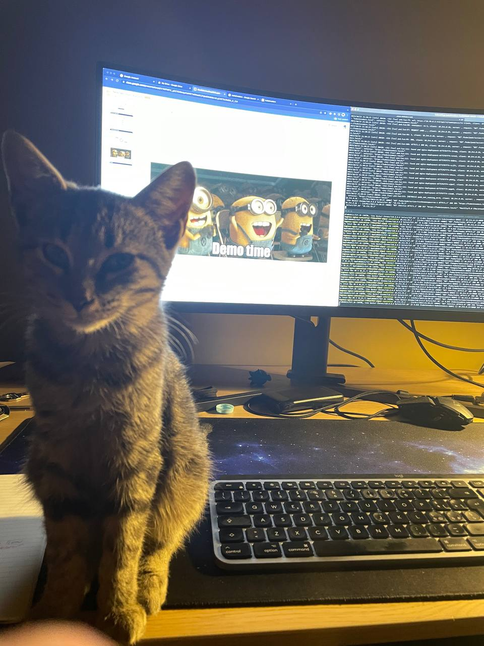
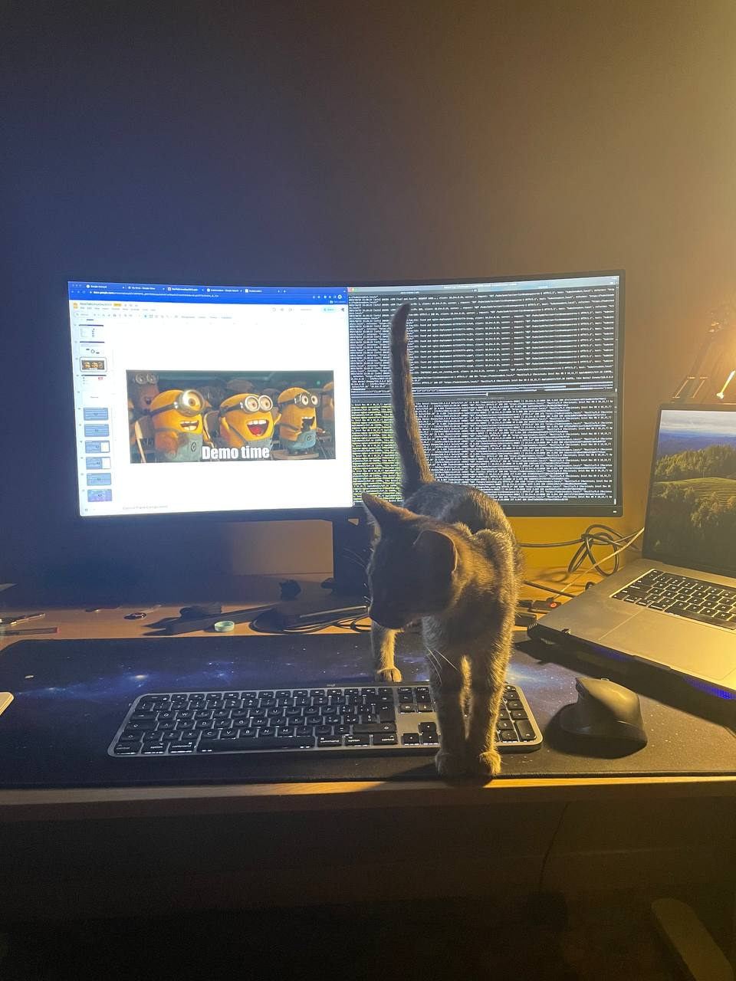
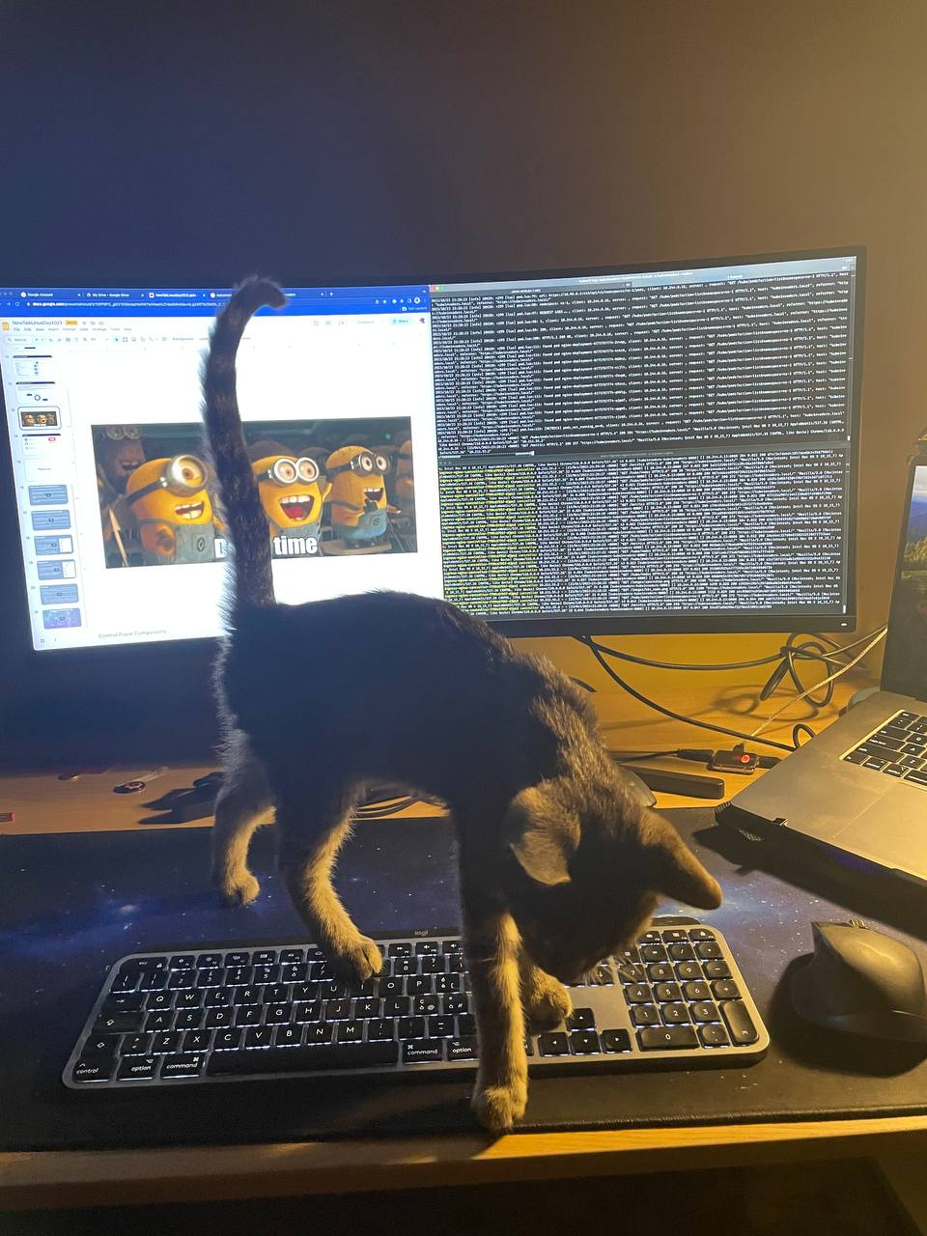
Miciogatto Fifì: typo generator
Agenda
Notes:
Control Plane Components
kube-apiserver
The API server is a component of the Kubernetes control plane that exposes the Kubernetes API. The API server is the front end for the Kubernetes control plane.
etcd
Consistent and highly-available key value store used as Kubernetes' backing store for all cluster data.
kube-scheduler
Control plane component that watches for newly created Pods with no assigned node, and selects a node for them to run on.
cloud-controller-manager
Control plane component that embeds cloud-specific control logic.
kube-controller-manager
Control plane component that runs controller processes.
Logically, each controller is a separate process, but to reduce complexity, they are all compiled into a single binary and run in a single process.
Some types of these controllers are:
Node controller: Responsible for noticing and responding when nodes go down.
Job controller: Watches for Job objects that represent one-off tasks, then creates Pods to run those tasks to completion.
Node Components
Node components run on every node, maintaining running pods and providing the Kubernetes runtime environment.
kubelet
An agent that runs on each node in the cluster. It makes sure that containers are running in a Pod.
Responsibilities:
Ensuring that the node is doing its job
Ensuring state and health of running containers on the node
Enforce limits and options when containers are scheduled on the node
kube-proxy
kube-proxy is a network proxy that runs on each node in your cluster, implementing part of the Kubernetes Service concept.
Container runtime
The container runtime is the software that is responsible for running containers.

Slide 5

Memini!
Agenda
Quando non hai idea di cosa sia Linux, non hai conoscenze di networking, non hai mai usato un container e ti tuffi in Kubernetes
Notes:
Control Plane Components
kube-apiserver
The API server is a component of the Kubernetes control plane that exposes the Kubernetes API. The API server is the front end for the Kubernetes control plane.
etcd
Consistent and highly-available key value store used as Kubernetes' backing store for all cluster data.
kube-scheduler
Control plane component that watches for newly created Pods with no assigned node, and selects a node for them to run on.
cloud-controller-manager
Control plane component that embeds cloud-specific control logic.
kube-controller-manager
Control plane component that runs controller processes.
Logically, each controller is a separate process, but to reduce complexity, they are all compiled into a single binary and run in a single process.
Some types of these controllers are:
Node controller: Responsible for noticing and responding when nodes go down.
Job controller: Watches for Job objects that represent one-off tasks, then creates Pods to run those tasks to completion.
Node Components
Node components run on every node, maintaining running pods and providing the Kubernetes runtime environment.
kubelet
An agent that runs on each node in the cluster. It makes sure that containers are running in a Pod.
Responsibilities:
Ensuring that the node is doing its job
Ensuring state and health of running containers on the node
Enforce limits and options when containers are scheduled on the node
kube-proxy
kube-proxy is a network proxy that runs on each node in your cluster, implementing part of the Kubernetes Service concept.
Container runtime
The container runtime is the software that is responsible for running containers.

Slide 6
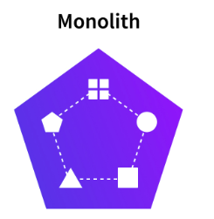
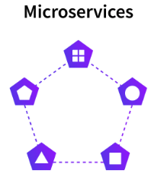
Come siamo arrivati a Kubernetes?
Agenda
Difficile da scalare
Difficile da aggiornare
Singola grande applicazione
Semplici da scalare
Complessità operativa
Isolamento e resilienza
Notes:
Control Plane Components
kube-apiserver
The API server is a component of the Kubernetes control plane that exposes the Kubernetes API. The API server is the front end for the Kubernetes control plane.
etcd
Consistent and highly-available key value store used as Kubernetes' backing store for all cluster data.
kube-scheduler
Control plane component that watches for newly created Pods with no assigned node, and selects a node for them to run on.
cloud-controller-manager
Control plane component that embeds cloud-specific control logic.
kube-controller-manager
Control plane component that runs controller processes.
Logically, each controller is a separate process, but to reduce complexity, they are all compiled into a single binary and run in a single process.
Some types of these controllers are:
Node controller: Responsible for noticing and responding when nodes go down.
Job controller: Watches for Job objects that represent one-off tasks, then creates Pods to run those tasks to completion.
Node Components
Node components run on every node, maintaining running pods and providing the Kubernetes runtime environment.
kubelet
An agent that runs on each node in the cluster. It makes sure that containers are running in a Pod.
Responsibilities:
Ensuring that the node is doing its job
Ensuring state and health of running containers on the node
Enforce limits and options when containers are scheduled on the node
kube-proxy
kube-proxy is a network proxy that runs on each node in your cluster, implementing part of the Kubernetes Service concept.
Container runtime
The container runtime is the software that is responsible for running containers.

Slide 7
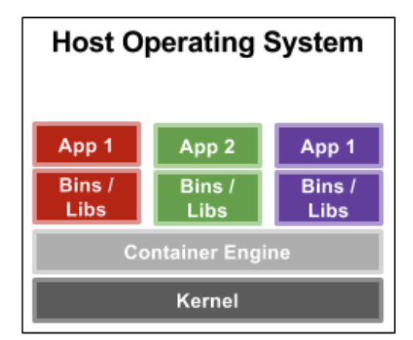
Cosa sono i container?
Agenda
Sono astrazioni che ci permettono di isolare e rendere portabili le nostre applicazioni. Le tecnologie di containerizzazione si basano su due feature del Kernel Linux:
Control Groups
Namespace
Gabriele Santomaggio- Containers da zero! Una panoramica di cgroups e namespace (2022)
Giulio De Donato - Isoliamo un processo senza container (2016)
Notes:
Control Plane Components
kube-apiserver
The API server is a component of the Kubernetes control plane that exposes the Kubernetes API. The API server is the front end for the Kubernetes control plane.
etcd
Consistent and highly-available key value store used as Kubernetes' backing store for all cluster data.
kube-scheduler
Control plane component that watches for newly created Pods with no assigned node, and selects a node for them to run on.
cloud-controller-manager
Control plane component that embeds cloud-specific control logic.
kube-controller-manager
Control plane component that runs controller processes.
Logically, each controller is a separate process, but to reduce complexity, they are all compiled into a single binary and run in a single process.
Some types of these controllers are:
Node controller: Responsible for noticing and responding when nodes go down.
Job controller: Watches for Job objects that represent one-off tasks, then creates Pods to run those tasks to completion.
Node Components
Node components run on every node, maintaining running pods and providing the Kubernetes runtime environment.
kubelet
An agent that runs on each node in the cluster. It makes sure that containers are running in a Pod.
Responsibilities:
Ensuring that the node is doing its job
Ensuring state and health of running containers on the node
Enforce limits and options when containers are scheduled on the node
kube-proxy
kube-proxy is a network proxy that runs on each node in your cluster, implementing part of the Kubernetes Service concept.
Container runtime
The container runtime is the software that is responsible for running containers.

Slide 8
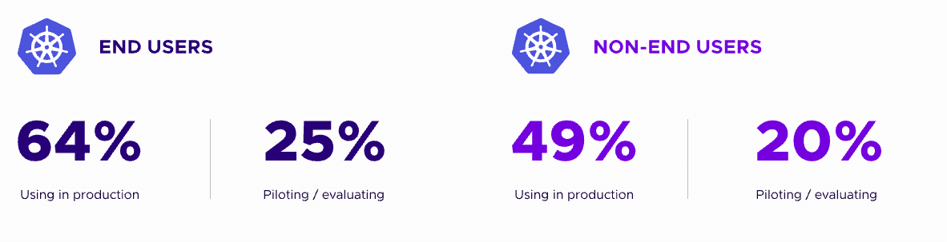
Cos’è Kubernetes?
Agenda
Kubernetes è un sistema open-source per l'orchestrazione e la gestione di container.
Fornisce una piattaforma automatizzata per distribuire, gestire e monitorare applicazioni containerizzate, facilitando la scalabilità, la disponibilità e la gestione delle applicazioni in un ambiente cloud o on-premises.
CNCF Annual Survey 2022
Notes:
Control Plane Components
kube-apiserver
The API server is a component of the Kubernetes control plane that exposes the Kubernetes API. The API server is the front end for the Kubernetes control plane.
etcd
Consistent and highly-available key value store used as Kubernetes' backing store for all cluster data.
kube-scheduler
Control plane component that watches for newly created Pods with no assigned node, and selects a node for them to run on.
cloud-controller-manager
Control plane component that embeds cloud-specific control logic.
kube-controller-manager
Control plane component that runs controller processes.
Logically, each controller is a separate process, but to reduce complexity, they are all compiled into a single binary and run in a single process.
Some types of these controllers are:
Node controller: Responsible for noticing and responding when nodes go down.
Job controller: Watches for Job objects that represent one-off tasks, then creates Pods to run those tasks to completion.
Node Components
Node components run on every node, maintaining running pods and providing the Kubernetes runtime environment.
kubelet
An agent that runs on each node in the cluster. It makes sure that containers are running in a Pod.
Responsibilities:
Ensuring that the node is doing its job
Ensuring state and health of running containers on the node
Enforce limits and options when containers are scheduled on the node
kube-proxy
kube-proxy is a network proxy that runs on each node in your cluster, implementing part of the Kubernetes Service concept.
Container runtime
The container runtime is the software that is responsible for running containers.

Slide 9
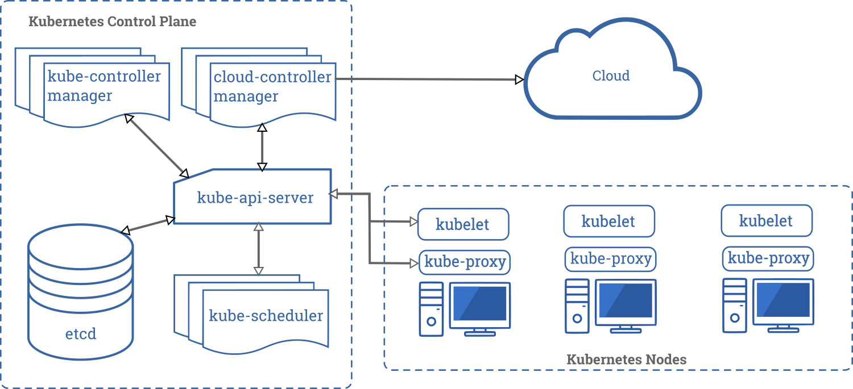
Kubernetes Components overview
Agenda
https://kubernetes.io/docs/concepts/overview/components/
Notes:
Control Plane Components
kube-apiserver
The API server is a component of the Kubernetes control plane that exposes the Kubernetes API. The API server is the front end for the Kubernetes control plane.
etcd
Consistent and highly-available key value store used as Kubernetes' backing store for all cluster data.
kube-scheduler
Control plane component that watches for newly created Pods with no assigned node, and selects a node for them to run on.
cloud-controller-manager
Control plane component that embeds cloud-specific control logic.
kube-controller-manager
Control plane component that runs controller processes.
Logically, each controller is a separate process, but to reduce complexity, they are all compiled into a single binary and run in a single process.
Some types of these controllers are:
Node controller: Responsible for noticing and responding when nodes go down.
Job controller: Watches for Job objects that represent one-off tasks, then creates Pods to run those tasks to completion.
Node Components
Node components run on every node, maintaining running pods and providing the Kubernetes runtime environment.
kubelet
An agent that runs on each node in the cluster. It makes sure that containers are running in a Pod.
Responsibilities:
Ensuring that the node is doing its job
Ensuring state and health of running containers on the node
Enforce limits and options when containers are scheduled on the node
kube-proxy
kube-proxy is a network proxy that runs on each node in your cluster, implementing part of the Kubernetes Service concept.
Container runtime
The container runtime is the software that is responsible for running containers.

Slide 10
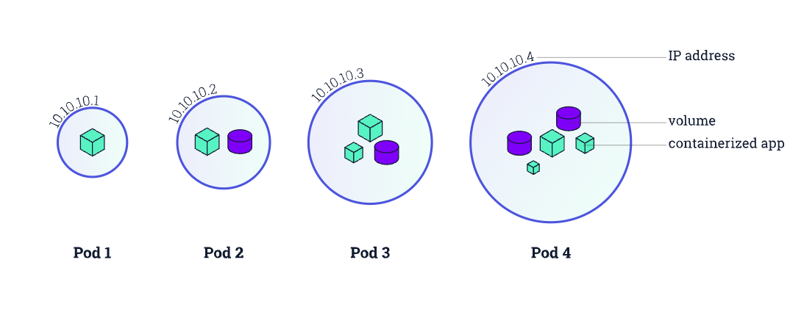
Unità atomica di Kubernetes: il Pod
Agenda
I pod sono la più piccola unità che Kubernetes è in grado gestire. Un pod può essere composto da uno o più container
I pod sono oggetti effimeri e facilmente sostituibili
Condivisione delle risorse: i container all’interno dello stesso pod condividono lo stesso network namespace, possono quindi comunicare su localhost. Kubernetes assegnerà ad ogni pod un indirizzo IP univoco
Notes:
Control Plane Components
kube-apiserver
The API server is a component of the Kubernetes control plane that exposes the Kubernetes API. The API server is the front end for the Kubernetes control plane.
etcd
Consistent and highly-available key value store used as Kubernetes' backing store for all cluster data.
kube-scheduler
Control plane component that watches for newly created Pods with no assigned node, and selects a node for them to run on.
cloud-controller-manager
Control plane component that embeds cloud-specific control logic.
kube-controller-manager
Control plane component that runs controller processes.
Logically, each controller is a separate process, but to reduce complexity, they are all compiled into a single binary and run in a single process.
Some types of these controllers are:
Node controller: Responsible for noticing and responding when nodes go down.
Job controller: Watches for Job objects that represent one-off tasks, then creates Pods to run those tasks to completion.
Node Components
Node components run on every node, maintaining running pods and providing the Kubernetes runtime environment.
kubelet
An agent that runs on each node in the cluster. It makes sure that containers are running in a Pod.
Responsibilities:
Ensuring that the node is doing its job
Ensuring state and health of running containers on the node
Enforce limits and options when containers are scheduled on the node
kube-proxy
kube-proxy is a network proxy that runs on each node in your cluster, implementing part of the Kubernetes Service concept.
Container runtime
The container runtime is the software that is responsible for running containers.

Slide 11
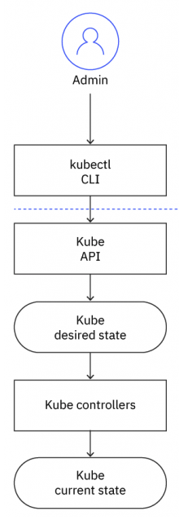
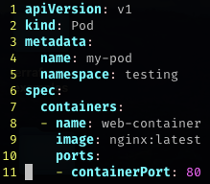
Come creiamo un pod all’interno del cluster?
Agenda
Approccio imperativo:
kubectl create deployment my-deployment --image=nginx:latest -n testing
Approccio dichiarativo:
kubectl apply -f manifest.yml
Notes:
Control Plane Components
kube-apiserver
The API server is a component of the Kubernetes control plane that exposes the Kubernetes API. The API server is the front end for the Kubernetes control plane.
etcd
Consistent and highly-available key value store used as Kubernetes' backing store for all cluster data.
kube-scheduler
Control plane component that watches for newly created Pods with no assigned node, and selects a node for them to run on.
cloud-controller-manager
Control plane component that embeds cloud-specific control logic.
kube-controller-manager
Control plane component that runs controller processes.
Logically, each controller is a separate process, but to reduce complexity, they are all compiled into a single binary and run in a single process.
Some types of these controllers are:
Node controller: Responsible for noticing and responding when nodes go down.
Job controller: Watches for Job objects that represent one-off tasks, then creates Pods to run those tasks to completion.
Node Components
Node components run on every node, maintaining running pods and providing the Kubernetes runtime environment.
kubelet
An agent that runs on each node in the cluster. It makes sure that containers are running in a Pod.
Responsibilities:
Ensuring that the node is doing its job
Ensuring state and health of running containers on the node
Enforce limits and options when containers are scheduled on the node
kube-proxy
kube-proxy is a network proxy that runs on each node in your cluster, implementing part of the Kubernetes Service concept.
Container runtime
The container runtime is the software that is responsible for running containers.

Slide 12
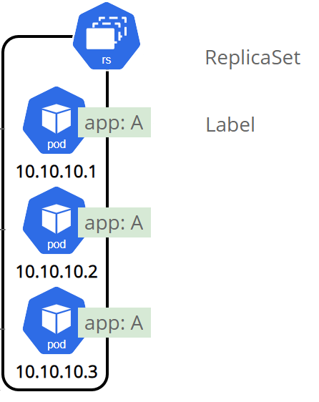
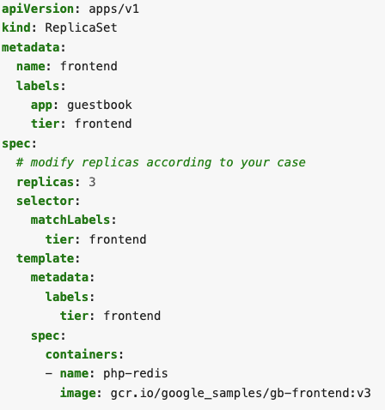
Controller: ReplicaSet
Agenda
Garantisce che un certo numero di repliche di un pod sia in esecuzione all’interno di un cluster.
Il ReplicaSet utilizza le etichette (labels) per selezionare i pod che gestisce.
Notes:
Control Plane Components
kube-apiserver
The API server is a component of the Kubernetes control plane that exposes the Kubernetes API. The API server is the front end for the Kubernetes control plane.
etcd
Consistent and highly-available key value store used as Kubernetes' backing store for all cluster data.
kube-scheduler
Control plane component that watches for newly created Pods with no assigned node, and selects a node for them to run on.
cloud-controller-manager
Control plane component that embeds cloud-specific control logic.
kube-controller-manager
Control plane component that runs controller processes.
Logically, each controller is a separate process, but to reduce complexity, they are all compiled into a single binary and run in a single process.
Some types of these controllers are:
Node controller: Responsible for noticing and responding when nodes go down.
Job controller: Watches for Job objects that represent one-off tasks, then creates Pods to run those tasks to completion.
Node Components
Node components run on every node, maintaining running pods and providing the Kubernetes runtime environment.
kubelet
An agent that runs on each node in the cluster. It makes sure that containers are running in a Pod.
Responsibilities:
Ensuring that the node is doing its job
Ensuring state and health of running containers on the node
Enforce limits and options when containers are scheduled on the node
kube-proxy
kube-proxy is a network proxy that runs on each node in your cluster, implementing part of the Kubernetes Service concept.
Container runtime
The container runtime is the software that is responsible for running containers.

Slide 13
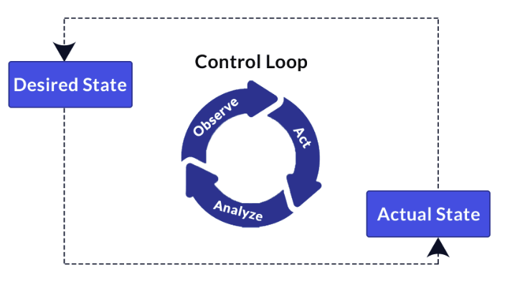
Agenda
Reconciliation Loops
In un cluster Kubernetes ci sono controller dedicati per gestire diversi tipi di risorse.
Ogni controller è responsabile di garantire che il numero di repliche o lo stato delle risorse che gestisce corrisponda allo stato desiderato.
Il Reconciliation Loops è il processo in cui il controller confronta questi due stati e se nota un configuration drift, prende le misure necessarie per allineare lo stato attuale con quello desiderato.
Questo Reconcile loop avviene in modo continuo e ciclico.
Notes:
Control Plane Components
kube-apiserver
The API server is a component of the Kubernetes control plane that exposes the Kubernetes API. The API server is the front end for the Kubernetes control plane.
etcd
Consistent and highly-available key value store used as Kubernetes' backing store for all cluster data.
kube-scheduler
Control plane component that watches for newly created Pods with no assigned node, and selects a node for them to run on.
cloud-controller-manager
Control plane component that embeds cloud-specific control logic.
kube-controller-manager
Control plane component that runs controller processes.
Logically, each controller is a separate process, but to reduce complexity, they are all compiled into a single binary and run in a single process.
Some types of these controllers are:
Node controller: Responsible for noticing and responding when nodes go down.
Job controller: Watches for Job objects that represent one-off tasks, then creates Pods to run those tasks to completion.
Node Components
Node components run on every node, maintaining running pods and providing the Kubernetes runtime environment.
kubelet
An agent that runs on each node in the cluster. It makes sure that containers are running in a Pod.
Responsibilities:
Ensuring that the node is doing its job
Ensuring state and health of running containers on the node
Enforce limits and options when containers are scheduled on the node
kube-proxy
kube-proxy is a network proxy that runs on each node in your cluster, implementing part of the Kubernetes Service concept.
Container runtime
The container runtime is the software that is responsible for running containers.

Slide 14

Notes:
Control Plane Components
kube-apiserver
The API server is a component of the Kubernetes control plane that exposes the Kubernetes API. The API server is the front end for the Kubernetes control plane.
etcd
Consistent and highly-available key value store used as Kubernetes' backing store for all cluster data.
kube-scheduler
Control plane component that watches for newly created Pods with no assigned node, and selects a node for them to run on.
cloud-controller-manager
Control plane component that embeds cloud-specific control logic.
kube-controller-manager
Control plane component that runs controller processes.
Logically, each controller is a separate process, but to reduce complexity, they are all compiled into a single binary and run in a single process.
Some types of these controllers are:
Node controller: Responsible for noticing and responding when nodes go down.
Job controller: Watches for Job objects that represent one-off tasks, then creates Pods to run those tasks to completion.
Node Components
Node components run on every node, maintaining running pods and providing the Kubernetes runtime environment.
kubelet
An agent that runs on each node in the cluster. It makes sure that containers are running in a Pod.
Responsibilities:
Ensuring that the node is doing its job
Ensuring state and health of running containers on the node
Enforce limits and options when containers are scheduled on the node
kube-proxy
kube-proxy is a network proxy that runs on each node in your cluster, implementing part of the Kubernetes Service concept.
Container runtime
The container runtime is the software that is responsible for running containers.

Slide 15
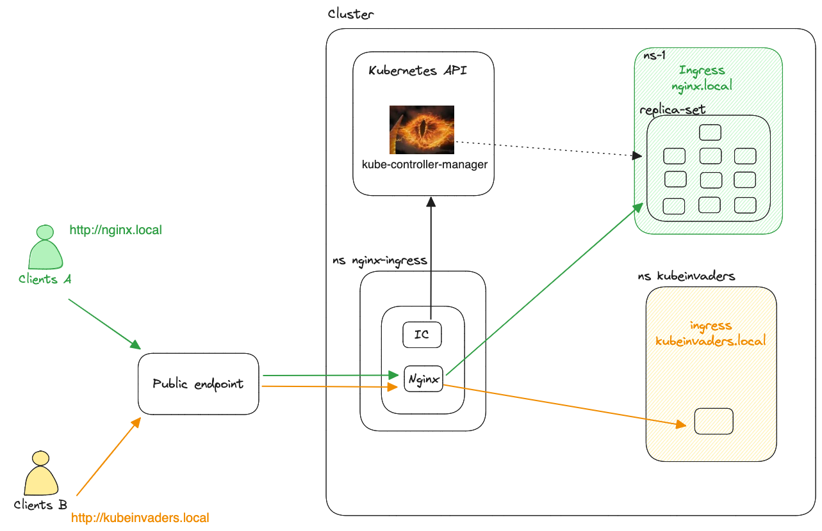
Agenda
Notes:
Control Plane Components
kube-apiserver
The API server is a component of the Kubernetes control plane that exposes the Kubernetes API. The API server is the front end for the Kubernetes control plane.
etcd
Consistent and highly-available key value store used as Kubernetes' backing store for all cluster data.
kube-scheduler
Control plane component that watches for newly created Pods with no assigned node, and selects a node for them to run on.
cloud-controller-manager
Control plane component that embeds cloud-specific control logic.
kube-controller-manager
Control plane component that runs controller processes.
Logically, each controller is a separate process, but to reduce complexity, they are all compiled into a single binary and run in a single process.
Some types of these controllers are:
Node controller: Responsible for noticing and responding when nodes go down.
Job controller: Watches for Job objects that represent one-off tasks, then creates Pods to run those tasks to completion.
Node Components
Node components run on every node, maintaining running pods and providing the Kubernetes runtime environment.
kubelet
An agent that runs on each node in the cluster. It makes sure that containers are running in a Pod.
Responsibilities:
Ensuring that the node is doing its job
Ensuring state and health of running containers on the node
Enforce limits and options when containers are scheduled on the node
kube-proxy
kube-proxy is a network proxy that runs on each node in your cluster, implementing part of the Kubernetes Service concept.
Container runtime
The container runtime is the software that is responsible for running containers.

Slide 16


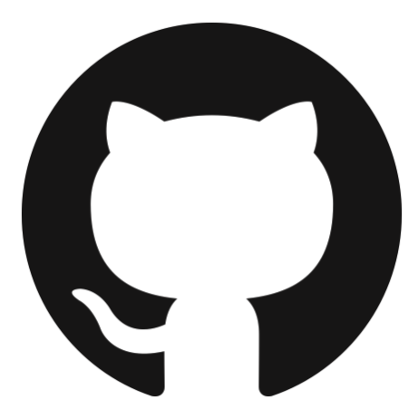


Contatti
Agenda
Ettore Ciarcia
Canale Telegram
info@twc-italia.org
ettoreciarcia
ettoreciarcia.com
Presentazione + Demo
Notes:
Control Plane Components
kube-apiserver
The API server is a component of the Kubernetes control plane that exposes the Kubernetes API. The API server is the front end for the Kubernetes control plane.
etcd
Consistent and highly-available key value store used as Kubernetes' backing store for all cluster data.
kube-scheduler
Control plane component that watches for newly created Pods with no assigned node, and selects a node for them to run on.
cloud-controller-manager
Control plane component that embeds cloud-specific control logic.
kube-controller-manager
Control plane component that runs controller processes.
Logically, each controller is a separate process, but to reduce complexity, they are all compiled into a single binary and run in a single process.
Some types of these controllers are:
Node controller: Responsible for noticing and responding when nodes go down.
Job controller: Watches for Job objects that represent one-off tasks, then creates Pods to run those tasks to completion.
Node Components
Node components run on every node, maintaining running pods and providing the Kubernetes runtime environment.
kubelet
An agent that runs on each node in the cluster. It makes sure that containers are running in a Pod.
Responsibilities:
Ensuring that the node is doing its job
Ensuring state and health of running containers on the node
Enforce limits and options when containers are scheduled on the node
kube-proxy
kube-proxy is a network proxy that runs on each node in your cluster, implementing part of the Kubernetes Service concept.
Container runtime
The container runtime is the software that is responsible for running containers.

Slide 17
Thank you
Agenda
Notes:
Control Plane Components
kube-apiserver
The API server is a component of the Kubernetes control plane that exposes the Kubernetes API. The API server is the front end for the Kubernetes control plane.
etcd
Consistent and highly-available key value store used as Kubernetes' backing store for all cluster data.
kube-scheduler
Control plane component that watches for newly created Pods with no assigned node, and selects a node for them to run on.
cloud-controller-manager
Control plane component that embeds cloud-specific control logic.
kube-controller-manager
Control plane component that runs controller processes.
Logically, each controller is a separate process, but to reduce complexity, they are all compiled into a single binary and run in a single process.
Some types of these controllers are:
Node controller: Responsible for noticing and responding when nodes go down.
Job controller: Watches for Job objects that represent one-off tasks, then creates Pods to run those tasks to completion.
Node Components
Node components run on every node, maintaining running pods and providing the Kubernetes runtime environment.
kubelet
An agent that runs on each node in the cluster. It makes sure that containers are running in a Pod.
Responsibilities:
Ensuring that the node is doing its job
Ensuring state and health of running containers on the node
Enforce limits and options when containers are scheduled on the node
kube-proxy
kube-proxy is a network proxy that runs on each node in your cluster, implementing part of the Kubernetes Service concept.
Container runtime
The container runtime is the software that is responsible for running containers.

