Slide 1
scenarios
BAU
Battery_Price_Update (BPU)
Critical_Materials_in_batteries (CMB)
Net zero (NZ)
Traditional_Cars_Ban (TCB)

Slide 2
Battery price update
(grafico con la linea default e la nostra linea)

Slide 3
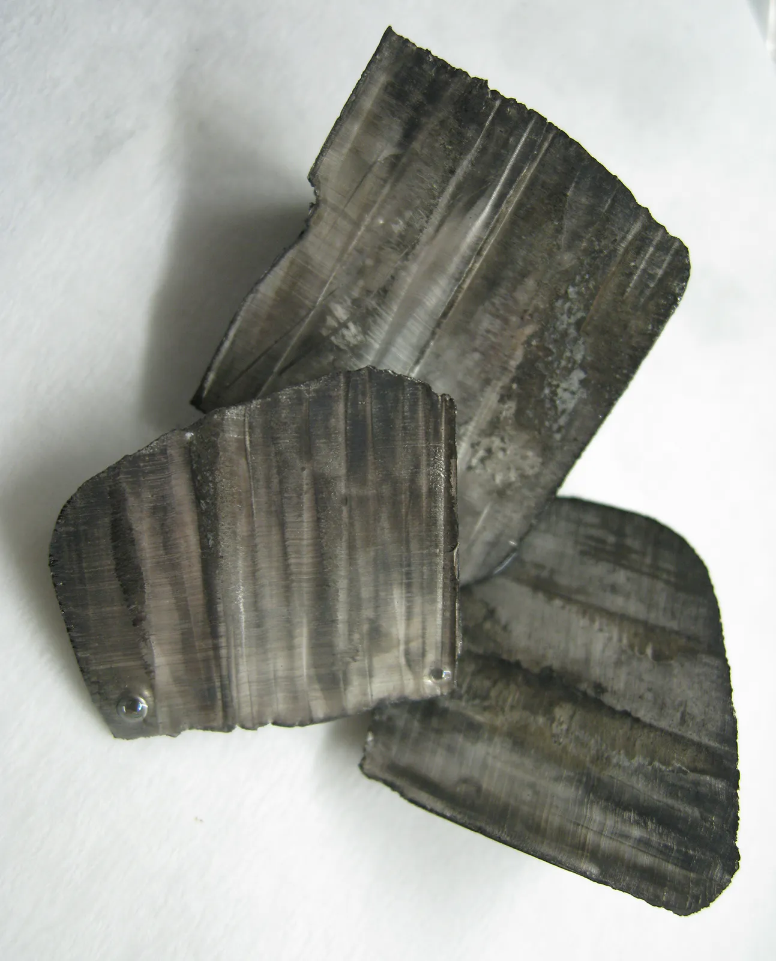
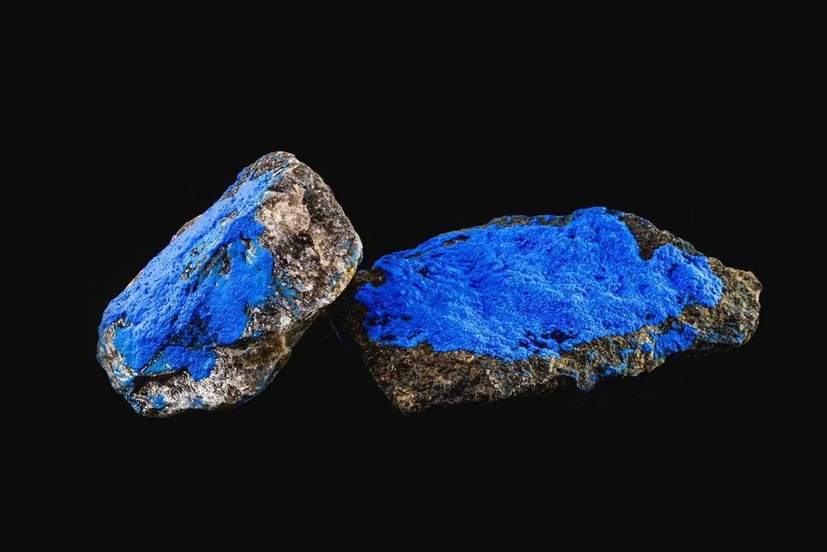
materials
Lithium
Cobalt

Slide 4
Critical Materials in batteries
Price battery
Price Lithium + Price Cobalt + Remainder Price

Slide 5


NET-ZERo
IRA (Inflation Reduction Act)
Net zero in 2050
50% of 2005 CO2 emissions in 2030
Fit-For-55
Net zero in 2050
55% of 1990 CO2 emissions in 2030

Slide 6

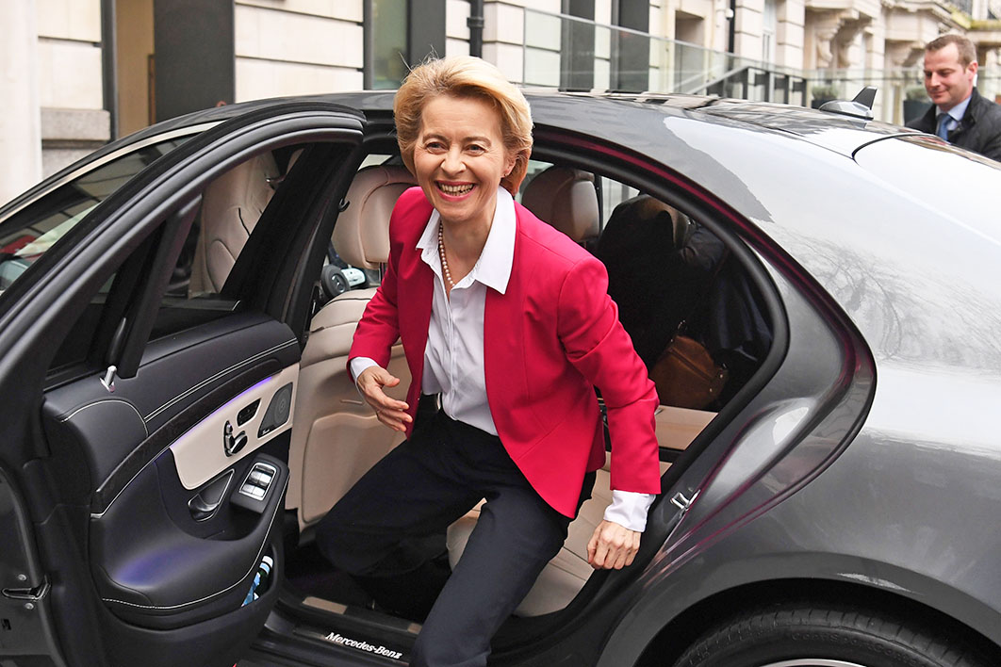
Traditional Cars ban
25% Zero-Emission Vehicle sales
Light Duty Vehicles
Starting from 2035
100% Zero-Emission Vehicle sales
Light Duty Vehicles
Starting from 2035

