Slide 1
Analysis and Evaluation of Dataset Using Machine Learning Algorithms
Elliot Tuckerman

Slide 2
Introduction
To discuss the analysis and evaluation of a dataset using various machine learning algorithms
Decide which algorithms, supervised and unsupervised, performed better on the dataset

Slide 3
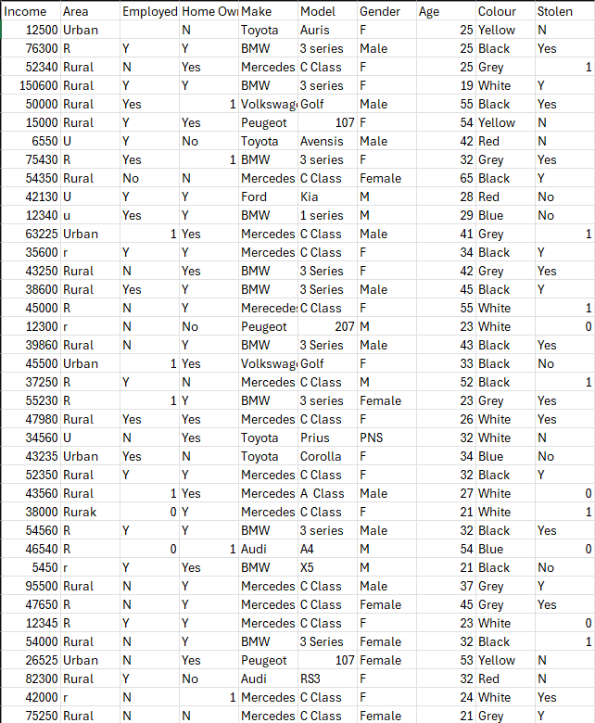
The Dataset
The dataset consist of information about car owners' data and whether their car is marked as stolen or not.
As you can see the dataset is messy and unorganised, there are multiple different values for the same outcome I.E “1, Yes, Y, y, yes” all meaning the same thing
Before performing machine learning algorithms on a dataset, it is vital to thoroughly clean the data.

Slide 4
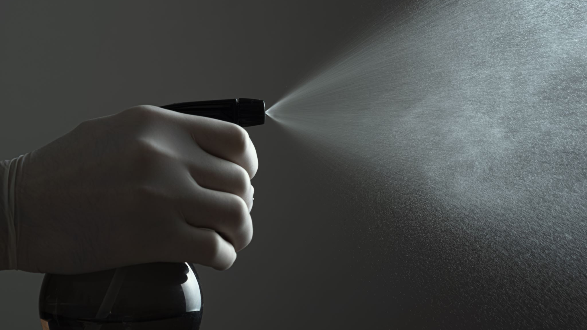
Data Cleaning

Slide 5
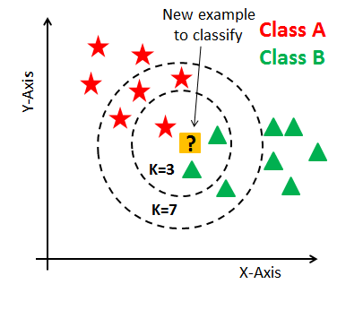
Supervised Learning: K-Nearest Neighbours (KNN)
KNN is an algorithm that works based on the principle of similarity. It classifies data points based on the majority class of their k-nearest neighbours in the feature space. The choice of k determines the number of neighbours considered during classification.

Slide 6
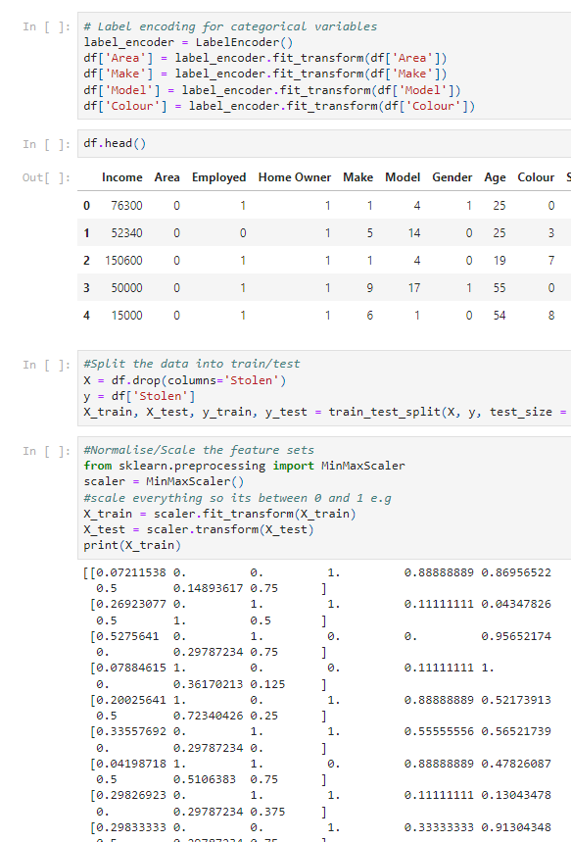
Supervised Learning: K-Nearest Neighbours (KNN)
Data Preprocessing:
Imported necessary libraries.
Read the dataset using pandas.
Encoded categorical variables using label encoding.
Split the data into training and testing sets.
Scaled the features using MinMaxScaler.

Slide 7
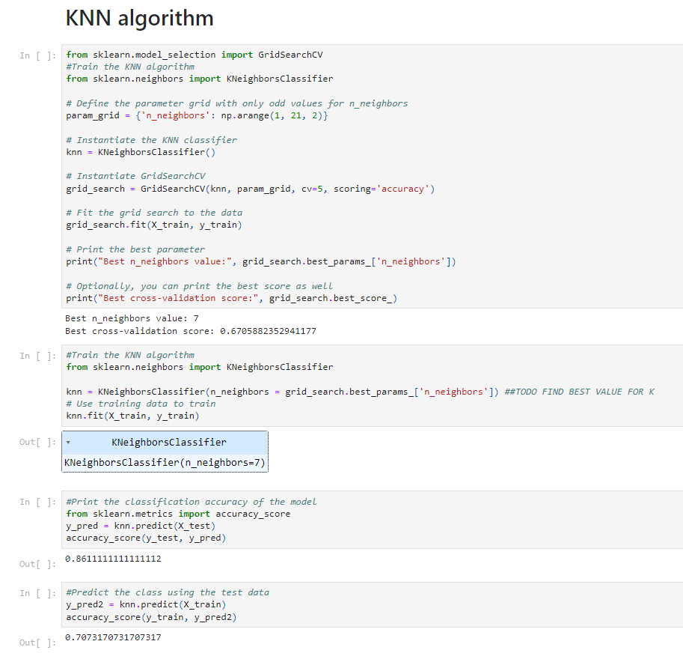
Supervised Learning: K-Nearest Neighbours (KNN)
Used GridSearchCV to find the best value for the hyperparameter n_neighbors.
Split your dataset into training and validation sets for each iteration of cross-validation. Let's say you choose 5-fold cross-validation. In each fold, 80% of the data will be used for training, and 20% will be used for validation.
Initialized and trained the KNN classifier with the best parameter.
Evaluated the model's performance on the training and testing sets.

Slide 8
Metrics
Accuracy:
Training Set: 70.73%
Testing Set: 86.11%
Indicates the overall correctness of the model's predictions.
While the testing set accuracy is reasonably high, the large gap between training and testing accuracies indicates that the model might be overfitting to the training data.
Despite this, the model seems to generalize reasonably well to unseen data. An accuracy of 86.11% on the testing set suggests that the model is performing well on new, unseen samples.

Slide 9
Metrics
Precision:
Precision for class 1: 82.61%
Precision for class 0: 92.31%
Proportion of correctly predicted positive cases out of all predicted positive cases.
The precision values indicate that the model performs well in terms of making accurate positive predictions for both classes

Slide 10
Metrics
Recall (Sensitivity):
Recall for class 1: 95.00%
Recall for class 0: 75.00%
Proportion of correctly predicted positive cases out of all actual positive cases.
High recall values suggest that the model is good at capturing positive instances, but it's important to note that recall may have come at the expense of precision.

Slide 11
Metrics
F1-score:
F1-score for class 1: 88.37%
F1-score for class 0: 83.15%
Harmonic mean of precision and recall, provides balance between the two.
The provided F1-score values indicate that the model achieves a good balance between precision and recall for both classes.

Slide 12
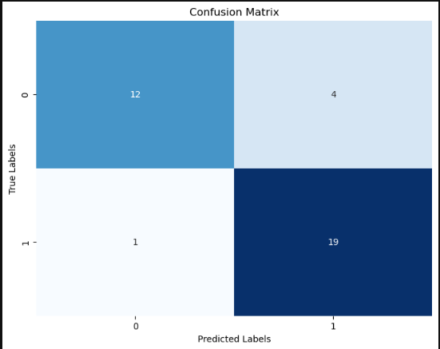
Metrics
Confusion Matrix:
True Positives (TP): 12
True Negatives (TN): 19
False Positives (FP): 4
False Negatives (FN): 1
Illustrates the distribution of correct and incorrect predictions.
The confusion matrix shows that the KNN model made 12 correct predictions of class 0 (true negatives) and 19 correct predictions of class 1 (true positives). However, it also made 4 incorrect predictions of class 1 (false positives) and 1 incorrect prediction of class 0 (false negative).

Slide 13
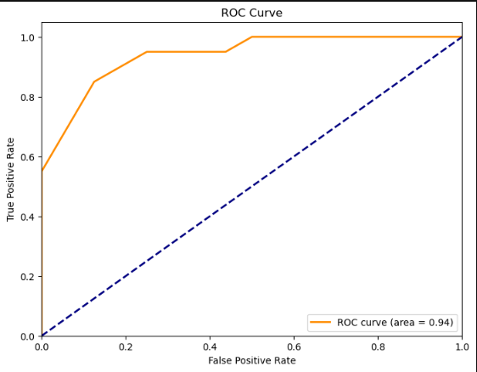
Metrics
ROC Curve:
Area Under Curve: 0.94
Demonstrates model's discrimination power across different threshold settings.
The area indicates that the model has good discriminatory power and performs well across various threshold settings.

Slide 14
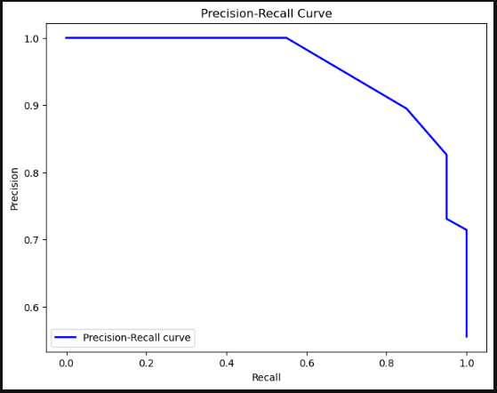
Metrics
Precision-Recall Curve:
Shows trade-off between precision and recall.
Highlights model's ability to minimize false positives while maximizing true positives.
The precision-recall curve showcases the trade-off between precision and recall across different threshold settings. The curve demonstrates high precision and recall values, suggesting that the model performs well in correctly identifying positive instances while minimizing false positives.

Slide 15
Possible Improvements for KNN
The KNN model demonstrates strong predictive performance overall, with high accuracy and AUC. It effectively discriminates between the two classes and maintains a good balance between precision and recall.
However, there are a few false positive and false negative predictions, indicating potential areas for improvement.
Consider techniques to reduce overfitting, such as regularization, collecting more diverse training data, or simplifying the model architecture.

Slide 16
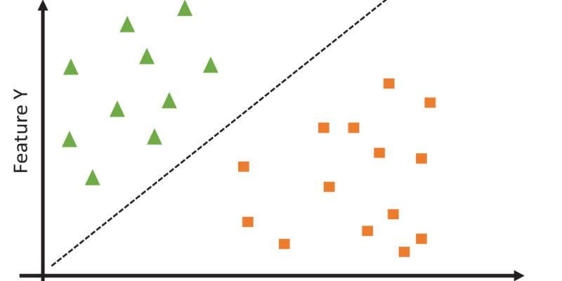
Supervised Learning: Support Vector Machine (SVM)
SVM is a powerful supervised learning algorithm used for classification tasks. It works by finding the hyperplane that best separates the classes in the feature space. The optimal hyperplane is the one that maximizes the margin, i.e., the distance between the hyperplane and the nearest data points (support vectors) from each class.

Slide 17
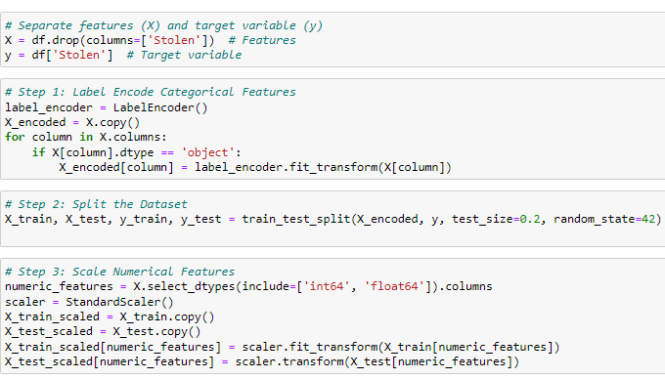
Supervised Learning: SVM
Data Loading as before
Data preprocessing - Separated the features (X) from the target variable (y) using DataFrame slicing.
Conducted label encoding for categorical features to convert them into numerical representations using LabelEncoder.
Split the dataset into training and testing sets using train_test_split from sklearn.model_selection.
Scaled the numerical features using StandardScaler to ensure that all features have the same scale, which is crucial for SVM.

Slide 18

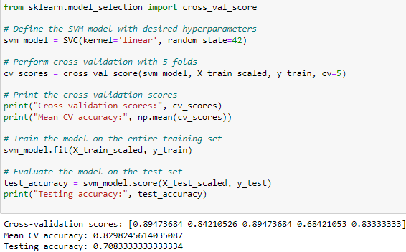
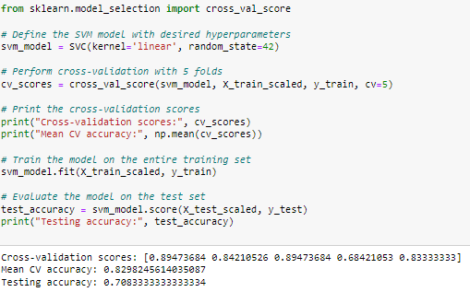
Supervised Learning: SVM
Initialized an SVM model with a linear kernel using SVC from sklearn.svm.
Trained the SVM model on the training data using the fit() method.
Performed cross-validation using cross_val_score to estimate the model's performance on unseen data.
Evaluated the trained model's performance on the test set using score() method to calculate accuracy.
Utilized classification metrics such as precision, recall, and F1-score using classification_report.
Examined feature importance by analysing the coefficients of the SVM model using svm_model.coef_.
Generated an ROC curve and calculated the AUC (Area Under the Curve) to assess the model's performance.
Constructed a confusion matrix using confusion_matrix to visualize the model's predictions.

Slide 19
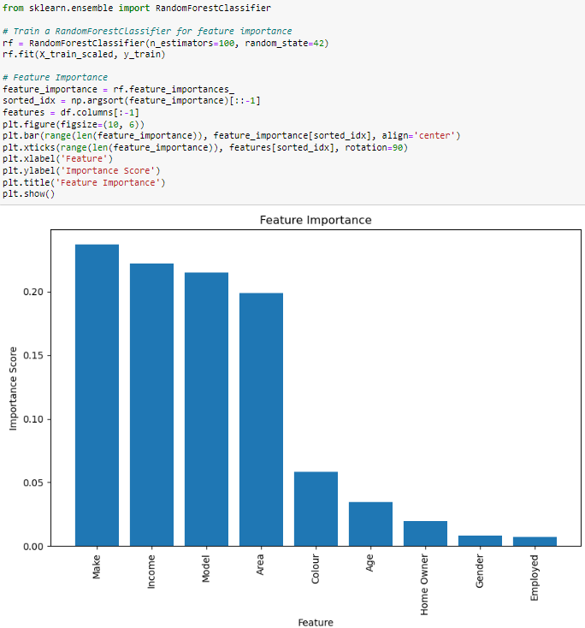
The Feature Analysis (Random Forest Classifier)
The RandomForestClassifier was used to analyze feature importance in the dataset.
Utilized RandomForestClassifier to assess feature importance.
Trained the classifier with 100 decision trees and a fixed random state for reproducibility.
Calculated feature importance scores using rf.feature_importances_.
Plotted feature importance scores in a bar chart to visualize the importance of each feature.
Income and age are the only numerical values in the dataset, but this can be used for other datasets which contain multiple numerical labels

Slide 20
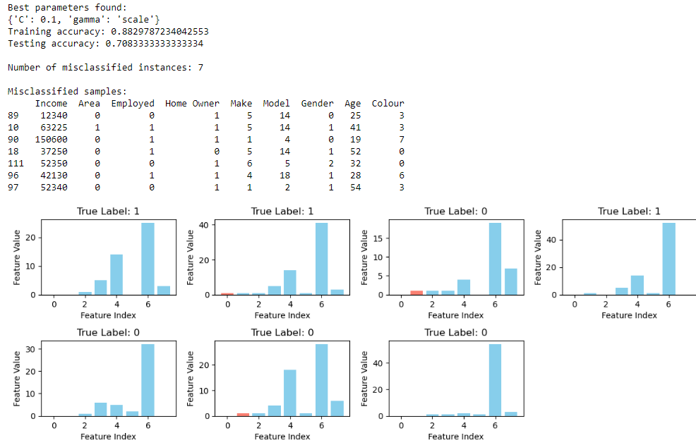
Metrics
A misclassified instance refers to a data point in a classification task that is incorrectly labelled by the model. In other words, the model predicted a different class label for the instance than its true label.
Misclassified instances include variations in features like "Income," "Area," and "Age."
Features with higher importance in predicting true labels include "Income," "Age," and "Gender."

Slide 21
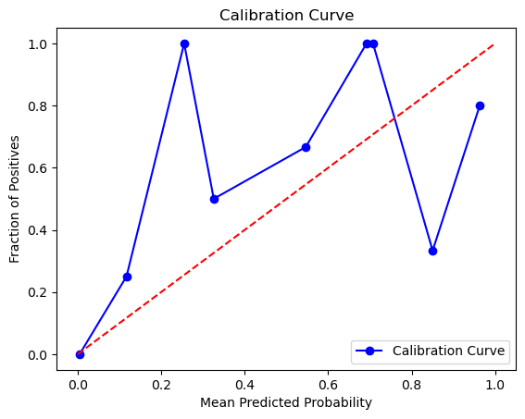
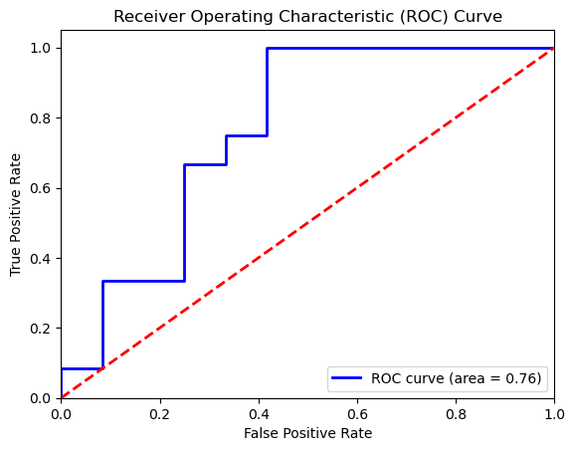
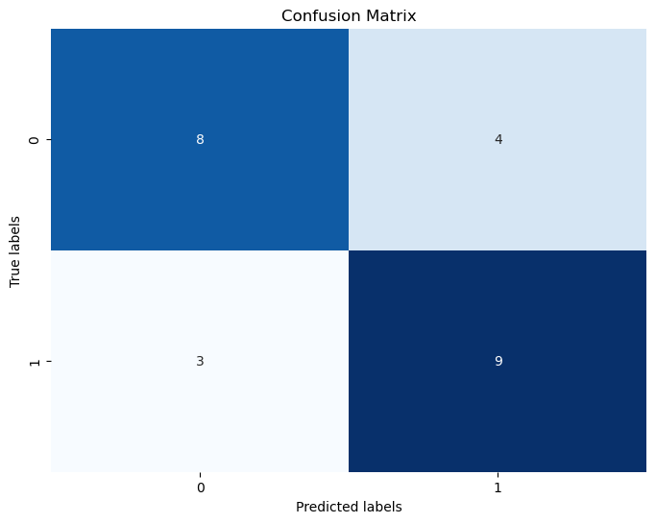
Metrics
The calibration curve visualizes the relationship between the mean predicted probability of a model and the fraction of positives (or true positives) in the dataset.
In binary classification tasks, the mean predicted probability represents the average probability assigned by the model for the positive class across different samples or instances.

Slide 22





Comparison so far
1. K-Nearest Neighbours (KNN):
Training Accuracy: 0.872
Testing Accuracy: 0.826
Classification Report:
Precision: 0.836
Recall: 0.765
F1-score: 0.799
Support Vector Machine (SVM):
Training Accuracy: 0.882
Testing Accuracy: 0.868
Classification Report:
Precision: 0.692
Recall: 0.773
F1-score: 0.721

Slide 23
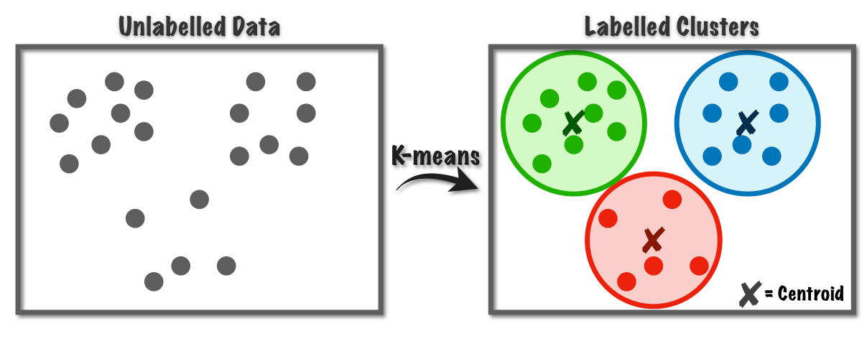
Unsupervised Learning Algorithms - K-Means Clustering
K-Means is a popular unsupervised learning algorithm used for clustering tasks. It partitions the dataset into k clusters based on similarities in the feature space. The algorithm iteratively assigns data points to the nearest cluster centroid and updates the centroids until convergence.

Slide 24
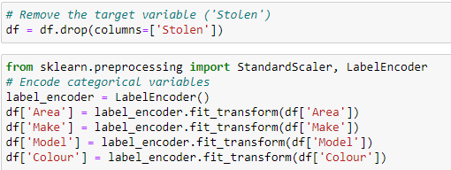
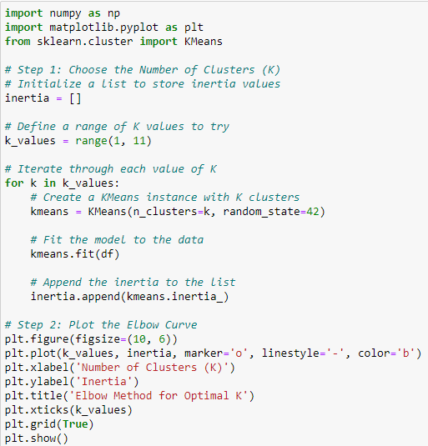
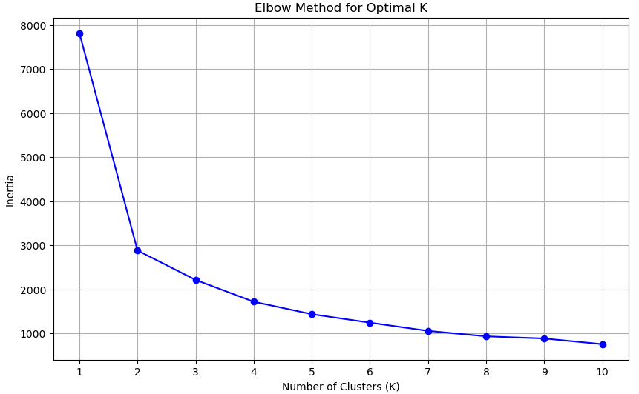
Unsupervised Learning Algorithms - K-Means Clustering
Data Preprocessing and drop “Stolen”
Determining the Optimal Number of Clusters (K):

Slide 25
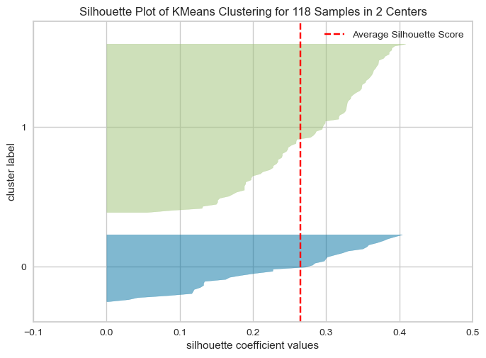
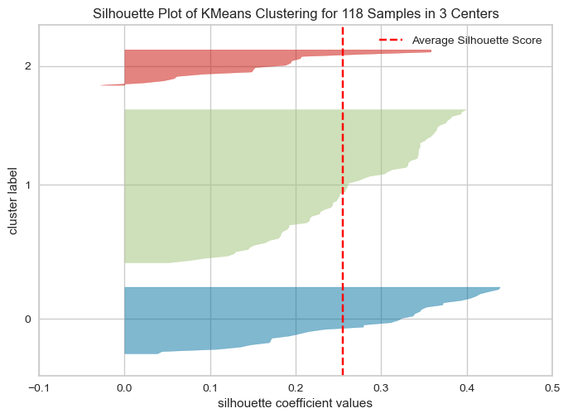
Unsupervised Learning Algorithms - K-Means Clustering
Ensure value of K is correct with silhouette graphs
When a data point has a negative silhouette coefficient, it means that it is closer to neighbouring clusters than to its assigned cluster. This suggests poor clustering quality and indicates that the clusters may be overlapping or poorly separated.

Slide 26
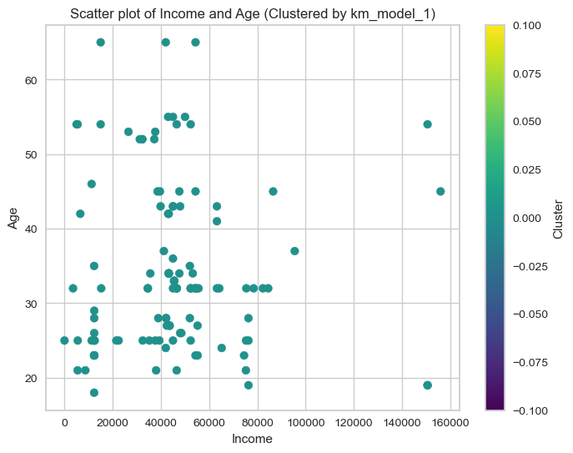
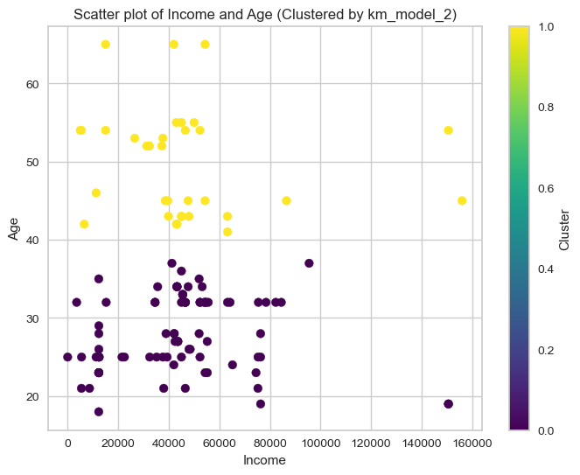
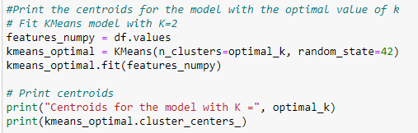
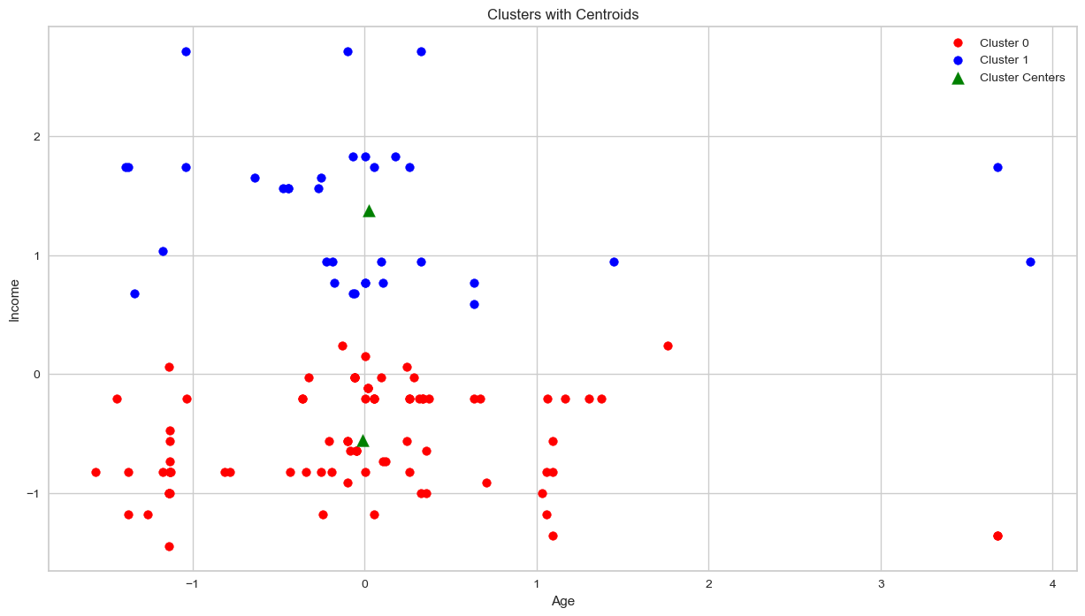
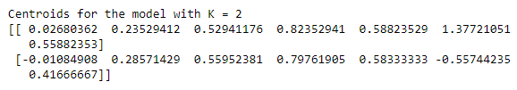
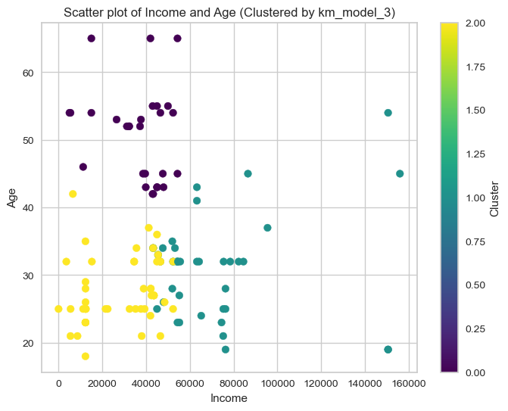
Unsupervised Learning Algorithms - K-Means Clustering
Fitted a K-means clustering model with optimal K value to the scaled data.
Added cluster labels to dataset
Visualised clusters by plotting scatter plot of data points coloured by cluster labels and plotted centroids of clusters.

Slide 27
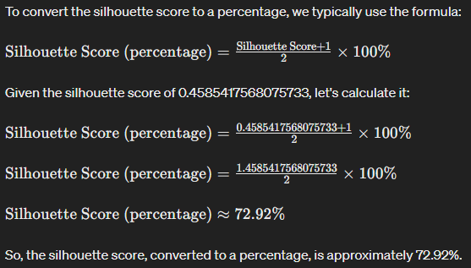
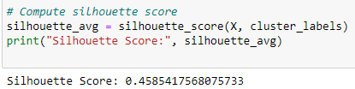
Metrics
Since K-means clustering is unsupervised, it doesn't have precision, recall, and F1-score like supervised algorithms.
However, you can still analyse the clusters to see if they align with your expectations and domain knowledge.
Let’s examine whether the clusters represent distinct groups or if there is overlap between them.
For accuracy we can check the silhouette score
A silhouette score of 0.4585 indicates a reasonably good separation between the clusters. Here's how to interpret this score:
The silhouette score ranges from -1 to 1.
A score closer to 1 suggests that the clusters are well-separated.
A score around 0 indicates overlapping clusters.
A negative score suggests that data points may have been assigned to the wrong cluster.
To convert the silhouette score to a percentage, we typically use the formula:
Given the silhouette score of 0.46, the calculation would be:
So, the silhouette score converted to a percentage is approximately 72.92%

Slide 28
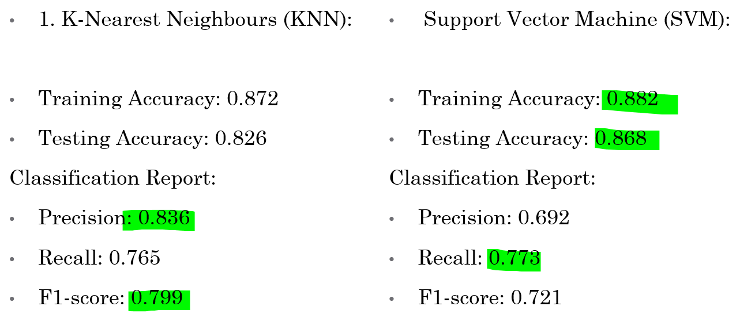
Comparison so far
SUPERVISED UNSUPERVISED
K-Means Clustering
Silhouette score as a percentage: 72.92%

Slide 29
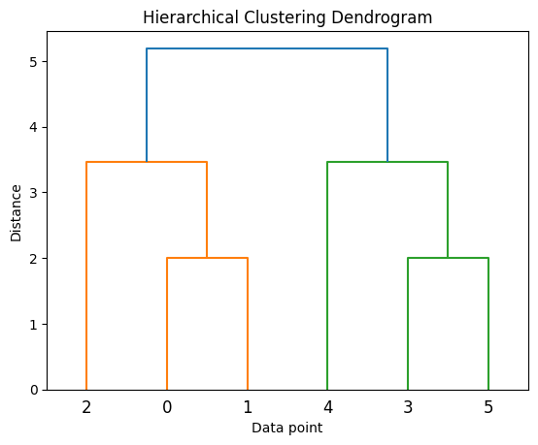
Unsupervised Learning: Hierarchical Clustering
Hierarchical Clustering is another unsupervised learning algorithm used for clustering tasks. It creates a hierarchy of clusters by recursively merging or splitting them based on the similarity between data points.

Slide 30
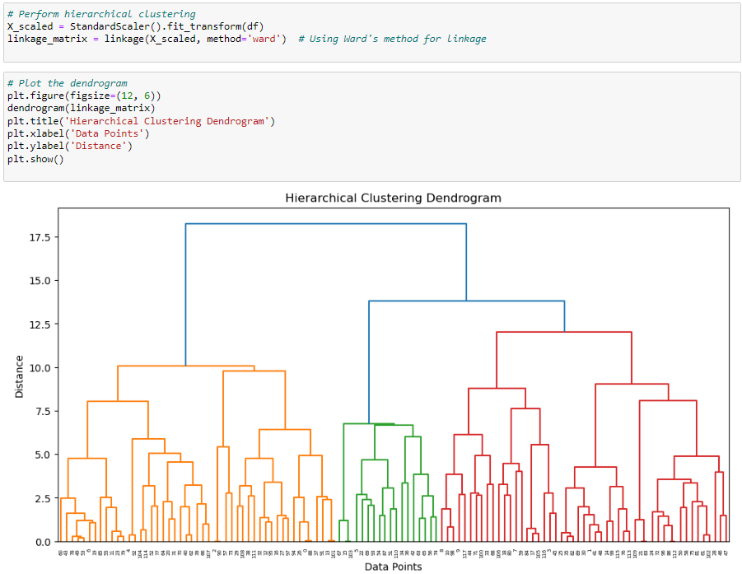
Unsupervised Learning: Hierarchical Clustering
Accurate but sensitive to outliers
Loaded and pre-processed the dataset and dropped the 'Stolen' column since it represents the target variable.
Performed hierarchical clustering on the scaled data using Ward's method for linkage, which minimizes the within-cluster variance.
The dendrogram was plotted to visualize the hierarchical clustering structure.
Specified the desired number of clusters (in this case, 2 clusters) based on prior knowledge or analysis.
Cluster assignments were extracted using the fcluster function with the specified number of clusters.

Slide 31
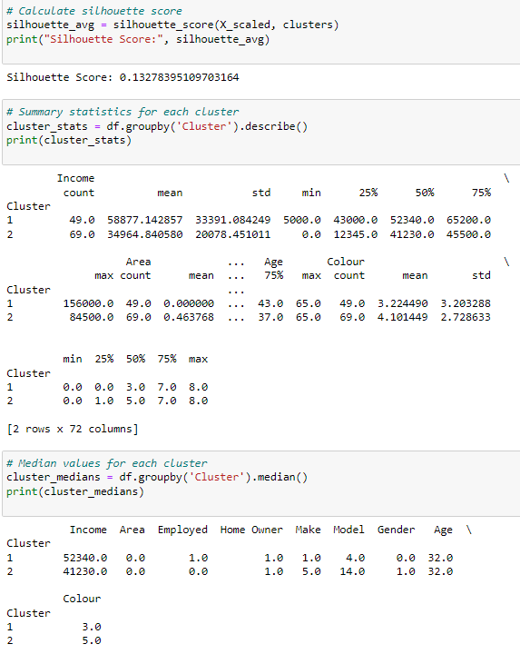
Metrics
Silhouette score was calculated as a metric to evaluate the quality of the clustering. The silhouette score measures the compactness and separation of clusters, with higher scores indicating better-defined clusters.
Summary statistics and median values for each cluster were computed to understand the characteristics of the clusters.
The silhouette score provides an overall assessment of the clustering quality. A higher silhouette score suggests better clustering performance.
Summary statistics and visualizations help interpret the characteristics of each cluster, such as median income and age, providing insights into the differences between clusters.
A low silhouette score in hierarchical clustering (HC) compared to other clustering algorithms could be due to several factors, including:
Sensitivity to noise and outliers: HC is sensitive to noise and outliers because it uses the distance between points to form clusters. Outliers or noisy data points can affect the clustering results and lead to lower silhouette scores.
Difficulty in identifying the optimal number of clusters: Unlike algorithms like K-means, which require specifying the number of clusters beforehand, HC doesn't have an explicit mechanism for determining the optimal number of clusters. Choosing the appropriate number of clusters can be challenging and may result in suboptimal clustering solutions, leading to lower silhouette scores.

Slide 32
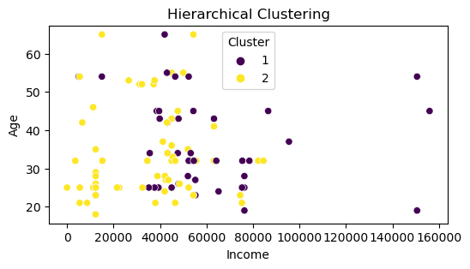
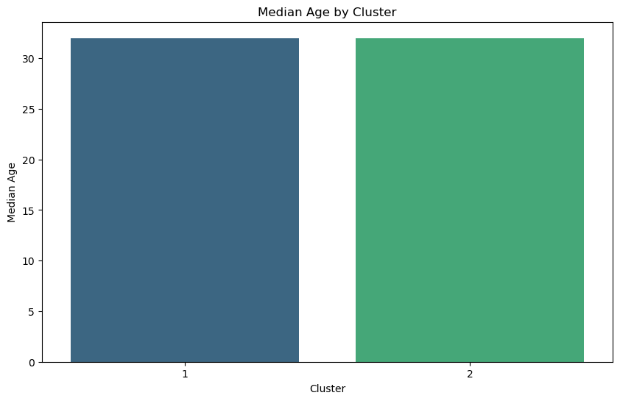
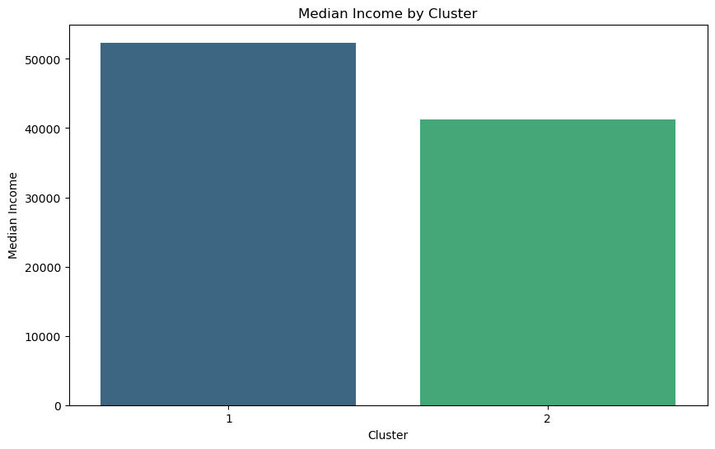
Metrics
Visualizations, such as scatterplots and bar charts, were created to visualize cluster profiles, including median income and age for each cluster.
As the scatter shows, the clustering is quite inaccurate with multiple cluster overlaps.
This could be due to the outliers present on the far right of the graph and the sensitivity of HC .

Slide 33










Conclusion
SUPERVISED UNSUPERVISED
K-Means Clustering
Silhouette score as a percentage: 72.92%
Hierarchical Clustering
Silhouette score as a percentage: 56.35%
Overall, for supervised algorithms, it’s open to personal interpretation which is better in this scenario as KNN carried the best F1-Score but lacked in both testing and training accuracy. Both KNN and SVM had similar and high results.
However, among the supervised algorithms, Support Vector Machine (SVM) demonstrated the highest testing accuracy by far and is clearly the best for the car information dataset.

Slide 34
Conclusion
Overall, for supervised algorithms, it’s open to personal interpretation which is better in this scenario as KNN carried the best F1-Score but lacked in both testing and training accuracy. Both KNN and SVM had similar and high results.
However, among the supervised algorithms, Support Vector Machine (SVM) demonstrated the highest testing accuracy by far and is clearly the best for the car information dataset.

