Slide 1



Spam or Ham?
Ephrathah Gebremichael and Turbat Enkhtur
Notes:
Spam Filtering System using Machine Learning Algorithms

Slide 2

Introduction
Unsolicited electronic messages that disrupt efficient communication.
Machine learning algorithms can be used for spam filtering
Notes:
we use machine learning algorithms to automatically identify and filter out spam messages, without requiring manual intervention from humans.

Slide 3
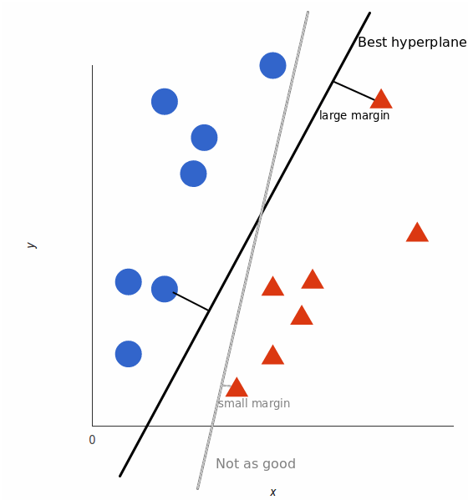
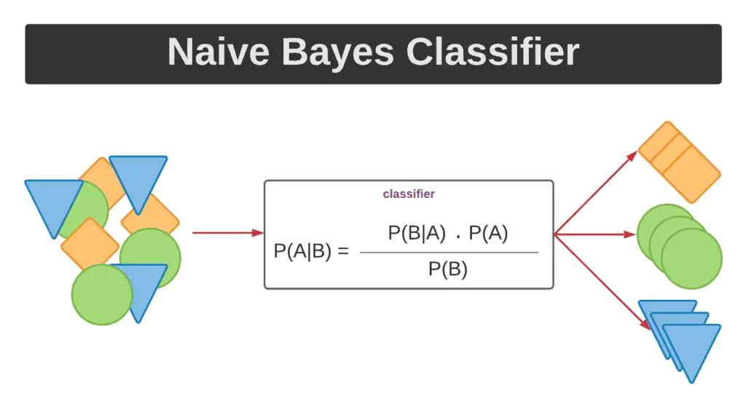
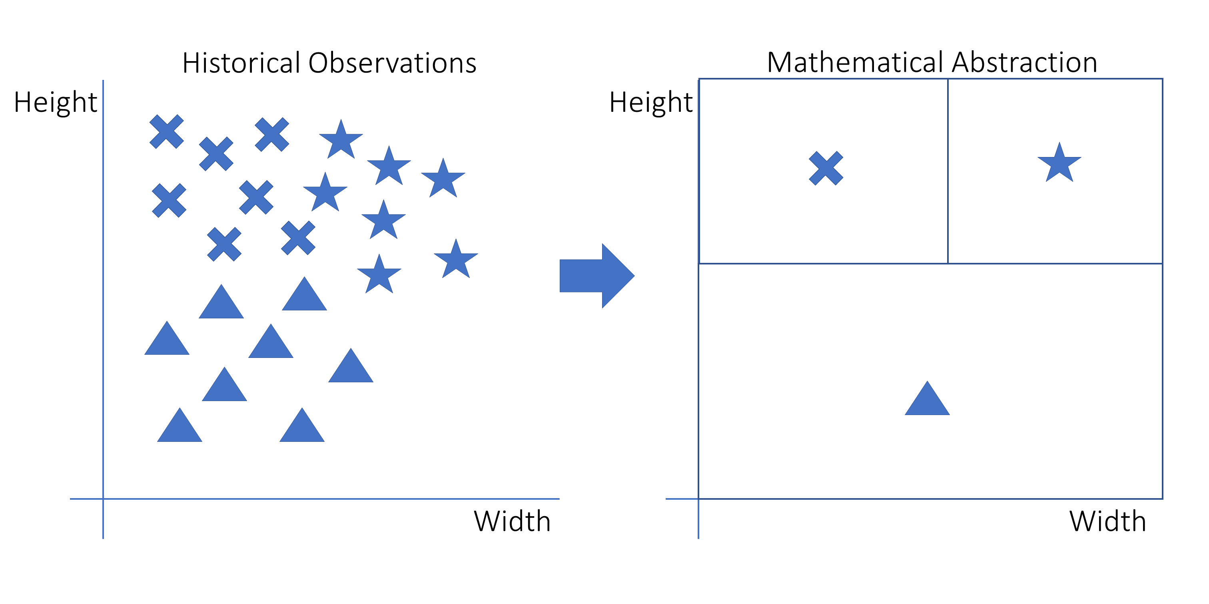
Background
Supervised learning methods evaluated for spam filtering:
Naïve Bayes algorithm estimates conditional probabilities of features given a class
k-NN algorithm looks for K nearest neighbors in the training set and assigns the class of the majority of these neighbors to the new instance
Support Vector Machine (SVM) is a parametric algorithm that tries to find a hyperplane that separates the data into different classes
Notes:
There are many different techniques that have been proposed to address the problem of spam.
There are supervised machine learning methods that have been evaluated for spam filtering:
Some examples of specific algorithms that have been used include Naïve Bayes, Super Vector Machine (SVM), and k-Nearest Neighbors (k-NN).
Naïve Bayes estimates the likelihood of a message being spam.
The best hyperplane is that plane that has the maximum distance from both the classes

Slide 4
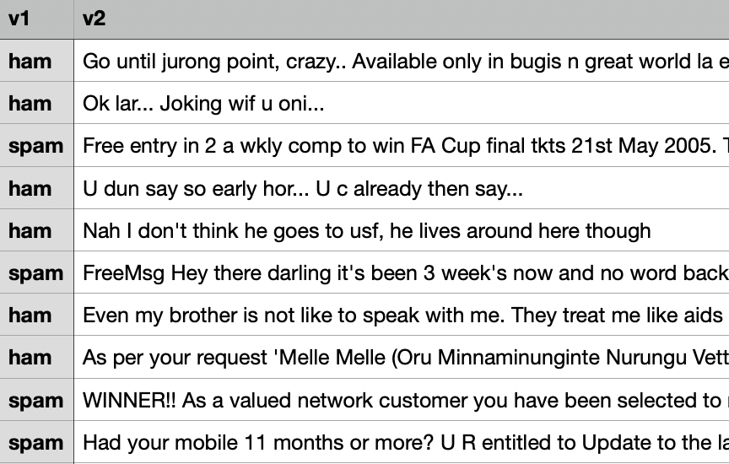
Methodology
The Spam Dataset
Advanced text preprocessing techniques and feature extraction methods employed, such as Term Frequency-Inverse Document Frequency (TF-IDF)
Supervised learning algorithms implemented, including Naïve Bayes, SVM, and k-NN
Performance evaluation based on accuracy

Slide 5
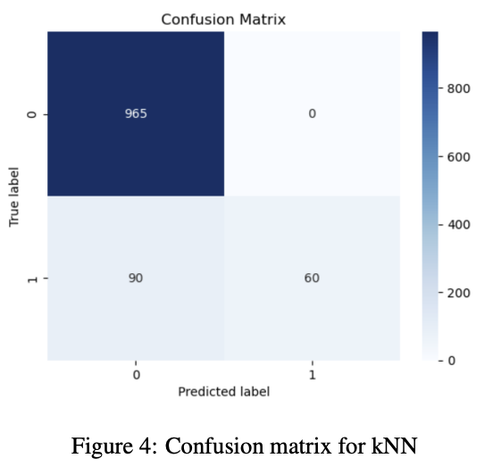
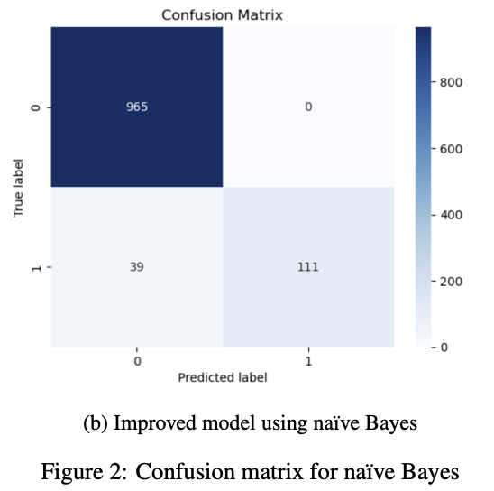
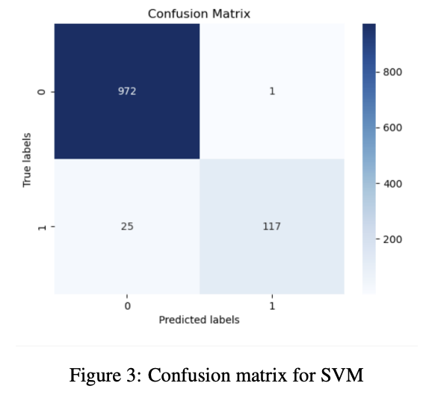
Results
k-NN classifier achieves an accuracy of 91.9%
Naive Bayes classifier achieves an accuracy of 96.5%
SVM classifier outperforms the other classifiers, achieving an accuracy of 97.6%
Notes:
SVMs are effective in high-dimensional feature spaces, which is important in spam filtering, where the number of features can be very large due to the large number of words and phrases in the text.
SVMs are robust to the presence of irrelevant features, which can be a problem in spam filtering, where many words are not indicative of whether an email is spam or not.

Slide 6
Conclusion
Feature engineering and preprocessing are essential for accurate classification
Advanced machine learning techniques can develop effective spam filtering systems
SVM classifier shows the highest accuracy among the three classifiers
Potential for further research to improve spam filtering accuracy using machine learning algorithms and feature engineering techniques.

