Slide 1
Distributed Auction- Bank
Adam Spanswick

Slide 2
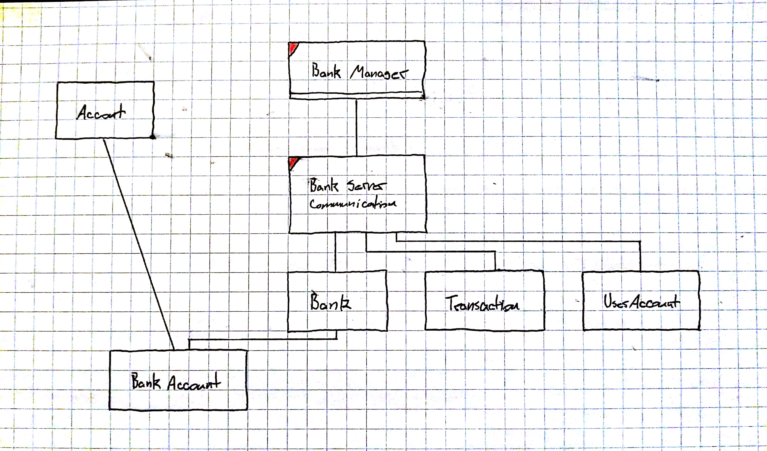
Design Diagram

Slide 3
Bank
CreateNewAccount
GetAccount
GetBankKey
NewAccount
CheckForDuplicateAccountnumbers
HandleDuplicateAccountNumbers
CheckForDuplicateBankKeys
handleDuplicateBankKeys

Slide 4
BankAccount
BankAccount
GetBankKey
GetAccountNumber
GetBalance
UpdateBalance
NewAccountNumber
NewBankKey
SetHoldBalance
GetHoldBalance
DeductHoldAmount
Inquire
GenerateBankKey
generateAccountNumber

Slide 5
BankManager
main

Slide 6
BankServerCommunication
BankServerCommunication
run

