Slide 1


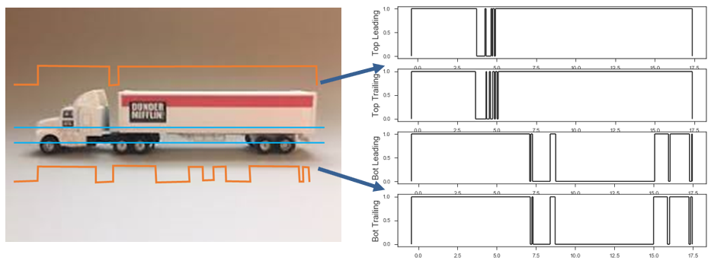
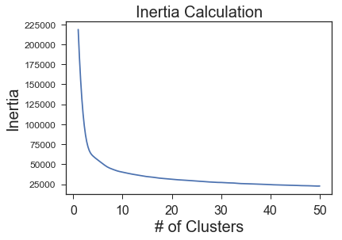
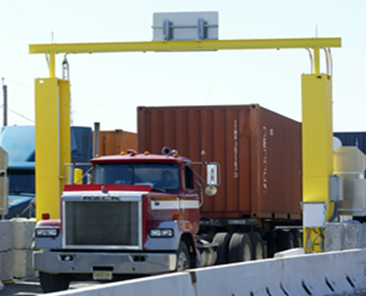
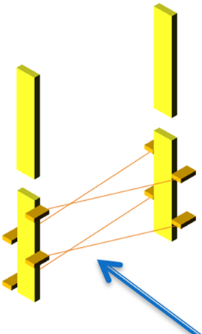
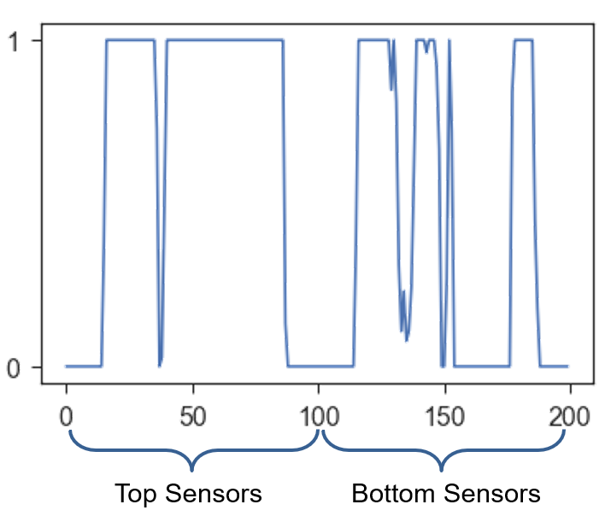
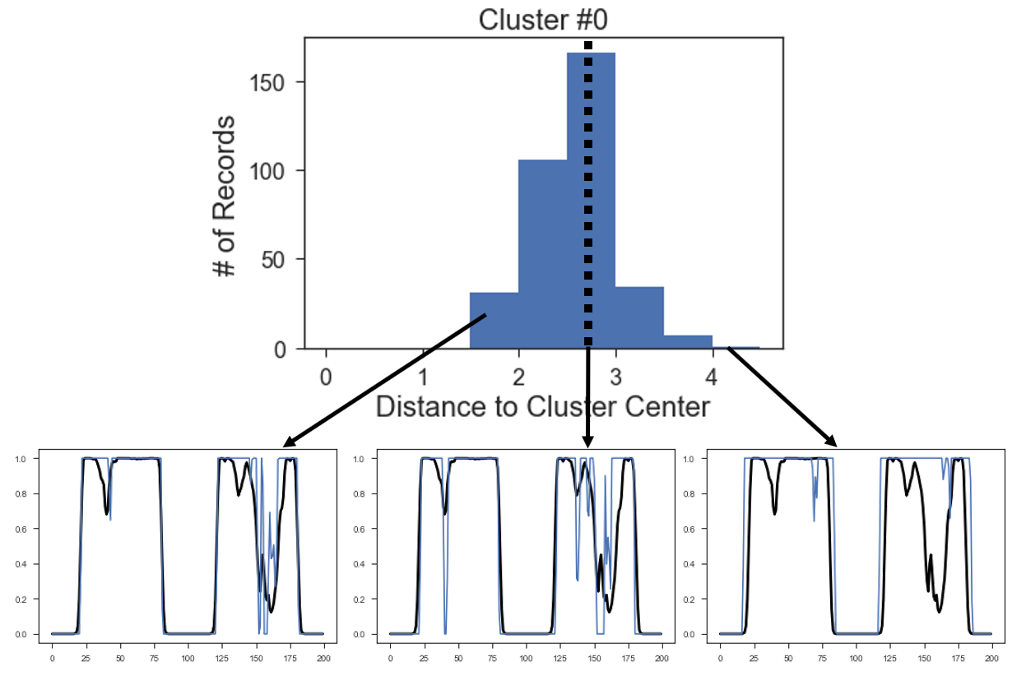
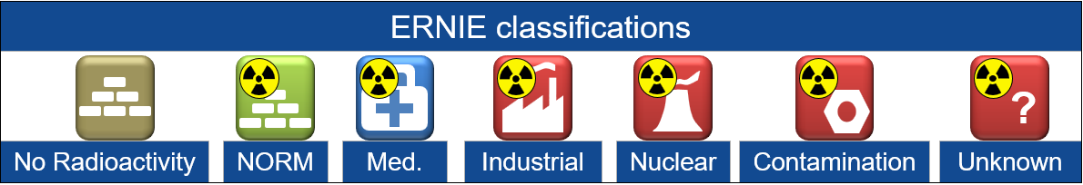
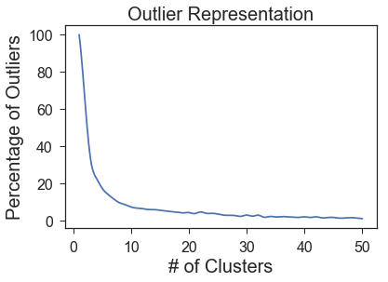
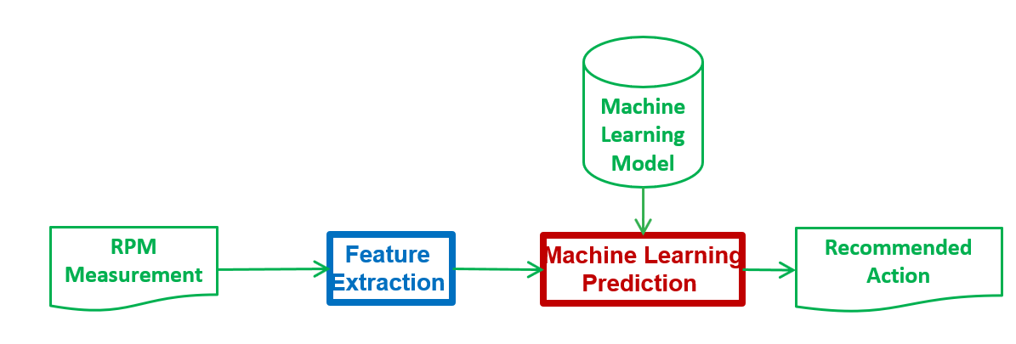
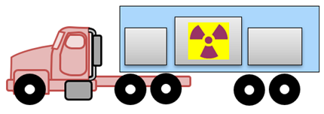
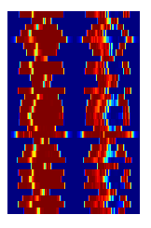
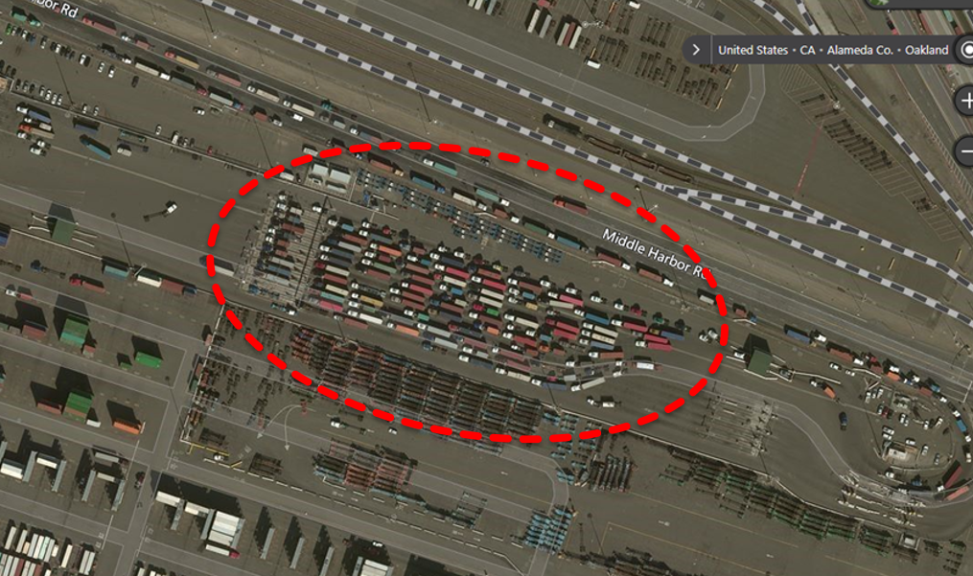

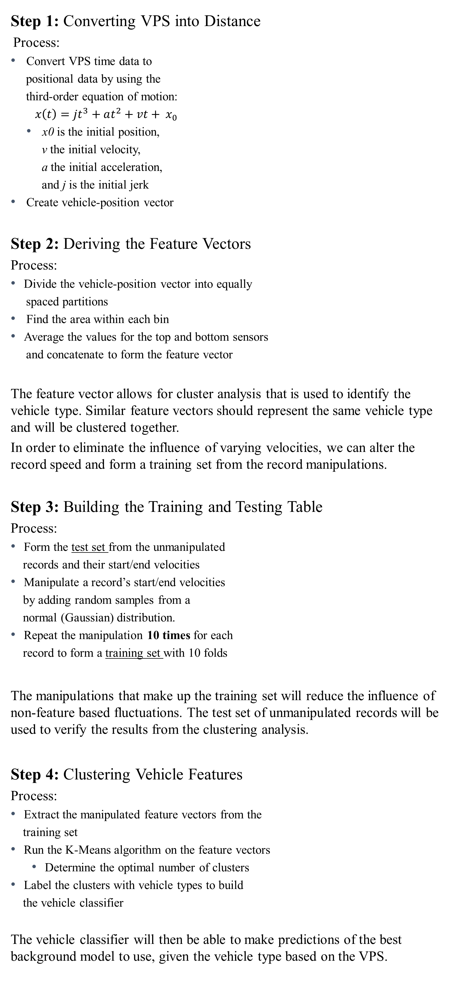


Nuclear Detection through Machine Learning
Erin Werner
Department of Homeland Security DNDO Internship - 2018
MOTIVATION
APPROACH
RESULTS
CONCLUSION
Enhanced Radiological Nuclear Inspection and Evaluation (ERNIE) is a computer system that classifies radioactive material in vehicles and cargo. ERNIE uses signal processing to extract multiple features from each radiation portal monitor scan, then uses machine learning to classify scans and make an alarm decision.
Before extracting features, ERNIE uses vehicle-specific models to account for shielding of natural background radiation. It relies on data from the Vehicle Presence Sensors (VPS) to determine the appropriate vehicle model for each scan. Picking the right vehicle model, through vehicle classification, helps ERNIE better classify scans.
Step 1: Converting VPS into Distance
Process:
Convert VPS time data to
positional data by using the
third-order equation of motion:
$x\left(t\right)=jt^{3}+at^{2}+vt+ x_{0}$
x0 is the initial position,
v the initial velocity,
a the initial acceleration,
and j is the initial jerk
Create vehicle-position vector
Step 2: Deriving the Feature Vectors
Process:
Divide the vehicle-position vector into equally
spaced partitions
Find the area within each bin
Average the values for the top and bottom sensors
and concatenate to form the feature vector
The feature vector allows for cluster analysis that is used to identify the vehicle type. Similar feature vectors should represent the same vehicle type and will be clustered together.
In order to eliminate the influence of varying velocities, we can alter the record speed and form a training set from the record manipulations.
Step 3: Building the Training and Testing Table
Process:
Form the test set from the unmanipulated
records and their start/end velocities
Manipulate a record’s start/end velocities
by adding random samples from a
normal (Gaussian) distribution.
Repeat the manipulation 10 times for each
record to form a training set with 10 folds
The manipulations that make up the training set will reduce the influence of non-feature based fluctuations. The test set of unmanipulated records will be used to verify the results from the clustering analysis.
Step 4: Clustering Vehicle Features
Process:
Extract the manipulated feature vectors from the
training set
Run the K-Means algorithm on the feature vectors
Determine the optimal number of clusters
Label the clusters with vehicle types to build
the vehicle classifier
The vehicle classifier will then be able to make predictions of the best background model to use, given the vehicle type based on the VPS.
Determining the Number of Clusters
Main criteria for picking the optimum number of clusters:
Inertia Calculation
Inertia is the sum of squared distances
of samples to their closest cluster center.
The optimal number of clusters is
determined by where the inertia levels
off. This will prevent over representation
of vehicle types in clusters.
Outlier Representation
It is apparent that the third vehicle (an
outlier) is not of the same vehicle-type
classification that is represented by
this cluster.
Thus, the optimal number of clusters is
also determined the percentage of
outliers represented within each cluster.
A number that has below 5% will prevent
under representation of vehicle types in
clusters.
Labeling Clusters
The optimal number of clusters that balances inertia and outlier representation is 32.
This number will ensure proper vehicle type representation within the set of clusters. These clusters form the classifier that quickly categorizes new scans and determines the best background model to use for nuclear material detection.
ERNIE can then provide the most likely classification of radioactive source type and location.
Vehicle classification will make ERNIE better at distinguishing the threating from non-threating material in cargo. This will reduce the number of false alarms and make the detection process more accurate and efficient.
Feature extraction through machine learning applications will help to increase threat sensitivity and improve nuclear material detection sensors at U.S. border stations.
Figure 3.1 VPS vehicle position visualization.
Figure 4.1 Inertia given the # of Clusters.
Running the K-Means algorithm with
10 clusters:
Outlier Distinction:
Distance from cluster center above 2.8
Figure 1.1 Vehicle driving through a Radiation Portal Monitor (RPM).
Figure 1.2 Setup of sensors within the portal monitors.
Figure 5.1 Table of different ERNIE classifications for detected nuclear material.
Figure 3.2 Vehicle feature vector.
1
2
3
Cluster Center
Vehicle Sample
Figure 4.2 Distribution of distance from the cluster-center and sample feature vectors from a small (1), medium (2), and large (3) distance away from the center.
OBJECTIVE
Record ID | Start Velocity | End Velocity | Feature Vector
593068297 | 3.06 m/s | 3.46 m/s | [0 0.88 1 …
593068297 | 2.74 m/s | 2.96 m/s | [0 0.35 1 …
593068297 | 3.21 m/s | 2.83 m/s | [0 0.76 1 …
593068298 | 2.48 m/s | 5.61 m/s | [0 0 0.52 …
593068298 | 4.77 m/s | 2.88 m/s | [0 0 0 0 …
NEXT STEPS
Vehicles move at varying speeds through the RPM sensors. We want to recognize the same vehicle regardless of its variations.
Calculating key attributes, such as vehicle type, will help to reduce the impact of background fluctuations.
Reducing these inconsistencies then produces a more accurate background model that can determine the cargo features for gamma feature extraction in nuclear material detection.
Vehicle classification can be achieved through:
Forming Feature Vectors
Vectors represent the vehicle structure
Running Cluster Analysis
Similar vehicles are clustered together
Building a Vehicle Classifier
Classifications indicate the vehicle type
Extract background models for each of the clusters.
Convert the vehicle classifier into Java and integrate it as part of the tool chain in ERNIE.
Make sure the tools can be run remotely at different RPM stations.
Figure 3.3 Samples from the training set.
Figure 4.3 Percentage of Outliers given the # of Clusters.
Average VPS:
Dark Blue=VPS open, Red=VPS blocked,
Other=VPS sometimes blocked
Upper Lower
Possible Labels:
40’+ tractor/trailer
40’ tractor/trailer
40’ tractor/trailer (short haul)
40’ tractor/trailer (long haul)
20’ tractor/trailer
20’ tractor/trailer (extended)
20’ tractor/trailer (on flat)
20’ tractor/trailer (triple rear)
20’ tractor/trailer (on 40’ flat)
Tractor only
Tractor only (long haul)
Tractor only (short haul)
Tractor/empty flatbed
Truck
Light Duty
Figure 2.1 Truck with nuclear material in its cargo.
Figure 6.1 Diagram of ERNIE’s procedure.
20’ tractor/trailer
CONTACT
Erin Werner, etwerner@ucsd.edu 949.422.2388
Figure 3.4 Image of RPM station with vehicles used to label clusters.
outlier cluster
ACKNOWLEDGEMENTS
40’ tractor/trailer
Tractor only
Advisor: Simon Labov labov1@llnl.gov
Mentor: Karl Nelson nelson85@llnl.gov
Figure 4.4 Average VPS.
LLNL-POST-755705

