Slide 1
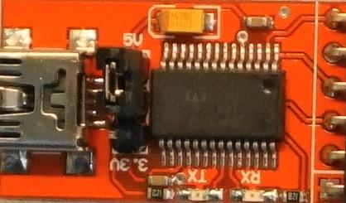

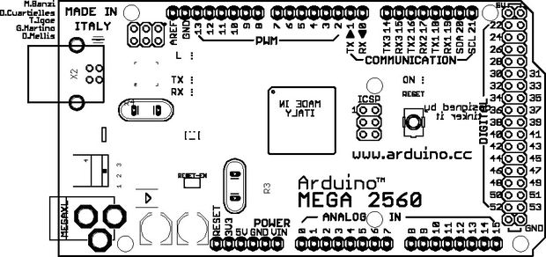
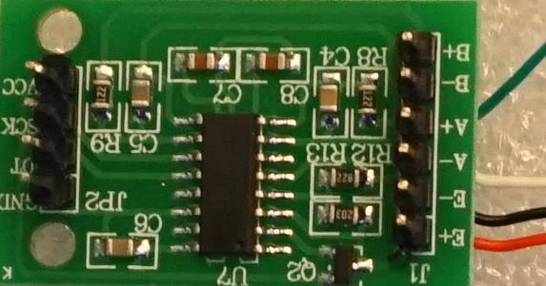
1000uF
25V
10K
NeoPixel 8pix
FTDI serial adapter
for console output
24-bit ADC
for LoadCell

