Slide 1
Saint Bernard Bus Lines
Emily Zeng, Nicole Kirby, Elizabeth Berryman, Ashley Brainer, Sam Marshall

Slide 2
Objective
Design comprehensive model to assign bus fleet to six destinations while minimizing costs
Maximize gross profit by using additional cargo space
Show potential room for improvement over the current system

Slide 3
Approach
Attempt to manually assign bus fleet in order to ensure excel model is working properly
Set up solver to assign optimal bus fleet routes without extra cargo
Set up second solver to maximize revenues with extra cargo
Set up third solver to maximize gross profit
Evaluate results and assess options to come up with optimal solution

Slide 4
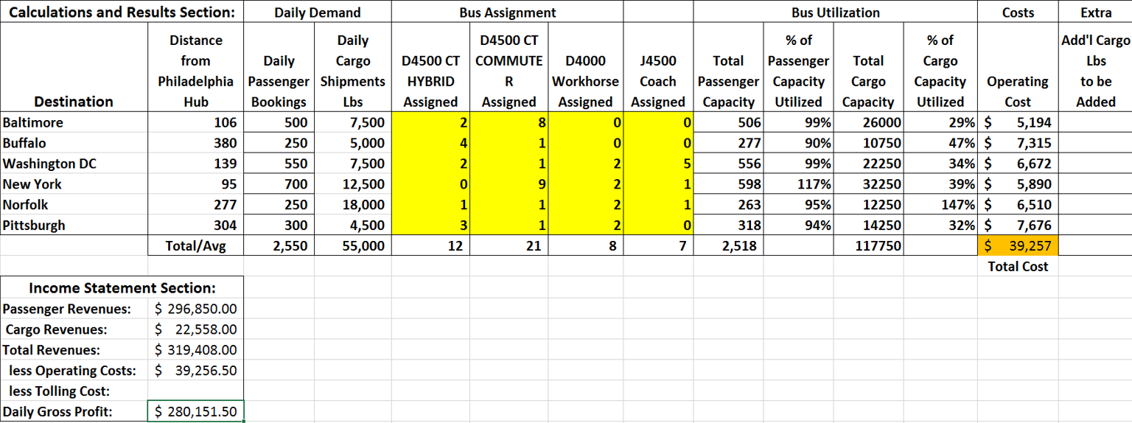
Manual solution
Did not meet all of the required constraints

Slide 5
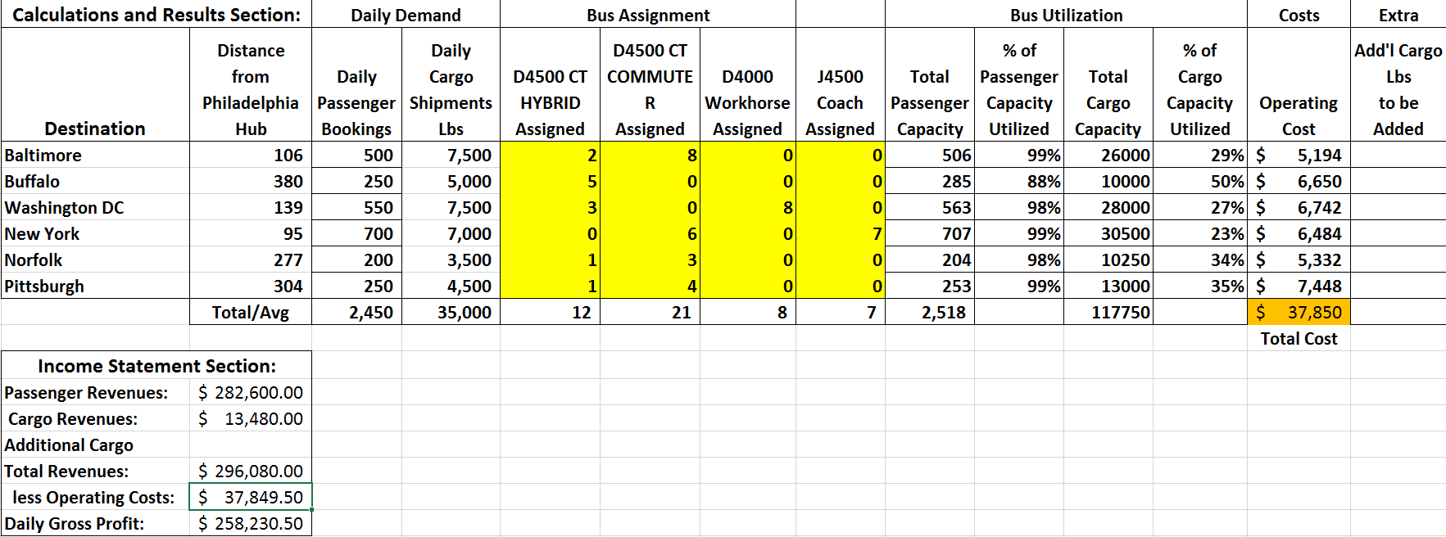
First solver solution
Lower operating costs than manual attempt
Lower gross profit

Slide 6
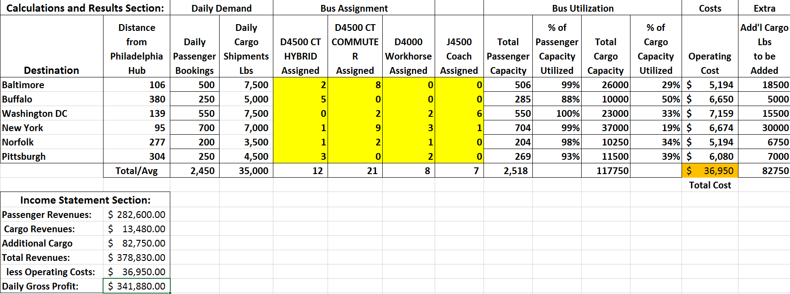
Second solver solution
Utilized extra cargo space
Yielded lower total cost and higher gross profit than the manual attempt and the first solver

Slide 7

Third solver solution
Confirms that second solver provided the optimal solution

Slide 8
Recommendation
Optimal solution - St. Bernard Bus Lines should utilize additional cargo space in order to maximize profits (second solver)
Met all constraints
Total cost of $36,950
Total gross profit of $341,880.
Improve gross profit by approximately $83,649.50

Slide 9
Risks
Keep in mind:
Cost of damaged cargo
Fuel costs
Possible expansion into other metropolitan cities to enhance target market
Promotion and advertising costs

Slide 10
Questions?

