Slide 1

Final project
Machine Learning Fundamentals
November 2018
Emilian Utma

Slide 2
Topics
Exploration of the Dataset
Question(s) to Answer
Augmenting the Dataset
Classification Approaches
Classification Model Comparison
Regression Approaches
Regression Model Comparison
Conclusions/Next steps

Slide 3
Exploration of the Dataset
Data is defined in a local file: profiles.csv
Columns of interests (with bold): "age","body_type","diet","drinks","drugs","education","essay0","essay1","essay2","essay3","essay4","essay5","essay6","essay7","essay8","essay9","ethnicity","height","income","job","last_online","location","offspring","orientation","pets","religion","sex","sign","smokes","speaks","status"

Slide 4
Exploration of the Dataset
Columns descriptions: age – int type. Values from 18 to 110 drugs – str type. Values [nan, 'never', 'often', 'sometimes'] education – str type. Values like [nan, 'college/university', …] income – int type. Values from -1, 20000 to 1000000 job – str type. Values like [nan, 'artistic / musical / writer', …] sex – str type. Values ['f', 'm'] "essay0“ – My self summary "essay3“ – The first thing people usually notice about me "essay6“ – I spend a lot of time thinking about "essay8“ – The most private thing I am willing to admit

Slide 5
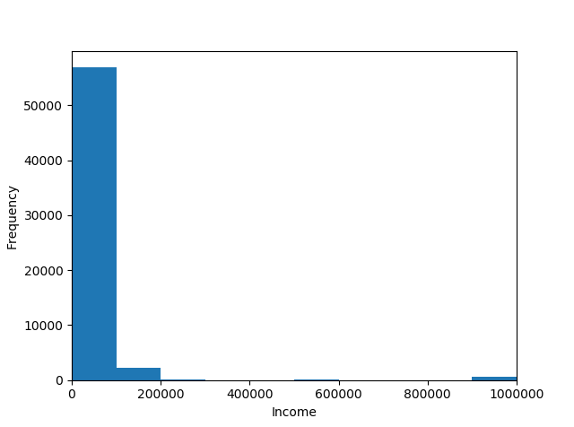
Exploration of the Dataset
Distribution of income
Code:
plt.hist(df.income, bins=32)
plt.xlabel(“Income")
plt.ylabel("Frequency")
plt.xlim(0, 32)
plt.show()

Slide 6
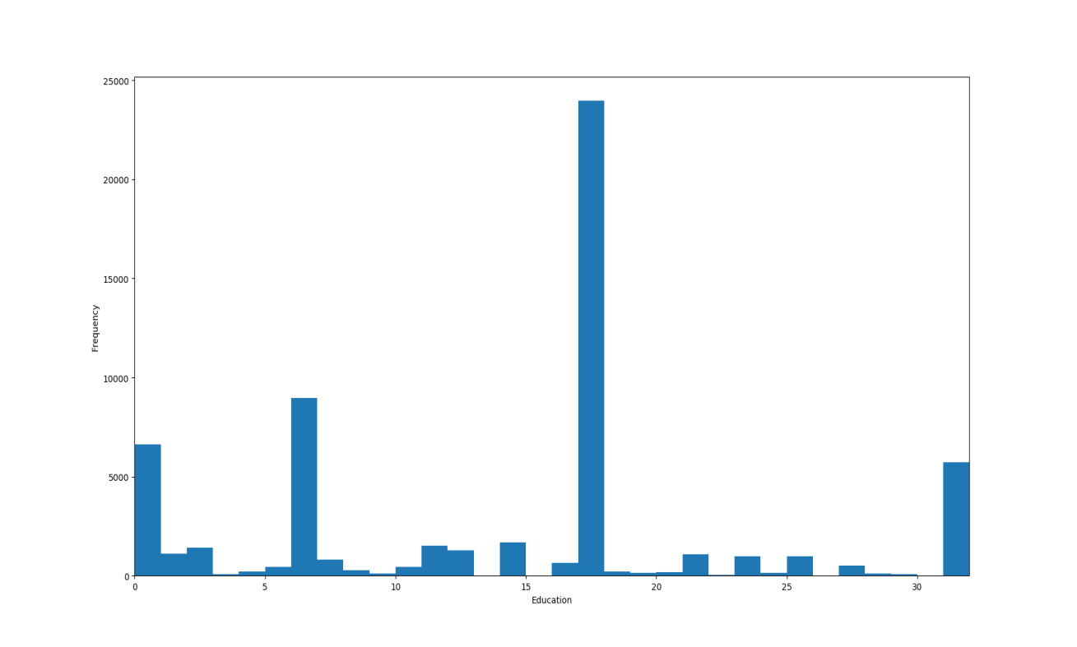
Exploration of the Dataset
Distribution of education
Education codes:
'graduated from med school': 5,
'graduated from masters program': 6,
'college/university': 7,
'dropped out of med school': 15,
'graduated from space camp': 16,
'graduated from college/university': 17,
'two-year college': 18,
'masters program': 19,
'dropped out of two-year college': 20,
'working on two-year college': 21,
Code: plt.hist(df.education_code, bins=32)
plt.xlabel("Education")
plt.ylabel("Frequency")
plt.xlim(0, 32)
plt.show()

Slide 7
Question(s) to Answer
Predicts if "Is male" by job, education and income. Example: Is male a person with 'graduated from law school' as education level, takes drugs often and has an income of 20000 $ per year ? Scripts: “classify_sex_knr.py”
Predicts if "Is male" based on: essay0, essay3, essay6, essay8. Example: Is male a person that says ‘i believe that life is a bold, dashing adventure’ ? Scripts: “classify_sex_naive_bayes.py”, “classify_sex_naive_svc.py”
Predicts age with income and job. Example: What age is a person earning 50000 $ per year and job as 'science / tech / engineering‘? Scripts: “predict_age_knr.py”, “predict_age_mlr.py”
Predicts income based on education, drugs and sex. Example: What income has a person with 'graduated from law school' as education level, takes drugs often and is a woman? Scripts: “predict_income_knr.py”, “predict_income_mlr.py”
*Reason to go for these questions – could be helpful in sociological studies.

Slide 8
Augmenting the Dataset
Columns (features) like “education”, “drugs”, “job”, “sex” are mapped to “int” values. Used in training/testing the models.
Example augmenting data set with education_code, drugs_code and sex_code columns from predict_income_knr.py:
data_frame["education_code"] = data_frame.education.map(generate_column_mapping(data_frame["education"]))
data_frame["drugs_code"] = data_frame.drugs.map(generate_column_mapping(data_frame['drugs']))
data_frame["sex_code"] = data_frame.sex.map(generate_column_mapping(data_frame['sex']))
X = data_frame[['education_code','drugs_code','sex_code']]
y = data_frame[["income"]]
def generate_column_mapping(column_values):
unique_column_values = list(set(column_values))
column_mapping = {}
index = 0
for val in unique_column_values:
column_mapping[val] = index
index += 1
return column_mapping

Slide 9
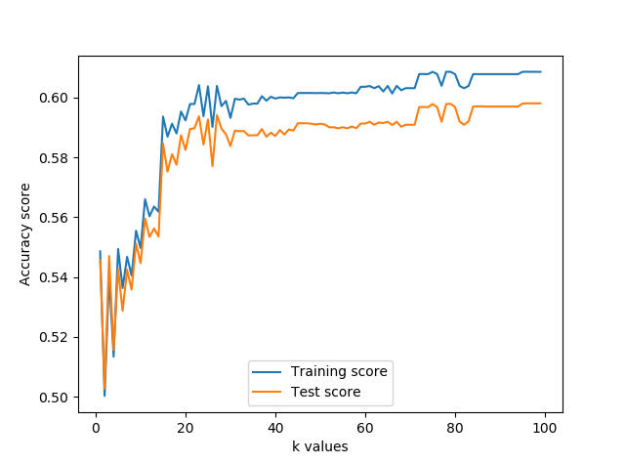
Classification Approaches
K-Nearest Neighbors Classifier (classify_sex_knr.py) model for question: “Is male a person with 'graduated from law school' as education level, takes drugs often and has an income of 20000 $ per year ?” (formalized as “Predicts if "Is male" by job, education and income”).
Action | Exec time (sec)
Prediction of a question | 1.623999834060669
Performance analysis for k between 1 and 100 | 508.3199999332428

Slide 10
Classification Approaches
For question: “Is male a person that says ‘i believe that life is a bold, dashing adventure’ ?” (formalized as “Predicts if "Is male" based on: essay0, essay3, essay6, essay8”) the following models have been used: Naive Bayes Classifier (classify_sex_naive_bayes.py) Support Vector Machines (classify_sex_naive_svc.py)

Slide 11
Classification model comparison
Model | Action | Exec time (sec)
Naive Bayes Classifier | Prediction of a question | 0.059999942779541016
Naive Bayes Classifier | Performance tests time | 0.10199999809265137
Support Vector Machines | Prediction of a question | 993.8599998950958
Support Vector Machines | Performance tests time | 593.0480000972748
Model | Accuracy score | Precision score | Recall score
Naive Bayes Classifier | 0.5993678387988938 | 0.6002485948984003 | 0.9816173221387539
Support Vector Machines | 0.6008277033002016 | 0.6008277033002016 | 1.0

Slide 12
Regression Approaches
For question: “What age is a person earning 50000 $ per year and job as 'science / tech / engineering‘?”, formalized as: “Predict age with income and job”, the following models has been used: K-Nearest Neighbors Classifier Regression (predict_age_knr.py) LinearRegression (predict_age_mlr.py)
For question: “What income has a person with 'graduated from law school' as education level, takes drugs often and is a woman?”, formalized as: “Predict income based on education, drugs and sex”, the following models has been used: K-Nearest Neighbors Classifier Regression (predict_income_knr.py) LinearRegression (predict_income_mlr.py)

Slide 13
Regression model comparison
Model | Action | Exec time (sec)
K-Nearest Neighbors Classifier Regression | Predict age with income and job | 1.4320001602172852
K-Nearest Neighbors Classifier Regression | Test performance for k between 1 and 100 | 350.4079999923706
Linear Regression | Predict age with income and job | 0.029000043869018555
Linear Regression | Test performance | 0.003000020980834961
K-Nearest Neighbors Classifier Regression | Predict income based on education, drugs and sex | 0.7210001945495605
K-Nearest Neighbors Classifier Regression | Test performance for k between 1 and 100 | 378.03399991989136
Linear Regression | Predict income based on education, drugs and sex | 0.009999990463256836
Linear Regression | Test performance | 0.006999969482421875

Slide 14
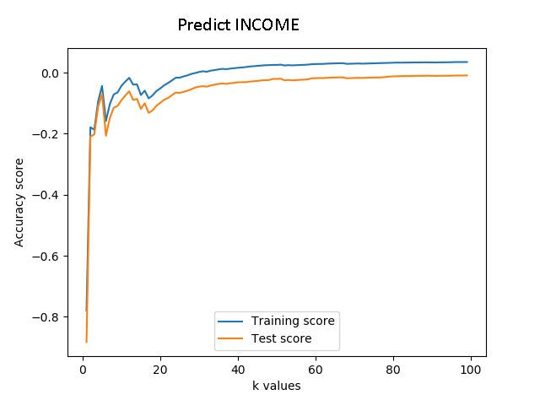
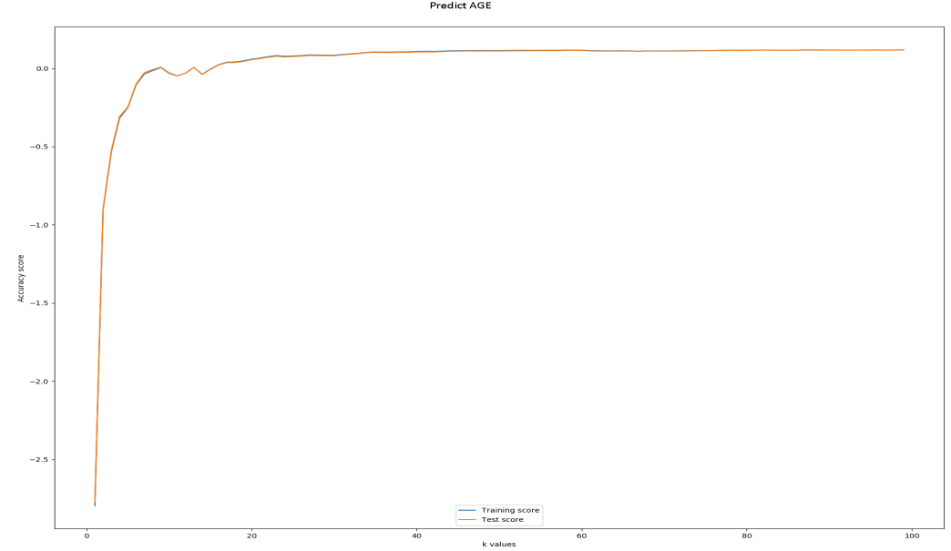
Regression model comparison
Model | Action | Training data accuracy score | Test data accuracy score
Linear Regression | Predict age with income and job | 0.0001112635695025288 | 0.00039512717792733465
Linear Regression | Predict income based on education, drugs and sex | 0.008727840073769255 | 0.008369123807991374

Slide 15
Conclusions/Next steps

