Slide 1

Final project
Machine Learning Fundamentals
November 2018
Emilian Utma

Slide 2
Topics
Exploration of the Dataset
Question(s) to Answer
Augmenting the Dataset
Classification Approaches
Classification Model Comparison
Regression Approaches
Regression Model Comparison
Conclusions/Next steps

Slide 3
Exploration of the Dataset
Data is defined in a local file: profiles.csv
Columns of interests (with bold): "age","body_type","diet","drinks","drugs","education","essay0","essay1","essay2","essay3","essay4","essay5","essay6","essay7","essay8","essay9","ethnicity","height","income","job","last_online","location","offspring","orientation","pets","religion","sex","sign","smokes","speaks","status"

Slide 4
Exploration of the Dataset
Columns descriptions: age – int type. Values from 18 to 110 drugs – str type. Values [nan, 'never', 'often', 'sometimes'] education – str type. Values like [nan, 'college/university', …] income – int type. Values from -1, 20000 to 1000000 job – str type. Values like [nan, 'artistic / musical / writer', …] sex – str type. Values ['f', 'm'] "essay0“ – My self summary "essay3“ – The first thing people usually notice about me "essay6“ – I spend a lot of time thinking about "essay8“ – The most private thing I am willing to admit

Slide 5
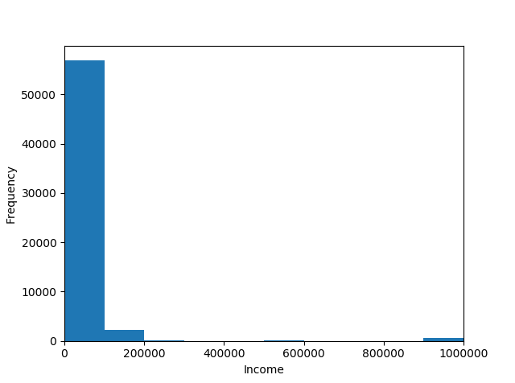
Exploration of the Dataset
Distribution of income
Code:
plt.hist(df.income, bins=32)
plt.xlabel(“Income")
plt.ylabel("Frequency")
plt.xlim(0, 32)
plt.show()

Slide 6
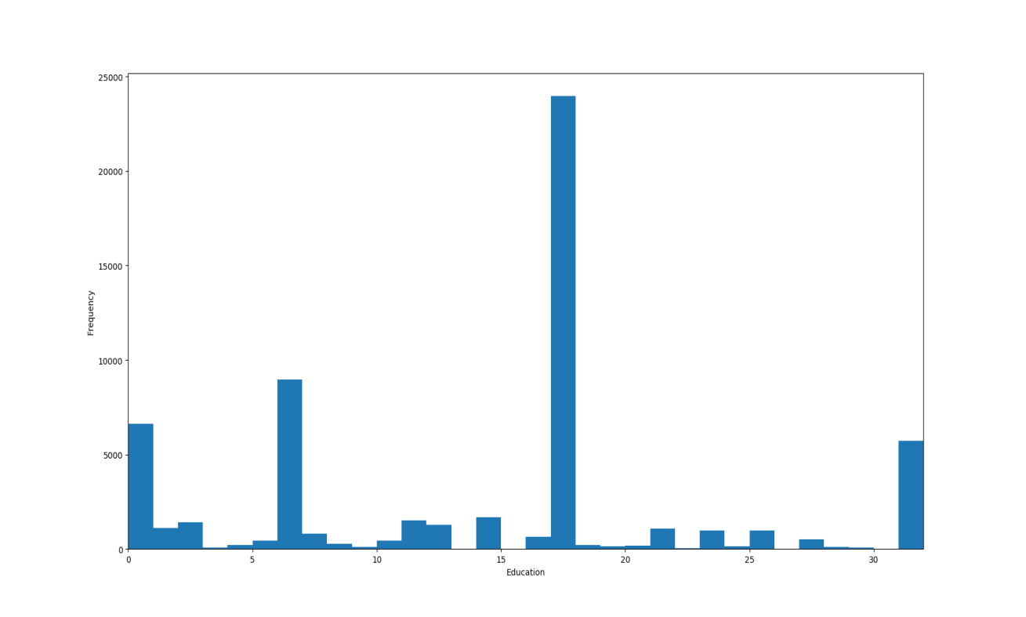
Exploration of the Dataset
Distribution of education
Education codes:
'graduated from med school': 5,
'graduated from masters program': 6,
'college/university': 7,
'dropped out of med school': 15,
'graduated from space camp': 16,
'graduated from college/university': 17,
'two-year college': 18,
'masters program': 19,
'dropped out of two-year college': 20,
'working on two-year college': 21,
Code: plt.hist(df.education_code, bins=32)
plt.xlabel("Education")
plt.ylabel("Frequency")
plt.xlim(0, 32)
plt.show()

Slide 7
Question(s) to Answer
Predicts if "Is male" by job, education and income. Example: Is male a person with 'graduated from law school' as education level, takes drugs often and has an income of 20000 $ per year ? Scripts: “classify_sex_knr.py”
Predicts if "Is male" based on: essay0, essay3, essay6, essay8. Example: Is male a person that says ‘i believe that life is a bold, dashing adventure’ ? Scripts: “classify_sex_naive_bayes.py”, “classify_sex_naive_svc.py”
Predicts age with income and job. Example: What age is a person earning 50000 $ per year and job as 'science / tech / engineering‘? Scripts: “predict_age_knr.py”, “predict_age_mlr.py”
Predicts income based on education, drugs and sex. Example: What income has a person with 'graduated from law school' as education level, takes drugs often and is a woman? Scripts: “predict_income_knr.py”, “predict_income_mlr.py”
*Reason to go for these questions – could be helpful in sociological studies.

Slide 8
Augmenting the Dataset
Columns (features) like “education”, “drugs”, “job”, “sex” are mapped to “int” values. Used in training/testing the models.
Example augmenting data set with education_code, drugs_code and sex_code columns from predict_income_knr.py:
data_frame["education_code"] = data_frame.education.map(generate_column_mapping(data_frame["education"]))
data_frame["drugs_code"] = data_frame.drugs.map(generate_column_mapping(data_frame['drugs']))
data_frame["sex_code"] = data_frame.sex.map(generate_column_mapping(data_frame['sex']))
X = data_frame[['education_code','drugs_code','sex_code']]
y = data_frame[["income"]]
def generate_column_mapping(column_values):
unique_column_values = list(set(column_values))
column_mapping = {}
index = 0
for val in unique_column_values:
column_mapping[val] = index
index += 1
return column_mapping

Slide 9
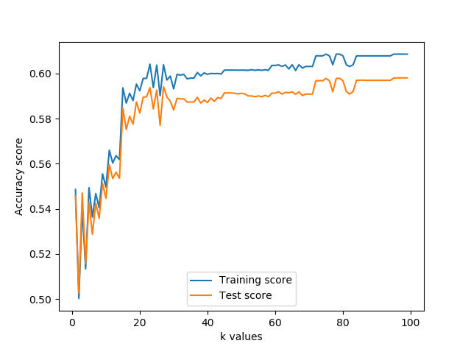
Classification Approaches
K-Nearest Neighbors Classifier (classify_sex_knr.py) model for question: “Is male a person with 'graduated from law school' as education level, takes drugs often and has an income of 20000 $ per year ?” (formalized as “Predicts if "Is male" by job, education and income”).
Action | Exec time (sec)
Prediction of a question | 1.623999834060669
Performance analysis for k between 1 and 100 | 508.3199999332428

Slide 10
Classification Approaches
For question: “Is male a person that says ‘i believe that life is a bold, dashing adventure’ ?” (formalized as “Predicts if "Is male" based on: essay0, essay3, essay6, essay8”) the following models have been used: Naive Bayes Classifier (classify_sex_naive_bayes.py) Support Vector Machines (classify_sex_naive_svc.py)

Slide 11
Classification model comparison
Model | Action | Exec time (sec)
Naive Bayes Classifier | Prediction of a question | 0.059999942779541016
Naive Bayes Classifier | Performance tests time | 0.10199999809265137
Support Vector Machines | Prediction of a question | 993.8599998950958
Support Vector Machines | Performance tests time | 593.0480000972748
Model | Accuracy score | Precision score | Recall score
Naive Bayes Classifier | 0.5993678387988938 | 0.6002485948984003 | 0.9816173221387539
Support Vector Machines | 0.6008277033002016 | 0.6008277033002016 | 1.0

Slide 12
Regression Approaches
For question: “What age is a person earning 50000 $ per year and job as 'science / tech / engineering‘?”, formalized as: “Predict age with income and job”, the following models has been used: K-Nearest Neighbors Classifier Regression (predict_age_knr.py) LinearRegression (predict_age_mlr.py)
For question: “What income has a person with 'graduated from law school' as education level, takes drugs often and is a woman?”, formalized as: “Predict income based on education, drugs and sex”, the following models has been used: K-Nearest Neighbors Classifier Regression (predict_income_knr.py) LinearRegression (predict_income_mlr.py)

Slide 13
Regression model comparison
Model | Action | Exec time (sec)
K-Nearest Neighbors Classifier Regression | Predict age with income and job | 1.4320001602172852
K-Nearest Neighbors Classifier Regression | Test performance for k between 1 and 100 | 350.4079999923706
Linear Regression | Predict age with income and job | 0.029000043869018555
Linear Regression | Test performance | 0.003000020980834961
K-Nearest Neighbors Classifier Regression | Predict income based on education, drugs and sex | 0.7210001945495605
K-Nearest Neighbors Classifier Regression | Test performance for k between 1 and 100 | 378.03399991989136
Linear Regression | Predict income based on education, drugs and sex | 0.009999990463256836
Linear Regression | Test performance | 0.006999969482421875

Slide 14
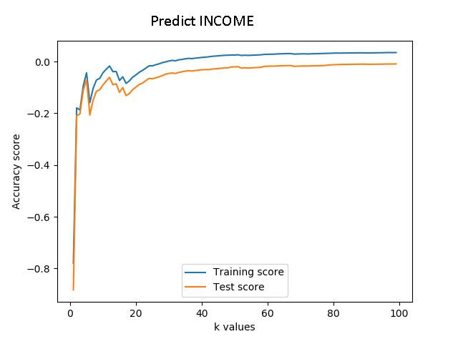
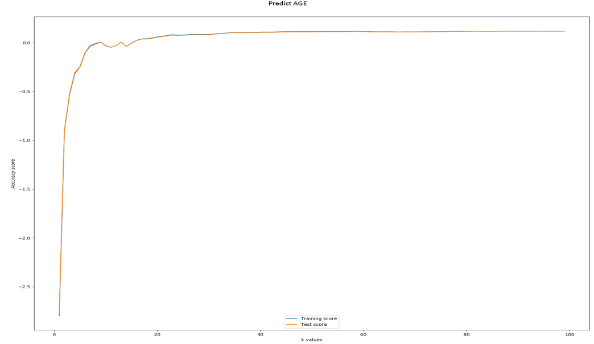
Regression model comparison
Model | Action | Training data accuracy score | Test data accuracy score
Linear Regression | Predict age with income and job | 0.0001112635695025288 | 0.00039512717792733465
Linear Regression | Predict income based on education, drugs and sex | 0.008727840073769255 | 0.008369123807991374

Slide 15
Conclusions/Next steps
The ML models implementations in Python are very productive and easier to use even for a “junior data scientist”. What also to mention is the data preparation is very fast to implement.
The “matplotlib” module is not to ignore as well, for generating graphs in other “non-python” projects.
As next step the most interesting to play with is “Naive Bayes Classifier” model in order to improve its accuracy in prediction other features based on users opinions.

