Slide 1

Final project
Machine Learning Fundamentals
November 2018
Emilian Utma

Slide 2
Topics
Exploration of the Dataset
Question(s) to Answer
Augmenting the Dataset
Classification Approaches
Regression Approaches
Conclusions/Next steps

Slide 3
Exploration of the Dataset
Data is defined in a local file: profiles.csv
Columns of interests (with bold): "age","body_type","diet","drinks","drugs","education","essay0","essay1","essay2","essay3","essay4","essay5","essay6","essay7","essay8","essay9","ethnicity","height","income","job","last_online","location","offspring","orientation","pets","religion","sex","sign","smokes","speaks","status"

Slide 4
Exploration of the Dataset
Columns descriptions: age – int type. Values from 18 to 110 drugs – str type. Values [nan, 'never', 'often', 'sometimes'] education – str type. Values like [nan, 'college/university', …] income – int type. Values from -1, 20000 to 1000000 job – str type. Values like [nan, 'artistic / musical / writer', …] sex – str type. Values ['f', 'm'] "essay0“ – My self summary "essay3“ – The first thing people usually notice about me "essay6“ – I spend a lot of time thinking about "essay8“ – The most private thing I am willing to admit

Slide 5
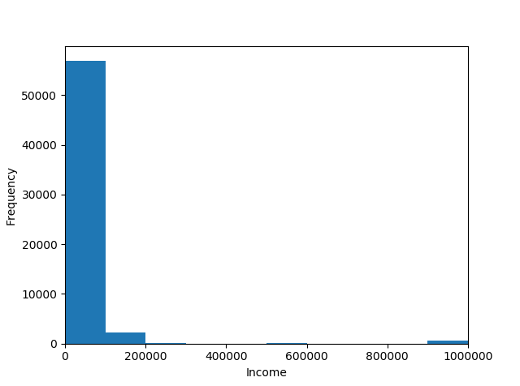
Exploration of the Dataset
Distribution of income
Code:
plt.hist(df.income, bins=32)
plt.xlabel(“Income")
plt.ylabel("Frequency")
plt.xlim(0, 32)
plt.show()

Slide 6
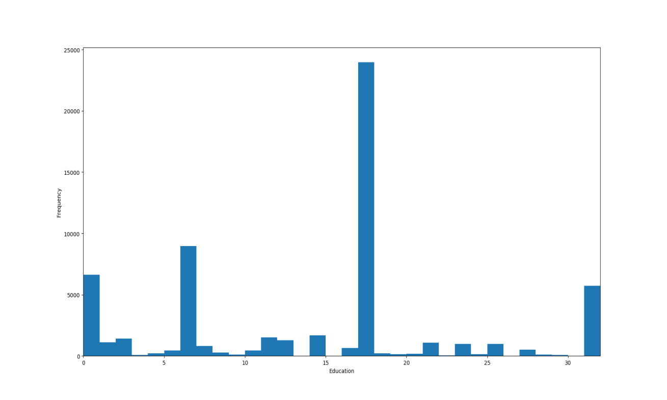
Exploration of the Dataset
Distribution of education
Education codes:
'graduated from med school': 5,
'graduated from masters program': 6,
'college/university': 7,
'dropped out of med school': 15,
'graduated from space camp': 16,
'graduated from college/university': 17,
'two-year college': 18,
'masters program': 19,
'dropped out of two-year college': 20,
'working on two-year college': 21,
Code: plt.hist(df.education_code, bins=32)
plt.xlabel("Education")
plt.ylabel("Frequency")
plt.xlim(0, 32)
plt.show()

Slide 7
Question(s) to Answer
Predicts if "Is male" by job, education and income. Example: Is male a person with 'graduated from law school' as education level, takes drugs often and has an income of 20000 $ per year ? Scripts: “classify_sex_knr.py”
Predicts if "Is male" based on: essay0, essay3, essay6, essay8. Example: Is male a person that says ‘i believe that life is a bold, dashing adventure’ ? Scripts: “classify_sex_naive_bayes.py”, “classify_sex_naive_svc.py”
Predicts age with income and job. Example: What age is a person earning 50000 $ per year and job as 'science / tech / engineering‘? Scripts: “predict_age_knr.py”, “predict_age_mlr.py”
Predicts income based on education, drugs and sex. Example: What income has a person with 'graduated from law school' as education level, takes drugs often and is a woman? Scripts: “predict_income_knr.py”, “predict_income_mlr.py”
*Reason to go for these questions – could be helpful in sociological studies.

Slide 8
Augmenting the Dataset
Columns (features) like “education”, “drugs”, “job”, “sex” are mapped to “int” values. Used in training/testing the models.
Example of code from predict_income_knr.py:
data_frame["education_code"] = data_frame.education.map(generate_column_mapping(data_frame["education"]))
data_frame["drugs_code"] = data_frame.drugs.map(generate_column_mapping(data_frame['drugs']))
data_frame["sex_code"] = data_frame.sex.map(generate_column_mapping(data_frame['sex']))
X = data_frame[['education_code','drugs_code','sex_code']]
y = data_frame[["income"]]
def generate_column_mapping(column_values):
unique_column_values = list(set(column_values))
column_mapping = {}
index = 0
for val in unique_column_values:
column_mapping[val] = index
index += 1
return column_mapping

Slide 9
Classification Approaches

Slide 10


Lessons learnt
Sometimes the reviews from the market are not reliable – see https://play.google.com/store/apps/details?id=com.jupiter.account .
This type of software product MUST have a dedicated QA team before making available to market. Reasons: is for public use and a lot of similar applications are already on the market.
Testing this application, personally helped me to improve my self-organizing skills: test-cases management and bugs tracking.

