Slide 1
Data warehouse for…superstore
MSc in Business Analytics – A.U.E.B.
Data Management and Business Intelligence
Evangelia Arseniou – p2822026
Sotiria Ligkou - p2822023

Slide 2
Description of the case …
The dataset refers to an online Superstore based in United States
Provided products : Technology, Office supplies, Furniture
Main scope: The mobility of the e-commerce between 2014-2018
US
SUPERSTORE
US
SUPERSTORE
E.T.L.
21 Variables
9.994 Transactions
16 Variables
9.994 Transactions

Slide 3
Description of the columns…
CATEGORY
ORDER ID
ORDER DATE
SUBCATEGORY
ORDER ID
QUANTITY
QUANTITY
CUSTOMER ID
SEGMENT
CUSTOMER ID
COUNTRY
COUNTRY
SHIP DATE
SALES
SALES
STATE
POSTAL CODE
SHIP MODE
CITY
DISCOUNT
DISCOUNT
ROW ID
ROW ID
CUSTOMER NAME
PRUDUCT ID
PRODUCT NAME
PRUDUCT ID
REGION
PROFIT
PROFIT

Slide 4
Creating dimensions……
SEGMENT
SUBCATEGORY
CUSTOMER NAME
SHIP MODE
PRODUCT NAME
CATEGORY
CATEGORY_ID
CATEGORY
SUB-CATEGORY
PRODUCT_NAME
CITY
REGION
STATE
SHIP DATE
ORDER DATE
POSTAL CODE

Slide 5
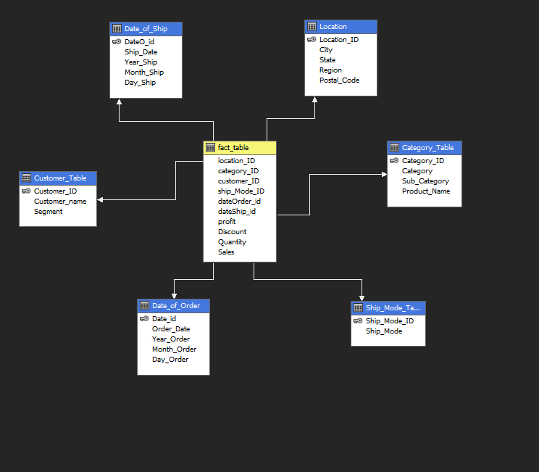
Star schema

Slide 6
Creating a cube……
Defining hierarchies
Location ID
Postal code
City
Region
State
Category ID
Product Name
Sub Category
Category
Customer ID
Customer Name
Segment

Slide 7
Measurements
𝐴𝑣𝑔(𝑆𝑎𝑙𝑒𝑠) = 𝑆𝑎𝑙𝑒𝑠 / 𝑇𝑜𝑡𝑎𝑙 𝑆𝑎𝑙𝑒s
Average Sales
𝐶𝑜𝑠𝑡 = 𝑆𝑎𝑙𝑒𝑠 − 𝑃𝑟𝑜𝑓𝑖t
Cost
𝑃𝑟𝑜𝑓𝑖𝑡% = 𝑃𝑟𝑜𝑓𝑖𝑡 / 𝐶𝑜𝑠𝑡 ∗ 100
Profit Percentage

Slide 8

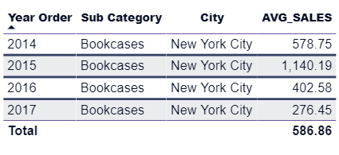
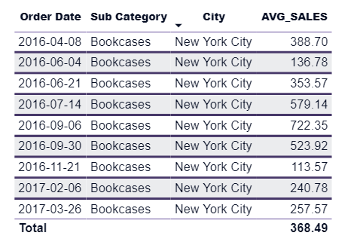
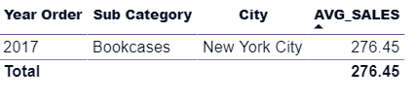
OLAP Reports…
Average Sales
Roll Up
Average sales for bookcases
in New York for all years
City
Year
Sub Category
Drill Down
Average sales for bookcases
in New York for 2017
Slice and Dice
Average sales
for bookcases in New York
between 01/04/2016
and 01/04/2017

Slide 9
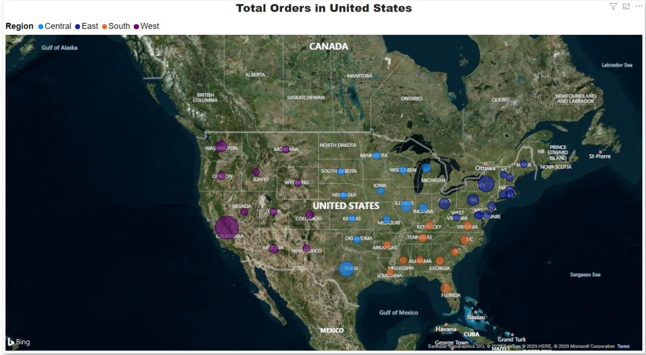
Visualizations with Power BI…
California is the state
with the most orders
during the years

Slide 10
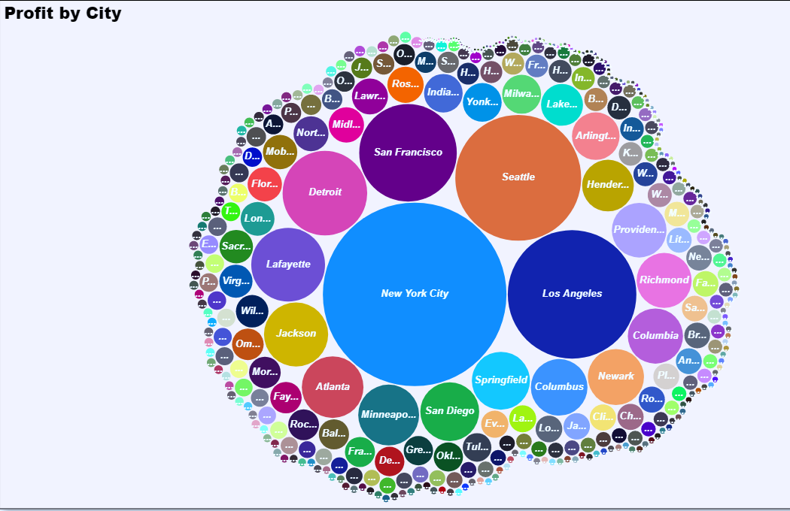
Visualizations with Power BI…
The most profitable
cities are
New York and
Los Angeles

Slide 11
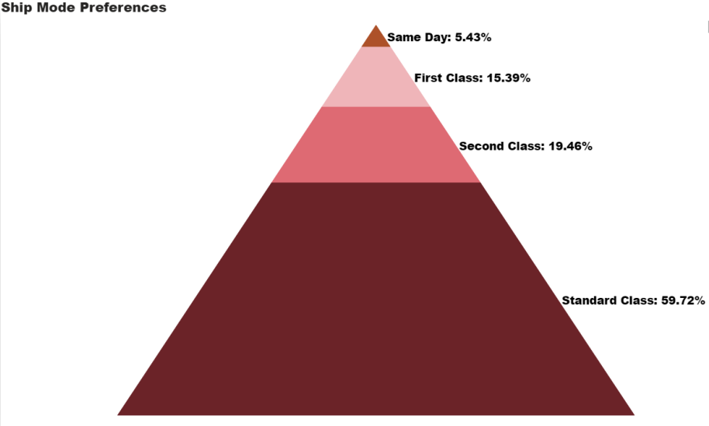
Visualizations with Power BI…
The majority of people prefer standard class shipment
while only a few choose the same day shipping.

Slide 12

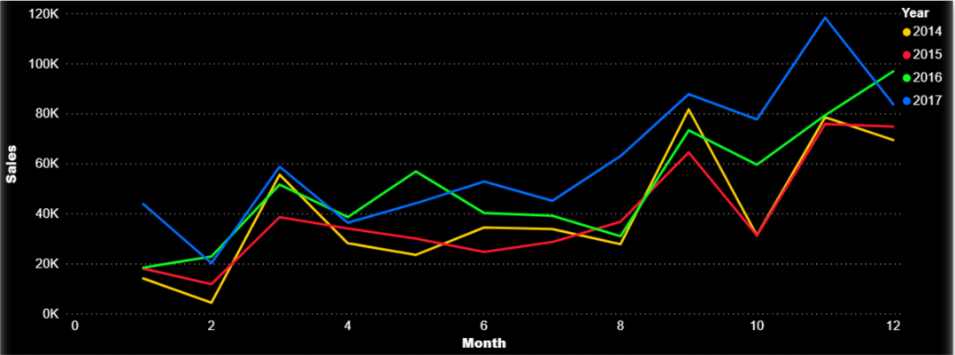
Visualizations with Power BI…
There is an increasing tendency of sales by the years with peak season to be during autumn time

Slide 13
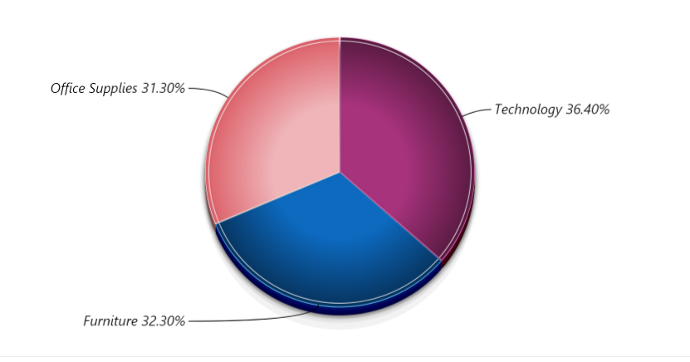
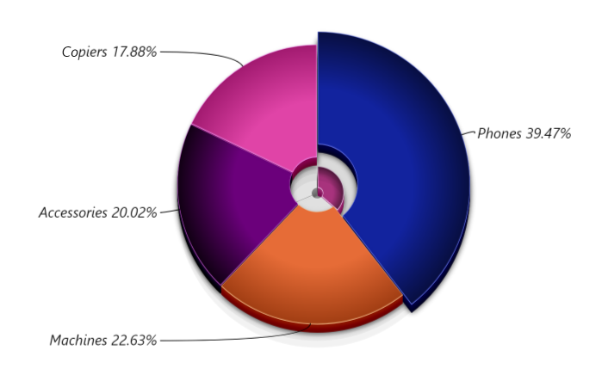
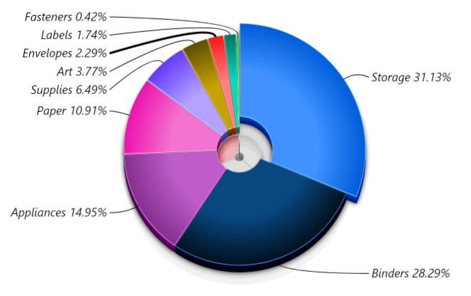
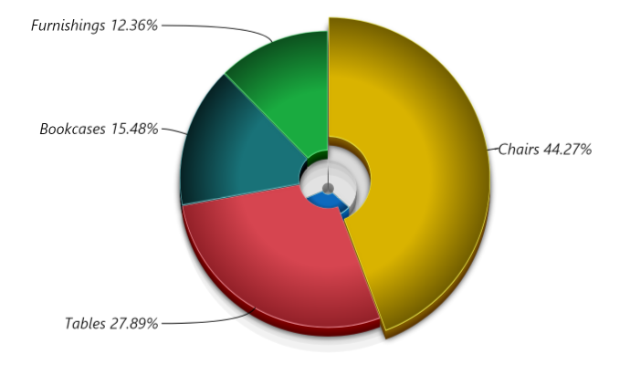
Visualizations with Power BI…
Sales By Category
Sales by Technology
Sales by Office Supplies
Sales by Furniture

Slide 14
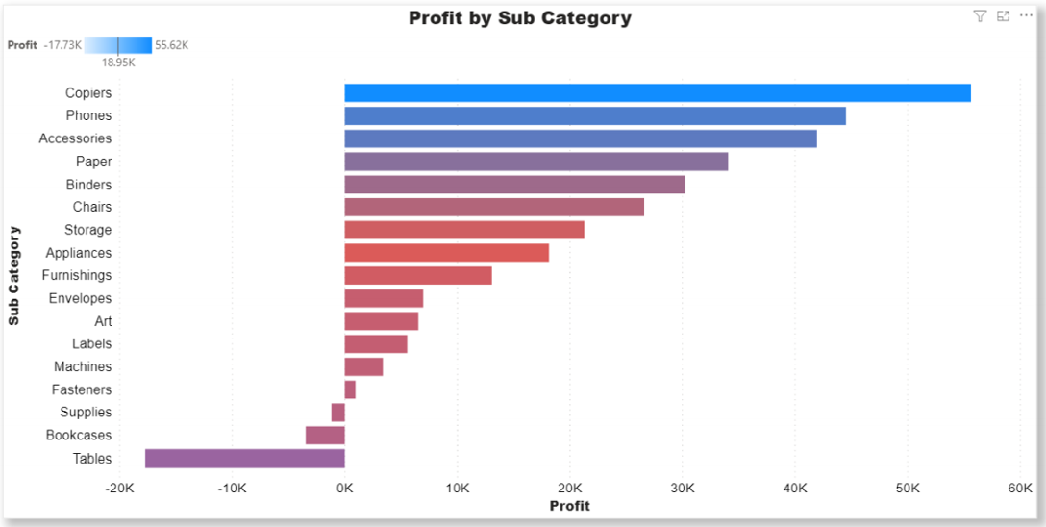
Visualizations with Power BI…
Copiers has given the most profit out of all the sub categories. Moreover, we could
conclude that there is a huge loss from Tables.

Slide 15

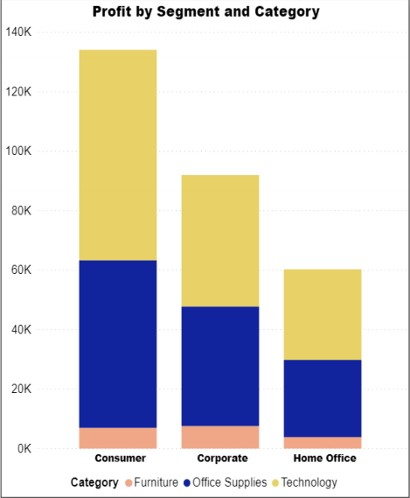
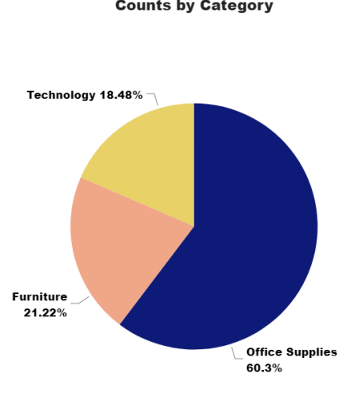
Visualizations with Power BI…
Although office supplies are the most selling category the profit is highest for
the technology sector under which the profit has come more from the Consumers segment

Slide 16
Conclusions…
Tables are causing a lot of loss, so the company
could stop selling this product or should increase the price
The company should focus more on the technology section
which is the most profitable!

Slide 17
Thank you for your attention!

