Slide 1

Machine Learning Utilisation in Call Categorisation

Slide 2


Task
To apply a machine learning algorithm to call transcripts to categorise calls.
Working with a labelled training set, to train a classification algorithm to then work with unlabelled data.
Category 6 Calls
Category 7 Calls
Introducing the customer to the company and process
Gathering customer preferences
Briefing customers on loan application process
Finalise loan application
Explaining further customer benefits
Clarifying next steps

Slide 3
Overview of Data
The call transcripts are stored in a large language model format
The transcripts are broken down into segmentation levels:
High-Level Key Segments: Scans the entire call for high-level information without going into detail.
Business Standards: Compliance checks and general sales practices that apply to all call categories.
Low-Level and Mid-Level Key Segments:
Low-Level: Provides key details of what was expected from a Category 6 call.
Mid-Level: Provides key details of what was expected from a Category 7 call.
Legacy Segments: This segment contains information from a previously used service.

Slide 4
Overview of Data
Call_Type_Name | Low_Level_Segment6
Category 1 | {'item1': 'Red', 'item2': 'Red', 'item3': 'Red', 'item4': 'Red', 'item5': 'Red', 'item6': 'uncategorized'}
Category 4 | {'item1': 'Red', 'item2': 'Red', 'item3': 'Red', 'item4': 'Red', 'item5': 'Red', 'item6': 'uncategorized'}
Category 7 | {'item1': 'Red', 'item2': 'Red', 'item3': 'Red', 'item4': 'Green', 'item5': 'Red', 'item6': 'initial_call'}
Category 7 | {'item1': 'Red', 'item2': 'Green', 'item3': 'Red', 'item4': 'Green', 'item5': 'Red', 'item6': 'initial_call'}
Category 7 | {'item1': 'Red', 'item2': 'Red', 'item3': 'Green', 'item4': 'Green', 'item5': 'Red', 'item6': 'initial_call'}
Category 7 | {'item1': 'Red', 'item2': 'Green', 'item3': 'Green', 'item4': 'Green', 'item5': 'Red', 'item6': 'initial_call'}
Category 7 | {'item1': 'Green', 'item2': 'Red', 'item3': 'Red', 'item4': 'Green', 'item5': 'Red', 'item6': 'initial_call'}
Category 7 | {'item1': 'Red', 'item2': 'Red', 'item3': 'Red', 'item4': 'Green', 'item5': 'Red', 'item6': 'initial_call'}
Category 7 | {'item1': 'Red', 'item2': 'Green', 'item3': 'Green', 'item4': 'Green', 'item5': 'Green', 'item6': 'initial_call'}
Category 6 | {'item1': 'Green', 'item2': 'Green', 'item3': 'Green', 'item4': 'Green', 'item5': 'Green', 'item6': 'initial_call'}
The columns contain dictionaries instead of simple values, making it difficult to process
Machine learning models expect structured tabular data, not nested dictionaries
The dataset includes text labels like "Red", "Green", "uncategorized", which are not machine-readable
These need to be converted into numerical features for machine learning

Slide 5
Our Solution
Call_Type_Name | Low_Level_Segment6_item1 | Low_Level_Segment6_item2 | Low_Level_Segment6_item3 | Low_Level_Segment6_item4 | Low_Level_Segment6_item5 | Low_Level_Segment6_item6
Other | 0 | 0 | 0 | 0 | 0 | 3
Other | 0 | 0 | 0 | 0 | 0 | 3
Category 7 | 0 | 0 | 0 | 2 | 0 | 0
Category 7 | 0 | 2 | 0 | 2 | 0 | 0
Category 7 | 0 | 0 | 2 | 2 | 0 | 0
Category 7 | 0 | 2 | 2 | 2 | 0 | 0
Category 7 | 2 | 0 | 0 | 2 | 0 | 0
Category 7 | 0 | 0 | 0 | 2 | 0 | 0
Category 7 | 0 | 2 | 2 | 2 | 2 | 0
Category 6 | 2 | 2 | 2 | 2 | 2 | 0
Flattened nested data by converting dictionary values into separate columns
Ensured consistent formatting so all data follows a structured tabular format
Converted categorical text to numbers using Label Encoding
Converted Category 1-5 calls to ‘Other”

Slide 6

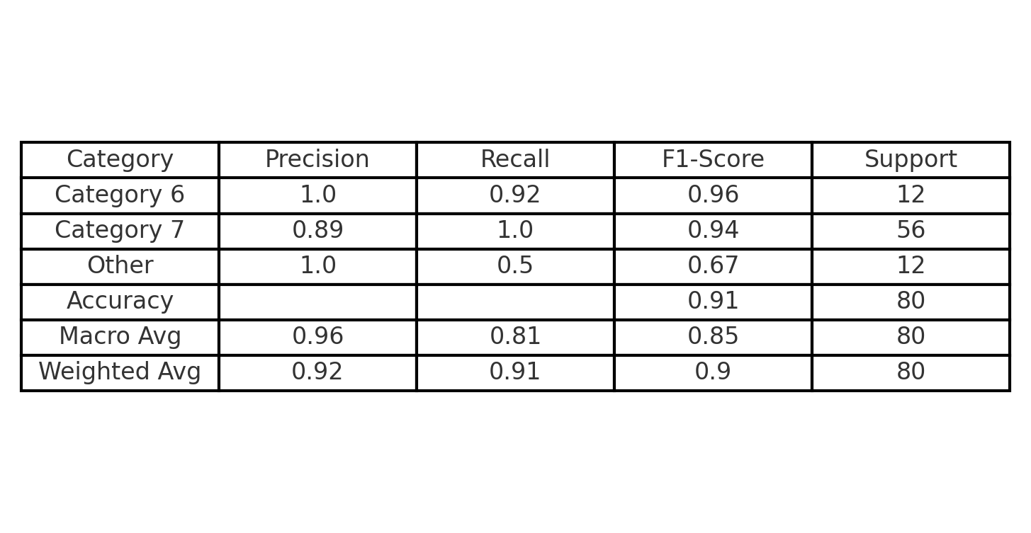
Supervised Model
Category Predictions
Category | Count
Other | 2121
Category 7 | 714
Category 6 | 56
A fully supervised classification algorithm that can be trained with labelled data and categorise call types between category 6 and 7 calls
Creating a Random Forest algorithm to provide classification
Utilising its decision tree architecture to involve all segmentation levels in its pursuit of categorising calls
Each segmentation level populating a different decision tree within the classification algorithm
Incorporating all the data in final prediction and operates well when working with large complex datasets
Evaluation of model:

Slide 7
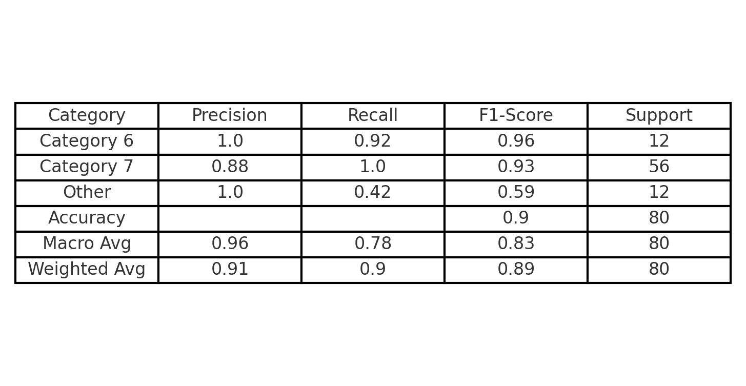
Semi-Supervised Model
Category Predictions
Augmenting the designed random forest algorithm to become semi-supervised
Category | Count
Other | 2159
Category 7 | 675
Category 6 | 57
This change allows for the algorithm to then label its own data and not requiring the training with such a large labeled dataset
Evaluation of model:

