Slide 1
T-Systems workshop
Development point of View
Chris Grzegorczyk
Founder & Principal Architect

Slide 2
Agenda
Overview of the Eucalyptus architecture
major components
programming languages
development frameworks

Slide 3
Logical Deployment
Users
Admins
Cloud
NC
(KVM/Xen)
CC
Cloud Controller
Vmware
Broker
SC
Netapp
Equallogic
Vsphere
ESXi
Resources
Partition
Virtual Networking
S3 API
EC2 API
IAM API
EUCA APIs
Walrus
Cloud Controller
EUARE
Admin
Services

Slide 4
Physical Deployment
Host 1
Host 2
Service Bus
CLC
Euare
Walrus
CC
Proxy
VMware
Broker
SC
JBOD
SOAP
CC
VSphere
Netapp
SOAP
NC
...
NC
ESX
...
ESX
Equallogic
Notes:
highlight languages

Slide 5
Anatomy of a Service
Top-Half
Resource Allocation
Resource State
Persistent State
In-flight State
User-facing
Bottom-Half
Service’s worker threads
Asynchronous
Resource
Actual Resource
“Ground Truth”™
Users
User
Request
Authorization
Validation
Reservation
Update State
Ground Truh
Resource Allocation

Slide 6
Service-to-Service Message Flow
CLC
Service Lookup
Network
WS Stack
Service Routing
Sending Service
Walrus
Service Addressing
State handling
Address resolution
Message Transport
Message Transport
WS Stack
Service Routing
Receiving Service
Refers to destination using abstract name
Async Request Processing
Dest. service protocol
Async Request Procesing
Recv. service protocol
Dispatch to service
Service operations invoked

Slide 7
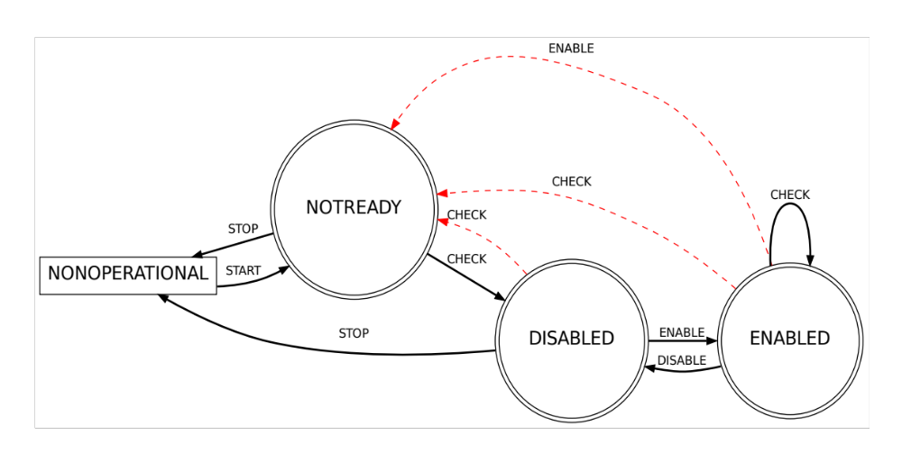
Service State Management

Slide 8
HA Deployment
Host 17
Host 18
Host 19
Host 20
Service Bus
CLC_17
CLC_18
CC
CC
SC
VMware
Broker
Walrus
Walrus
VMware
Broker
SC
VSphere
ESX
...
ESX
SAN

Slide 9
HA Deployment
Host 17
Host 18
Host 19
Host 20
Service Bus
CLC_17
JDBC
CLC_18
CC
CC
SC
VMware
Broker
Walrus
DRBD
Walrus
VMware
Broker
SC
VSphere
ESX
...
ESX
SAN

Slide 10
Java
C
CLC
Walrus
SC
CC
NC
Staged Execution (Mule)
Staged Execution (Axis2/c)
  message routing
  & web services (Netty)
Message Routing
& Transport
Service Naming,
Registration & LIfecycle
(Axis2/c + Rampart/C)
Protocol Multiplexing (Netty/JiBX)
Service State
Management
Distributed Lifecycle
Integration
Distributed Service
Configuration
Distributed Lifecycle
Integration
Service Naming &
Registration
distributed
bootstrap
Persistence (Hibernate)
& Caching (TreeCache)
Local Bootstrap
(Apache)
Distributed Bootstrap (JGroups)
Local Bootstrap
Component Discovery

Slide 11
Entity Mapping
@Entity
class StatefulData
Service Implementation
@Entity
class StatefulData
@Entity
class StatefulData
Persistence APIs
Distributed Cache
DB
Replication
DB

Slide 12
Persistence & Caching
Component Service
Persistence APIs (JPA)
L1 Object & Query Caching (Hibernate)
L2 Distributed Object Caching (TreeCache)
message routing
& web services
Object Relational Mapping (Hibernate)
DB Connection Pooling (Proxool)
Distributed DB Connection (HA-JDBC)
distributed
bootstrap
JDBC Connection (Postgres JDBC)
Relational Database (Postgres)

Slide 13
Web Services
Stack (SOAP)
Component
Service
Request Routing
Reply Handling
Service Context Dispatch
{
Service State Checks
Binding
Protocol
Multiplicity
WS-Security
SOAP Envelope Processing
SOAP Unmarshalling/Marshalling
Protocol Selection
HTTP Chunking
HTTP Decoding/Encoding
SSL Decoding/Encoding
Port 8773

Slide 14
Tools/Languages Used
Editors/IDE’s
  Eclipse
  IntelliJ IDEA
  NetBeans
  Emacs/VIM….
Languages (in order of usage)
  Java, C, Groovy, Shell, Perl, Python

Slide 15
Thanks!
Chris Grzegorczyk
Founder / Principal Architect

