Slide 1
BRA-EUR
DECEA & PRU

Slide 2
Overview

Slide 3
Data Status
Initial data processing

Slide 4
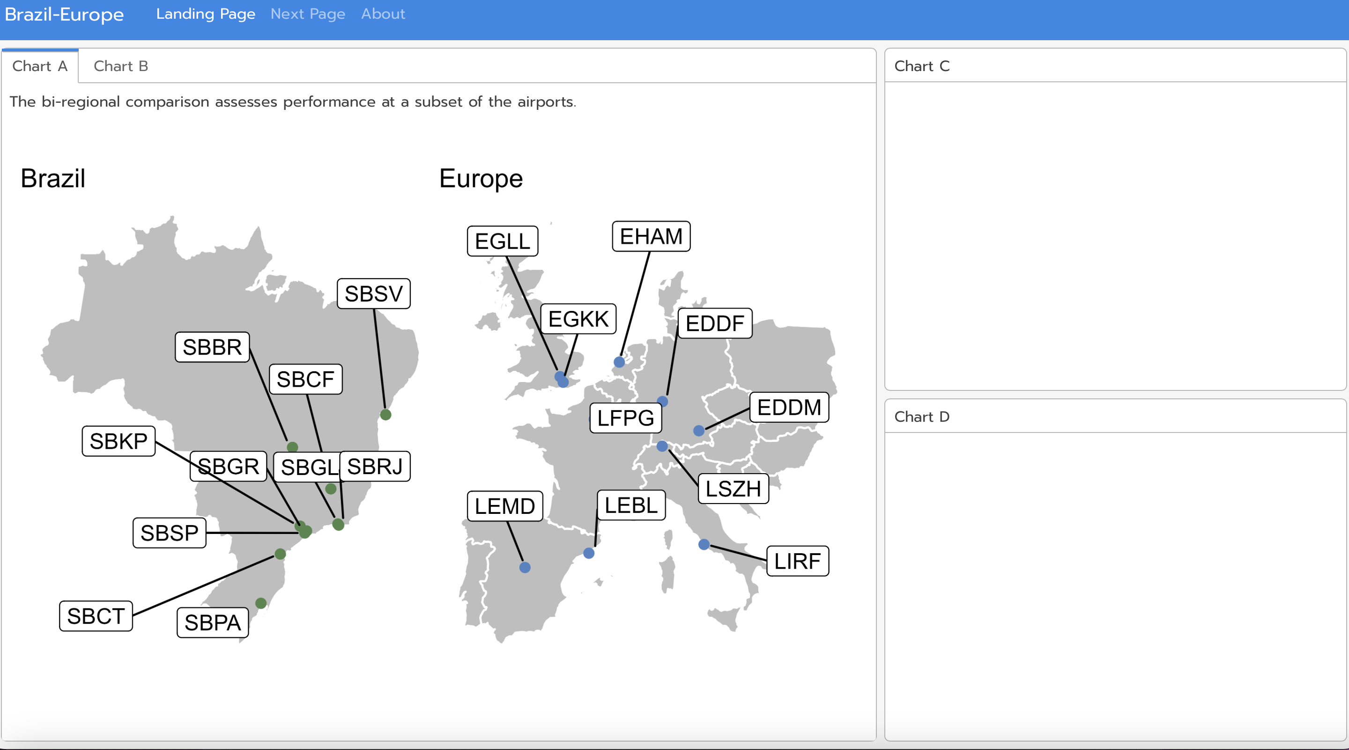
Dashboard
basic dashboard with {flexdashboard}
agree on tabs ~ develop incremental

