Slide 1


“The partnership between DECEA and EUROCONTROL continues to consolidate itself as a reference in international technical cooperation aimed at excellence in ATM performance management. The Performance Review Commission (PRC), in particular, has been a strategic partner in deepening comparative studies between Brazil and Europe, with ongoing support for data sharing, indicator analysis, and the adoption of best practices in performance management.
This report reflects the results of that joint effort, which has expanded with each edition. The inclusion of new topics, such as the Point Merge, as well as the comparison related to the Curitiba and Lisbon ACCs, shows that even with distinct regional characteristics and operational specificities, benchmarking is not only possible but highly valuable. It broadens mutual understanding and reinforces the feasibility of applying solutions and concepts to the reality of each system.
This promising journey highlights the evolution of our air navigation system, driven by performance measurement and continuous dialogue with partners such as EUROCONTROL. It demonstrates that we are on the right path — one guided by cooperation, transparency, and a commitment to continuous improvement.
”
General Maurício Augusto Silveira de Medeiros
Director General of DECEA
“This forth edition of the Brazil-Europe comparison demonstrates the close link between our organisations and the shared desire to provide safe and highly efficient operations in both regions. The close collaboration with DECEA allows for the identification of drivers of performance by understanding similarities and differences in the operational concepts and underlying technological enablers. This is an essential step in working towards a level playing field in both regions and support the wider global performance-based approach to air navigation.”
Dr Peter Whysall
Chairman of the Performance Review Commission

Slide 2
The partnership between DECEA and EUROCONTROL continues to consolidate itself as a reference in international technical cooperation aimed at excellence in ATM performance management. The Performance Review Commission (PRC), in particular, has been a strategic partner in deepening comparative studies between Brazil and Europe, with ongoing support for data sharing, indicator analysis, and the adoption of best practices in performance management.
This report reflects the results of that joint effort, which has expanded with each edition. The inclusion of new topics, such as the Point Merge, as well as the comparison related to the Curitiba and Lisbon ACCs, shows that even with distinct regional characteristics and operational specificities, benchmarking is not only possible but highly valuable. It broadens mutual understanding and reinforces the feasibility of applying solutions and concepts to the reality of each system.
This promising journey highlights the evolution of our air navigation system, driven by performance measurement and continuous dialogue with partners such as EUROCONTROL. It demonstrates that we are on the right path — one guided by cooperation, transparency, and a commitment to continuous improvement.
General Maurício Augusto Silveira de Medeiros
Director General of DECEA
Dr Peter Whysall
Chairman of the Performance Review Commission

Slide 3
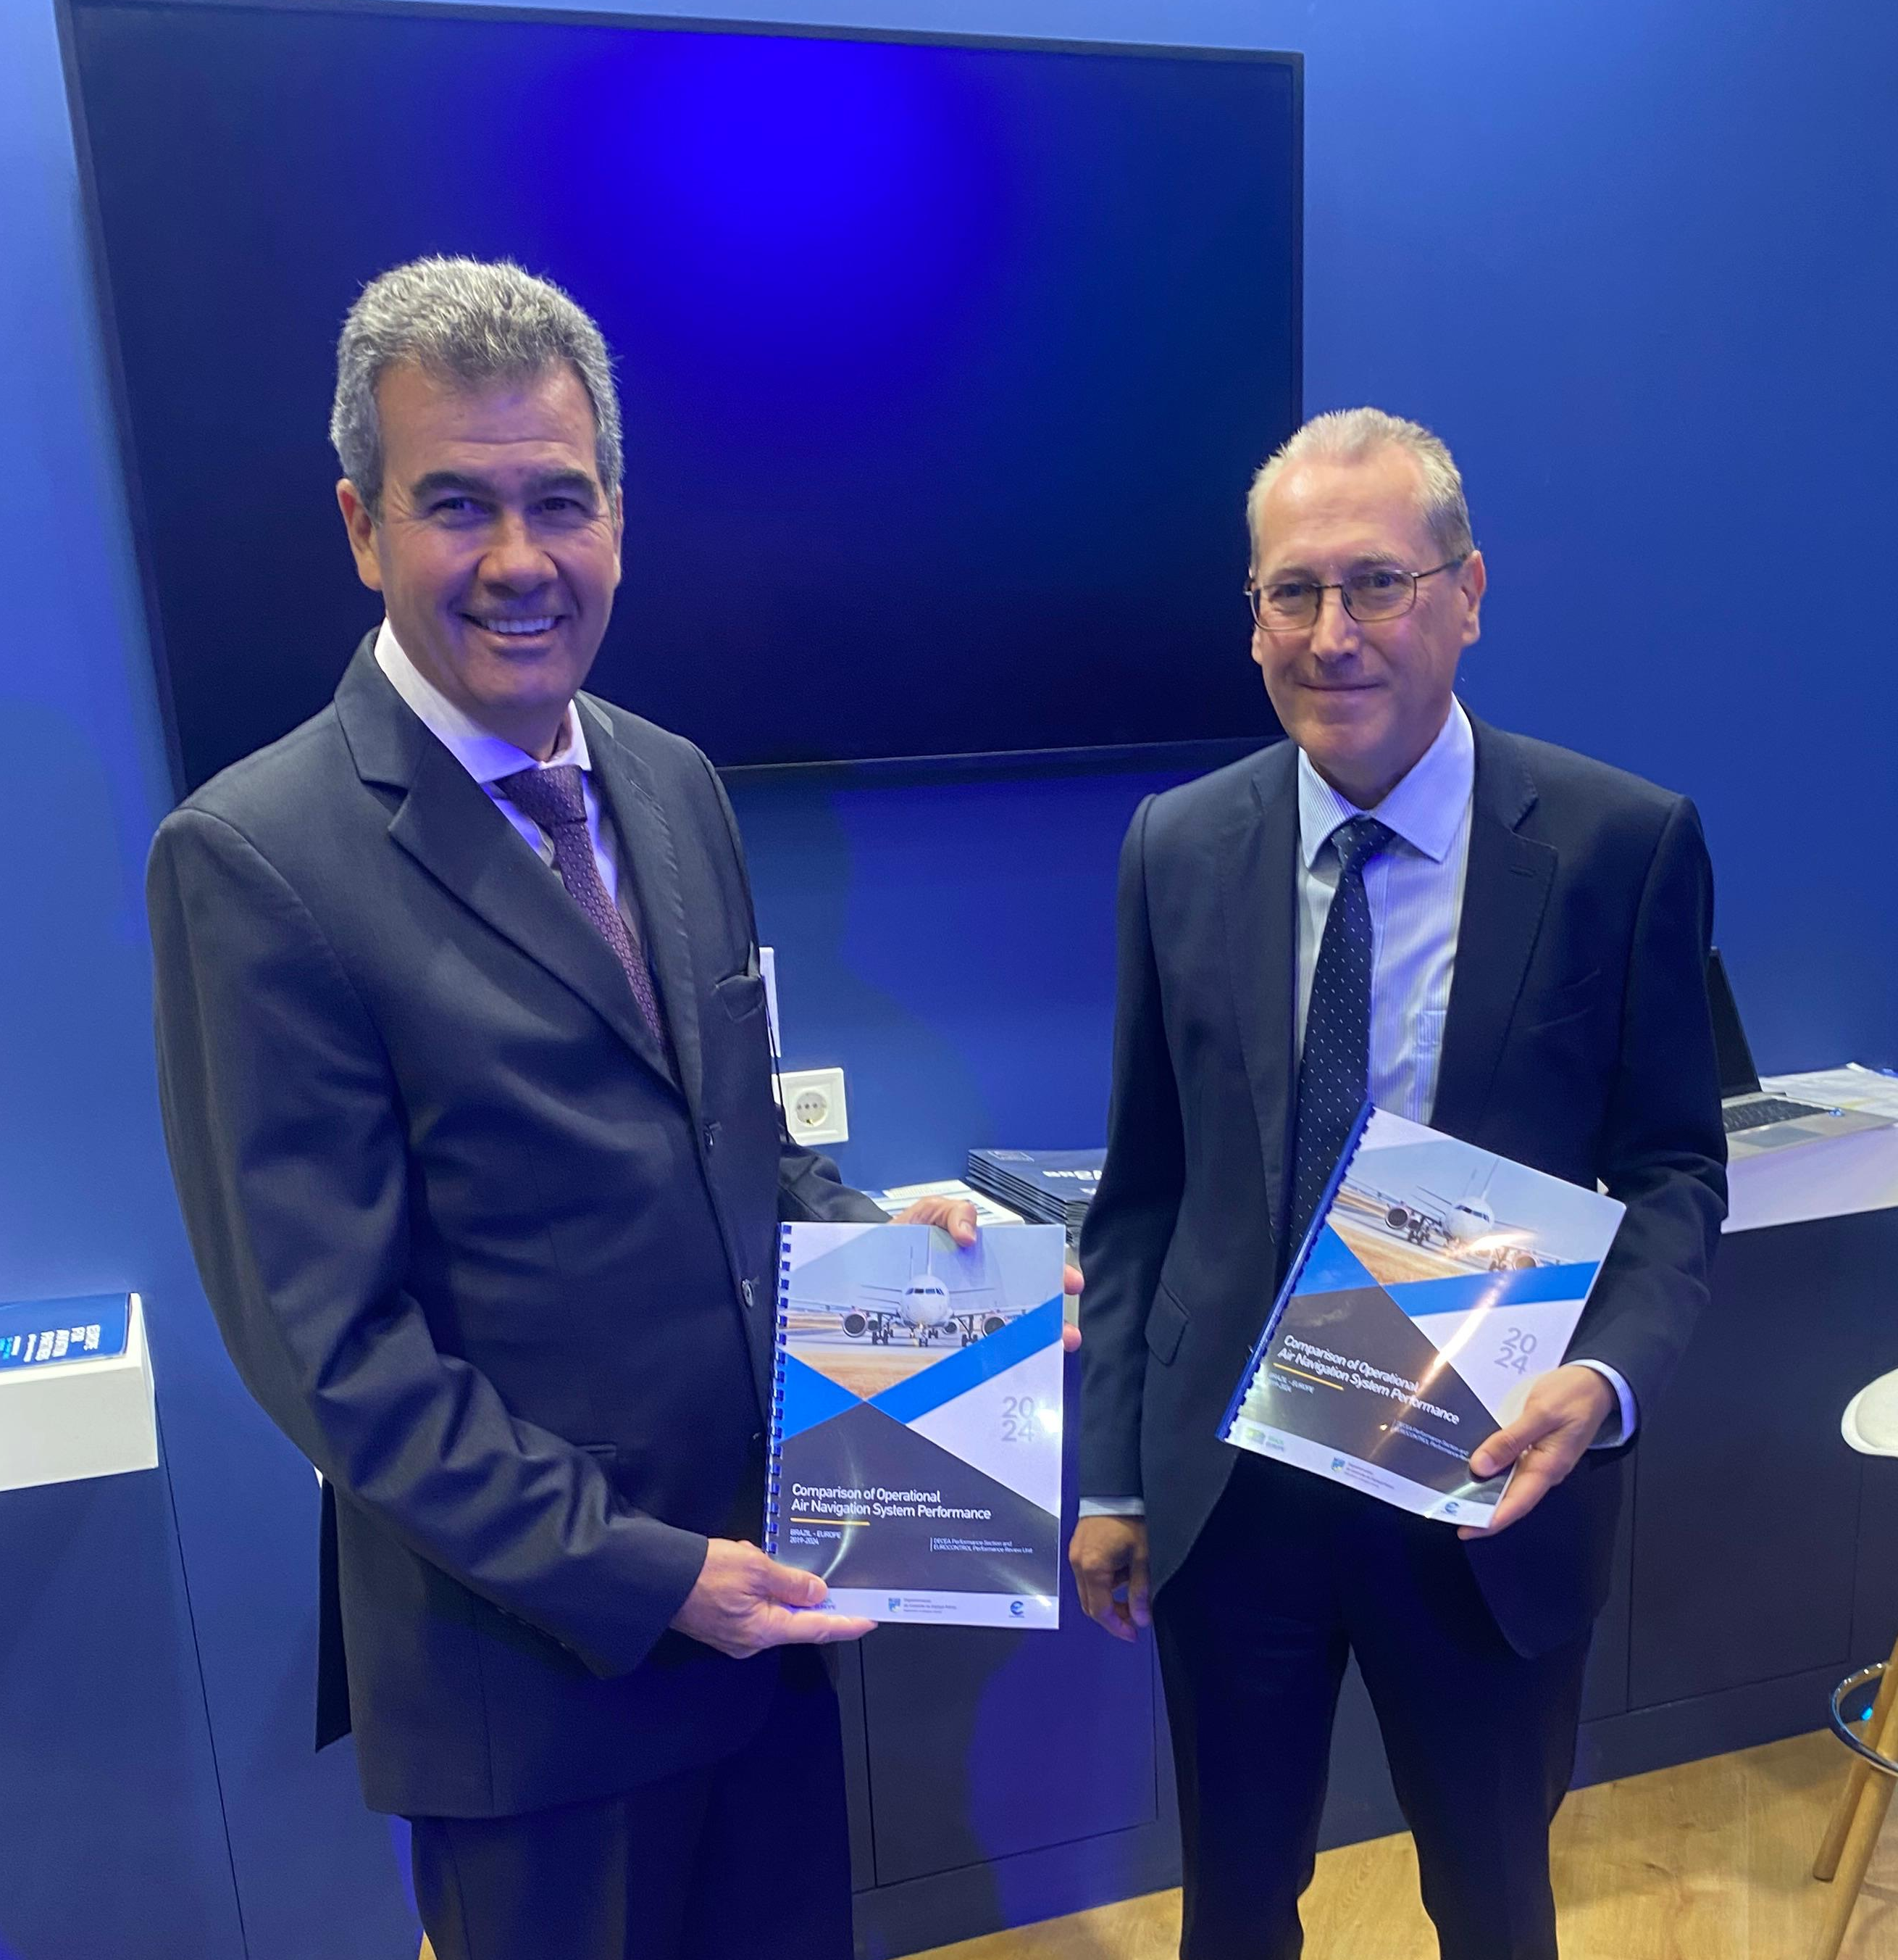

Slide 4
KPA | Brazil 2019 | Brazil 2023 | Europe 2019 | Europe 2023 | Brazil/Europe 2019 | Brazil/Europe 2023
geographic area (non-oceanic, million km²) | 8.5 |  | 11.5 |  | 74%
number of en-route ANSPs | 1 |  | 36 |  | single provider vs multiple
number of TWR | 59 | 57 + 1 DTWR⁽²⁾ | 400+ |  | ATS facilities mostly unchanged
number of APP | 43 | 41 | 19 (stand-alone) | 19 (stand-alone)
number of ACC | 5 |  | 58 | 58
number of ATCOs in OPS | 3 126 | 3 677 | 17 563 | 16552⁽¹⁾ | 17.8% | 22.2%
controlled flights | 1 594 442 | 1 801 109 | 10 995 092 | 9 237 693 | 14.5% | 19.5%
flights/ATCO | 510 | 490 | 626 | 558 | 81.5% | 87.8%
traffic density (non-oceanic, flights/km²) | 0.187 | 0.212 | 0.956 | 0.80 | 20% | 26.5%
 | c.f. ACE report; further staff and facility numbers refer to EUROCONTROL States, excluding Georgia, Ukraine, Canary Islands and Oceanic areas. European staff and facility numbers refer to 2021 which is the latest year available. DTWR: DECEA has deployed a digital TWR

Slide 5
