Slide 1

Extension of the SWIFT option pricing scheme for European options calibration under Heston stochastic volatility model
Master in Advanced Mathematics and Mathematical Engineering
Master's thesis
Supervised by Luis Ortiz-Gracia
Eudald Romo Grau
July 2020
Notes:
This study extends the SWIFT option pricing scheme to option contracts calibration, specifically, under Heston stochastic volatility dynamics.
1 (4m) 2 (3m) 3 (5m) 4 (5m) 5 (2-3 m) 6 (5m) 7 (2-3m)

Slide 2
Motivation
1
Challenges in option contracts trading.
Notes:
This has direct applications to real-market options trading, so it is interesting to know why the principal components of the study: calibration, the Heston model, and SWIFT are relevant for that.

Slide 3
Option Trading Cycle
Fetch
Option Prices
Tune
Model
Send
Orders
Set
Option
Prices
Notes:
Why calibration is relevant can be seen from a simplified option trading cycle, where one starts by fetching option market prices and uses them to tune certain option dynamics model. Then, this model is used to give prices to all relevant options and this information is finally used to decide a course of action given a certain investing strategy.

Slide 4
Option Trading Cycle
Market data
Fetch
Option Prices
Tune
Model
Get the required option and underlying asset data.
Send
Orders
Set
Option
Prices
Notes:
Let’s look at each node more closely. Given a certain contracts exchange market one can retrieve option market prices for each product one is interested in. This is typically automated through market data fetching software that, from my experience in options trading, can typically take just dozens of microseconds.

Slide 5
Option Trading Cycle
Market data
Fetch
Option Prices
Tune
Model
Option calibrator
Get the required option and underlying asset data.
Choose model parameters that fit the prices of a set of strikes and maturities.
Send
Orders
Set
Option
Prices
Notes:
Then, one can calibrate the option dynamics model to fit the prices of a previously defined set of strikes and maturities. This step is typically computationally expensive and can easily become a bottleneck in the process.

Slide 6
Option Trading Cycle
Market data
Fetch
Option Prices
Tune
Model
Option calibrator
Get the required option and underlying asset data.
Choose model parameters that fit the prices of a set of strikes and maturities.
Send
Orders
Set
Option
Prices
Option pricer
Use the calibrated model all the options of interest.
Notes:
Once the model is calibrated, it can be used to price the rest of the options of interest. The calibration step usually includes several pricing iterations on a reduced number of options, as will be seen later, so this step doesn’t tend to be a bottleneck.

Slide 7
Option Trading Cycle
Market data
Fetch
Option Prices
Tune
Model
Option calibrator
Get the required option and underlying asset data.
Choose model parameters that fit the prices of a set of strikes and maturities.
Investing strategy
Send
Orders
Set
Option
Prices
Option pricer
Decide how to react to the current theoretic prices and inform the exchange.
Use the calibrated model all the options of interest.
Notes:
One then applies a certain investing strategy. If this step is automated, as in high frequency trading, it can also take dozens of microseconds, so a certain speed requirement would be needed of the option calibration and option pricing steps, so that they don’t become clear bottlenecks of the system.

Slide 8
Option Trading Cycle
Market data
Fetch
Option Prices
Tune
Model
Option calibrator
Get the required option and underlying asset data.
Choose model parameters that fit the prices of a set of strikes and maturities.
Investing strategy
Send
Orders
Set
Option
Prices
Option pricer
Decide how to react to the current theoretic prices and inform the exchange.
Use the calibrated model all the options of interest.
Notes:
Outside of extremely computationally demanding environments like high frequency trading, one can consider situations where a human supervisor trader uses trading software to obtain real-time market price estimations, which then uses to apply a certain investing strategy. The investing strategy can also be partially automated and only require human confirmation. In both cases, it is sufficient that the calibration and pricing are fast enough that the human trader has a fluid real-time option price updating experience.

Slide 9
Option Pricing
2
Risk-neutrality applied to European options.
Notes:
In order to see why the Heston model or the SWIFT method are relevant I need to first delve into how options are typically priced, in particular how European options are priced.

Slide 10
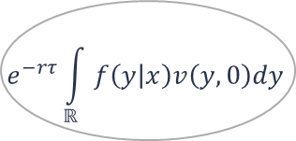
European Option Price
Risk-neutral
assumption
Option payoff
$$e^{−rτ}\int_{ℝ}{f\left(y | x\right)v\left(y,0\right)dy}$$
State variable
choice
Underlying
asset
model
Notes:
In the middle, you can see the risk-neutral European option price formula, and around it are the four key concepts that define it.

Slide 11
European Option Price
Risk-neutral
assumption
Option payoff
$$e^{−rτ}\int_{ℝ}{f\left(y | x\right)v\left(y,0\right)dy}$$
State variable
choice
Underlying
asset
model
Notes:
First, if one assumes that there are no arbitrage opportunities, one can consider the market as risk-neutral. Under this assumption, the price of the option is the expected payoff under the risk-neutral metric discounted at the risk-free rate r.

Slide 12
European Option Price
Risk-neutral
assumption
Option payoff
$$e^{−rτ}\int_{ℝ}{f\left(y | x\right)v\left(y,0\right)dy}$$
State variable
choice
Underlying
asset
model
Notes:
The payoff is the benefit obtained from exercising the option contract. European options can only be exercised on expiry, so their payoff can simply be stated as a function of the final state of the option, y.

Slide 13
European Option Price
Risk-neutral
assumption
Option payoff
$$e^{−rτ}\int_{ℝ}{f\left(y | x\right)v\left(y,0\right)dy}$$
State variable
choice
Underlying
asset
model
Notes:
The expectation under the risk-neutral metric is defined by the underlying asset price evolution model, which appears in the formula as the probability function of the final state of the underlying asset y, conditioned to initial state x.

Slide 14
European Option Price
Risk-neutral
assumption
Option payoff
$$e^{−rτ}\int_{ℝ}{f\left(y | x\right)v\left(y,0\right)dy}$$
State variable
choice
Underlying
asset
model
Notes:
Both the underlying asset final state probability distribution and the payoff expressions depend on the underlying asset state variables used, in the thesis the benefits of logarithmic state variables are shown.

Slide 15
Underlying asset models
3
Why is Heston stochastic model relevant?

Slide 16
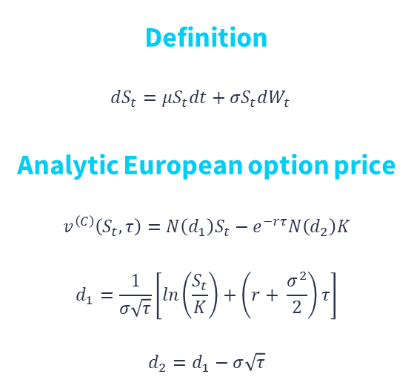
Black-Scholes-Merton model
Definition
$$dS_{t}=μS_{t}dt+σS_{t}dW_{t}$$
Analytic European option price
$$v^{\left(C\right)}\left(S_{t},τ\right)=N\left(d_{1}\right)S_{t}−e^{−rτ}N\left(d_{2}\right)K$$
$$d_{1}=\frac{1}{σ\sqrt{τ}}\left[ln\left(\frac{S_{t}}{K}\right)+\left(r+ \frac{σ^{2}}{2}\right)τ\right]$$
$$d_{2}=d_{1}−σ\sqrt{τ}$$
Notes:
An underlying asset model typically used is the Black-Scholes-Merton model, which assumes the underlying asset prices follow a geometric Brownian motion. The PDE that define it can be solved for European options to provide a simple analytic expression of the option price. Further, the closed expression of the gradient of the price with respect to sigma can be easily obtained, so BS models can easily be calibrated using gradient descent methods.

Slide 17
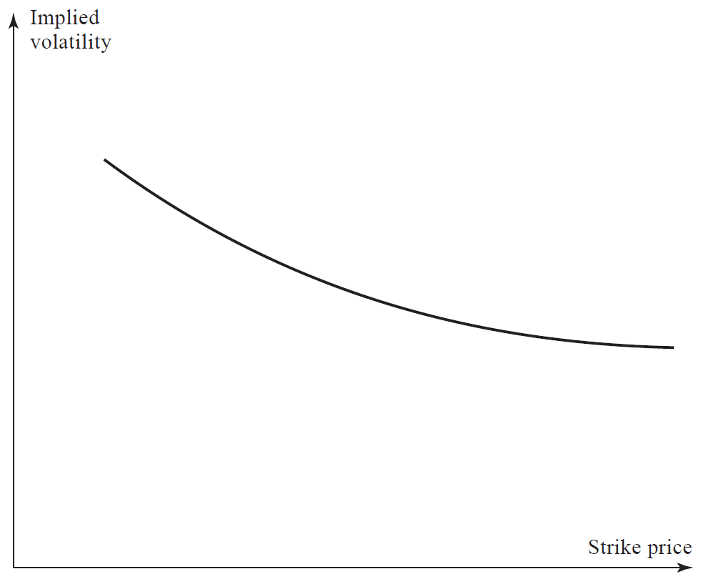
Volatility Smile
Notes:
Despite the computation speed benefits of the closed form and readily available gradients, the BS model fails to capture real-market behavior which can be seen from the existence of the volatility smile.
The volatility smile arises when calibrating the single parameter of the BS model sigma, called implied BS volatility, with market prices of options at different strikes.
Each option price will determine a value for the IV and, if BS described real-markets accurately, the IV should stay constant through the different strikes. Instead, the obtained IV values follow what’s called as the volatility smile.

Slide 18
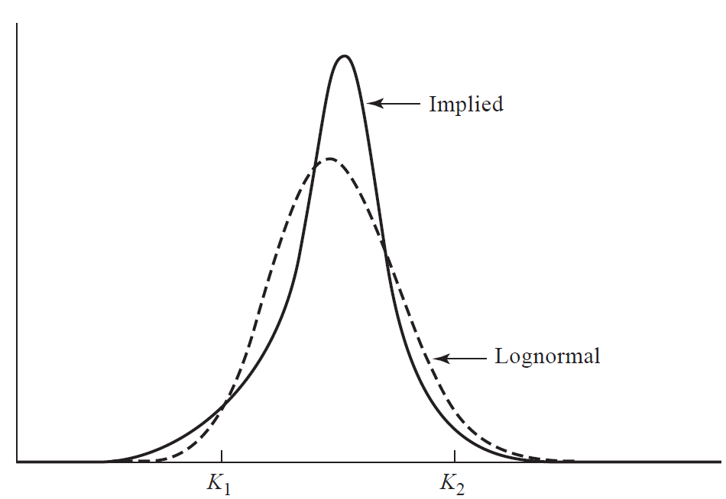
Volatility Smile
Notes:
The IV smile is related to the IV distribution, which is the theoretic underlying asset distribution that, once introduced into the risk-neutral option valuation formula, would yield prices that match the real market ones.
Talk about volatility surface too. In particular about term structure.

Slide 19
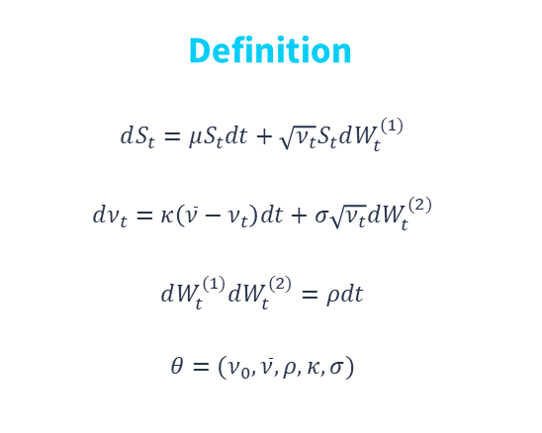
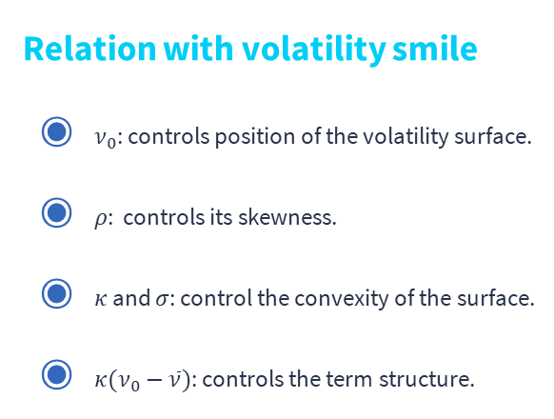
Heston model
Definition
$$dS_{t}=μS_{t}dt+\sqrt{ν_{t}}S_{t}dW_{t}^{(1)}$$
$$dν_{t}=κ\left(\overline{ν}−ν_{t}\right)dt+σ\sqrt{ν_{t}}dW_{t}^{(2)}$$
$$dW_{t}^{(1)}dW_{t}^{(2)}=ρdt$$
$$θ=(ν_{0},\overline{ν},ρ,κ,σ)$$
Relation with volatility smile
$ν_{0}$: controls position of the volatility surface.
$ρ$: controls its skewness.
$κ$ and $σ$: control the convexity of the surface.
$κ(ν_{0}−\overline{ν})$: controls the term structure.
Notes:
In order to account for the shortcomings of the BS model, other models, like the Heston stochastic volatility model were developed. In particular, the Heston model introduces a new geometric Brownian motion to describe the volatility evolution.
This model ends up with a total of 5 parameter variables that are deeply related to the volatility surface described before, and allow to capture its shape.
But, a major drawback is that the increased complexity translates in the inexistence of a closed form solution for option prices, not even for simple contracts like European options.

Slide 20
Characteristic function expressions
Heston
Discontinuous
Complicated gradient
Schoutens
Continuous
Complicated gradient
Del Baño-Rollin
Discontinuous
Simple gradient
Cui
Continuous
Simple gradient
Notes:
Fortunately, the characteristic function of probability distribution of the underlying asset final state has a closed form that has been available since Heston originally presented the model in 1993 and Inverse Fourier transforms pricing methods were used to successfully price European options under Heston dynamics (the exact pricing method will be discussed in the next section). But it was not until an alternative expression was presented in 2017 by Cui, del Ba;o-Rollin, and Germano that a Heston model was efficiently calibrated using European option data.

Slide 21
Characteristic function expressions
Heston
Discontinuous
Complicated gradient
Schoutens
Continuous
Complicated gradient
Del Baño-Rollin
Discontinuous
Simple gradient
Cui
Continuous
Simple gradient
Notes:
Previously, an efficient calibration was not possible because the characteristic function expression was both discontinuous for large expiries and had a complicated gradient expression that most studies deemed untreatable. So, if one wanted to use gradient-descent based methods, one needed to use numerically approximated gradients, which were computationally expensive and numerical errors could arise due to the discontinuities of the characteristic function. To avoid that, studies either constrained the parameters with heuristics to reduce the dimension of the calibration problem, or used gradient free methods. The former risked leaving the optimum out of the calibration domain, and the latter proved insufficient for real-time updating of an underlying asset model.

Slide 22
Characteristic function expressions
Heston
Discontinuous
Complicated gradient
Schoutens
Continuous
Complicated gradient
Del Baño-Rollin
Discontinuous
Simple gradient
Cui
Continuous
Simple gradient
Notes:
Several alternative expressions have been studied since the original one proposed by Heston. In particular, Schoutens was able to avoid the discontinuities in the original formulation by using the secondary value of a complex-valued square root that appeared in the expression.

Slide 23
Characteristic function expressions
Heston
Discontinuous
Complicated gradient
Schoutens
Continuous
Complicated gradient
Del Baño-Rollin
Discontinuous
Simple gradient
Cui
Continuous
Simple gradient
Notes:
Del Ba;o-Rollin proposed an alternative, more compact expression, derived from the Moment generating function of the probability distribution that defined the underlying assets movement. This equivalent expression replaced some of the parts of the original characteristic function with an alternative expression based on hyperbolic functions, which greatly simplified gradient computation. Unfortunately, this expression also presented discontinuities.

Slide 24
Characteristic function expressions
Heston
Discontinuous
Complicated gradient
Schoutens
Continuous
Complicated gradient
Del Baño-Rollin
Discontinuous
Simple gradient
Cui
Continuous
Simple gradient
Notes:
Finally, Cui, del Ba;o Rollin and Germano followed Schoutens study and analyzed the origin of the discontinuities and successfully proposed an alternative expression that avoided them.

Slide 25
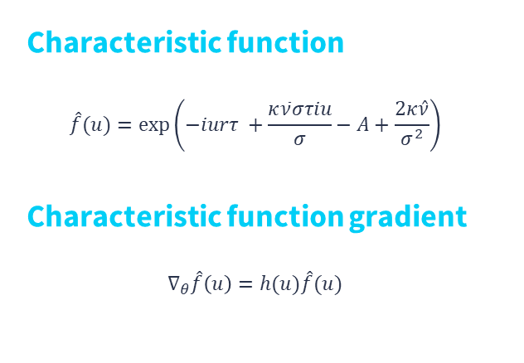
Cui’s expression
Characteristic function
$$\hat{f}(u)=\exp\left(−iurτ +\frac{κ\overline{ν}στiu}{σ}−A+\frac{2κ\hat{ν}}{σ^{2}}\right)$$
Characteristic function gradient
$$∇_{θ}\hat{f}\left(u\right)=h(u)\hat{f}(u)$$
Notes:
The last characteristic function expression is as shown in the slides, and has an analytic expression for its gradient, which is included in the thesis document. It is worth noting that the gradient at a certain point explicitly depends on the characteristic function at the same point, which allows to reuse several computations during the calibration process that will be described later.

Slide 26
European Option Pricing
4
What advantages does SWIFT provide?

Slide 27
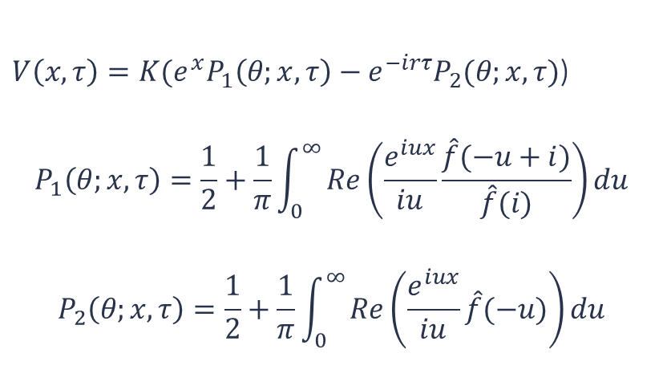
Heston formula
$V\left(x,τ\right)=K(e^{x}P_{1}\left(θ;x,τ\right)−e^{−irτ}P_{2}(θ;x,τ)$)
$$P_{1}\left(θ;x,τ\right)=\frac{1}{2}+\frac{1}{π}\int_{0}^{∞}{Re\left(\frac{e^{iux}}{iu}\frac{\hat{f}(−u+i)}{\hat{f}(i)}\right)}du$$
$$P_{2}\left(θ;x,τ\right)=\frac{1}{2}+\frac{1}{π}\int_{0}^{∞}{Re\left(\frac{e^{iux}}{iu}\hat{f}(−u)\right)}du$$
Notes:
This can be extended to other models outside from Heston.

Slide 28
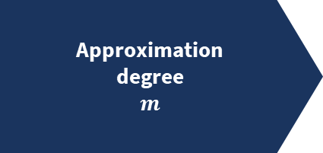
MRA and Shannon wavelets
Approximation
degree
$m$
Notes:
A multiresolution analysis (or MRA) is a method to approximate a given function at increasingly accurate degrees of approximation by projecting it defining a family of nested approximation spaces of increasing accuracy and projecting the function of interest into one of them.

Slide 29
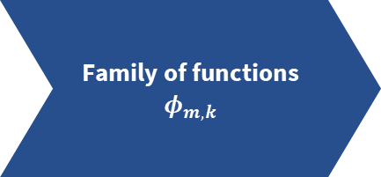
MRA and Shannon wavelets
Approximation
degree
$m$
Family of functions
$$φ_{m,k}$$
Notes:
At each level of approximation, the projection subspace is defined by a family of functions phi_m,k, which can be generated from a single father function phi.

Slide 30
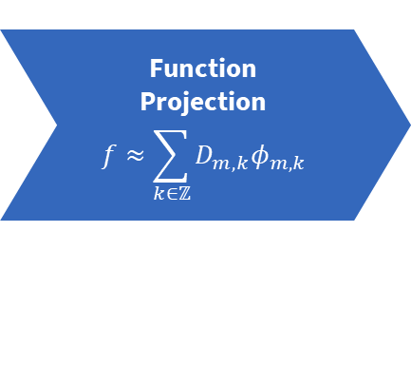
MRA and Shannon wavelets
Approximation
degree
$m$
Family of functions
$$φ_{m,k}$$
Function
Projection
$$f≈\sum_{k∈ℤ}{D_{m,k}φ_{m,k}}$$
Notes:
The function is then approximated by computing the scalar product with each function of the family (denoted by D_m,k In the slides).

Slide 31
MRA and Shannon wavelets
Approximation
degree
$m$
Family of functions
$$φ_{m,k}$$
Function
Projection
$$f≈\sum_{k∈ℤ}{D_{m,k}φ_{m,k}}$$
Sinc
function
Notes:
A particular case of MRA of interest is the one obtained by using the sinc function as the father function, or wavelet.

Slide 32
MRA and Shannon wavelets
Approximation
degree
$m$
Family of functions
$$φ_{m,k}$$
Function
Projection
$$f≈\sum_{k∈ℤ}{D_{m,k}φ_{m,k}}$$
Sinc
function
Shannon
wavelets
Notes:
This spans a family of functions called Shannon wavelets for each approximation subspace, and can be used to project the initial function f. The exact expression of these wavelets can be found in the thesis document.

Slide 33
MRA and Shannon wavelets
Approximation
degree
$m$
Family of functions
$$φ_{m,k}$$
Function
Projection
$$f≈\sum_{k∈ℤ}{D_{m,k}φ_{m,k}}$$
Sinc
function
Shannon
wavelets
Compact and
simple Fourier
transform
Notes:
One of the main advantages of using Shannon wavelets for MRA is that the father sinc function and all its derived wavelets have simple and compact Fourier transforms (they are rectangular pulse functions).

Slide 34
MRA and Shannon wavelets
Approximation
degree
$m$
Family of functions
$$φ_{m,k}$$
Function
Projection
$$f≈\sum_{k∈ℤ}{D_{m,k}φ_{m,k}}$$
Sinc
function
Shannon
wavelets
Compact and
simple Fourier
transform
Notes:
There are methods to compute the projection coefficients D_m,k in terms of these simple Fourier transforms. Further, on a finite domain all the projection coefficients can be computed through a single iteration of a Fast Fourier Transform algorithm, allowing for a highly computationally efficient computation.

Slide 35
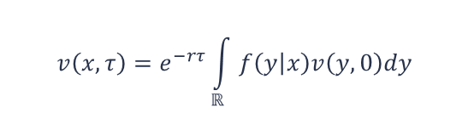
SWIFT
Wavelet projection
Series truncation
$$v\left(x,τ\right)=e^{−rτ}\int_{ℝ}{f\left(y | x\right)v\left(y,0\right)dy}$$
Density coefficients approximation
Payoff coefficients approximation
Notes:
SWIFT method starts from the risk-neutral European option price valuation equation presented before. It then applies a series of consecutive approximations that allow to compute the integral in terms of the Fourier transform of the density distribution function.

Slide 36

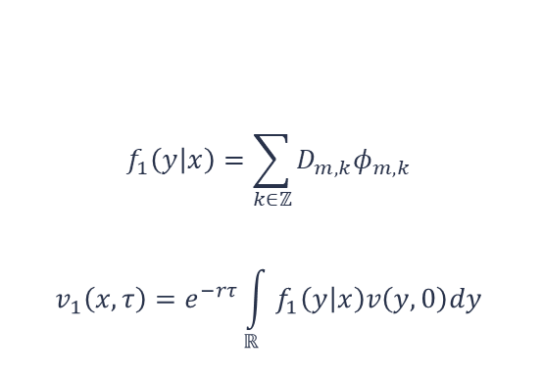
SWIFT
Wavelet projection $(m)$
$$f_{1}\left(y | x\right)=\sum_{k∈ℤ}{D_{m,k}φ_{m,k}}$$
$$v_{1}\left(x,τ\right)=e^{−rτ}\int_{ℝ}{f_{1}\left(y | x\right)v\left(y,0\right)dy}$$
Series truncation
Density coefficients approximation
Payoff coefficients approximation
Notes:
Then it apples

Slide 37

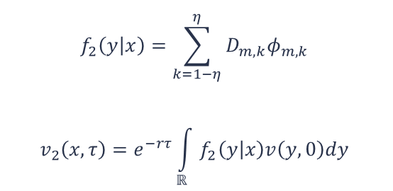
SWIFT
Wavelet projection
$$f_{2}\left(y | x\right)=\sum_{k=1−η}^{η}{D_{m,k}φ_{m,k}}$$
$$v_{2}\left(x,τ\right)=e^{−rτ}\int_{ℝ}{f_{2}\left(y | x\right)v\left(y,0\right)dy}$$
Series truncation $(η)$
Density coefficients approximation
Payoff coefficients approximation

Slide 38
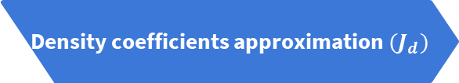
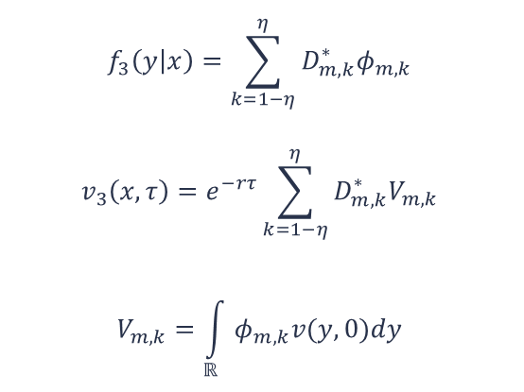
SWIFT
Wavelet projection
$$f_{3}\left(y | x\right)=\sum_{k=1−η}^{η}{D_{m,k}^{∗}φ_{m,k}}$$
$$v_{3}\left(x,τ\right)=e^{−rτ}\sum_{k=1−η}^{η}{D_{m,k}^{∗}V_{m,k}}$$
$$V_{m,k}=\int_{ℝ}{φ_{m,k}v(y,0)dy}$$
Series truncation
Density coefficients approximation $(J_{d})$
Payoff coefficients approximation

Slide 39

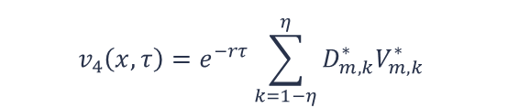
SWIFT
Wavelet projection
Series truncation
$$v_{4}\left(x,τ\right)=e^{−rτ}\sum_{k=1−η}^{η}{D_{m,k}^{∗}V_{m,k}^{∗}}$$
Density coefficients approximation
Payoff coefficients approximation $(J_{p})$
Notes:
Further, there are SWIFT parameter choice methods that, given a certain desired tolerance, provide values for the 4 parameters of the SWIFT method.

Slide 40
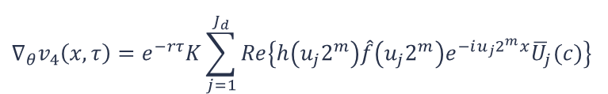
New contributions
Gradient computation
Invariant parameters assumption.
Using an alternative SWIFT formulation for multiple strikes presented in previous studies.
$${∇_{θ}v}_{4}\left(x,τ\right)=e^{−rτ}K\sum_{j=1}^{J_{d}}{Re\left\{h\left(u_{j}2^{m}\right)\hat{f}\left(u_{j}2^{m}\right)e^{−iu_{j}2^{m}x}{\overline{U}}_{j}(c)\right\}}$$

Slide 41
New contributions
Gradient computation
Invariant parameters assumption.
Using an alternative SWIFT formulation for multiple strikes presented in previous studies.
Speed-up techniques
Extension of previous techniques to the gradient computation.
Reusing computations through all calibration steps.
Reusing computations between price and gradient computations.
$${∇_{θ}v}_{4}\left(x,τ\right)=e^{−rτ}K\sum_{j=1}^{J_{d}}{Re\left\{h\left(u_{j}2^{m}\right)\hat{f}\left(u_{j}2^{m}\right)e^{−iu_{j}2^{m}x}{\overline{U}}_{j}(c)\right\}}$$

Slide 42
Option calibration
5
Minimization problem approach

Slide 43
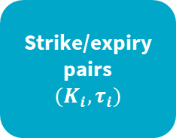
What is a calibrated model?
Strike/expiry
pairs
$${(K}_{i},τ_{i})$$

Slide 44
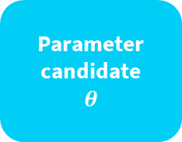
What is a calibrated model?
Fetch
market
data
Strike/expiry
pairs
$${(K}_{i},τ_{i})$$
Parameter
candidate
$$θ$$

Slide 45
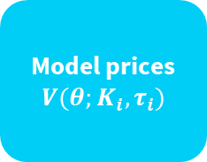
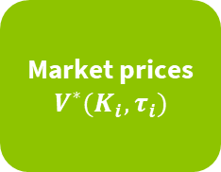
What is a calibrated model?
Fetch
market
data
Market prices
$$V^{∗}(K_{i},τ_{i})$$
Strike/expiry
pairs
$${(K}_{i},τ_{i})$$
Parameter
candidate
$$θ$$
Model prices
$$V(θ;K_{i},τ_{i})$$

Slide 46
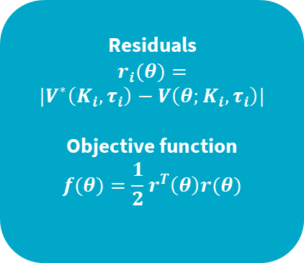
What is a calibrated model?
Fetch
market
data
Market prices
$$V^{∗}(K_{i},τ_{i})$$
Residuals
$$r_{i}(θ)=$$
$$|V^{∗}\left(K_{i},τ_{i}\right)−V\left(θ;K_{i},τ_{i}\right)|$$
Objective function
$$f(θ)=\frac{1}{2}r^{T}\left(θ\right)r(θ)$$
Strike/expiry
pairs
$${(K}_{i},τ_{i})$$
Parameter
candidate
$$θ$$
Model prices
$$V(θ;K_{i},τ_{i})$$

Slide 47
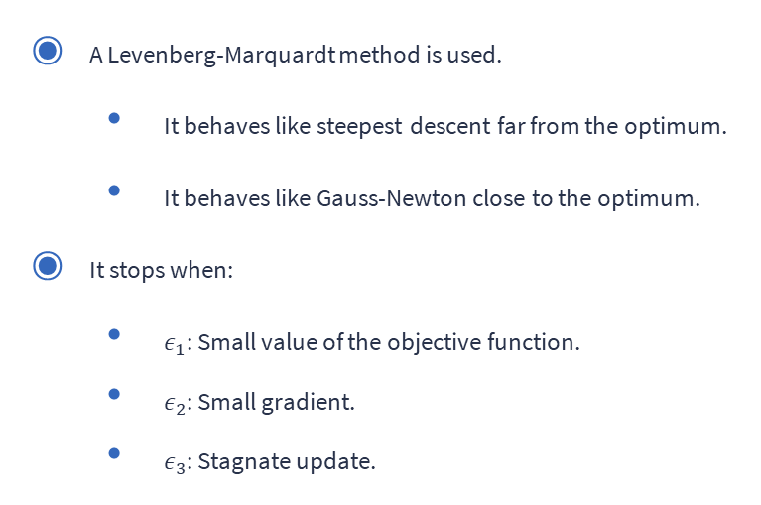
How is the optimum reached?
A Levenberg-Marquardt method is used.
It behaves like steepest descent far from the optimum.
It behaves like Gauss-Newton close to the optimum.
It stops when:
$ε_{1}$: Small value of the objective function.
$ε_{2}$: Small gradient.
$ε_{3}$: Stagnate update.

Slide 48
Numerical results
6
Extreme situations, speed, and applicability.

Slide 49

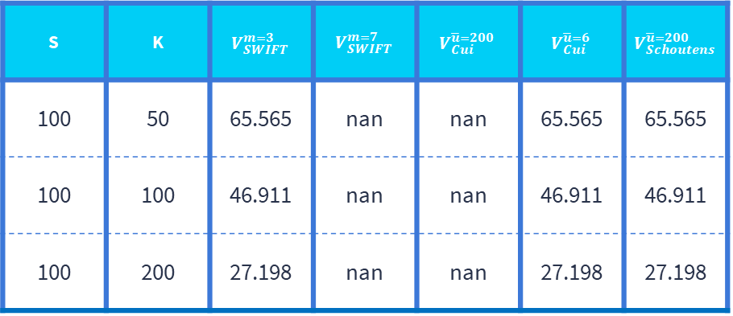
Stress Tests. $τ=45$ years.
S | K | $$V_{SWIFT}^{m=3}$$ | $$V_{SWIFT}^{m=7}$$ | $$V_{Cui}^{\overline{u}=200}$$ | $$V_{Cui}^{\overline{u}=6}$$ | $$V_{Schoutens}^{\overline{u}=200}$$
100 | 50 | 65.565 | nan | nan | 65.565 | 65.565
100 | 100 | 46.911 | nan | nan | 46.911 | 46.911
100 | 200 | 27.198 | nan | nan | 27.198 | 27.198

Slide 50
Speed Tests
 | 40 strikes x 1 expiry | 8 strikes x 5 expiries | 8 strikes x 5 expiries (disabling reusable data across strikes)
SWIFT (no speed-ups) | 7s | 36s | [36s]
SWIFT (with speed-ups) | 4.5ms | 45ms | 170ms
Comparison test | 46ms | 63ms | [63ms]
Notes:
No speedups meant no reusing

Slide 51

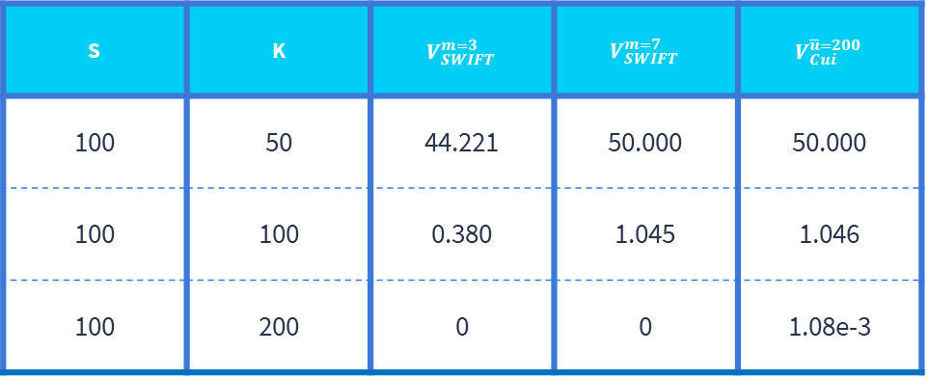
Stress Tests. $τ=2$ weeks.
S | K | $$V_{SWIFT}^{m=3}$$ | $$V_{SWIFT}^{m=7}$$ | $$V_{Cui}^{\overline{u}=200}$$
100 | 50 | 44.221 | 50.000 | 50.000
100 | 100 | 0.380 | 1.045 | 1.046
100 | 200 | 0 | 0 | 1.08e-3

Slide 52
Realistic Convergence Tests
 | Foreign exchange | Interest rate | Equity
Max absolute error in parameter estimation | 1.98e-3 | 2.66e-4 | 1.16e-3
Average number of iterations | 13.85 | 6.32 | 6.78
Average time (ms) | 334 | 194 | 201
Objective function final value | 2.87e-11 | 2.03e-11 | 3.64e-11

Slide 53
Conclusions and further research
7

Slide 54
Conclusions
A complete extension of SWIFT for calibration is provided.
Cui’s Heston characteristic expression numerical problems are discussed.
The presented calibration method execution time is comparable to the highly efficient reference one.
Useful for supervised trading.
Insufficient for high-frequency trading.
Challenging volatility surfaces are properly calibrated in under 1 second.

Slide 55
Conclusions
A complete extension of SWIFT for calibration is provided.
Cui’s Heston characteristic expression numerical problems are discussed.
The presented calibration method execution time is comparable to the highly efficient reference one.
Useful for supervised trading.
Insufficient for high-frequency trading.
Challenging volatility surfaces are properly calibrated in under 1 second.
Further research
Extend SWIFT calibrator to other contracts.
Investigate alternative optimal parameters.
Apply the speed-ups to the reference calibrator.

Slide 56
Thanks for you time.
Contact information
eudald.rg@gmail.com

