Slide 1
Hands on Training
Using LMWG Example Scripts to Develop Dynamic Load Records
(PSS®E Examples)
Patrick Harwood, NERC, Senior Engineer – Transmission Assessments
2025 Dynamic Load Modeling Workshop
October 20, 2025

Slide 2
LMWG Workbook
The legacy “LMDT Tool” is basically an Excel workbook that maps powerflow data to load composition data so that it can be exported to .DYR or .DYD formats
Bus, Area, Owner, Zone, or Load Type Numbers
Load Composition and Motor Parameters
.DYR or .DYD
Load Feeder Type

Slide 3
LMWG Workbook Git Repository
https://dev.azure.com/nerc/LMWG_ResourcesTest
LMWG has refreshed the Load Modeling Data Tool (LMDT) and provided new example implementations:
Separate workbooks for PSSE and PSLF
Excel Macro to export each workbook
Python “Win32” library-based exporter, which can run from PSSE
While you may use these examples as you see fit, they are not necessarily the best fit for every need – please improve and modify
Historical versions of the “LMDT Tool” and the last LMDT Load Composition dataset can also be found at this repository
Note that powerflow data is not included in the repository to protect the confidentially of that data. The provided workbooks are only templates.

Slide 4
PSSE Example Problem 1
You are the Planning Coordinator for Area 1 and Area 2 of the system
You have:
A system dynamics case (“Example1.sav” and “Example1_wCLOD.snp”) that contains CLOD models for your system.
The workbook “NERC_LMWG_PSSE_Bus_wMacro_example1.xlsm” that contains a “MasterLoadMapping” worksheet to map of each load in the entire system to a load composition and feeder type
Load composition tables for each hour of Summer, Winter, and Spring seasons for the entire system
You need to produce:
A new dynamics case for a peak summer hour (hour ending 16) that uses the CMLD model for the loads on your system.
Can you build this model and demonstrate that it works?

Slide 5
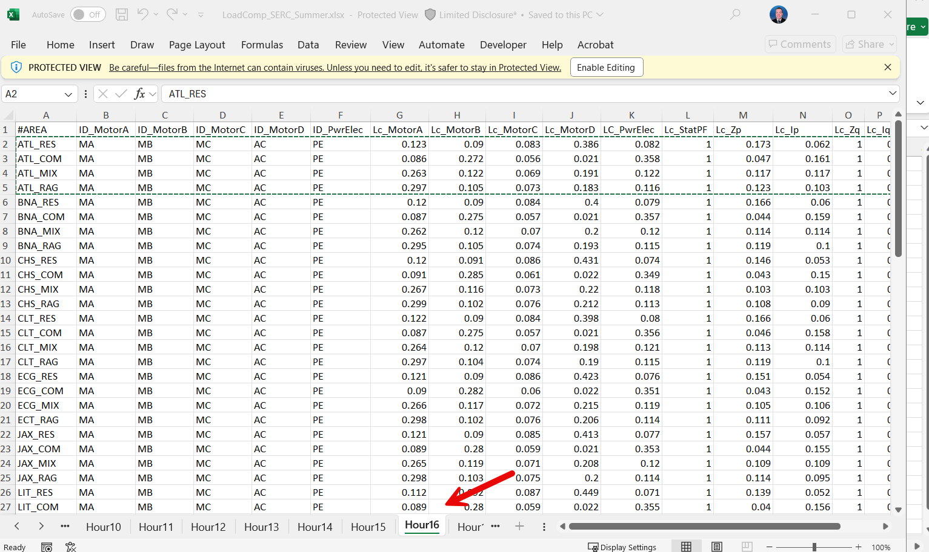
PSSE Example Problem 1 – A Potential Solution
Step 1a: copy and paste Load Compositions values from the latest dataset for the desired hour (here, Hour Ending 16).

Slide 6
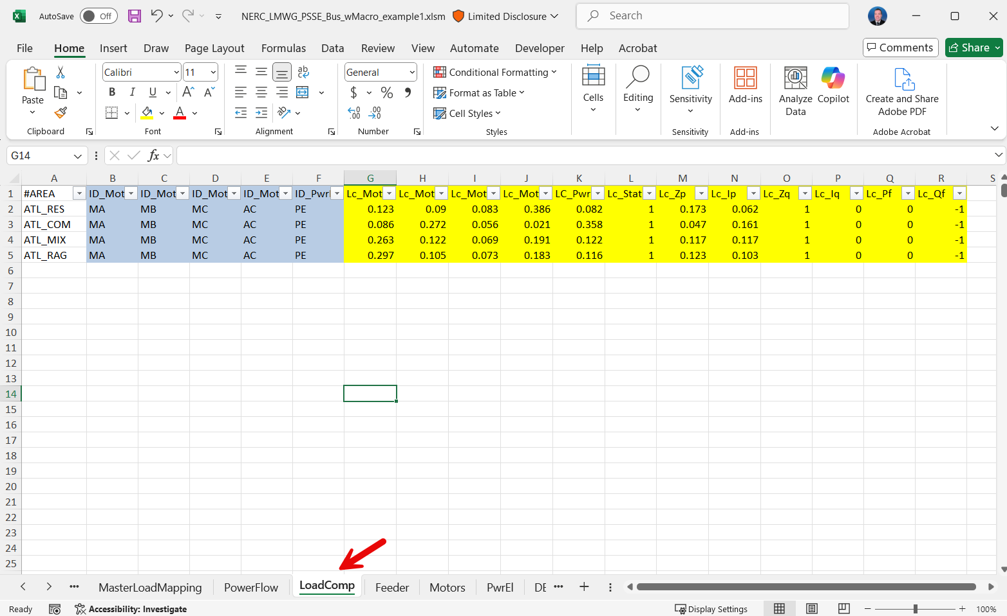
PSSE Example Problem 1 – A Potential Solution
Step 1b: paste them into your “NERC_LMWG_PSSE_Bus_wMacro_example1.xlsm” workbook, “LoadComp” tab
Note: if you had already made a combined copy of all the HE16 Summer load compositions for your system, you could just reuse that workbook.

Slide 7
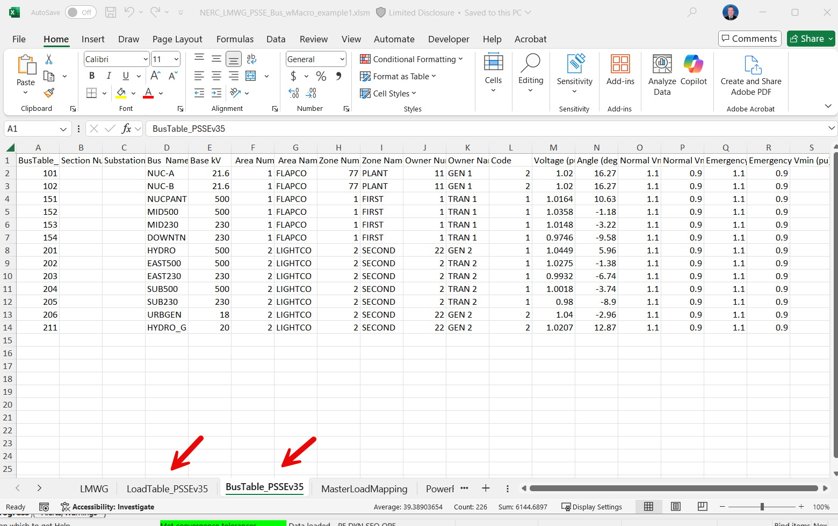
PSSE Example Problem 1 – A Potential Solution
Step 2: Open PSSE
Load “Example1.sav”
Convert Generators and Loads
Solve for Swtiching
Save as “.cnv”
Filter by subsystem (Area 1 and Area 2)
Copy entire “Bus” table into your workbook, table “BusTable_PSSEv35”
Copy entire “Load” table into your workbook, table “LoadTable_PSSEv35”

Slide 8
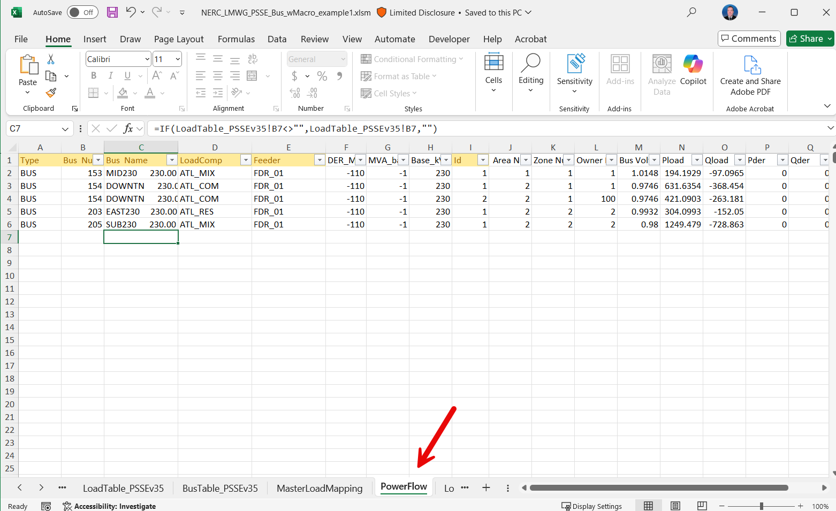
PSSE Example Problem 1 – A Potential Solution
Step 3: Check the “PowerFlow” tab of your workbook. The formulas on this tab should automatically populate it. (If you need to modify, you may have to “unprotect” the worksheet.

Slide 9
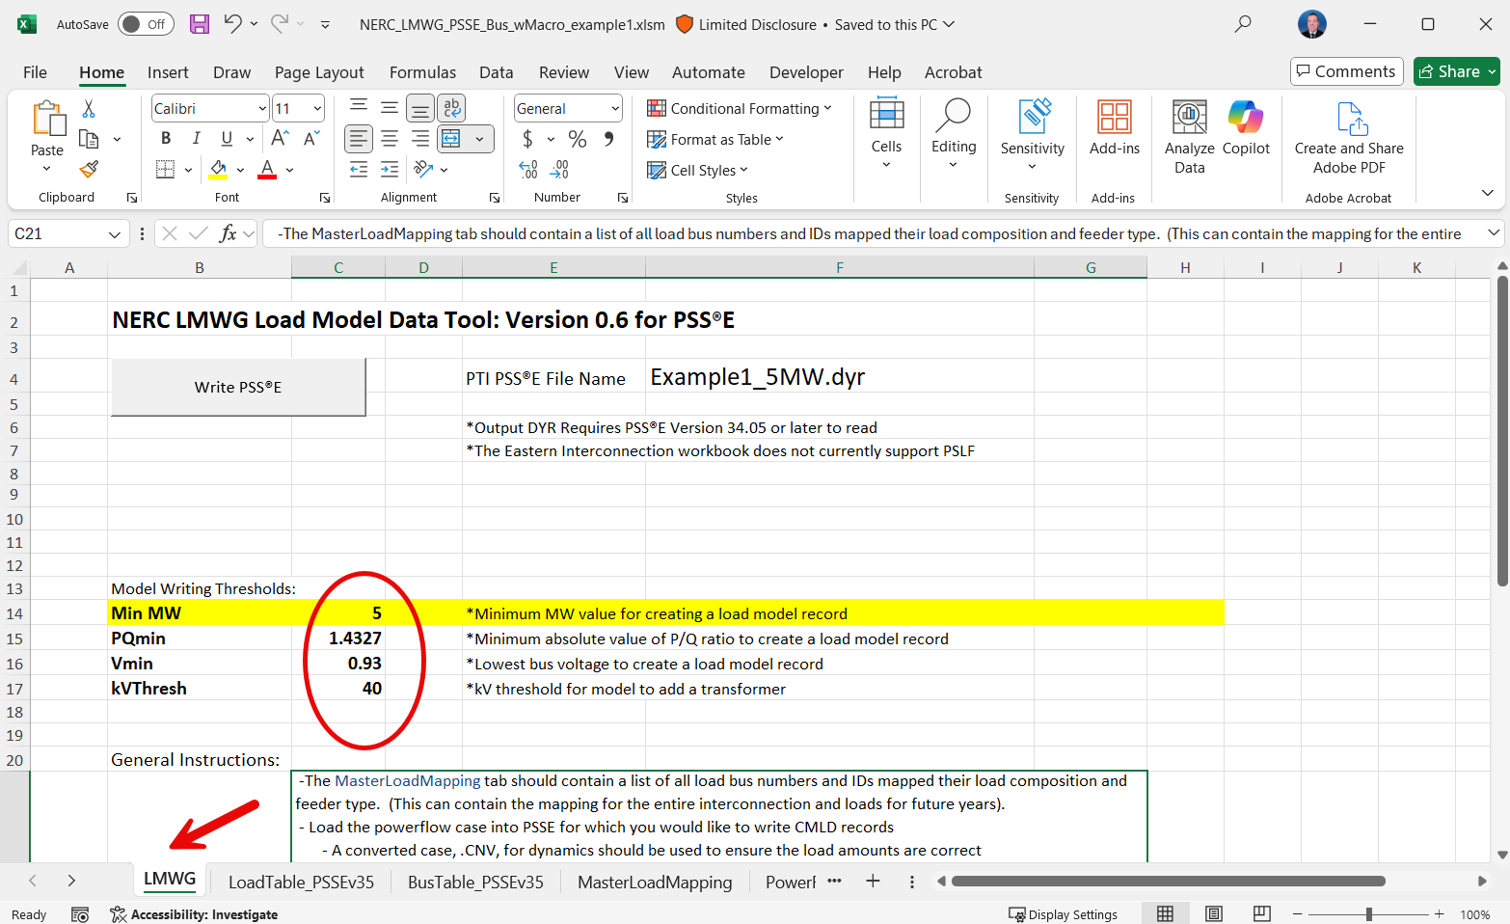
PSSE Example Problem 1 – A Potential Solution
Step 4: Move to the “LMWG” tab of your workbook, and set your desired thresholds for writing composite load models

Slide 10
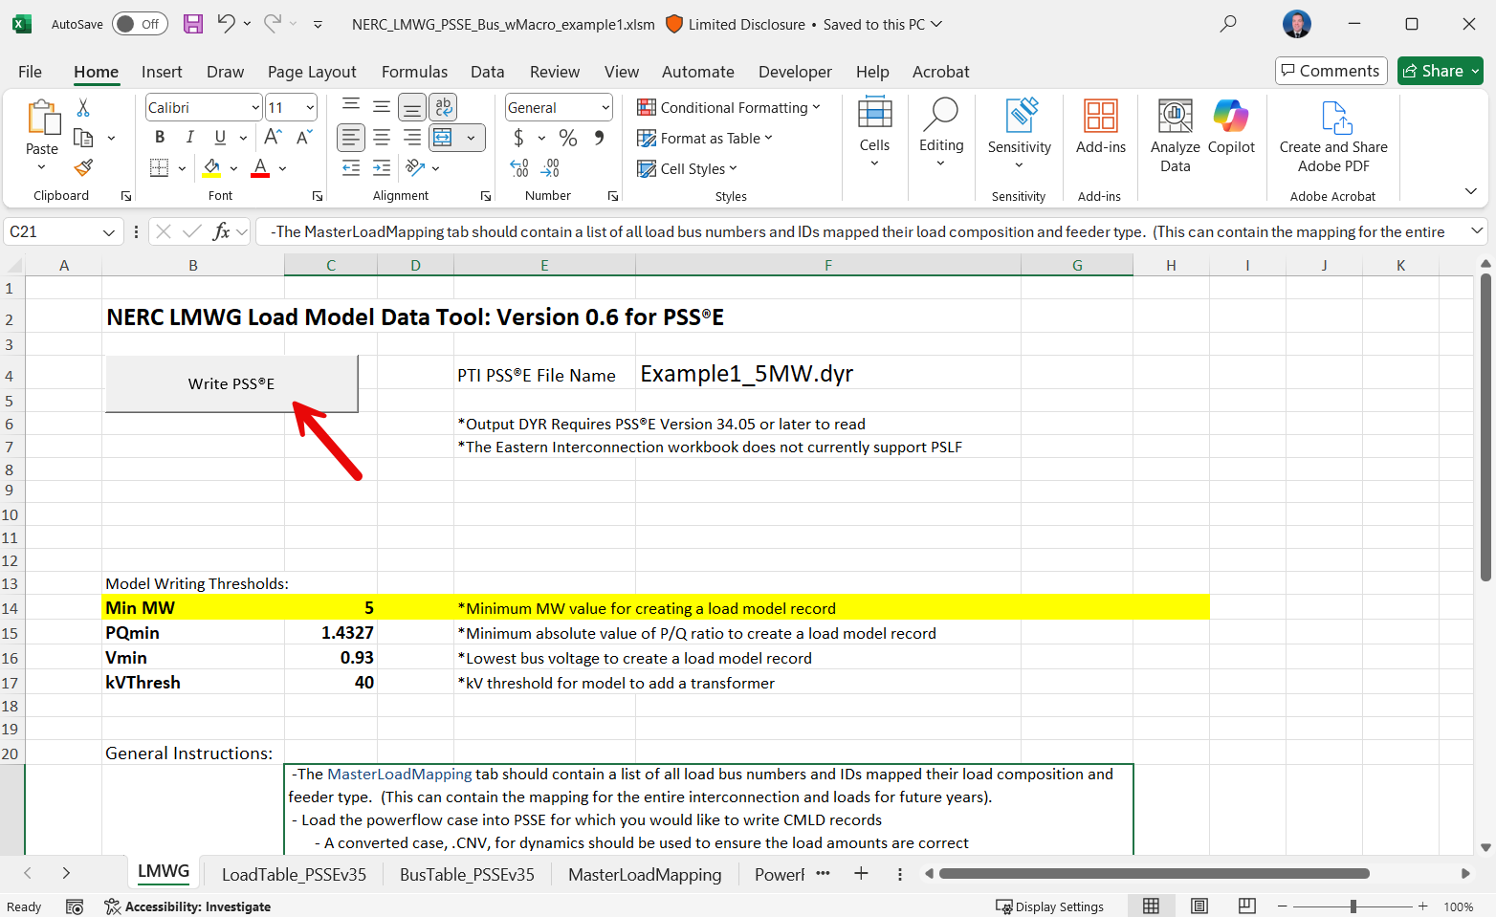
PSSE Example Problem 1 – A Potential Solution
Step 5: Click the button to export the .dyr file
You can now close the workbook for the time-being.

Slide 11
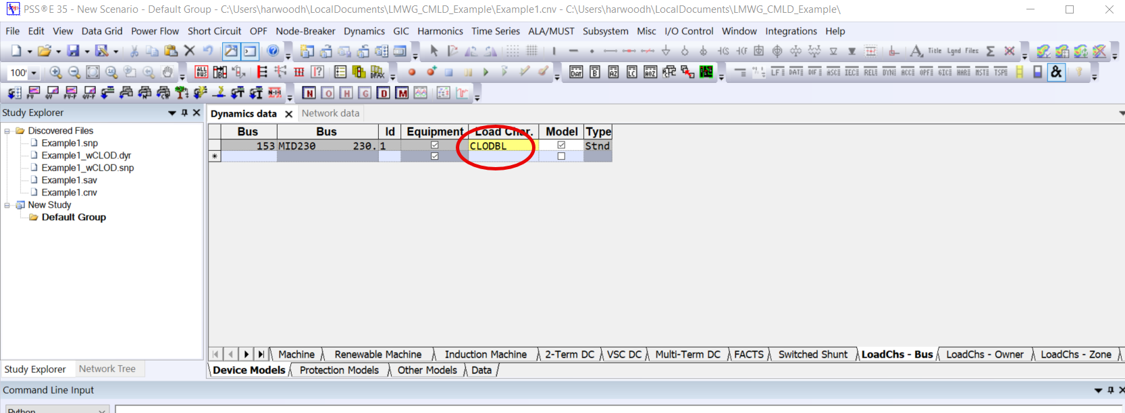
PSSE Example Problem 1 – A Potential Solution
Step 6: Return to PSSE
Load your full dynamics model (“Example1_wCLOD.dyr”)
You will have to remove CLOD and any other Load Characteristic models from your areas before importing your CMLD .dyr
Run “Remove_LoadCh_Models.py” to do this

Slide 12
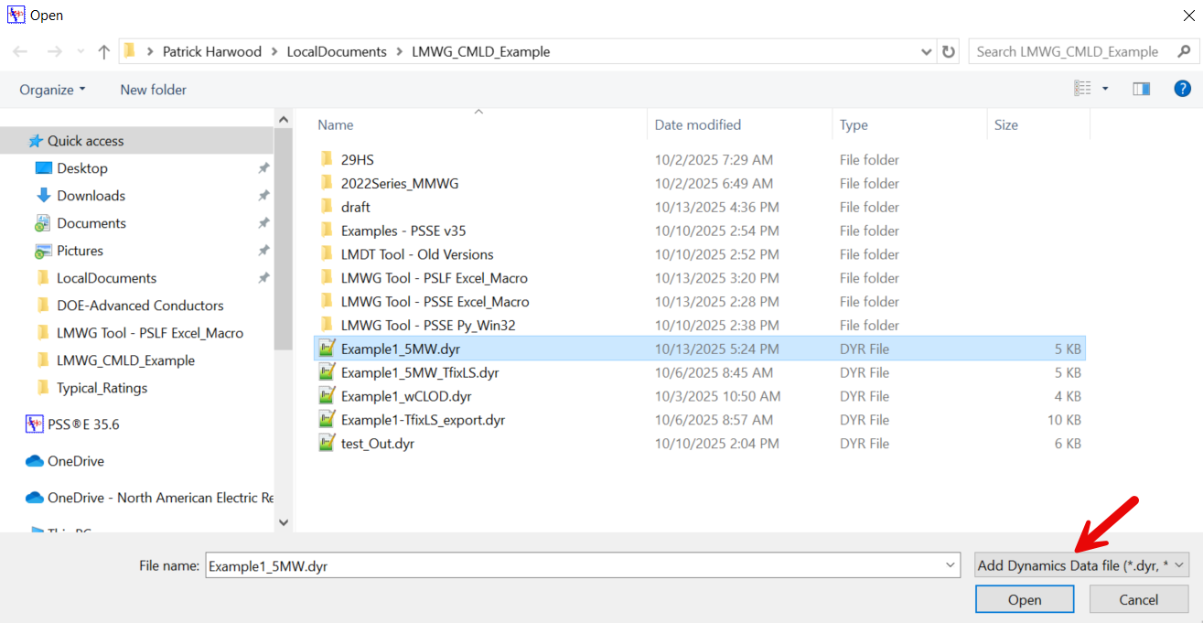
PSSE Example Problem 1 – A Potential Solution
Step 7: Open your CMLD dynamics files (“Example1_5MW.dyr”)
Note: Make sure to select “Add Dynamics Data file”
You can now save the dynamics snapshot and/or .dyr.

Slide 13
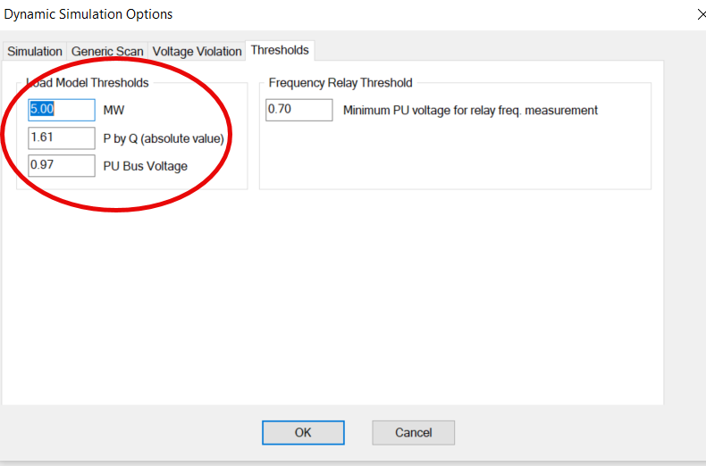
PSSE Example Problem 1 – A Potential Solution
You’re almost done…but wait…
Step 8: Don’t forget to test your files in a simulation!
Run “run_Simulation_Ex1.bat” and “CreatePlots_Ex1.bat”
Simulation Tip:
You can set the load model threshold to the same values as your workbook. Load models not meeting the thresholds will be turned off at initialization.

Slide 14
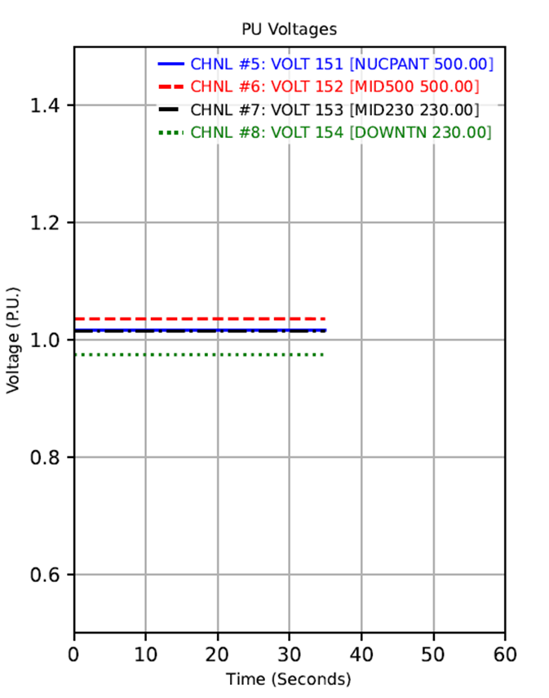
PSSE Example Problem 2
What happened around 30 seconds? Can you correct anything in your CMLD workbook to resolve it?

Slide 15
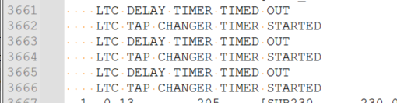

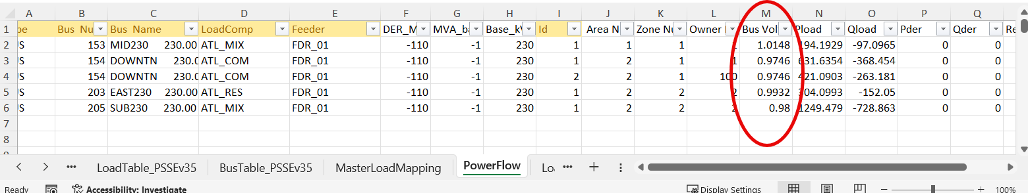
PSSE Example Problem 2 – A Potential Solution
Step 1: Review the simulation logs to see potential sources of errors
Here, it looks like LTCs are moving around 35 seconds, with timers triggering around 30 seconds.
Check the values in the case and workbook. Here, it looks like initial bus voltages are outside of LTC targets.

Slide 16
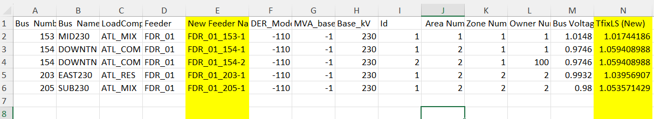
PSSE Example Problem 2 – A Potential Solution
Step 2: Develop a list of new Feeder values for each bus.
See “Example2_LTC_Corrections.xlsx” for an example of how to do this
Here, assume that the step-down transformers were not modeled in your system, but most do in fact have LTC control. Feeder_01 parameters are a fair representation of your system, but the initial low-side fixed tap settings could be adjusted to better tune the load-side voltages.

Slide 17
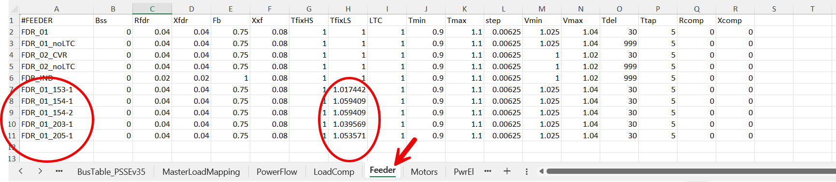
PSSE Example Problem 2 – A Potential Solution
Step 3: Copy and paste new Feeder values into the “Feeder” tab of your LMWG workbook (append the list of feeders)

Slide 18
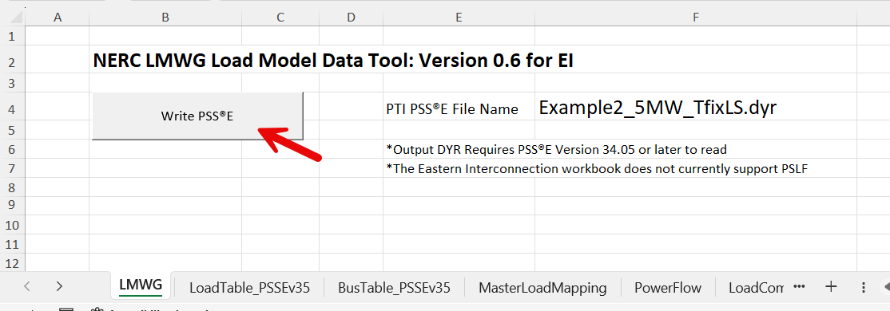
PSSE Example Problem 2 – A Potential Solution
Step 4: Click the button to export a revised .dyr file.

Slide 19
PSSE Example Problem 2 – A Potential Solution
Step 5: Using the same process as in Example 1, steps 6 and 7, combine the new CMLD .dyr with the dynamics data for the rest of your system to create a new .snp and/or .dyr to test in a simulation.
(Remove old Load Characteristic Models)
(Add new CMLD .dyr to case)
(Save as new snapshot and/or .dyr)
“Example2-TfixLS.snp”

Slide 20
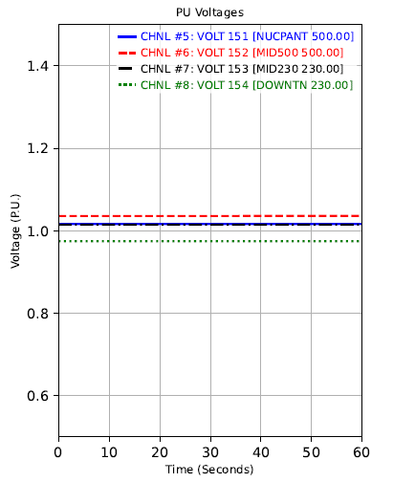

PSSE Example Problem 2 – A Potential Solution
Step 6: Test in a simulation
Here is an example:
“run_Simulation_Ex2.bat”
“CreatePlots_Ex2.bat”
You did it!

Slide 21
Problem 1 and 2 – Alternate Approach
This is a more python-based approach rather than having to make updates to the Excel Workbook:
LMWG_Write_CMLD_DYR_PSSE.py (instead of copying tabs from PSSE and using Excel macro to export the .dyr)
Correct_Feeder1_FixedTaps.py (instead of creating a separate spreadsheet)
Optional: ExportDYR_Lodchr.py (to save a copy to the corrected CMLD models)

Slide 22
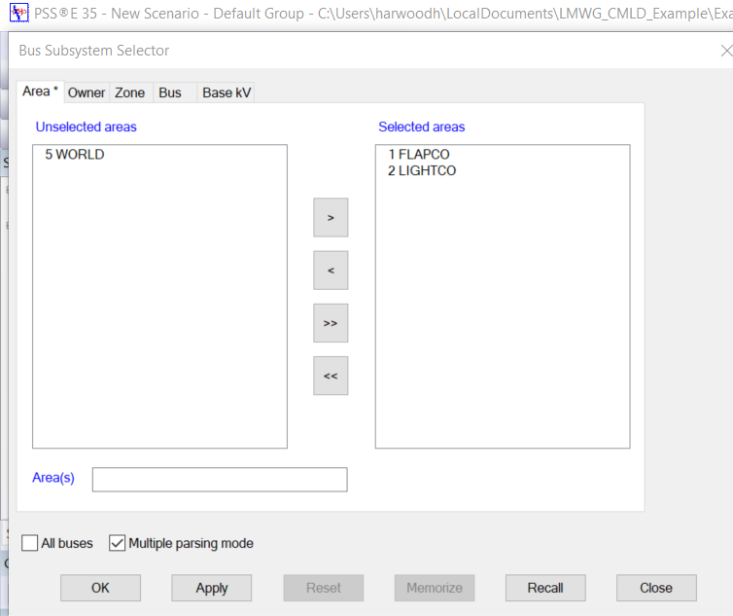
Problem 1 and 2 – Alternate Approach
Step 1: Open PSSE and load the case (“Example1.cnv”)
Step 2: Create a Bus subsystem of for the loads that you would like to export CMLD records (in this example, Areas 1 and 2).

Slide 23
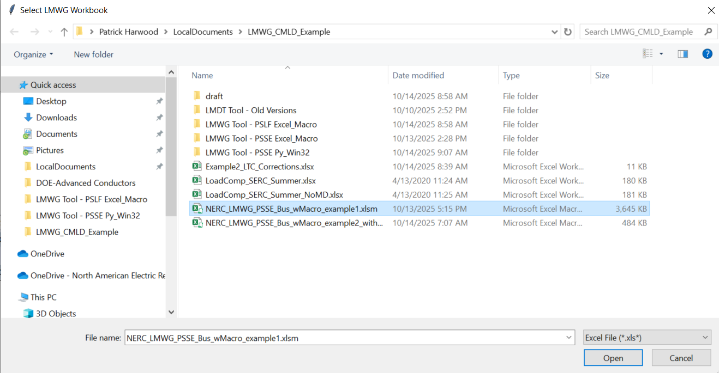
Problem 1 and 2 – Alternate Approach
Notes:
The “MasterLoadMapping” tab must have a bus number, load id, Feeder, and LoadComp for each load in your bus subsystem that meets thresholds, or else it will not be written to the .dyr.
You do not need to update the “PowerFlow” tab with this python script.
It may take a minute or so for this script to run
Step 3: Run Automation file, and choose “LMWG_Write_CMLD_DYR_PSSE.py”
Select your LMWG workbook.

Slide 24
Problem 1 and 2 – Alternate Approach
Step 4: Using the same process as in Example 1, steps 6 and 7, combine the new CMLD .dyr with the dynamics data for the rest of your system.
(Remove old Load Characteristic Models -- Remove_LoadCh_Models.py)
(Add the new CMLD .dyr to case)
(Save as new snapshot and/or .dyr)

Slide 25
Problem 1 and 2 – Alternate Approach
Step 5: Run Automation File, and select “Correct_Feeder1_FixedTaps.py” to fix the low-side fixed tap settings of the transformers within the CMLD models of your system
You can now save the snapshot and/or .dyr for use with simulations
Optionally, run automation file and select “ExportDYR_Lodchr.py” to save a .dyr of just the corrected CMLD models (may be useful for later)
(Step 6: Test with a simulation.)

Slide 26
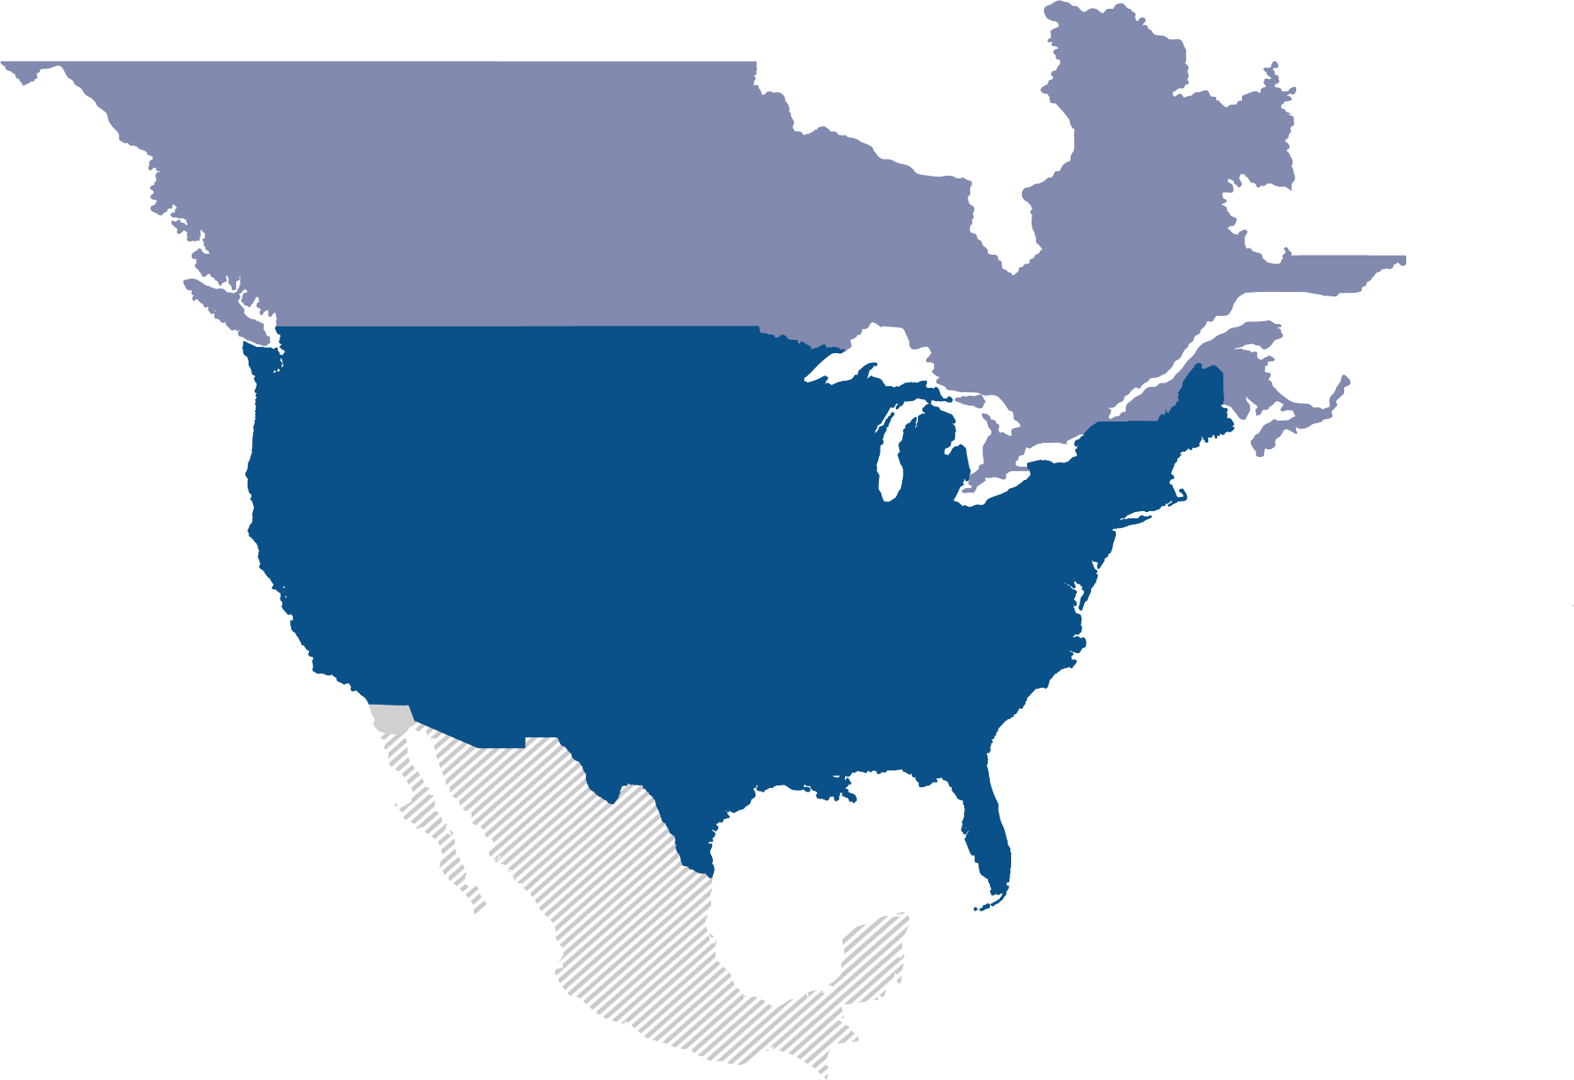
Questions and Answers

