Slide 1

Pattern Mining and Machine Learning for Demographic Sequences
Dmitry I. Ignatov¹, Ekaterina Mitrofanova², Anna Muratova¹, and Danil Gizdatulin¹
¹Computer Science Faculty & ²Institute of Demography
National Research University Higher School of Economics, Moscow, Russia
KESW 2015, Moscow

Slide 2

Outline
Problem Statement
Demographic Data
Methods and Results
Decision Trees
First lifecourse event prediction
Next lifecourse event prediction
Rules for ‘gender’ attribute
Frequent Patterns
Frequent closed sequences
Emerging sequences for men and women
Conclusion and Future Work
2
KESW 2015, Moscow

Slide 3
Problem Statement
Analysis of demographic data by means of machine learning and data mining
[Blockeel et al, 2001; Billari et al., 2006]
Demographers questions:
What are the differences between demographic behaviour of men and women?
What are the typical (frequent) event sequences that appear in lifecourse trajectories?
What are the first and the next starting events a particular person may have?
And many more…
Simple DM & ML tools preferably with GUI:
Orange http://orange.biolab.si/
SPMF http://www.philippe-fournier-viger.com/spmf/
Ad-hoc scripts in Python
3
KESW 2015, Moscow

Slide 4
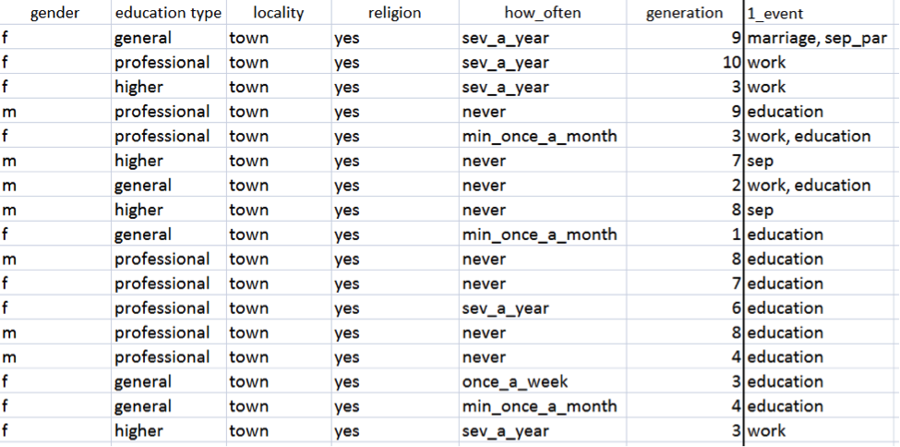
Demographic Data
The survey «Parents and children, men and women in family and society» www.socpol.ru/gender/RIDMIZ.shtml
4857 people including 1545 men 3312 women
11 generations are split in 5 years intervals from 1930 till 1984
4
KESW 2015, Moscow

Slide 5
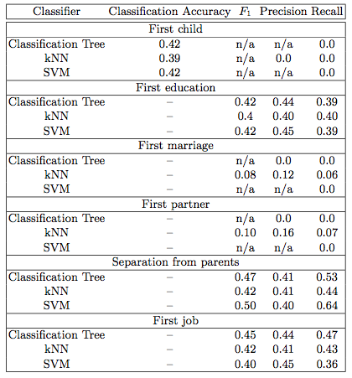
Comparison of classifiers for the first event prediction
5
KESW 2015, Moscow

Slide 6

Why Decision Trees?
Not a black-box approach
Simple if-then rule based representation
However…
5
KESW 2015, Moscow

Slide 7
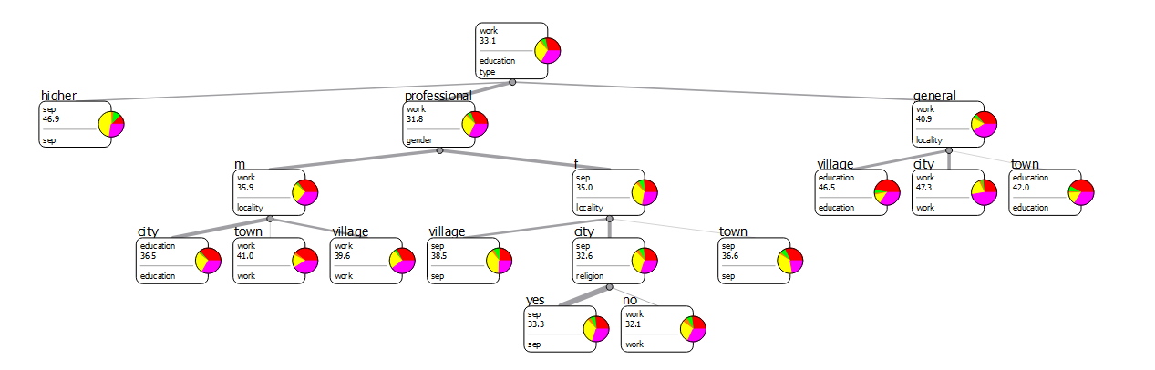
The first event prediction by Decision Trees
The tree is built in Orange
The first event mainly depends on education type
6
KESW 2015, Moscow

Slide 8
Feature Encoding Schemes
General attributes:
Gender
Generation
Type of education
Locality
Religious views
Religious activity
Events encoding:
Binary encoding (0 - absence, 1 - presence)
Time-base encoding (age in months)
Pairs of events ordered by precedence relations (<, >, =, n/a)
The anonymised datasets for each experiment are freely available in CSV files: http://bit.ly/KESW2015seqdem
7
KESW 2015, Moscow

Slide 9
Influence of feature encoding on the next event prediction
Encoding type | Classification Accuracy
 | Imbalanced data | Balanced data
Binary (BE) | 0.8498 | 0.8780 (*)
Time-based (TE) | 0.3516 | 0.3591
Pairs of events (PE) | 0.7076 | 0.7013
BE+ TE | 0.7293 (~) | 0.7459
BE + PE | 0.8407 | 0.8438
TE + PE | 0.5465 | 0.4959
BE + TE + PE | 0.7295 (~) | 0.7503
(*) means the best result, (~) means almost equivalent results
8
KESW 2015, Moscow

Slide 10
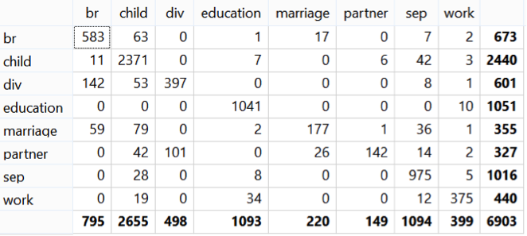
The confusion matrix for the next event prediction
– binary encoding for balanced dataset – “br” means “break up” and “div” means “divorce” events
8
KESW 2015, Moscow

Slide 11
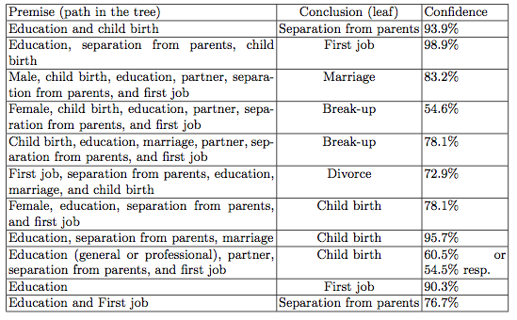

Examples of rules for the next event prediction
9
KESW 2015, Moscow

Slide 12
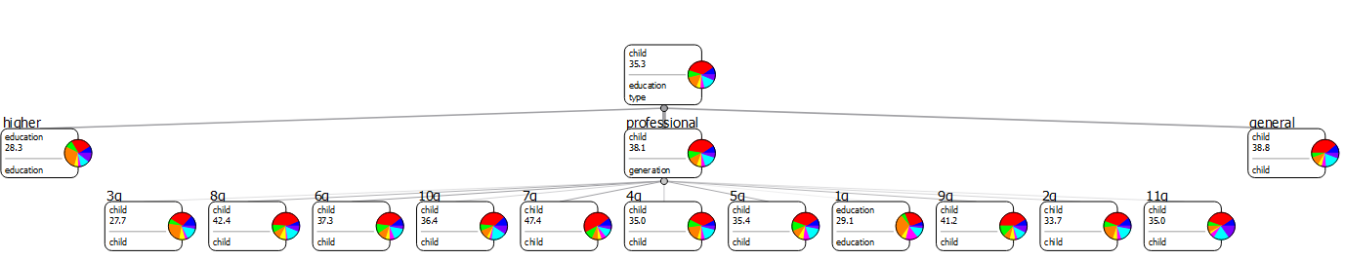
The next event prediction based on general attributes
A decision tree diagram built only for general attributes.
The next event is influenced by the type of education.
10
KESW 2015, Moscow

Slide 13
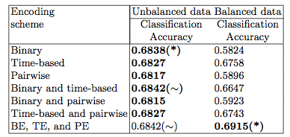
Classification accuracy of different encoding schemes for gender prediction
(∼) means very close results, and (*) means the best result in the column.
11
KESW 2015, Moscow

Slide 14
Examples of rules for prediction of target attribute «gender»
Men:
Women:
Antecedent | Confidence
First job after 19.9 years, marriage in 20.6-22.4, education before 20.7, break up after 27.6, divorce before 30.5 | 65.9%
First job after 19.9, marriage in 20.6-22.4, break-up before 27.6 | 61.1%
First job before 17.2, marriage in 20.6-22.4, break-up before 27.6 | 61.3%
First job after 21, marriage after 29.5 | 70.2%
Antecedent | Confidence
First job in 18.2-19.9, marriage in 20.6-22.4, break-up after 27.6, divorce after 30.5 | 71.9%
First job in 18.2-19.9, marriage in 20.6-22.4, break-up after 27.6, divorce before 30.5 | 70.9%
First job in 17.2-19.9, marriage in 20.6-22.4, break-up before 27.6 | 62.8%
First job in 17.7-21, marriage after 29.5 | 62.8%
12
KESW 2015, Moscow

Slide 15



Sequence Mining
[Zaki & Meira, 2014; Agrawal & Srikant, 1995]
A sequence is an ordered set of elements (events)
The support of sequence r in database is the number of sequences in D that contain r
The relative support of r is the fraction of sequences that contain r
A sequence r is frequent in a database D if
, where minsup is a minimal support threshold
A frequent closed sequence is a sequence such that there is no any its supersequence with the same support
13
KESW 2015, Moscow

Slide 16


Emerging Sequences
An emerging sequence is a sequence such that its support growths drastically in the transition from one database to another one
The growth rate of a sequence s in the transition from databases D₁ to D₂:
(1)
The contribution of a sequence to a particular class:
, (2)
where e is a subsequence of s
The idea is based on [Mill, 1843; Finn, 1983; Dong & Li, 1999]
14
KESW 2015, Moscow

Slide 17
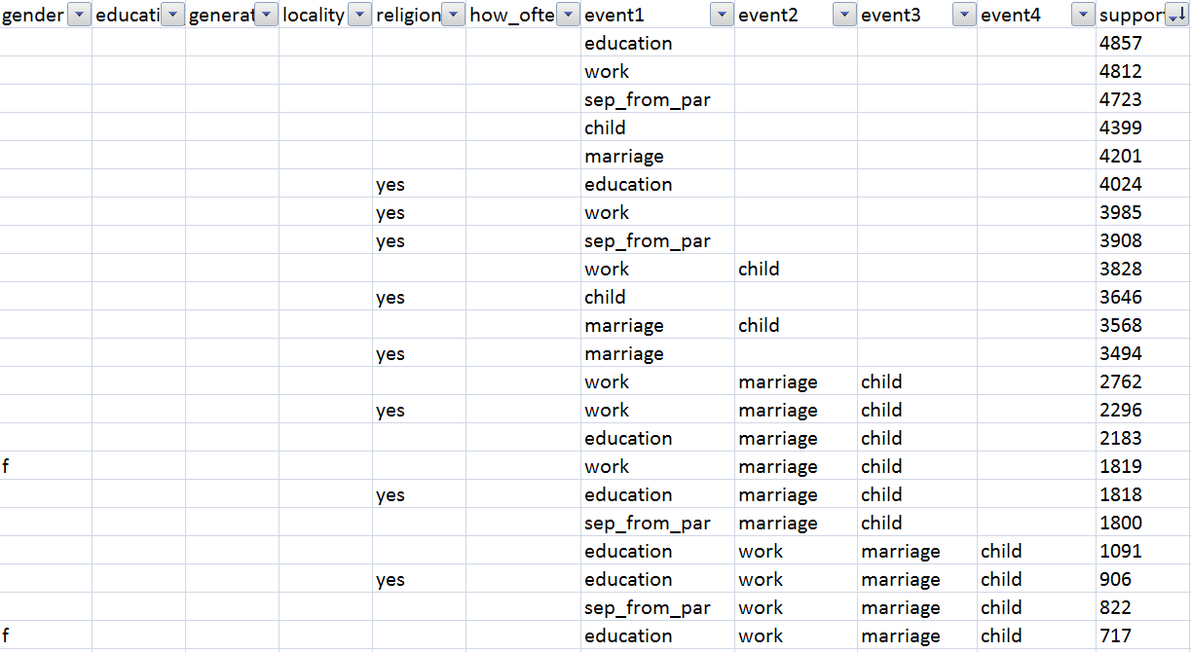
Frequent closed sequences
An SPMF output for frequent closed sequences mining
15
KESW 2015, Moscow

Slide 18
Emerging Sequence Mining
Implemented in Python 2.7
Input: two datasets for men and women with age indication for demographic events
Transformation of events to sequences (80:20 test-to-training ratio)
Passing the test set to SPMF and finding frequent sequences.
Finding emerging sequences (classification rules) and their contributions to classes.
Defining the class of a rule by its contribution and then contribution normalisation.
Accuracy calculation for the test set.
Output: files with classification rules for men and women
minsup = 0.005; for each class we use 3312 sequences after oversampling.
The best classification accuracy (0.936) has been reached at minimal growth rate 1.0, with 577 rules for men and 1164 for women, and 3 non-covered objects.
16
KESW 2015, Moscow

Slide 19
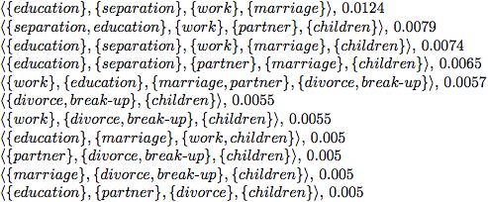
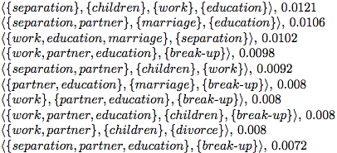
Emerging sequences
The list of emerging sequences for men (with their class contribution):
The list of emerging sequences for women:
17
KESW 2015, Moscow

Slide 20
Conclusion and Future Work
We have shown that decision trees and sequence mining could become the tools of choice for demographers.
Machine learning and data mining tools can help in finding regularities and dependencies that are hidden in voluminous demographic datasets. However, these methods need to be properly tuned and adapted to the domain needs.
In the near future we are planning:
to implement emerging prefix-string mining and learning to deal with sequences without gaps
to use different rule-based techniques that are able to cope with unbalanced multi-class data (Cerf et al., 2013)
to apply Pattern Structures to demographic sequence mining (Kuznetsov et al., 2013).
and many more ideas and tricks…
18
KESW 2015, Moscow

Slide 21
Thank you. Questions?
KESW 2015, Moscow

