Slide 1
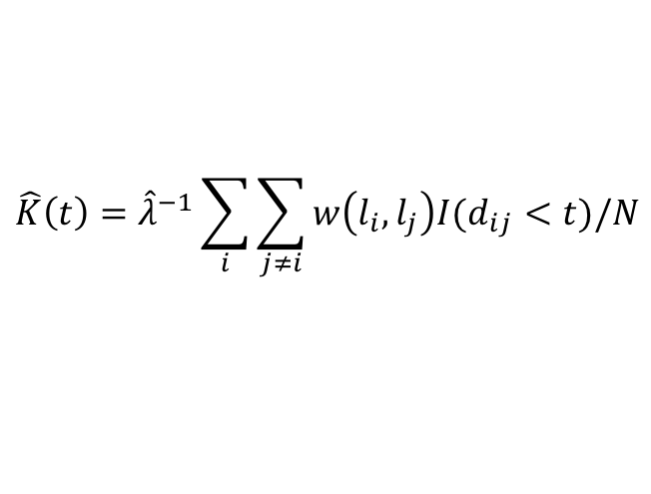
K function
Ripley’s K function is designed to analyze completely mapped spatial point process.
$$\hat{K}\left(t\right)={\hat{λ}}^{−1}\sum_{i}{\sum_{j≠i}{w\left(l_{i}, l_{j}\right)I(d_{ij}<t)/N}}$$
K(t): a ratio of a numerator and the density of events.
λ: density in the study region
t: distance of a point in the study area (radius)
I: indicator function
if d_{ij} < t : return 1
w(l_{i}, l_{j}): edge correction
t

Slide 2

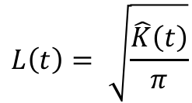
L function
Normalized by Besag so its expected value is t (linear).
$$L\left(t\right)= \sqrt{\frac{\hat{K}\left(t\right)}{π}}$$
H function
Normalized so the expected value is 0 at Poison Point Process.
$$H\left(t\right)=L\left(t\right)−t$$

Slide 3
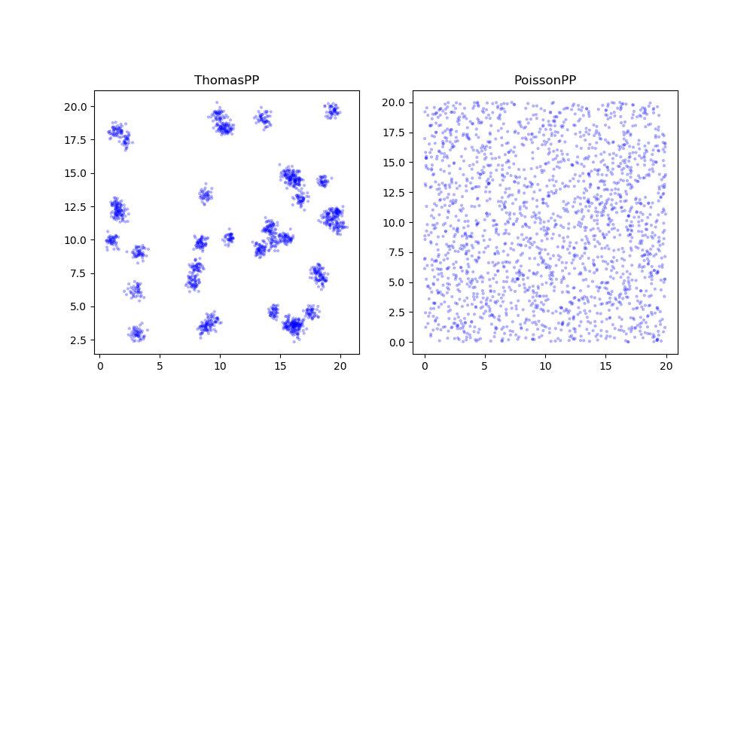
Test Dataset

Slide 4
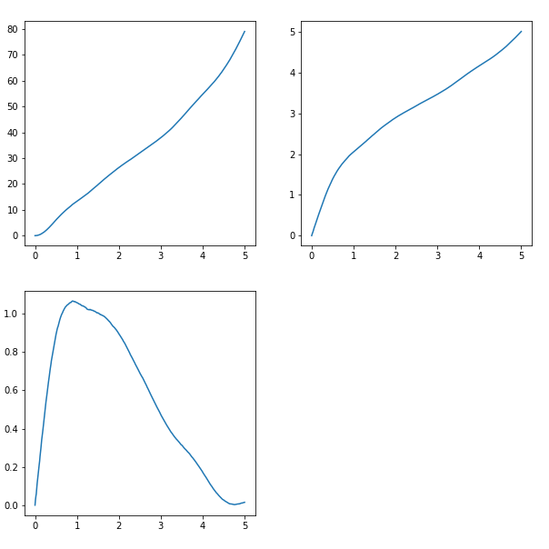
Point Process
(xyarray_all)
Flowchart
Slice PP by ROI
xyroi_idx
Sliced Point Process
xyarray_ref
Point Process
(xyarray_all)
ripleyk()
Iterate through points
Average count in the range of given t
Plot
Remove ref point from xyarray_all
identify ref point
K function
Define ROI based on ref point
L function
Slice point by given ROI
H function
Calculate distance from ref to points
Series of t with defined step size
RList
Examine if point inside the range of given t
Count amount

Slide 5
Edge Correction
If Max t = 5

