Slide 1
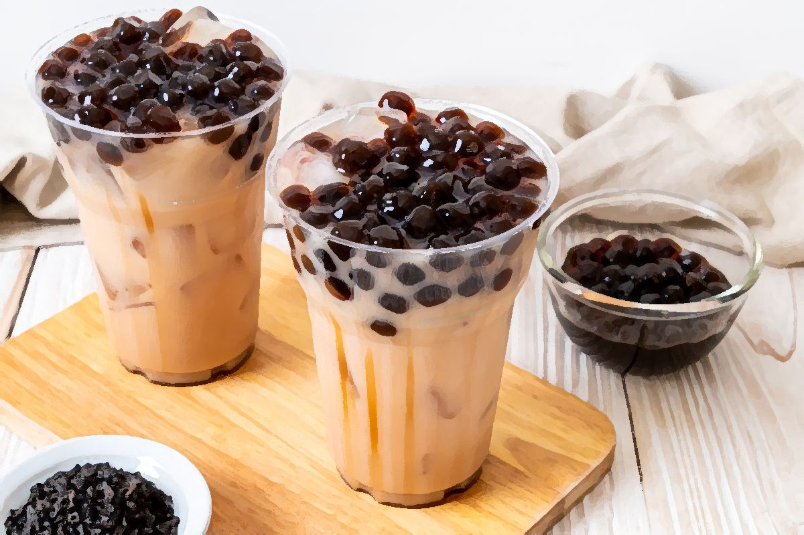
Opening a Bubble Tea Chain in Kuala Lumpur, Malaysia
IBM Applied Data Science Capstone
Capstone Project: The Battle of Neighbourhoods

Slide 2
Business Problem
If a bubble tea brand intends to open a chain in Kuala Lumpur, Malaysia, where would be the ideal location to set up a shop?
Target Audience:
New bubble tea brands looking to venture into the Malaysian market
Existing bubble tea chains in Malaysia looking to expand their store locations

Slide 3
Data Sources
List of neighbourhoods in Kuala Lumpur, Malaysia
Data scraped from Wikipedia page
Geographical coordinates of the neighbourhoods
Extracted latitude and longitude coordinates with Geopy’s Geocoder library, available in Python
Bubble tea shops in each neighbourhood
Foursquare location data
Called Foursquare API to search for bubble tea shops (venue) in each neighbourhood’s vicinity

Slide 4
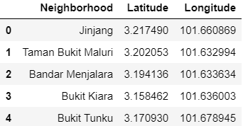
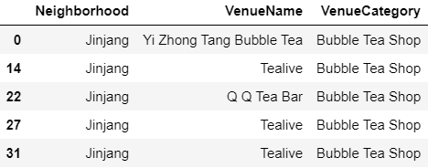
Data Preparation
Removed any duplicate data
Geopy’s Geocoder unable to detect certain neighbourhoods’ geographical coordinates; these neighbourhoods were omitted from the analysis
Total of 61 neighbourhoods available for analysis
Foursquare’s search query radius limit set at 3,000 meters, and results limit at 100 per neighbourhood
Venue name & venue category were extracted
Removed any category that is not ‘Bubble Tea Shop’

Slide 5
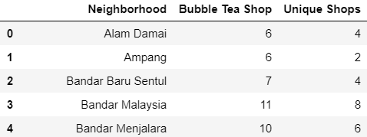
Data Analysis & Clustering
410 bubble tea shops in Kuala Lumpur
48 unique bubble tea shops
Aggregated and grouped results according to neighbourhoods based on:
Total number of bubble tea shops
Total number of unique bubble tea shops
K-Means clustering
Unsupervised machine learning algorithm
Grouped neighbourhoods into clusters with distinct characteristics

Slide 6
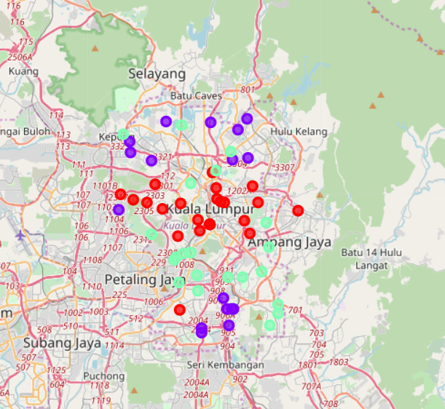
Data Visualization
Cluster 0: Red, Cluster 1: Purple, Cluster 2: Mint green
Each neighbourhood were assigned a cluster label (0, 1, or 2)
Superimposed resulting clusters onto Kuala Lumpur’s map using Folium
Added markers and individual colours for each cluster

Slide 7
Neighbourhood | Bubble Tea Shops | Unique Shops | Cluster Label
Ampang | 6 | 2 | 0
Bangsar | 6 | 2 | 0
Brickfields | 2 | 1 | 0
Bukit Kiara | 3 | 2 | 0
Bukit Nanas | 5 | 2 | 0
Chow Kit | 5 | 2 | 0
Damansara Heights | 4 | 1 | 0
Dang Wangi | 4 | 2 | 0
Federal Hill | 2 | 1 | 0
Jalan Cochrane | 3 | 3 | 0
Jalan Duta | 5 | 1 | 0
Kampung Datuk Keramat | 2 | 2 | 0
Kampung Sungai Penchala | 4 | 2 | 0
Kuala Lumpur City Centre | 2 | 1 | 0
Kuala Lumpur Sentral | 3 | 2 | 0
Medan Tuanku | 4 | 1 | 0
Mont Kiara | 5 | 3 | 0
Perdana Botanical Gardens | 3 | 1 | 0
Sentul | 6 | 2 | 0
Sri Hartamas | 5 | 3 | 0
Taman OUG | 5 | 3 | 0
Taman U-Thant | 3 | 3 | 0
Tun Razak Exchange | 4 | 3 | 0
Neighbourhoods in Cluster 0
23 neighbourhoods
Average bubble tea shops per neighbourhood: 4
Average unique bubble tea shops per neighbourhood: 2

Slide 8
Neighbourhood | Bubble Tea Shops | Unique Shops | Cluster Label
Bandar Malaysia | 11 | 8 | 1
Bandar Menjalara | 10 | 6 | 1
Bandar Tasik Selatan | 11 | 8 | 1
Bukit Jalil | 10 | 9 | 1
Desa Petaling | 8 | 7 | 1
Jinjang | 10 | 5 | 1
Kampung Malaysia | 10 | 8 | 1
Padang Balang | 8 | 7 | 1
Semarak | 12 | 6 | 1
Setapak | 9 | 6 | 1
Sri Petaling | 10 | 9 | 1
Sungai Besi | 9 | 8 | 1
Taman Bukit Maluri | 9 | 6 | 1
Taman Ibukota | 12 | 8 | 1
Taman Melati | 13 | 9 | 1
Taman Sri Sinar | 11 | 6 | 1
Taman Tun Dr Ismail | 10 | 6 | 1
Neighbourhoods in Cluster 1
17 neighbourhoods
Average bubble tea shops per neighbourhood: 10
Average unique bubble tea shops per neighbourhood : 7

Slide 9
Neighbourhood | Bubble Tea Shops | Unique Shops | Cluster Label
Alam Damai | 6 | 4 | 2
Bandar Baru Sentul | 7 | 4 | 2
Bandar Sri Permaisuri | 6 | 5 | 2
Bangsar South | 9 | 4 | 2
Bukit Tunku | 8 | 3 | 2
Damansara | 8 | 5 | 2
Damansara Town Centre | 6 | 3 | 2
KL Eco City | 8 | 4 | 2
Kampung Pandan | 5 | 4 | 2
Kerinchi | 8 | 4 | 2
Kuchai Lama | 5 | 4 | 2
Mid Valley City | 8 | 4 | 2
Pantai Dalam | 7 | 5 | 2
Salak South | 5 | 5 | 2
Shamelin Perkasa | 6 | 5 | 2
Taman Connaught | 7 | 4 | 2
Taman Desa | 7 | 5 | 2
Taman Len Seng | 7 | 4 | 2
Taman Midah | 6 | 4 | 2
Taman P. Ramlee | 8 | 5 | 2
Taman Wahyu | 9 | 5 | 2
Neighbourhoods in Cluster 2
21 neighbourhoods
Average bubble tea shops per neighbourhood: 7
Average unique bubble tea shops per neighbourhood: 4

Slide 10
Conclusion
Which location would be ideal to open a bubble tea chain in Kuala Lumpur, Malaysia?
Neighbourhoods in Cluster 0, would be recommended as it has minimal competition
Cluster 1, should be avoided due to its nature of a highly saturated market
Cluster 2, can be considered as the market is not at the point of saturation and if the brand positioned itself strategically, it could utilize the customer traffic provided by existing bubble tea shops in the area
Limitations of the analysis would be the number of variables included
Only 2 variables: Number of bubble tea shops & Number of unique bubble tea shops
To have an extensive analysis in the future, more variables can be considered
Accessibility (Nearby public transport & car parks)
Potential customer traffic in the area (Shopping malls & popular attractions)

